Slide 1
CAP776
PROGRAMMING IN PYTHON

Slide 2
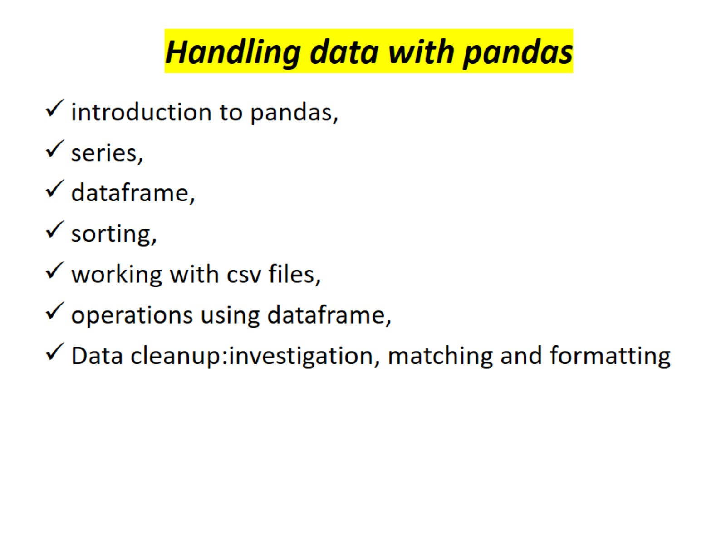
Handling data with pandas

Slide 3
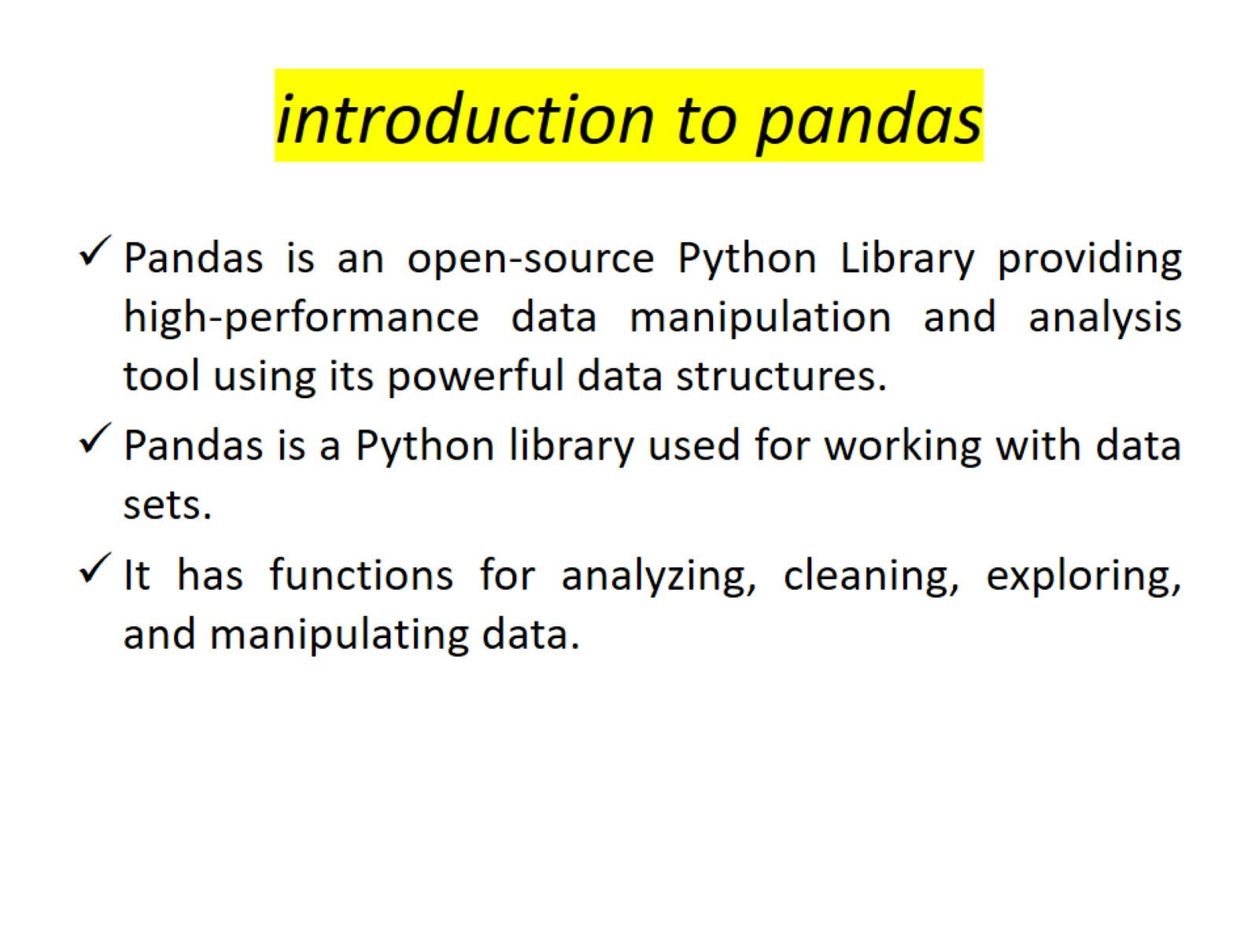
introduction to pandas

Slide 4
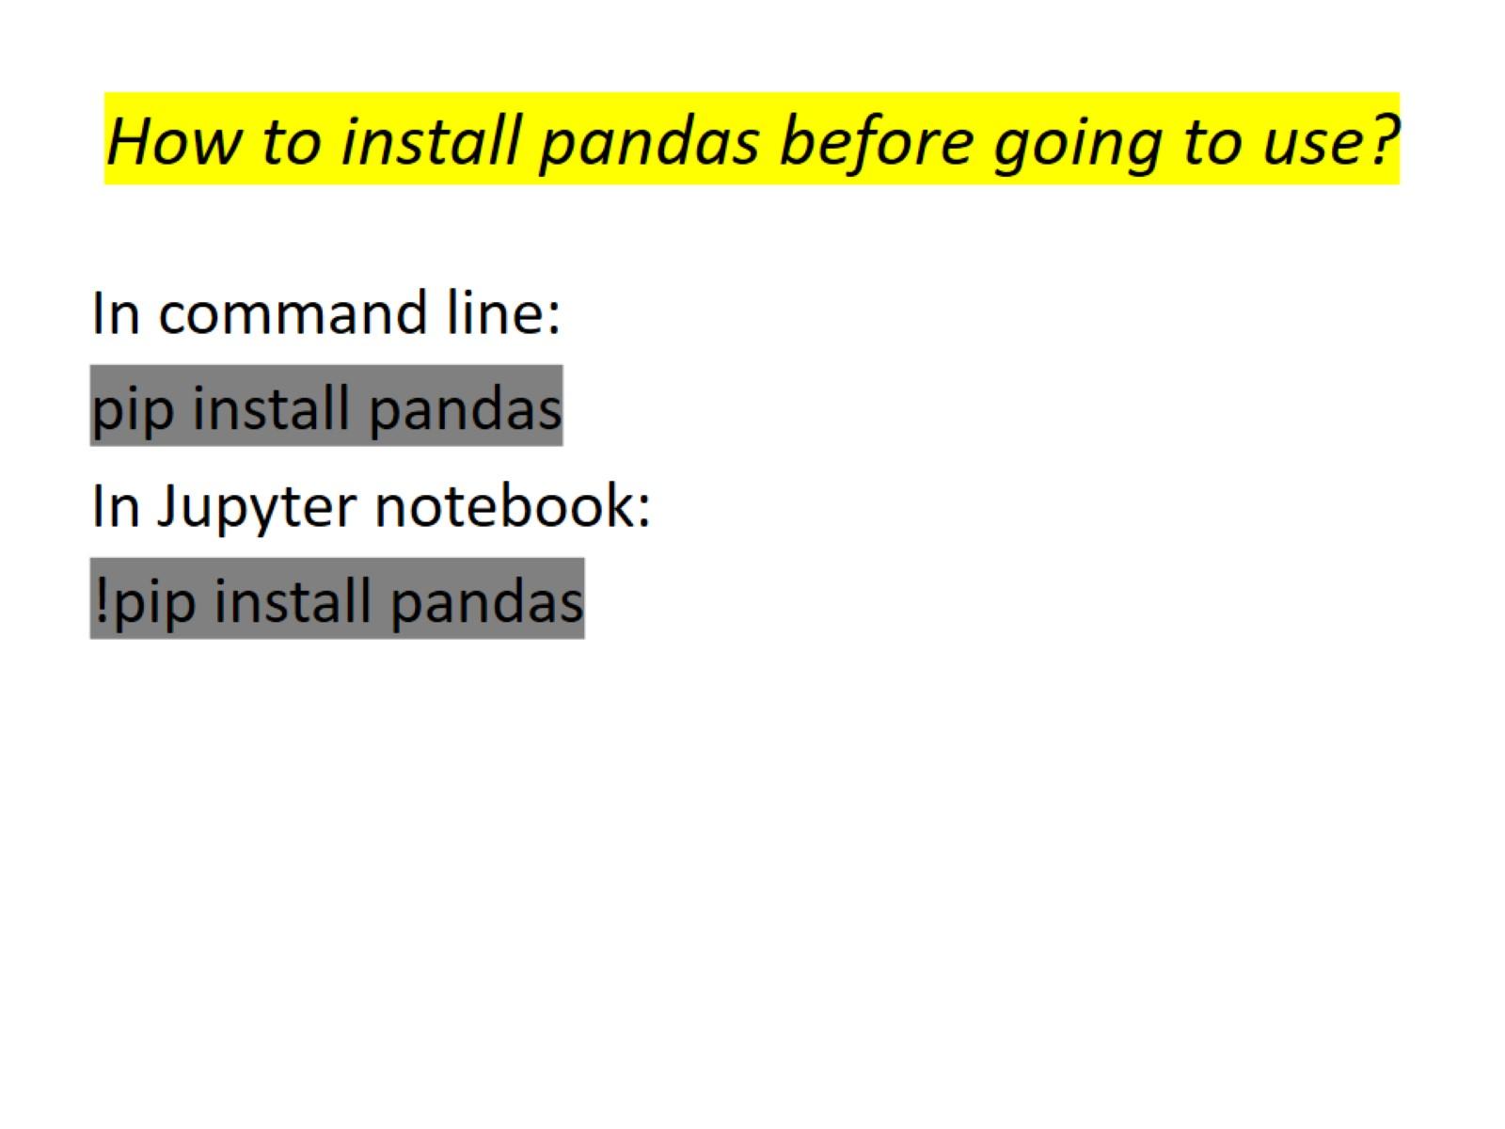
How to install pandas before going to use?

Slide 5
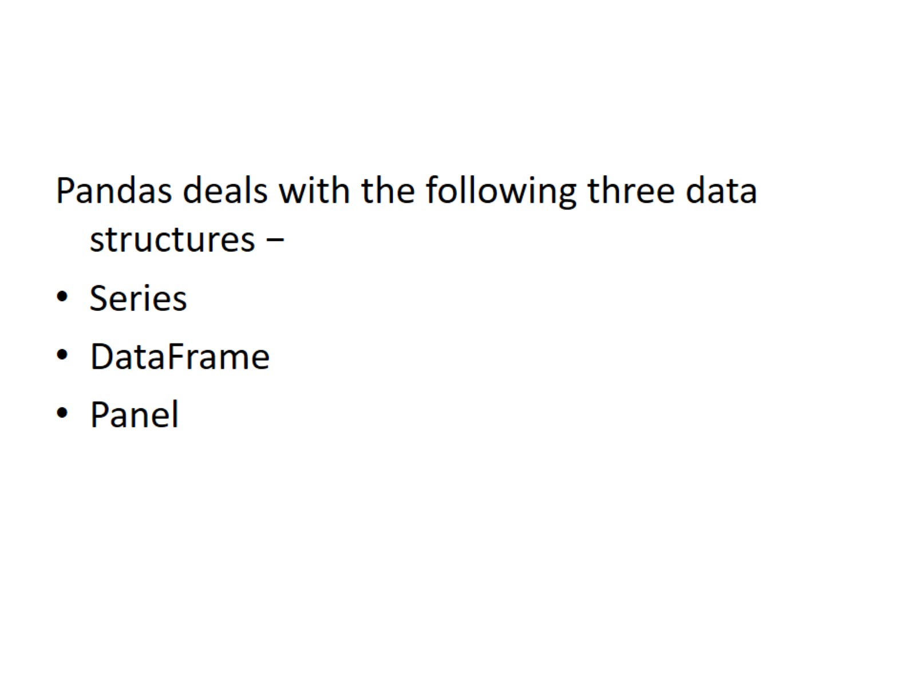

Slide 6
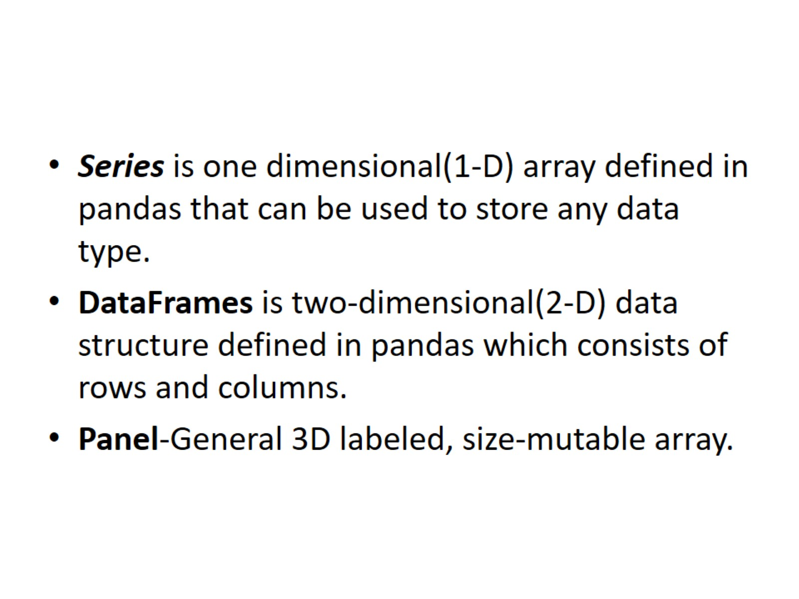

Slide 7
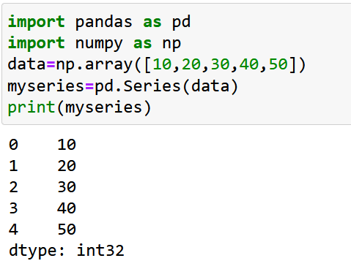
Series
Create a Series from ndarray

Slide 8
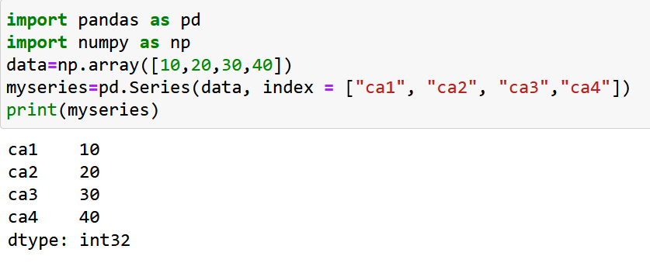
Labels
If nothing else is specified, the values are labeled with their index number. First value has index 0, second value has index 1 etc.
Create Labels
With the index argument, you can name your own labels.

Slide 9
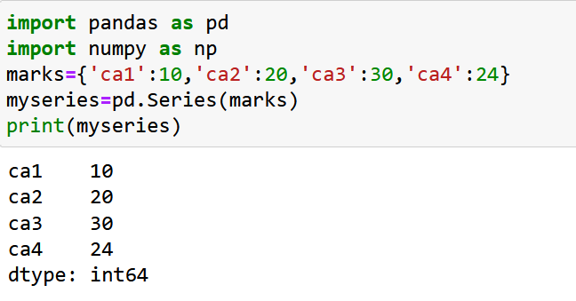
Create a Series from dictionary

Slide 10
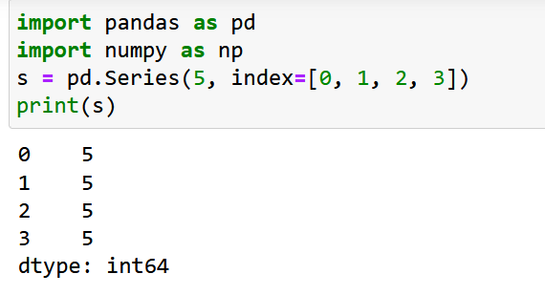
Create a Series from Scalar
If data is a scalar value, an index must be provided. The value will be repeated to match the length of index

Slide 11
A scalar value is simply a value that only has one component to it, the magnitude. For example, your speed is a scalar value because it only has one component, how fast you are going. Your height is also a scalar value because the only component is how tall you are.

Slide 12
Data frame
A Data frame is a two-dimensional data structure, i.e., data is aligned in a tabular fashion in rows and columns.
DataFrame can be created using :Lists,dict,Series,Numpy ndarrays another DataFrame
DataFrame can be created using the following constructor −
pandas.DataFrame( data, index, columns, dtype, copy)
data can be Lists,dict,Series,Numpy ndarrays another DataFrame
index: For the row labels
columns: For column labels
dtype: data type of each column
copy: copying of data

Slide 13
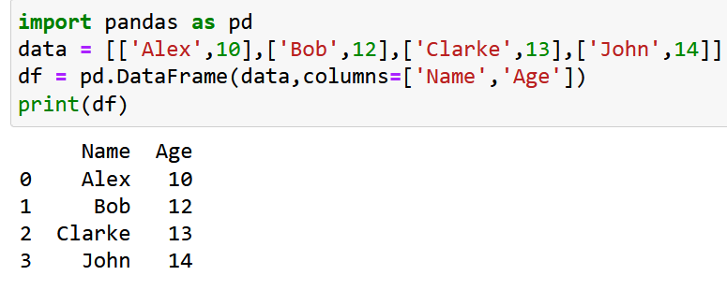
Name | Age
Alex | 10
Bob | 12
Clarke | 13
John | 14

Slide 14
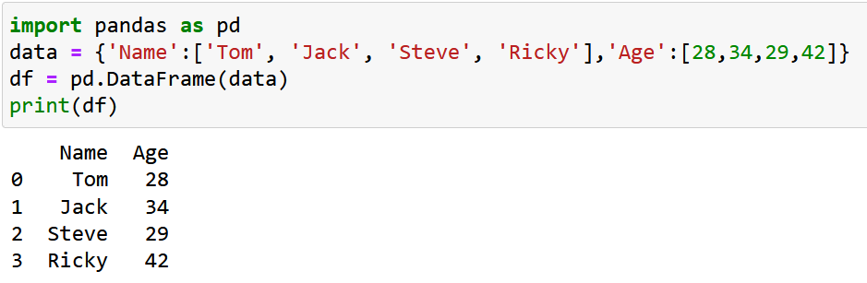
Create a DataFrame from Dict of ndarrays / Lists

Slide 15
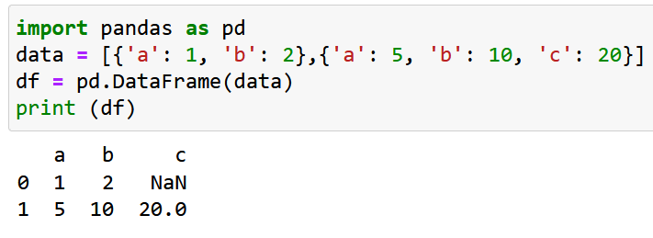
Create a DataFrame from List of Dicts

Slide 16
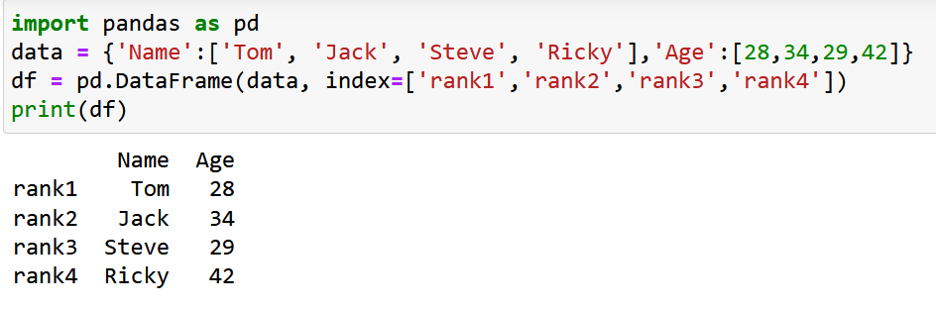
create an indexed DataFrame

Slide 17
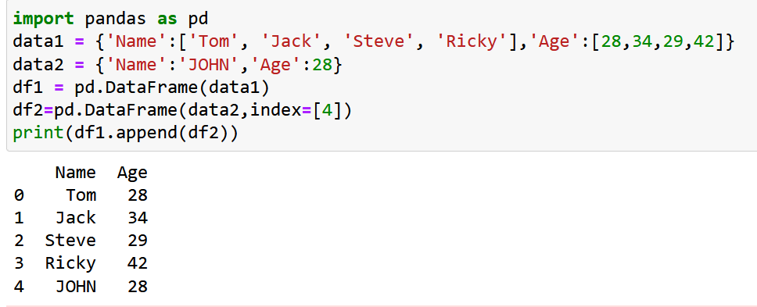
Addition of Rows
Add new rows to a DataFrame using the append function. This function will append the rows at the end.

Slide 18
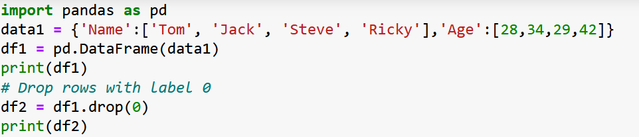
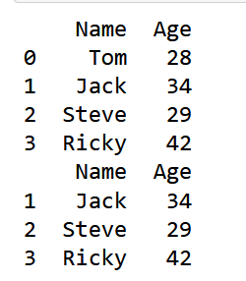
Deletion of Rows
Use index label to delete or drop rows from a DataFrame. If label is duplicated, then multiple rows will be dropped.

Slide 19
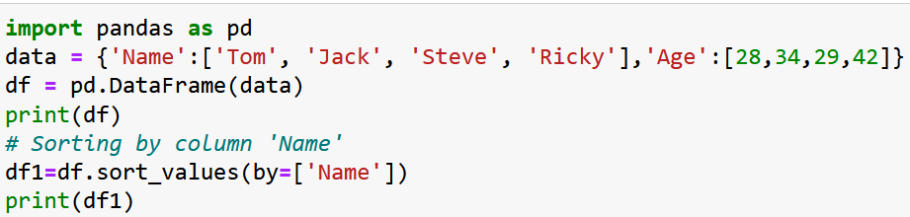
Sorting Pandas Data Frame
sort_values() can sort the data frame in Ascending or Descending order.
Sorting the Data frame in Ascending order

Slide 20
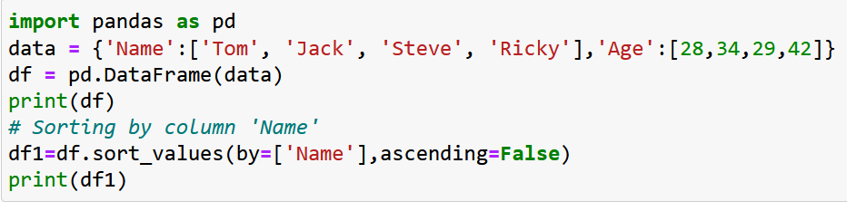
Sorting the Data frame in Descending order

