Slide 1
CAP776 PROGRAMMING IN PYTHON

Slide 2
Machine learning :
introduction,
types of machine learning,
linear regression,
k-nearest neighbours,
decision trees,
random forests,
k-means clustering

Slide 3
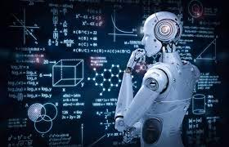
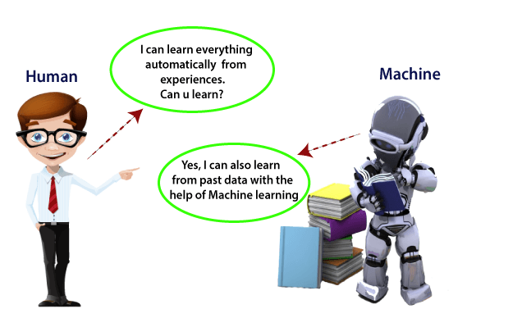
Machine learning

Slide 4
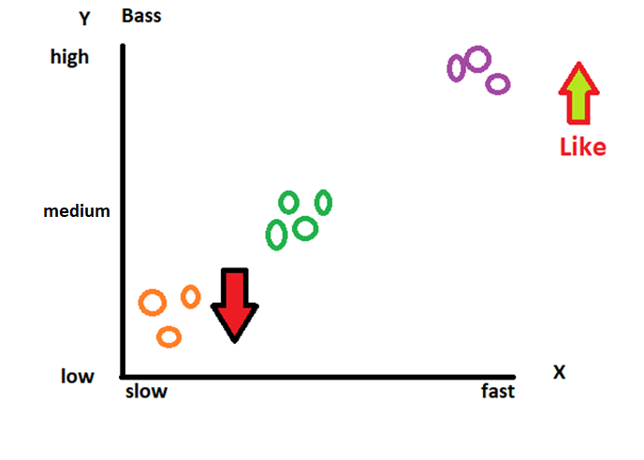
?
Suppose I like song based on songs type and music intensity.
Now one new song introduce which is having medium bass then I will like the song?

Slide 5
Machine learning
Machine learning is a growing technology which enables computers to learn automatically from past data. Machine learning uses various algorithms for building mathematical models and making predictions using historical data or information.
Currently, it is being used for various tasks such as image recognition, speech recognition, email filtering etc.

Slide 6
How does Machine Learning work
A Machine Learning system learns from historical data, builds the prediction models, and whenever it receives new data, predicts the output for it.

Slide 7
types of machine learning
Machine learning can be classified into three types:
Supervised learning
Unsupervised learning
Reinforcement learning

Slide 8
Supervised learning is a type of machine learning method in which we provide sample labeled data to the machine learning system in order to train it, and on that basis, it predicts the output.

Slide 9
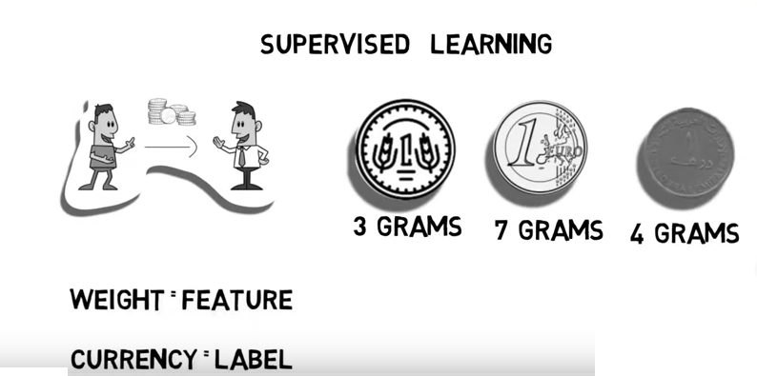

Slide 10
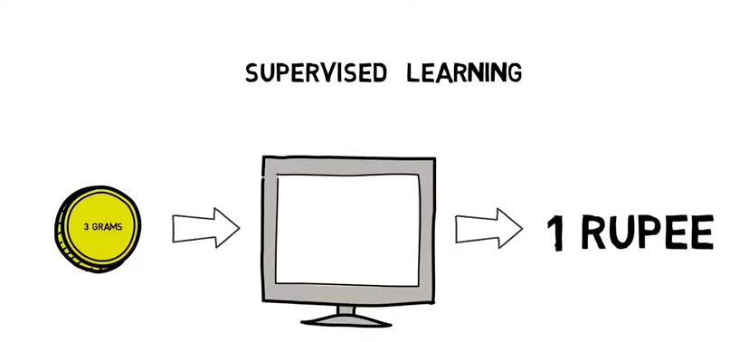

Slide 11
Unsupervised learning is a learning method in which a machine learns without any supervision. The training is provided to the machine with the set of data that has not been labeled, classified, or categorized, and the algorithm needs to act on that data without any supervision.

Slide 12
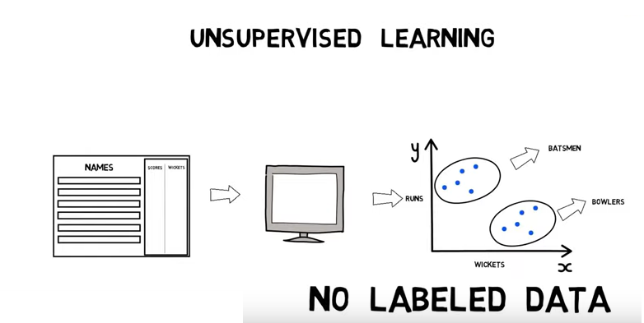

Slide 13
Reinforcement learning is a feedback-based learning method, in which a learning agent gets a reward for each right action. The agent learns automatically with these feedbacks and improves its performance.

Slide 14
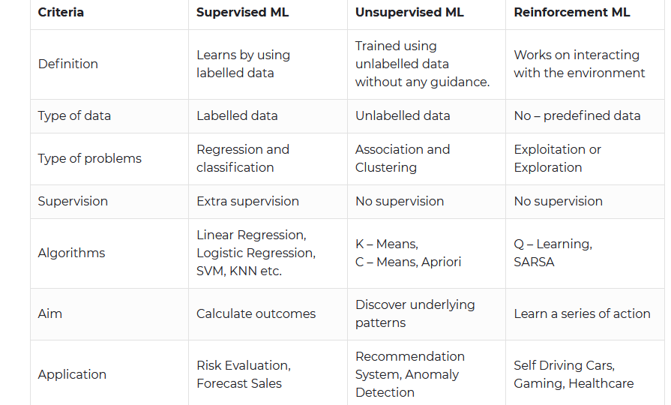

Slide 15
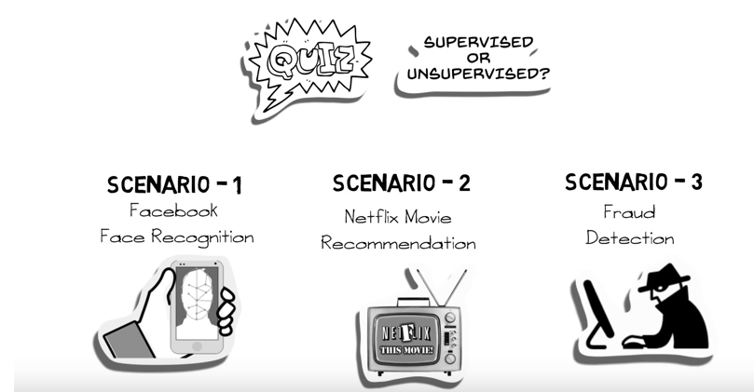

Slide 16
linear regression
The term regression is used when you try to find the relationship between variables.
In Machine Learning, and in statistical modeling, that relationship is used to predict the outcome of future events.
Linear regression algorithm shows a linear relationship between a dependent (y) and one or more independent (x) variables, hence called as linear regression.
Linear regression can be further divided into two types of the algorithm: Simple Linear Regression and Multiple Linear regression

Slide 17
Simple Linear Regression
Suppose you want to predict weight of a person from his height. So here, one dependent and one independent variable is used.
So, here weight is dependent variable and height is independent variable.
If a single independent variable is used to predict the value of a dependent variable, then such a Linear Regression algorithm is called Simple Linear Regression.

Slide 18
Multiple Linear regression
If more than one independent variable is used to predict the value of dependent variable, then such a Linear Regression algorithm is called Multiple Linear Regression.
Suppose you want predict house rent then there will multiple independent variables based on that you can predict house rent.

Slide 19
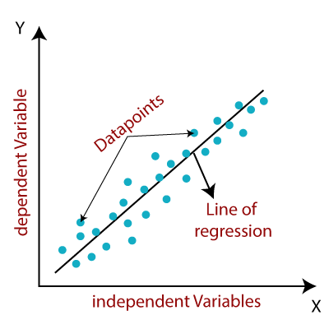
Since linear regression shows the linear relationship, which means it finds
how the value of the dependent variable is changing according to the value of the
independent variable.

Slide 20
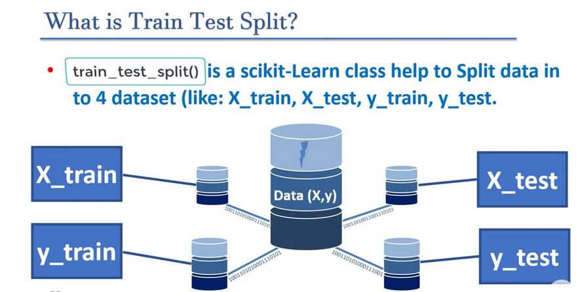

Slide 21
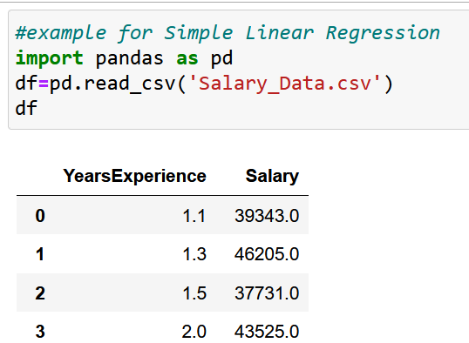
example for Simple Linear Regression
Import your dataset

Slide 22
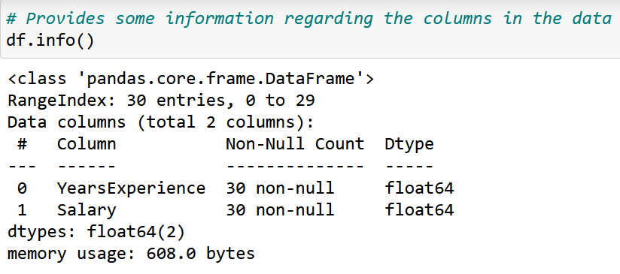

Slide 23
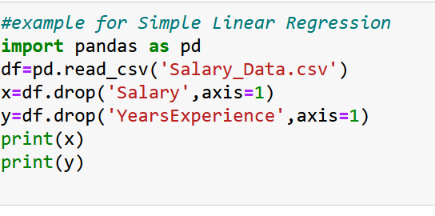
Define your dataset with dependent and independent variables

Slide 24
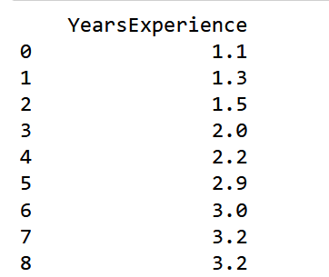
independent variable:

Slide 25
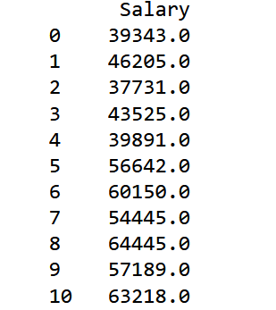
dependent variable:

Slide 26
Splitting the dataset into training and test set.
For that use scikit-learn
Install scikit-learn
Import now:

Slide 27
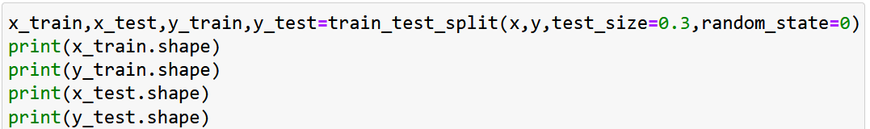
Use train_test_split()
test_size: define size of data set 0.3 means 30%
random_state=0 means value will be not shuffled

Slide 28
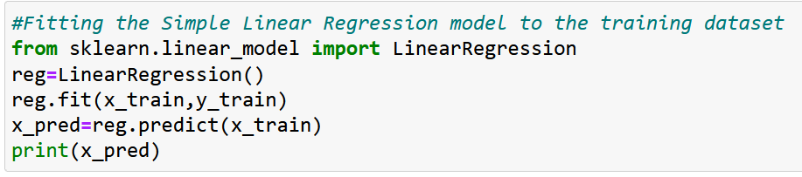
Fitting the Simple Linear Regression model to the training dataset

Slide 29
Now visualize your prediction for that we need to plot the regression line, we will use the plot() function. In this function, we will pass the years of experience for training set and predicted salary for training set x_pred

Slide 30
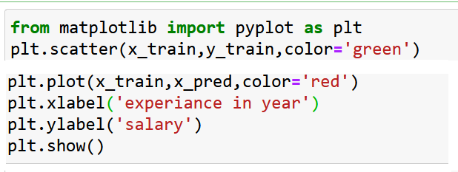
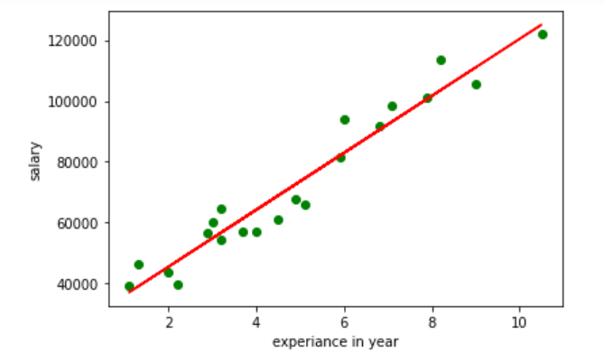

Slide 32
In the above plot, we can see the real values observations in green dots and predicted values are covered by the red regression line. The regression line shows a correlation between the dependent and independent variable.
The good fit of the line can be observed by calculating the difference between actual values and predicted values. But as we can see in the above plot, most of the observations are close to the regression line, hence our model is good for the training set.

Slide 33
k-nearest neighbor algorithm:
This algorithm is used to solve the classification model problems. K-nearest neighbor or K-NN algorithm basically creates an imaginary boundary to classify the data. When new data points come in, the algorithm will try to predict that to the nearest of the boundary line.
Using the k-nearest neighbor algorithm we fit the historical data (or train the model) and predict the future.

Slide 34
Suppose, we have an image of a creature that looks similar to cat and dog, but we want to know either it is a cat or dog. So for this identification, we can use the KNN algorithm, as it works on a similarity measure.

Slide 35
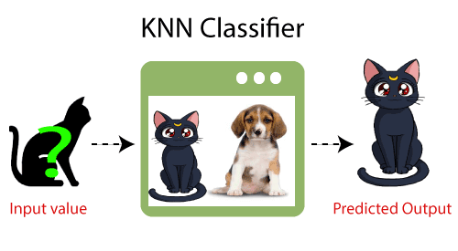

Slide 36
Decision Tree
Decision Tree is one of the easiest and popular classification algorithms to understand and interpret. It can be utilized for both classification and regression kind of problem.
As a loan manager, you need to identify risky loan applications to achieve a lower loan default rate. This process of classifying customers into a group of potential and non-potential customers or safe or risky loan applications is known as a classification problem.

Slide 37
Random forests
Random forests creates decision trees on randomly selected data samples, gets prediction from each tree and selects the best solution by means of voting. It also provides a pretty good indicator of the feature importance.

Slide 38
Example
Let’s suppose you have decided to ask your friends, and talked with them about their past travel experience to various places. You will get some recommendations from every friend. Now you have to make a list of those recommended places. Then, you ask them to vote (or select one best place for the trip) from the list of recommended places you made. The place with the highest number of votes will be your final choice for the trip.

Slide 39
In the above decision process, there are two parts. First, asking your friends about their individual travel experience and getting one recommendation out of multiple places they have visited. This part is like using the decision tree algorithm. Here, each friend makes a selection of the places he or she has visited so far.

Slide 40
k-means clustering
A cluster refers to a collection of data points aggregated together because of certain similarities.
You’ll define a target number k, which refers to the number of centroids you need in the dataset. A centroid is the imaginary or real location representing the center of the cluster.
Every data point is allocated to each of the clusters through reducing the in-cluster sum of squares.

Slide 41
Every data point is allocated to each of the clusters through reducing the in-cluster sum of squares.
The ‘means’ in the K-means refers to averaging of the data; that is, finding the centroid.

Slide 42
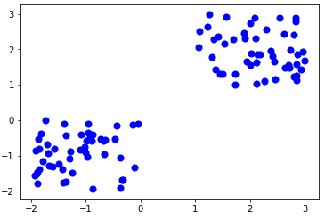

Slide 43
Thanks!!!

