Slide 1


Dental extraction in patient with a history of angioplasty
Dr. Priyanka Zanzari

Slide 2
Considerations
Patient Assessment:
A thorough medical and dental history is crucial. This includes information about the patient's heart condition (e.g., type of heart disease, history of heart attacks, angioplasty, stenting, valve issues), medications (especially anticoagulants and antiplatelet drugs), and any other relevant medical conditions.
Cardiac Risk Stratification:
Assess the patient's cardiac risk using tools like the American Heart Association/American College of Cardiology (AHA/ACC) guidelines or the American Society of Anesthesiologists (ASA) Physical Status Classification System.

Slide 3
Dental Evaluation:
A comprehensive dental examination is necessary to assess the teeth requiring extraction, the surrounding tissues, and the overall oral health. This includes checking for any signs of infection, inflammation, or other issues that could complicate the extraction or healing process.
Multidisciplinary Approach:
Close collaboration between the dentist and cardiologist is essential. The dentist should consult with the cardiologist to discuss the patient's cardiac status, medication regimen, and any specific precautions or recommendations.

Slide 4
Medication Management:
Review and potentially adjust medications, especially anticoagulants and antiplatelet drugs, in consultation with the cardiologist. This may involve temporarily stopping or reducing the dosage of these medications before the extraction to minimize bleeding risks, or using local hemostatic measures to control bleeding.
Local Anesthesia:
Use appropriate local anesthesia techniques, considering the patient's cardiac status and potential drug interactions. Aspiration prior to injection is crucial to avoid intravascular injection.

Slide 5
Surgical Technique
Employ atraumatic extraction techniques to minimize tissue trauma and bleeding. Debridement of the extraction socket and careful suturing (if needed) may be necessary to promote proper clot formation and healing.
Post-Extraction Care
Provide detailed post-extraction instructions to the patient, including measures to minimize bleeding (e.g., avoiding strenuous activity, eating soft foods, not rinsing vigorously).
Monitoring
Closely monitor the patient for any signs of complications, such as excessive bleeding, infection, or adverse cardiac events.

Slide 6
Specific Considerations for Angioplasty Patients
Timing of Extraction:
In general, elective dental extractions should be delayed for at least six months after a heart attack or stent placement to allow for cardiac stabilization.
Anticoagulation:
Patients on anticoagulants (e.g., warfarin) require careful management. The INR should be checked within 72 hours of the procedure. For patients on novel oral anticoagulants (NOACs), local hemostatic measures are crucial.

Slide 7
Infection Control:
Infections can pose a significant risk for heart patients. Therefore, meticulous attention to infection control measures is vital during and after the extraction.
Bleeding
While most dental extractions in patients with coronary stents can be performed safely without stopping antiplatelet agents, local hemostatic measures are essential to minimize bleeding risks.

Slide 8
Potential Complications
Bleeding
Excessive bleeding can be a concern, especially for patients on anticoagulants.
Infection
Infections can lead to endocarditis or other complications, particularly in patients with valve problems.

Slide 9
Cardiac Events
Stress from the procedure can potentially trigger a cardiac event in susceptible individuals.
Dry Socket
This painful condition can occur after tooth extractions and may be more problematic for patients with heart conditions.

Slide 10
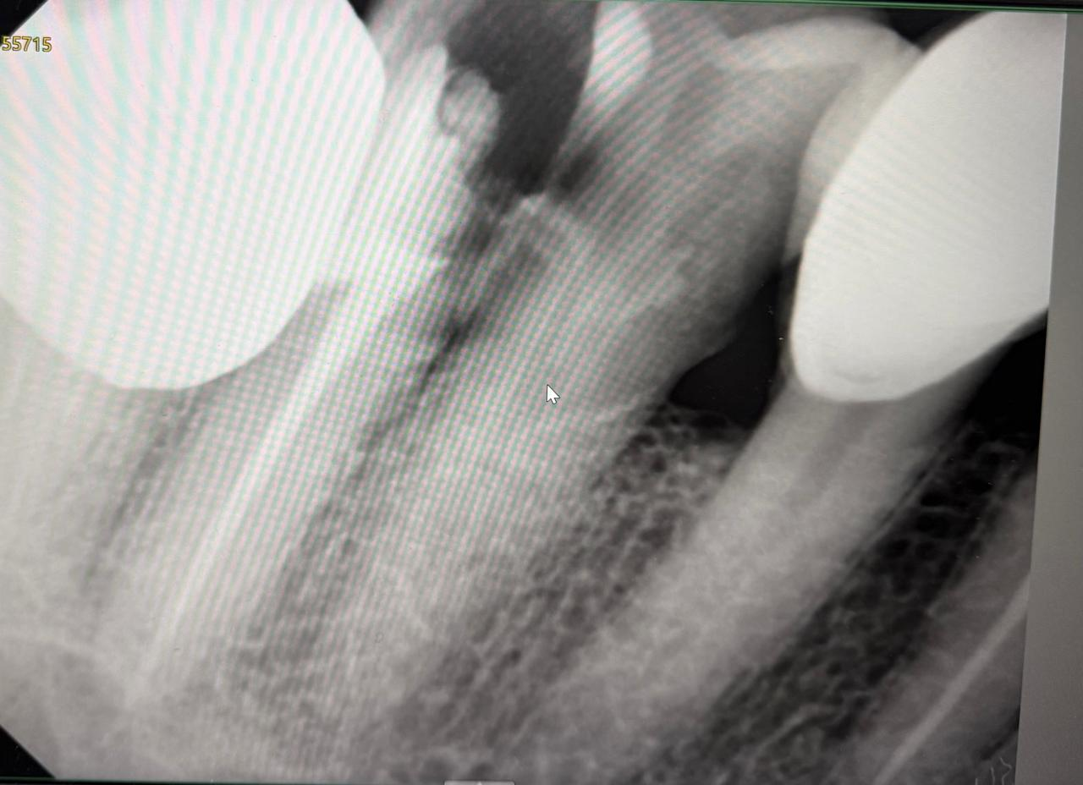
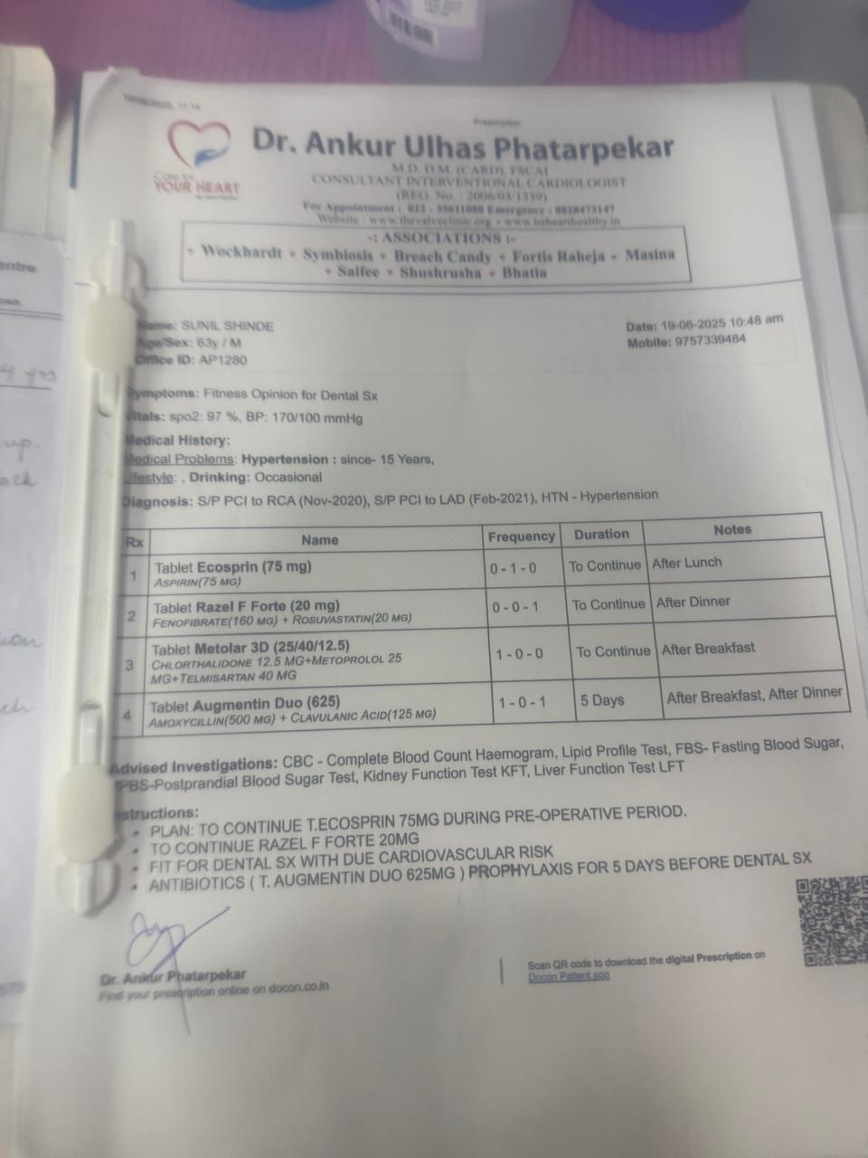
Pre operative radiography & Physician Concent

Slide 11

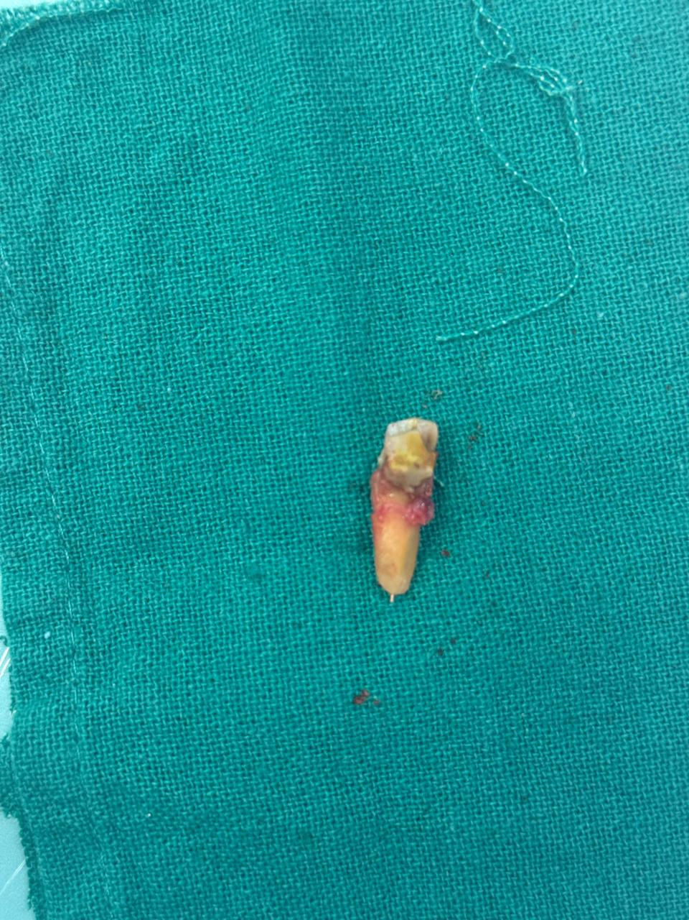
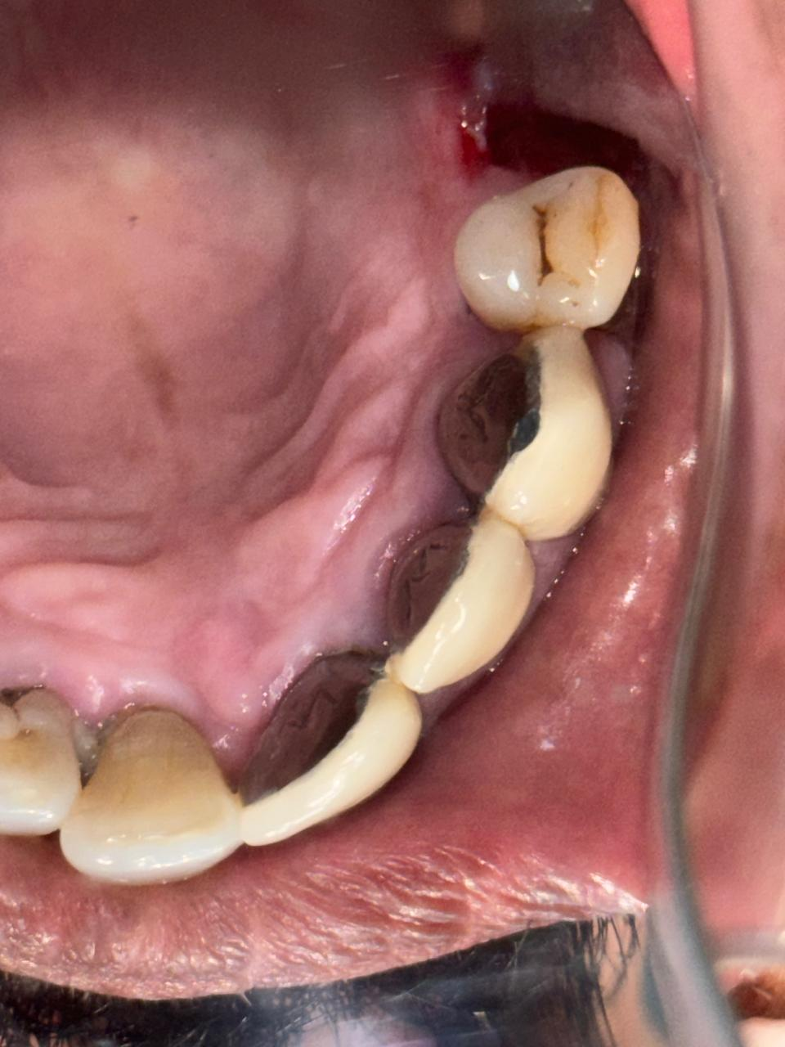
Extracted Teeth & Socket after Extraction

Slide 12
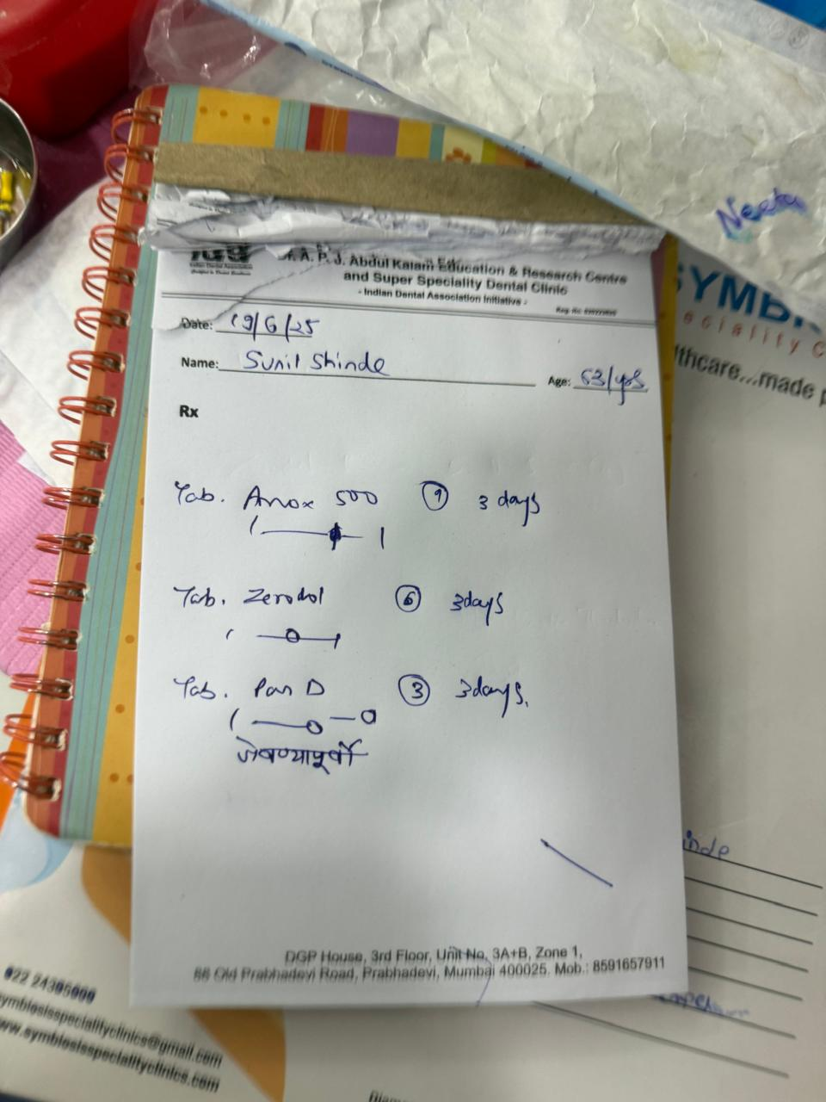
Medication

Slide 13
Conclusion
Dental extractions in patients with heart conditions, including those who have undergone angioplasty, require a comprehensive and coordinated approach.
By carefully assessing the patient's cardiac risk, managing medications appropriately, employing atraumatic surgical techniques, and providing diligent post-operative care, dentists can minimize the risks and ensure the safety and well-being of their patients.

Slide 14


Thank You!

