Slide 1
Digital Image processing
Shubham Kumar Sah
jatin jihirsu

Slide 2
Introduction
What is Digital Image Processing?
Digital Image Processing means using computers to performing operations on an image to enhance it or extract useful information. The image is made of small elements called pixels, and each pixel has color or brightness value. The computer processes these pixels to improve the image or get useful information from it.
What are the applications of Digital Image Processing?
Medical Scans: Helping doctors see problems in X-rays or MRIs.
Security Cameras: Spotting movement of any object or people automatically.
Satellite Images: Studying weather, crops, or forests from space.
Checking Products: Finding defects in items on factory lines.

Slide 3
Fundamental steps in digital image processing
Image Acquisition : Capturing a digital image using a camera or scanner.
Preprocessing : Enhancing the image by removing noise or adjusting contrast.
Image Segmentation : Dividing the image into meaningful parts or regions.
Feature Extraction : Identifying key features like edges, shapes, or textures.
Image Recognition : Understanding or labeling what’s in the image.
Image Compression : Reducing the image size for storage or transmission.
Image Display : Showing the final processed image or using it for further tasks.

Slide 4
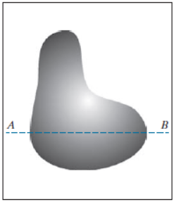
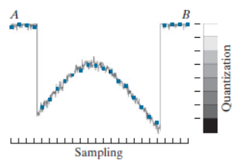
image digitization
Image Digitization is the process of converting a real-world image (like a photo or a scanned document) into a digital form that a computer can understand and process.
It involves Sampling and Quantization.
Sampling : It is the process of dividing a continuous image into a grid of small, equally spaced points called pixels.
Quantization : It is the process of converting the continuous range of pixel values (like brightness or color intensity) into a limited set of discrete values.

Slide 5
Representing a digital image
A digital image is represented as a 2D grid (matrix) of pixels, where each pixel holds a numerical value that represents brightness (in grayscale) or color (in color images).
Types:
Black & White Image: A type of digital image that has only two possible pixel values either black(0) or white(255).
Grayscale Image: A digital image where each pixel shows a shade of gray, ranging from black (0) to white (255).
Color Image: A color image is made up of three separate channels: Red, Green, and Blue (RGB). Each pixel has three values showing how much of each color it contains.

Slide 6
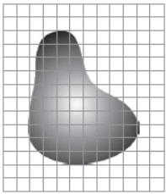
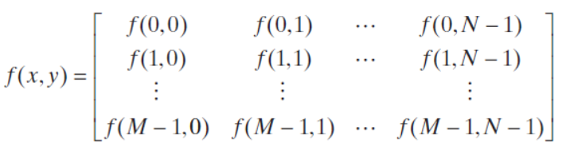
Image as a function
Image can be represented as a function.
Here M and N represent the dimensions of an image and x and y are the position of pixels.

Slide 7
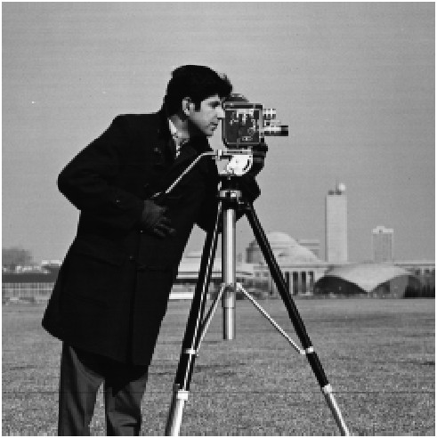
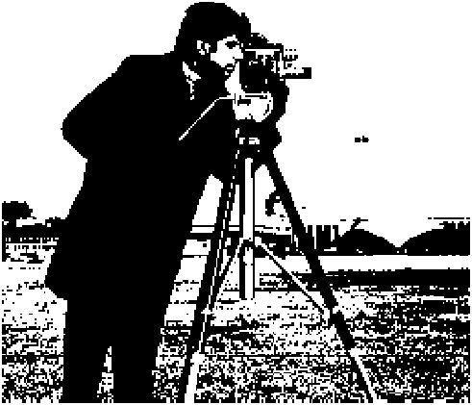
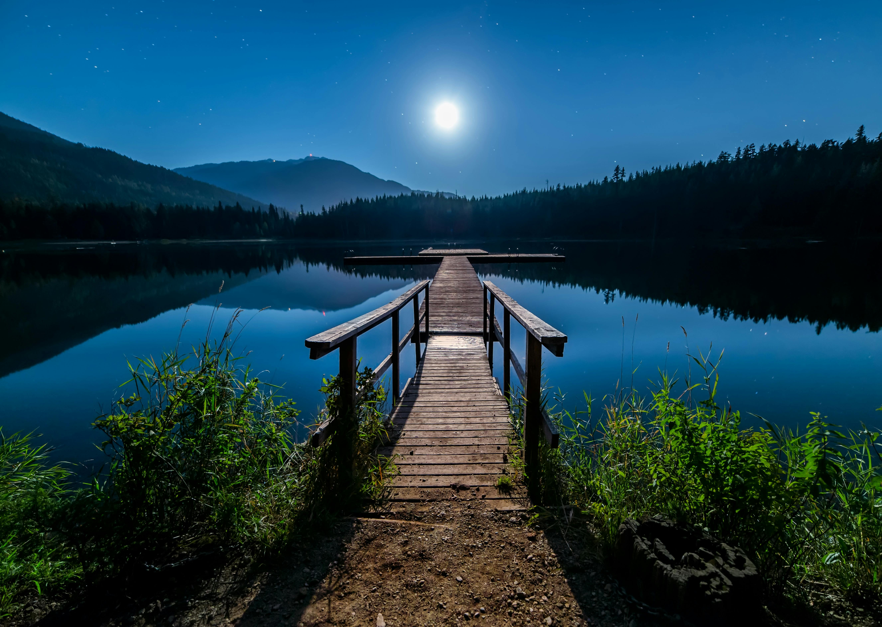
Types of image
Black & White Image | Grayscale Image | Color Image

Slide 8
Mathematical tools used in image processing
Arithmetic Operation:
Addition: Brightness enhancement
Subtraction: Motion detection
Multiplication: Masking
Division: Lighting correction
Logical Operation:
AND: Extract Region of Interest
OR: Combine Masking
NOT: Inverting foreground/background
XOR: Finding difference or edge region

Slide 9

Point processing techniques
Intensity transformations are point processing techniques that change the pixel values (intensities) of an image to enhance or extract features. These transformations are applied individually to each pixel using a transformation function.
General formula:
$s=T(r)$
where $T$ is the transfer function that maps intensity $r$ to output $s$.

Slide 10
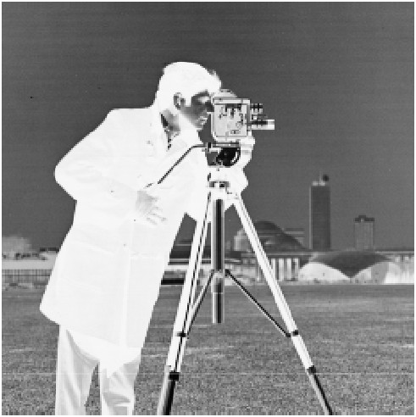

Types of Intensity Transformations
Image Negative: It inverts the intensities of an image. It transforms dark areas into bright and bright areas into dark.
Formula: $s=\left(L−1\right)+r$
here,
$s$ = transformed pixel value
$L$ = number of intensity value
$r$ = original pixel value
Use: a. Enhances white or light details in dark image
b. Common in X-ray or photographic negatives
Original Image | Transformed Image

Slide 11
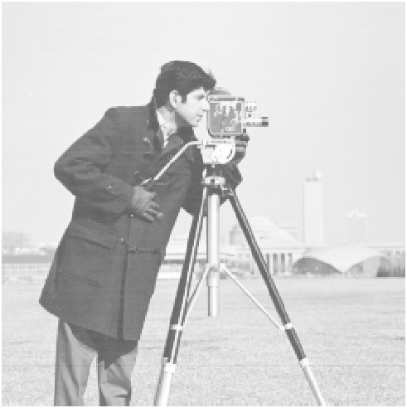

Logarithmic: Logarithmic transformation brightens dark areas in an image while compressing bright areas. It makes hidden details in dark regions more visible.
Formula: $s=c∗log⁡(1+r)$
here,
$s$ = new pixel value
$c$ = scaling constant
$r$ = original pixel value
Use: Expanding dark pixels (e.g., astronomical or medical imaging)
Original Image | Transformed Image

Slide 12
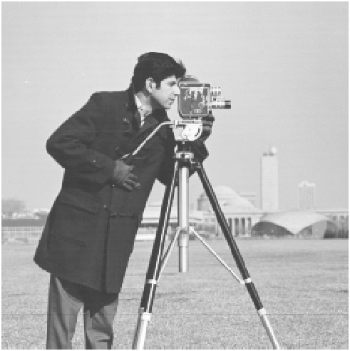

Power-Law(Gamma): Power-law transformation is used to adjust the brightness and contrast of an image by raising each pixel to a power (γ, called gamma).
Formula: $s=c∗rγ$
here,
$s$ = new pixel value
$c$ = scaling constant
$γ$ = exponent that controls the transformation
Use: Expanding dark pixels (e.g., astronomical or medical imaging)
Original Image
Transformed Image
Gamma (γ) Value | Effect on Image
γ < 1 | Brightens the image
γ > 1 | Darkens the image
γ = 1 | No change (identity function)

Slide 13


Threshold: Thresholding is a simple image processing technique used to convert a grayscale image into a binary image. It segments the image by turning pixels either black or white, based on a defined threshold value (T).
Formula: $s= \left\{\begin{aligned}1 ; if r\left(x,y\right)≥T \\ 0 ; if r\left(x,y\right)<T\end{aligned}\right.$
here,
$s$ = new pixel value in binary
$r(x,y)$ = original pixel value at (x, y)
Use: Object segmentation and Separating foreground and background
Original Image | Transformed Image

Slide 14

HISTOGRAM PROCESSING
An image histogram is a graph that shows how many pixels in the image have each possible intensity (brightness) value. Intensity ranges from 0 (black) to 255 (white).
Histogram Processing means changing an image by using its histogram — to make it look better, clearer, or more detailed.
Let $rk$ , for $k=0, 1, 2, . . ., L−1$, denote the intensities of an $L$- level digital image, $f(x,y)$. The unnormalized histogram of $f$ is defined as:
$h\left(rk\right)=nk$ for $k=0,1,2,. . . ,L−1$
where $nk$ is the number of pixels in $f$ with intensity $rk$, and the subdivisions of the intensity scale are called histogram bins. Similarly, the normalized histogram of $f$ is defined as:
$p\left(rk\right)= \frac{h(rk)}{MN}=\frac{nk}{MN}$

Slide 15
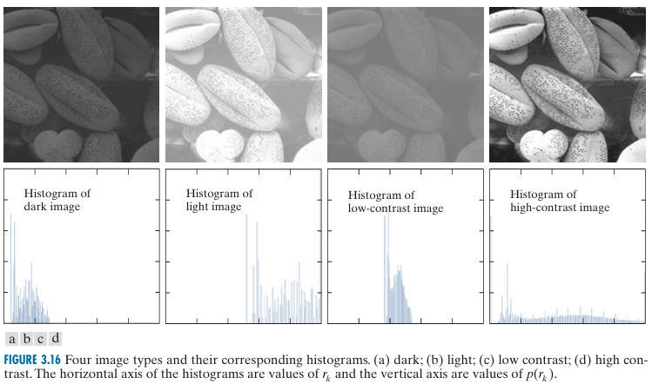
Graph showing intensity level and distribution of pixels

Slide 16

formula
To change the intensity value
$s=T\left(r\right)$ $0≤r≤L−1$
To change or revert back to old values
$r=T_1(s)$ $0≤s≤L−1$
where, $T$ : A transformation function that maps one intensity value to another.
$s$ : The output intensity value after transformation.
$r$ : The input intensity value before transformation
Conditions that are assumed before hand:
Condition (a): $T\left(r\right)$ is a monotonic increasing function in the interval $0≤r≤L−1$. This ensures that the output intensity values will never decrease with increasing input intensity values. It prevents artifacts or distortions in the transformed image.
Condition (b): $0≤T\left(r\right)≤L−1$for $0≤r≤L−1$. This ensures that the transformed intensity values remain within the valid range. It guarantees that the mapping does not exceed the expected limits of the image's intensity scale.

