Slide 1
E-COMMERCE DATA ANALYSIS, PREDICTION AND FORECASTING
SHOP
By – Shubham Kumar Sahu

Slide 2
OVERVIEW
INTRODUCTION
E-commerce, the buying and selling of goods and services online, has transformed the way businesses operate and consumers shop. With rapid growth driven by technology and changing consumer habits, it offers great opportunities but also poses challenges like intense competition and data security.
By analysing customer behaviour, predicting sales trends, and identifying why customers leave, businesses can make smarter decisions.
OBJECTIVE
Our aim is to improve the decision-making for more customer retention, and boost sales.
This project cover various machine learning methods for sales prediction, churn prediction, and forecasting, offering practical insights to help grow our business.

Slide 3




DATA OVERVIEW
02
03
01
04
Customer Purchase Data
Churn Data
Data Collected From
Kaggle and Data World
Sales and Marketing Data
Revenue and Net-Income Data

Slide 4
PROJECT OUTCOME
PAY
Data Analysis
01
Revenue Analysis
Churn Analysis
Sales and Marketing Analysis
Sales and Churn Prediction
02
Tools Used
Power BI and Python
XGBoost Regressor – Sales Prediction
XGBoost Classifier – Churn Prediction
03
Revenue and Net Income Forecasting
Exponention Smoothing – Income Forecasting
ARIMA – Revenue Forecasting
04
Customer Segmentation
RFM Model

Slide 5
PROJECT OUTLINE
01
02
03
04
Data Pre-processing
Exploratory Data Analysis
Outlier Treatment
Encoded Categorical Data
05
06
07
08
Model Building
Hyperparameter Tuning
Web Application Development
Deployment on Amazon AWS

Slide 6
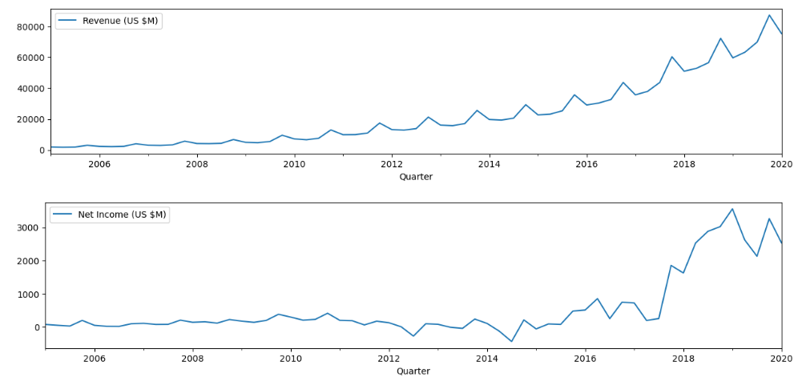
EXPLORATORY DATA ANALYSIS
Revenue and Income Over Years
SERVICES
INSIGHT
Revenue and Income Trend increasing over years
Revnue have additive seasonality but profit have multiplicative seasonality

Slide 7
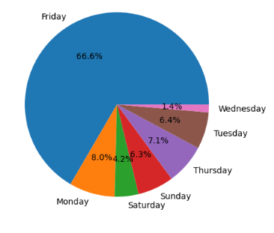
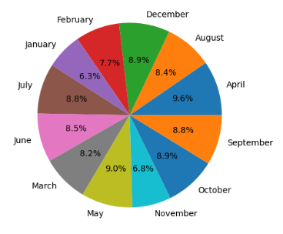
EXPLORATORY DATA ANALYSIS
Month wise Sales
Day wise Sales
Insight
April and May Month have Highest Sales
Insight
Friday have Highest Sales

Slide 8
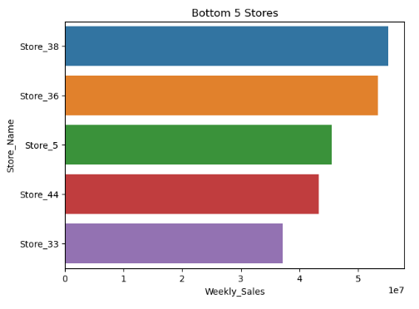
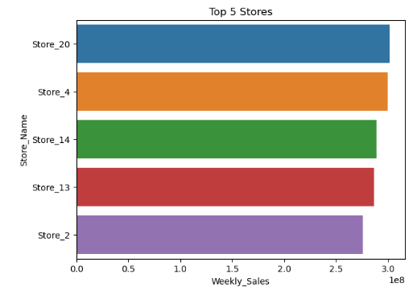
EXPLORATORY DATA ANALYSIS
Top 5 Stores Based on Sales
Bottom 5 Stores Based on Sales
Insight
StoreID – 20 have Highest Sales
Insight
StoreID – 33 have lowest Sales

Slide 9
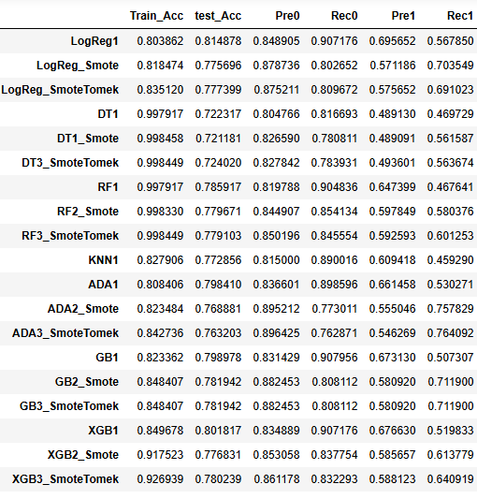
CHURN PREDICTION
Best Performed Model
XGBoost with SmoteTomek
Here SmoteTomek is used for treatment of data imbalance

Slide 10
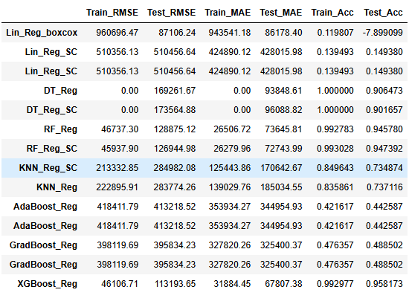
SALES PREDICTION
Best Performed Model
XGBoost Regressor
Train Score – 99%
Test Score – 96%

Slide 11



REVENUE FORECASTING
TES
ARIMA
Best Performed Model
ARIMA
SARIMA

Slide 12


INCOME FORECASTING
TES
ARIMA
Best Performed Model
TRIPLE EXPONENTIAL SMOOTHING

Slide 13
THANK YOU

