Slide 1

INVENTORY MANAGEMENT ANALYSIS
BY – SHUBHAM KUMAR SAHU

Slide 2
INTRODUCTION
In a world where effective supply chain management is paramount, understanding your inventory deeply is the key to optimizing operations, minimizing costs, and maximizing profitability. Today, we delve into the realm of inventory analysis to uncover invaluable insights that can revolutionize the way we manage the inventory
PROBLEM STATEMENT
The merchandise xyz company buys a liquor from various vendors and sell it to their clients.
The company has been experiencing issues with inventory management, including stockouts, excess inventory, and increased carrying costs. The management team wants to conduct an inventory analysis to identify areas for improvement and optimize their inventory management practices
The Analysis is performed using Power BI and MySQL
The analysis is centred on the following points :
Analysis of Purchase
Analysis of Sales
Analysis of Stocks
ABC Evaluation
XYZ Evaluation

Slide 3
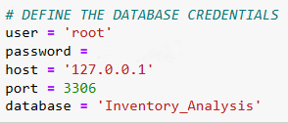
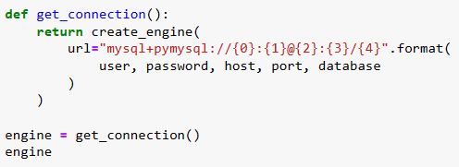
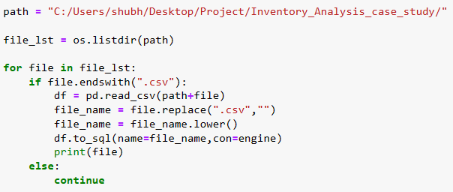
DATA IMPORT
PROBLEM
The inability to import all the files at once makes loading several files in Power BI and MySQL a time-consuming job.
Furthermore, importing big data files into MySQL takes time.
SOLUTION
I used the sqlalchemy and pymysql libraries to connect MySQL to Python and import all of the data from there.
Next, data was loaded into Power BI using a MySQL database.

Slide 4
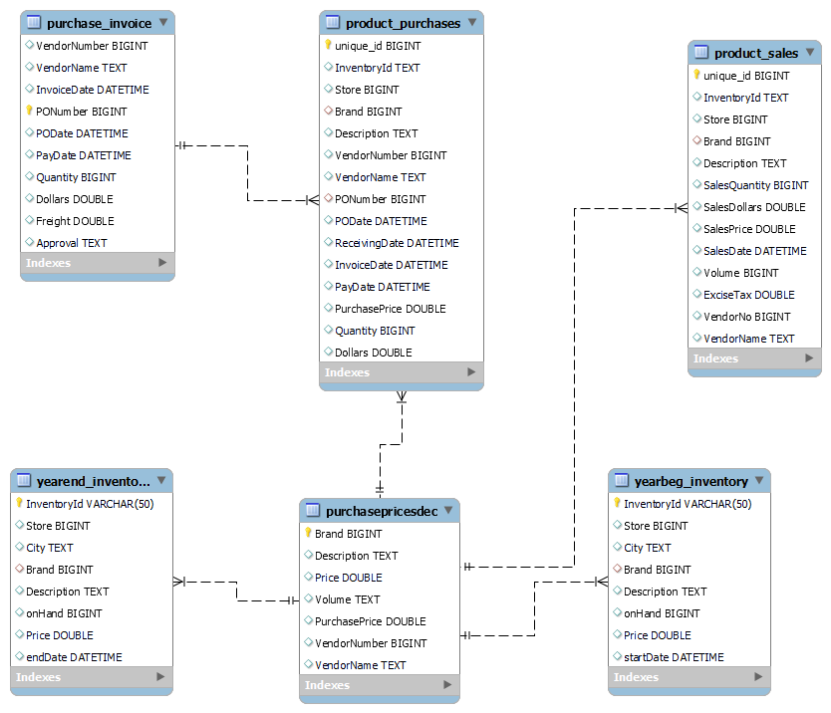
DATA OVERVIEW
The dataset contains information about liquor inventory for year 2016.
It contains six files :-
Purchase_invoice.csv
Product_purchase.csv
Product_sales.csv
Purchasepricedesc.csv
Yearend_inventory.csv
Yearbeg_inventory.csv
Dataset link:-
https://www.kaggle.com/datasets/bhanupratapbiswas/inventory-analysis-case-study/data

Slide 5
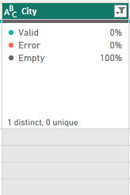
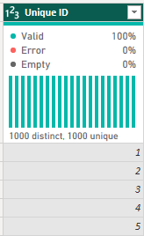
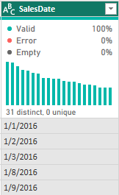
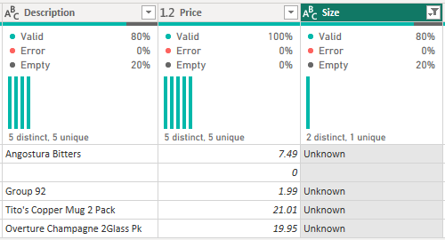
DATA PREPROCESSING
Deleted Irrelevant Features
Added Primary Key Column
Sales Date Column Reformatted in dd-mm-yyyy Format and then Datatype of Column Changed to Date Type
Null Values and Blank Values Treated
Ambiguous Rows are Treated

Slide 6
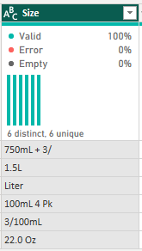
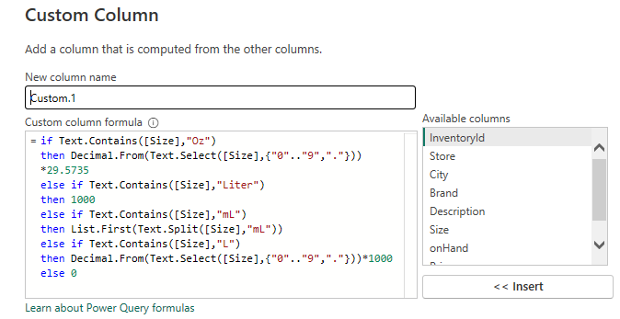
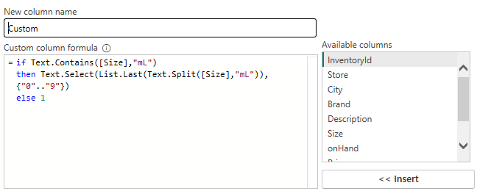
DATA PREPROCESSING

Slide 7
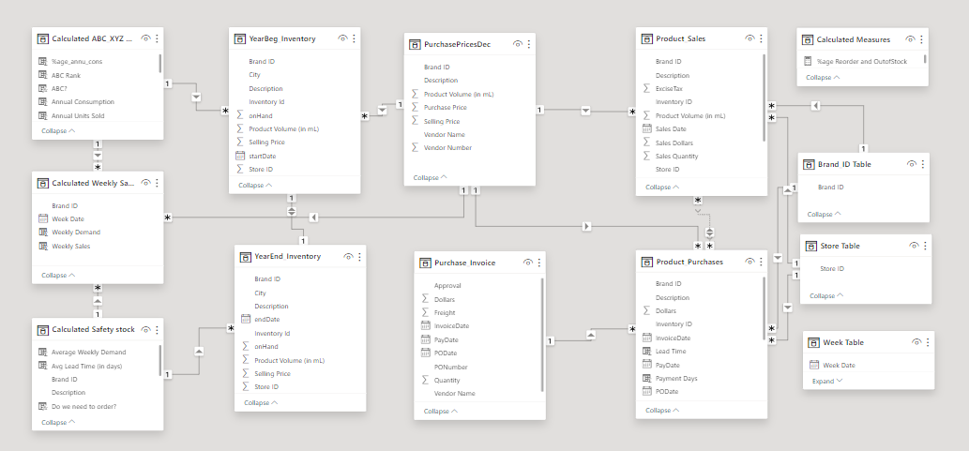
DATA MODELING

Slide 8
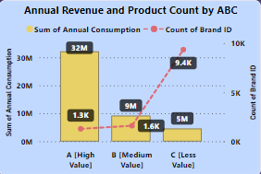
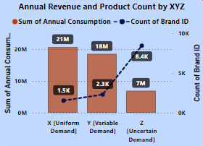
ABC–XYZ ANALYSIS
ABC analysis is an inventory management technique that determines the value of inventory items based on their importance to the business.
ABC Analysis Relates to the Pareto Principle.
An XYZ analysis divides items into three categories:
X items have the lowest demand variability.
Y items have a moderate amount of demand variability.
Z items have the highest demand variability and are therefore the hardest to forecast.

Slide 9
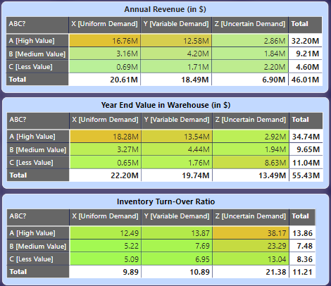
ABC–XYZ ANALYSIS
Positive Point: Products within the A category demonstrate high revenue performance, with particular emphasis on categories X and Y, which exhibit notably elevated revenue figures.
Positive Point: In category A, the X and Y categories have notably higher inventory levels compared to the Z category.
Negative Point: Within the C category, products categorized as Z are more heavily stocked at the end of the year
Positive Point: X and Y category products within category A demonstrate a higher turnover ratio.
Negative Point: Products categorized as Z exhibit a high inventory turnover ratio.

Slide 10
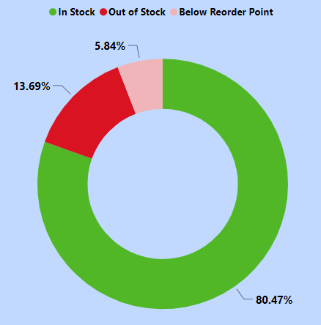
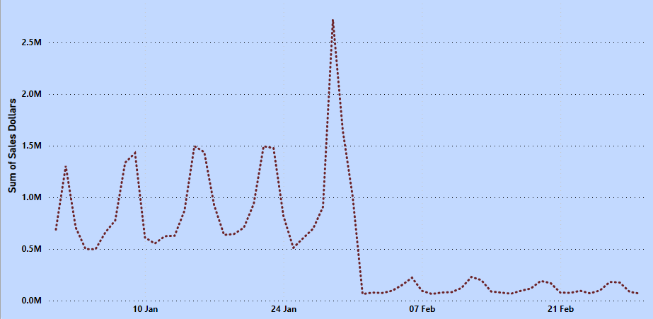
STOCK ANALYSIS
REORDER POINT = PEAK WEEKLY DEMAND*(MAX LEAD TIME/7)
13.69% products are Out of Stock at year end.
5.84% products are Below Reorder Point
Two month sales data represents a seasonality pattern in the product sales.
January month sales is greater than February month sales.

Slide 11
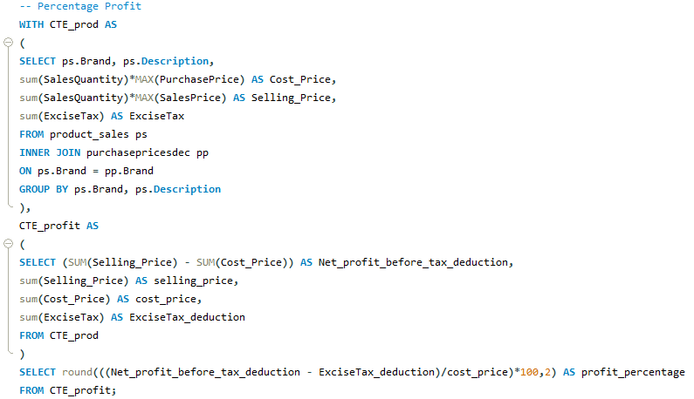
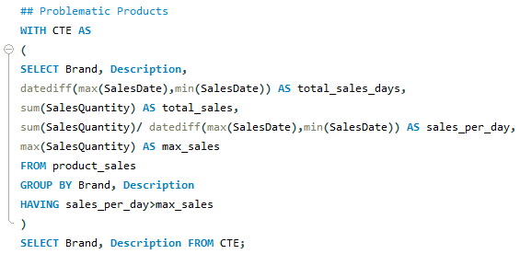
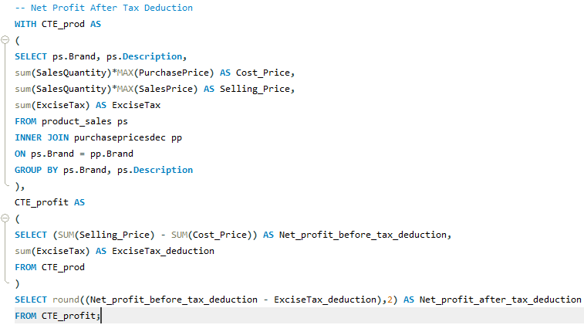
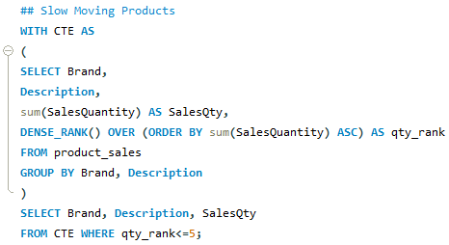
SQL QUERY
PROFIT PERCENTAGE
PROBLEMATIC PRODUCTS
NET PROFIT AFTER TAX DEDUCTON
SLOW-MOVING PRODUCTS

Slide 12
THANK YOU
ANY QUESTIONS?

