Slide 1


INSTITUTE FOR ADVANCED COMPUTING AND SOFTWARE DEVELOPMENT AKURDI, PUNE
Presentation On
Emergency Rescue Operation
PG-DAC March 2023
Submitted By: Group No: 22
Roll No. 233080
233038
Name:
Shubham Sandhan Omkar Goud
Mrs. Megha Mane
Mr. Rohit Puranik
Project Guide
Centre Coordinator

Slide 2
INTRODUCTION
In a world where emergencies and disasters can strike unexpectedly, having a reliable system for managing these situations is crucial. The Emergency Rescue Operation System, or EROS, is a web-based application designed to help people handle emergencies better.
This document outlines what EROS can do and what's needed to build it. It's like a blueprint for creating a powerful tool that will make it easier for authorities and emergency responders to manage crises and accidents.
EROS uses modern technology, like Spring Boot and ReactJS, to make it user-friendly and accessible to everyone. It simplifies tasks like reporting incidents, sorting them into categories, and communicating quickly during emergencies.
This document will explain how EROS manages users, helps report incidents, categorizes them, and keeps everyone informed in real-time. It also ensures the system is secure, reliable, and easy to use.
EROS is here to make emergencies easier to handle, so communities and organizations can keep people safe and minimize damage when disaster strikes.

Slide 3
Features: -
Administrator: Manages user accounts, resources, and system configuration.
Emergency Responder: Reports incidents, allocates resources, and updates incident statuses.
Regular User: Reports incidents, receives notifications, and views incident updates.
PROJECT OBJECTIVE
The purpose of the Emergency Rescue Operation System is to provide a digital platform that enables efficient and effective management of emergency incidents, resources, and communication during various types of disasters or crises and Accident.
PROJECT SCOPE
The system will allow users to report incidents, categorize them, allocate resources, monitor incident progress, and communicate in real-time. It will be accessible through web and, ensuring user-friendly interaction and responsiveness.

Slide 4
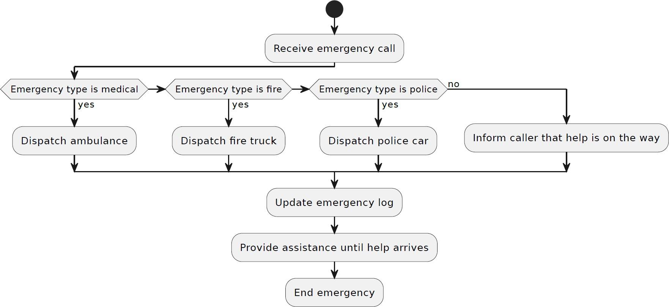
Activity Diagram

Slide 5
2.Software Requirements Specification for Emergency Rescue Operation

Slide 6
Introduction
Purpose
The purpose of the Emergency Rescue Operation System is to provide a digital platform that enables efficient and effective management of emergency incidents, resources, and communication during various types of disasters or crises and Accident.
Scope
The system will allow users to report incidents, categorize them, allocate resources, monitor incident progress, and communicate in real-time. It will be accessible through web and, ensuring user-friendly interaction and responsiveness.
Overview of the SRS
This document outlines the functional and non-functional requirements of the Emergency Rescue
Operation System. It describes the system's features, interactions, and constraints to guide the development process.
System Overview
Description of the System
The Emergency Rescue Operation System is a web-based application built on the Spring Boot framework for the backend and ReactJS for the frontend. It allows users to report incidents, allocate resources, track incident progress, and receive real-time notifications. The system supports different user roles, including administrators, emergency responders, and regular users.
High-Level Architecture
The system consists of a multi-tier architecture:
Presentation Layer: ReactJS-based frontend for user interaction.
Application Layer: Spring Boot-based backend for business logic and API management. Data Layer: MySQL database for storing incident, user, resource, and notification data.
User Roles and Responsibilities
Administrator: Manages user accounts, resources, and system configuration.
Emergency Responder: Reports incidents, allocates resources, and updates incident statuses. Regular User: Reports incidents, receives notifications, and views incident updates.
Interaction between Components/Modules
Components interact through RESTful APIs. The frontend communicates with the backend for user
authentication, incident reporting, resource allocation, and notification retrieval.

Slide 7
2.5 Operating Environment Core java, Spring boot ReactJS
MySQL Db
Rest API ,Spring Security
Functional Requirements
User Management
Users can register accounts with unique usernames and passwords.
Users can log in using their credentials.
Roles and permissions determine user access levels.
Administrators can manage user accounts, including adding, editing, and deleting users.
Incident Reporting
Users can report incidents, providing incident details, location, and severity.
Incidents can be categorized during reporting.
Users can attach media files (photos, videos) to incidents.
Incident Categorization
Incidents are categorized based on predefined incident categories.
Categories assist in incident prioritization and resource allocation.
Communication and Notification
Users receive real-time notifications regarding incident updates.
Notifications are sent via email, SMS, or push notifications.
Emergency responders can communicate through instant messaging for collaboration.
Resource Management
Resources include personnel, equipment, and supplies.
Emergency responders can allocate resources to incidents. Resources have quantities and availability status.

Slide 8
Future Scope
Incident Tracking and Status
Users can view incident statuses and progress.
Emergency responders can update incident statuses and provide comments.
Reporting and Analytics
The system generates reports on incident history, resource utilization, and response times.
Non-Functional Requirements
Performance
The system should handle simultaneous incident reports and updates.
Response times for critical actions should be within acceptable limits.
Security
User passwords are stored securely using encryption techniques. Role-based access control ensures proper authorization.
Data transmission is encrypted using HTTPS.
Reliability
The system should have a high availability rate, with minimal downtime.
Regular data backups and disaster recovery plans are in place.
Usability
The user interface should be intuitive and user-friendly.
Mobile responsiveness ensures usability on various devices.
5. System Constraints
The system will be developed using Spring Boot for the backend and ReactJS for the frontend.
The database will be MySQL for data storage.
The application will be hosted on a cloud infrastructure.

Slide 9
3.3.3 Database:
MySQL is used to design databases.
MySQL:
MySQL is the world's second most widely used open-source relational database management
system (RDBMS). The SQL phrase stands for Structured Query Language.

Slide 10
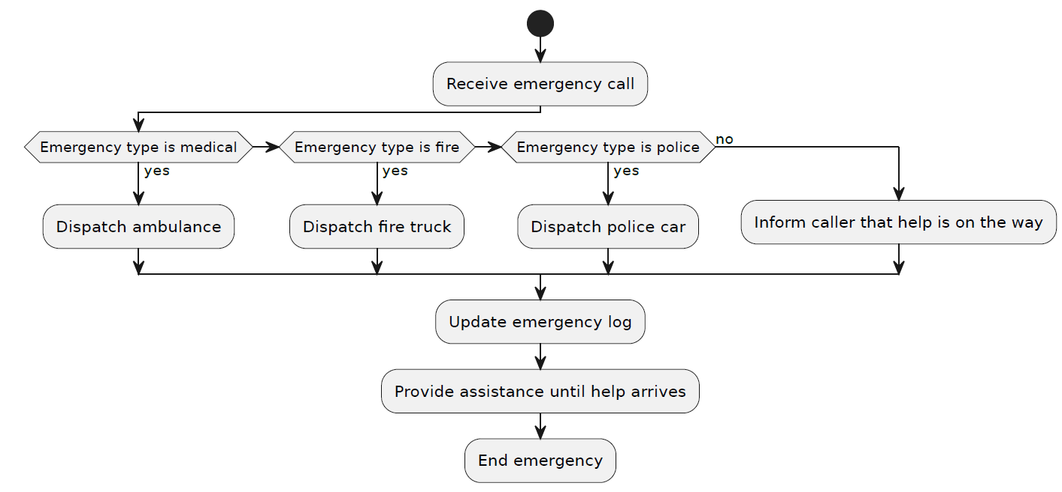
Activity diagram

Slide 11
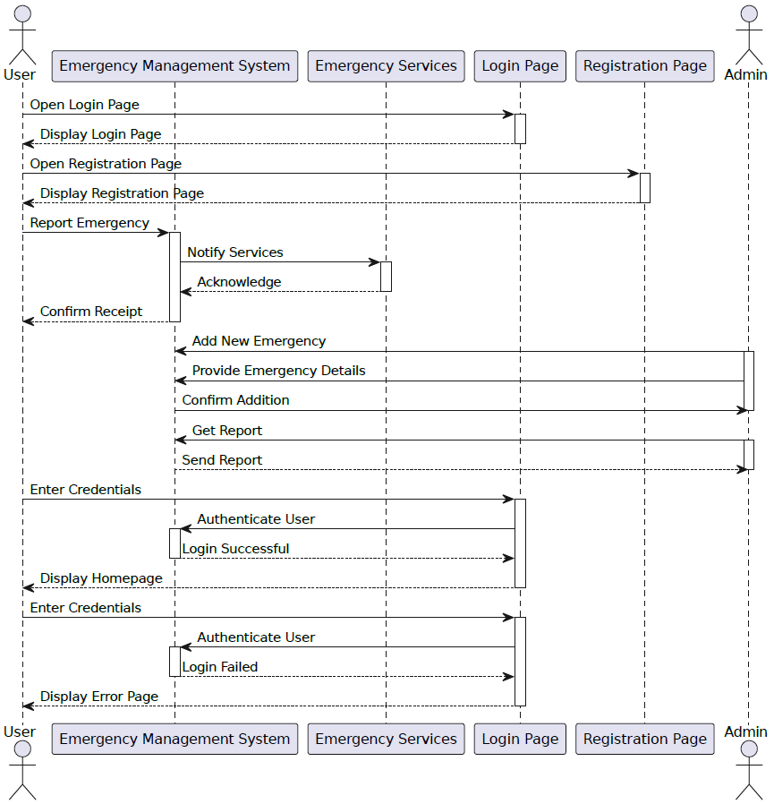
Sequence diagram:

Slide 12
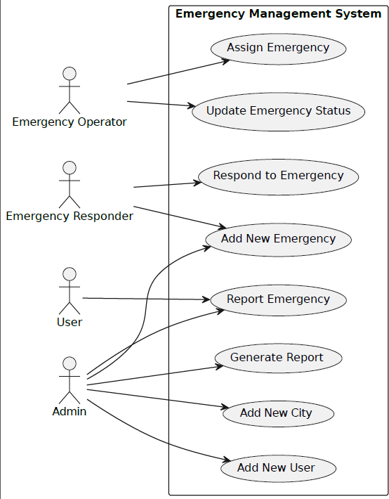
Use Case Diagram
Figure 9 Use Case Diagram

Slide 13
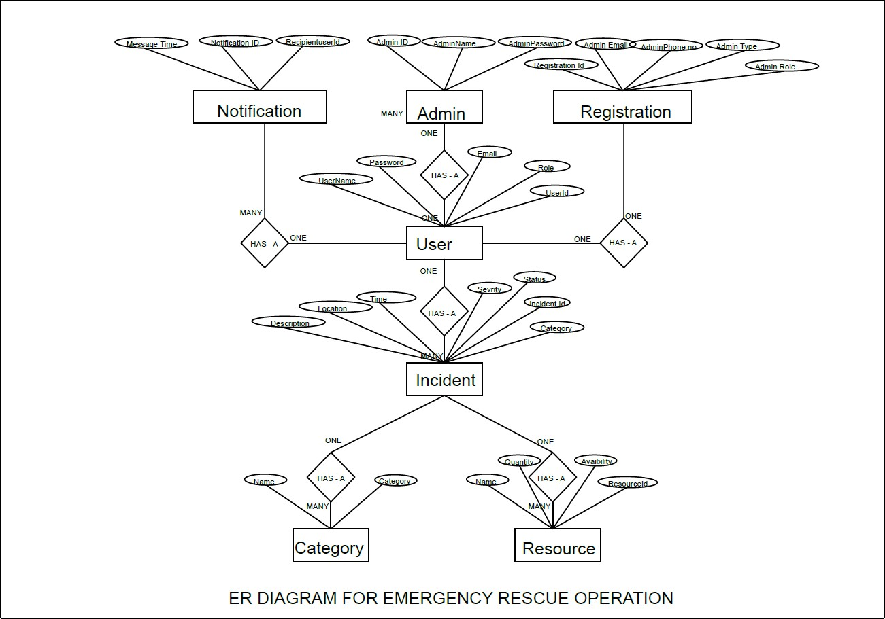
E-R Diagram:
ER Diagram

Slide 14
E-R Diagram:
Figure 13 ER Diagram(MY Sql Genrated)

Slide 15
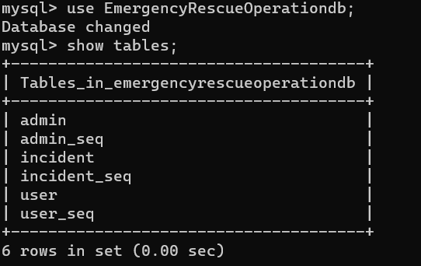

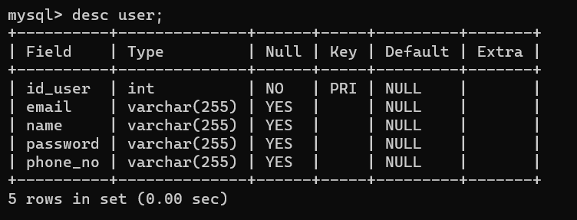
TABLE STRUCTURE:
Tables:
Category:
user:

Slide 16
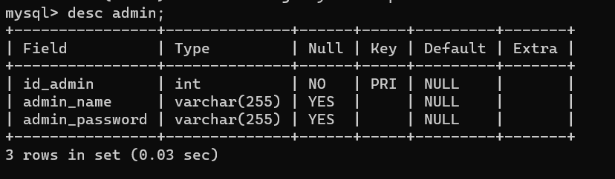
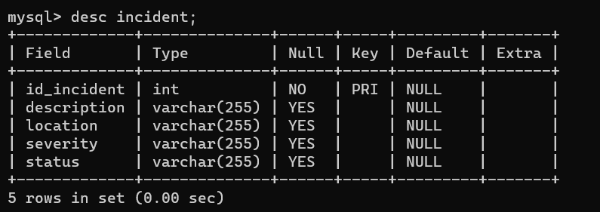
Admin:
Incident:

Slide 17
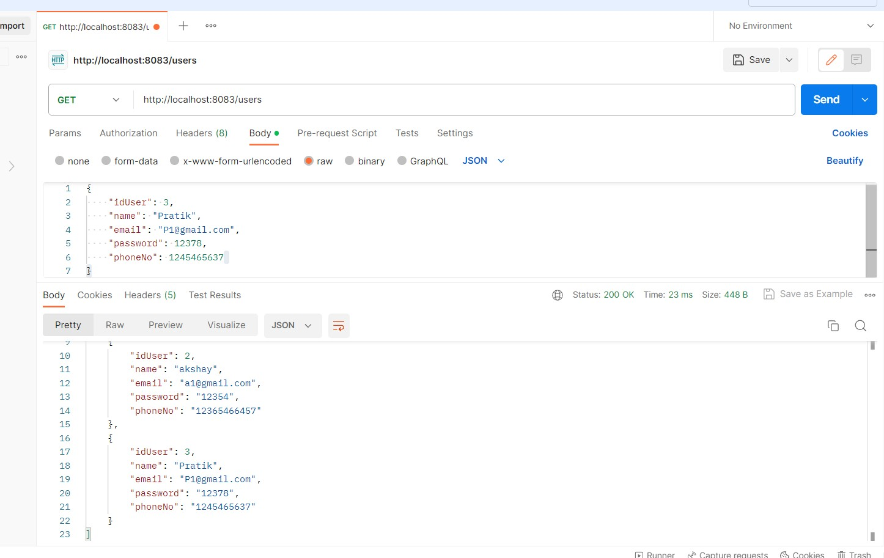
Screenshots: Postman:
Sign In

Slide 18
Admin Homepage
Admin display

Slide 19
Sign Out

Slide 20
Future Scope :
Incident Tracking and Status
Users can view incident statuses and progress.
Emergency responders can update incident statuses and provide comments.
Reporting and Analytics
The system generates reports on incident history, resource utilization, and response times.

Slide 21
Conclusion:
In conclusion, the Emergency Rescue Operation System (EROS) presents a promising solution for efficient emergency incident management. EROS, with its user-friendly design and robust feature set, has the potential to significantly improve emergency response efforts. By simplifying incident reporting, categorization, communication, resource allocation, and data analysis, EROS aims to enhance our ability to safeguard lives and resources during critical situations. As development progresses, EROS represents a beacon of hope for more effective and resilient emergency management

Slide 22
Thank You

