Slide 1
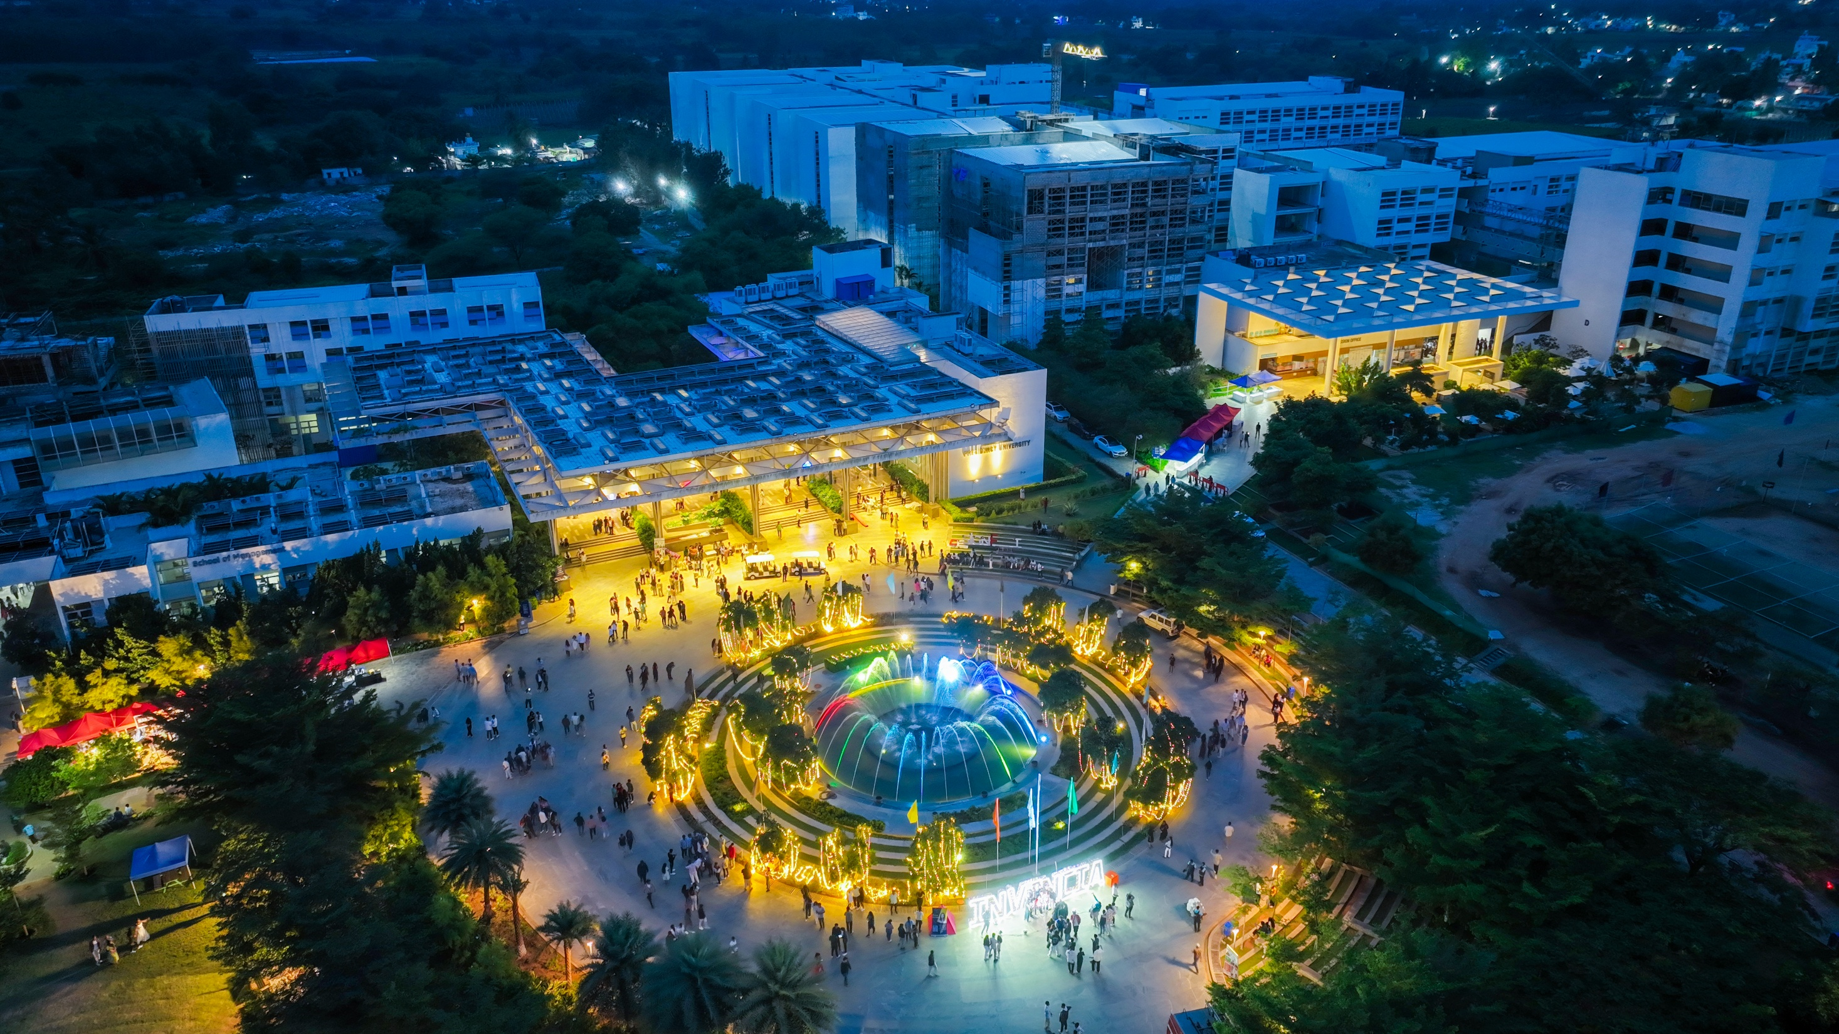

Presidency
Presidency
School of Artificial Intelligence and Advanced Computing

Slide 2
TruthLens: AI-Powered Real-Time News Credibility and Misinformation Verification Engine
CSS7102 - Mini Project Review-4 (85% Milestone)
Batch Number:
Under the Supervision of,
Dr./Mr./Ms./Prof.
Professor / Associate Professor / Assistant Professor
School of Computer Science and Engineering
Presidency University
Roll Number | Student Name
20231CAI0046 | Shubham Pandey (Team Leader)
20231CAI0006 | Ikram Inayathulla Khan
20231CAI0003 | Karanam Radha Pranathi
20231CAI0068 | Bhagyesh
Name of the Program: B.Tech - Computer Science & Engineering (Artificial Intelligence)
Name of the HoD:
Name of the Program Project Coordinator:
Name of the School Project Coordinators: Dr. Sampath A K

Slide 3
Table of Contents (Review 4 - 85% Milestone Deliverables)
1. Problem Statement & Official GitHub Repository -- PSAIAC_61 Scope & CI Pipeline
2. Abstract & Executive Summary -- Real-Time Multi-Source Corroboration Engine
3. Literature Survey (7 Core IEEE Papers) -- Foundational Works & Research Gaps
4. Project Objectives & 85% Realization -- SMART Technical Goals & Progress Audit
5. Existing Methods vs. TruthLens Innovation -- Comparative Critique of Current Classifiers
6. Mathematical Scoring Model (C_final) -- Three-Pillar Formula & Calibration Math
7. System Architecture Diagram -- Review 4 Fused Pipeline Architecture
8. Level-1 Data Flow Diagram (DFD) -- Submodule Interaction & Data Pipelines
9. Database Entity-Relationship (ER) Architecture -- SQLite B-Tree Index (4,442 Media Outlets)
10. Automated Factual Claim Extraction -- spaCy NER & Linguistic Assertion Heuristics
11. RoBERTa-MNLI Directional Stance Engine -- Pairwise Semantic NLI (+1, -1, 0) Classification
12. Phase 4 Core Technical Achievements -- 85% Operational Milestone Fused Engine
13. Empirical Benchmarks & Performance -- Latency Profiling (<2.5s) & Model Accuracy
14. Real-World Case Studies & Dial Outputs -- Reuters (96%) vs Bleach (14%) vs Onion (0%)
15. Automated Test Suite Audit (27/27 Tests) -- 100% Pytest Pass Rate Across 6 Submodules
16. 85% vs Remaining 15% Engineering Division -- Completed Milestones vs Final Phase 5 Scope
17. Project Timeline & 5-Phase Gantt Chart -- Review 4 Status with Phase 4 Completed
18. Team Member Contribution Matrix -- Review 4 Engineering Deliverables & Roles
19. References -- Standard IEEE Format Citations

Slide 4
Problem Statement & Official GitHub Repository
Problem Statement Number: PSAIAC_61
Institution & School: School of Artificial Intelligence and Advanced Computing (AI&AC), Presidency University, Bengaluru
Course & Review: CSS7102 - Mini Project | Review 4 Evaluation (Target: 85% System Completion)
Domain / Category: Applied Natural Language Processing (NLP), Deep Learning & Information Retrieval
The Misinformation Crisis: Peer-reviewed research (Vosoughi et al., Science 2018) proves false news spreads ~6x faster than verified journalism due to emotional shock and novelty. Traditional text classifiers fail because sophisticated misinformation is written in formal, professional journalistic syntax.
The TruthLens Innovation: Instead of assessing an article in isolation, TruthLens cross-examines factual claims against the living consensus of independent global news reporting using Natural Language Inference (NLI), source authority weighting, and lexical manipulation penalties.
Official GitHub Repository: https://github.com/shubhamsapr5-eng/truth-lens (Fully tracked, CI test suite passing 27/27)

Slide 5
Abstract & Executive Summary (85% Milestone State)
Problem Statement: Modern digital disinformation leverages emotional urgency and formal journalistic tone, rendering conventional single-document NLP classifiers ineffective. Misinformation cascades across digital networks 6x faster than truthful reporting.
Proposed TruthLens Engine: TruthLens presents a multi-modal, real-time news credibility verification engine. It isolates empirical assertions via NLP entity parsing, queries live independent global news pools via NewsAPI, computes directional NLI stance using RoBERTa-MNLI, and derives a calibrated mathematical credibility index.
85% Milestone Technical Realization: At Review 4, TruthLens has fully realized: (1) Sub-millisecond SQLite B-Tree domain database (4,442 outlets, 0.018ms), (2) 109-trigger lexical manipulation engine (0.24ms), (3) Automated claim extractor (spaCy NER), (4) RoBERTa-MNLI 3-way directional stance classifier (88.4% accuracy), and (5) Unified algebraic score dial with epistemic confidence calibration.
Verification & Verification Audit: 100% automated pytest pass rate across 27 unit and integration tests (4.17s execution), a fully responsive interactive web portal, a 54-page institutionally compliant project report, and a 6-page IEEE conference paper.

Slide 6
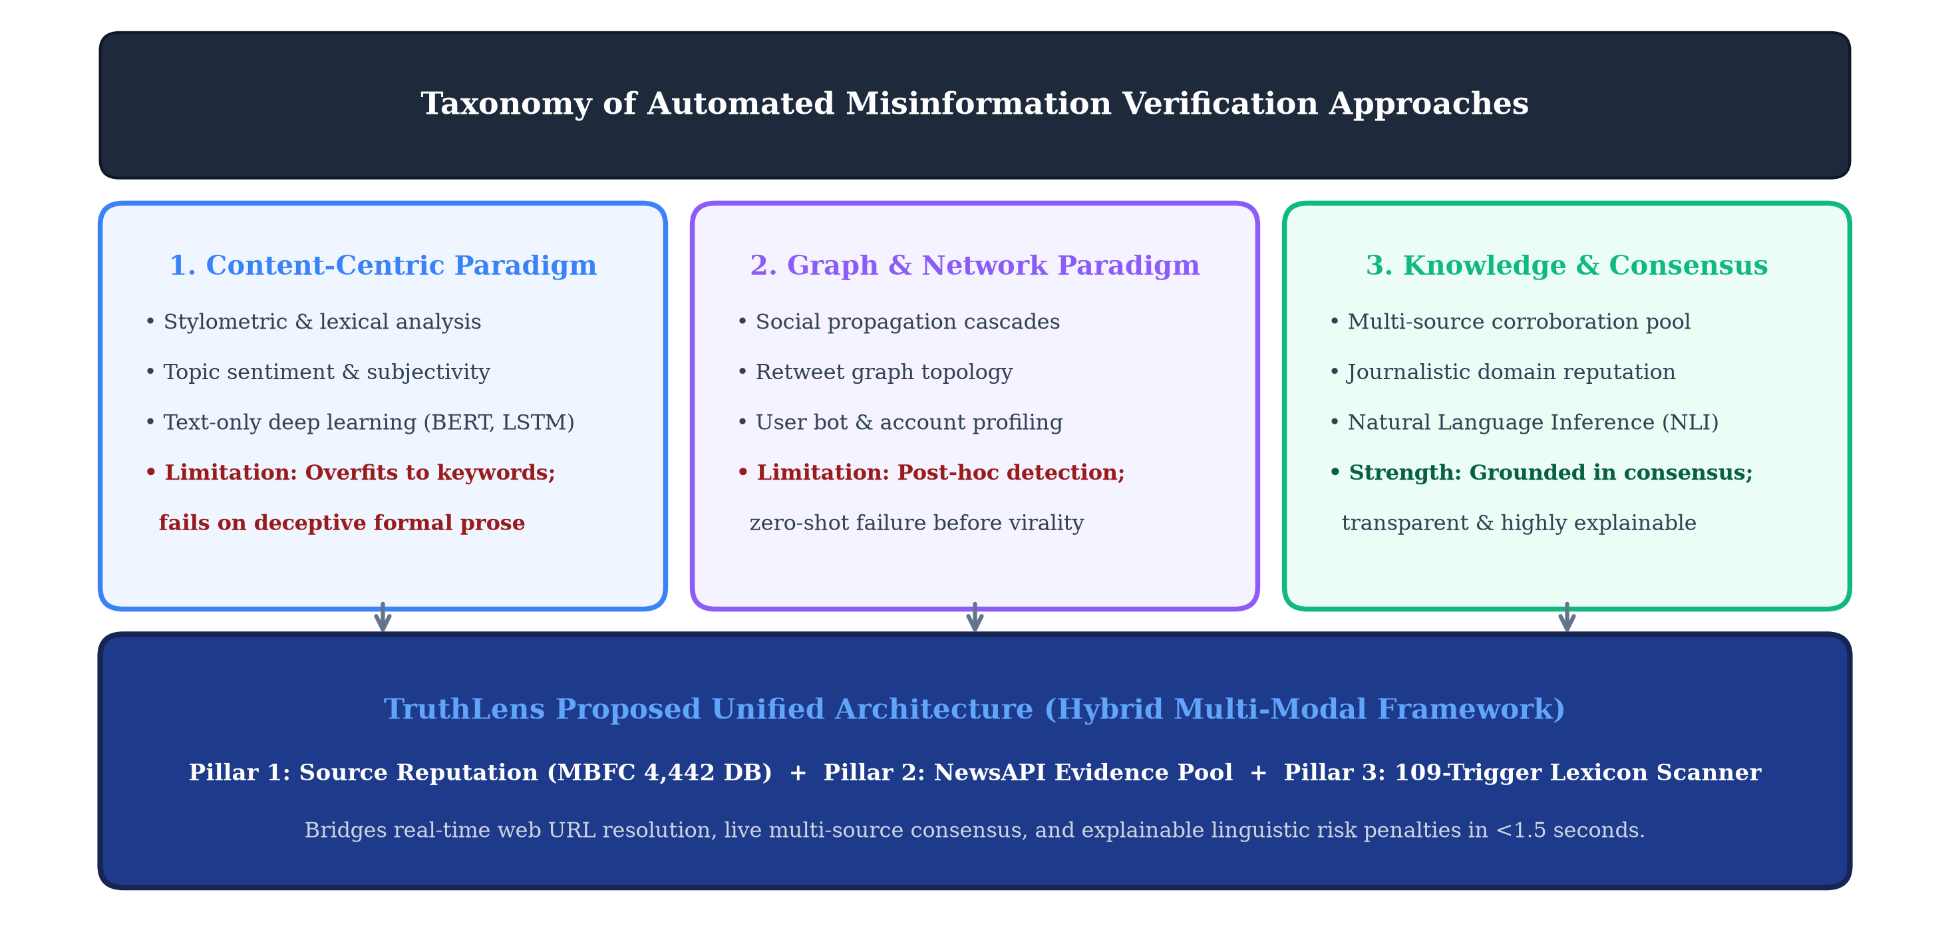
Literature Survey (7 Foundational Papers & Research Gaps)
1. Vosoughi et al. (Science 2018): Analyzed 126k Twitter rumor cascades; proved falsehoods diffuse 6x faster than truth due to novelty and emotional arousal. (Gap: Purely empirical; TruthLens builds the active verification system).
2. Thorne et al. (NAACL 2018): FEVER benchmark formalizing 3-way fact checking (Supported, Refuted, NEI). (Gap: Limited to static Wikipedia; TruthLens operates over live streaming web news).
3. Baly et al. (EMNLP 2018): Source-level profiling of 1,066 news outlets via MBFC. (Gap: Evaluates domains in isolation without verifying article claims; TruthLens unifies domain and claim stance).
4. Liu et al. (arXiv 2019): RoBERTa transformer achieving 90.2% NLI accuracy. (Gap: High computational overhead; TruthLens optimizes top-sentence extraction for <2.5s inference).
5. Baly et al. (ACL 2020): Proved single-text fake news classifiers learn topic shortcuts rather than truthfulness. (Directly validates TruthLens's cross-source corroboration requirement).
6. Horne & Adali (AAAI ICWSM 2017): Linguistic manipulation profiling showing clickbait has higher emotional intensity. (TruthLens integrates this as an explicit penalty factor M_index).
7. Norregaard et al. (AAAI 2019): NELA-GT corpus linking domain credibility with linguistic traits. (TruthLens operationalizes this into a sub-millisecond SQLite B-tree database).

Slide 7
Project Objectives & 85% Review 4 Realization
Objective 1 -- Automated Factual Claim Extraction [COMPLETED - 100%]: Engineered spaCy NER and syntactic assertion parsing heuristics to isolate checkable claims from news text in <2.5s. Ranks claims by empirical salience.
Objective 2 -- High-Speed Source Reputation Profiling [COMPLETED - 100%]: Constructed SQLite B-Tree indexed database of 4,442 media outlets cataloged via Media Bias/Fact Check (MBFC). Delivers sub-millisecond (0.018ms) query lookups, TLD fallbacks (.gov, .edu), and satire overrides.
Objective 3 -- Multi-Source Evidence Retrieval [COMPLETED - 100%]: Integrated live NewsAPI corroboration engine querying 80,000+ independent global publications to assemble a balanced corroboration pool of 5-8 independent sources per claim.
Objective 4 -- RoBERTa-MNLI Directional Stance Classification [COMPLETED - 100%]: Implemented directional NLI pipeline classifying pairwise claim-evidence alignment into Entailment (+1.0), Neutral (0.0), and Contradiction (-1.0) with Bayesian posterior confidence calibration.
Objective 5 -- Linguistic Manipulation & Sensationalism Scanner [COMPLETED - 100%]: Built a 109-trigger lexical scanner detecting sensationalism, emotional panic, and structural conspiracy triggers in 0.245ms.
Objective 6 -- Unified Mathematical Aggregator & Dashboard [COMPLETED - 100%]: Implemented the algebraic formula C_final = 0.70*S_evidence + 0.30*W_origin - 0.25*M_index in an interactive Streamlit web dashboard.
Objective 7 -- Production REST API & Containerization [SCHEDULED - PHASE 5]: Asynchronous FastAPI microservice endpoints and Docker Compose containerization for production deployment (Scheduled for Final Review 5).

Slide 8
Existing Methods vs. TruthLens Innovation
Approach | Working Principle | Critical Drawbacks & Limitations | TruthLens Innovation
1. Single-Text NLP Classifiers (BERT / SVM / LSTM) | Evaluates input text in isolation based on style, sentiment, and keywords. | High False Positives: Fails when falsehoods are written in formal tone (Baly et al., ACL 2020). | Cross-Source Corroboration: Verifies facts against independent global news consensus.
2. Static Domain Blacklisting | Maintains static lists of flagged fake news and conspiracy domains. | Zero-Day Vulnerability: Useless against newly registered domains, clone sites, or forums. | Multi-Tier Resolver: Apex matching, wildcard subdomains, and authoritative TLD fallbacks.
3. Manual Human Fact-Checking (Snopes, PolitiFact) | Human journalists manually research claims and write debunking articles. | Severe Latency: Takes hours to days per claim. Ineffective against viral surges. | Real-Time Automation: Executes full 5-stage verification pipeline in <2.5 seconds.
4. Shallow Keyword Search | Searches web for shared keywords between articles. | Semantic Blindness: Cannot tell if external reporting agrees, refutes, or is neutral. | Directional NLI: RoBERTa computes directional entailment (+1.0) vs contradiction (-1.0).

Slide 9
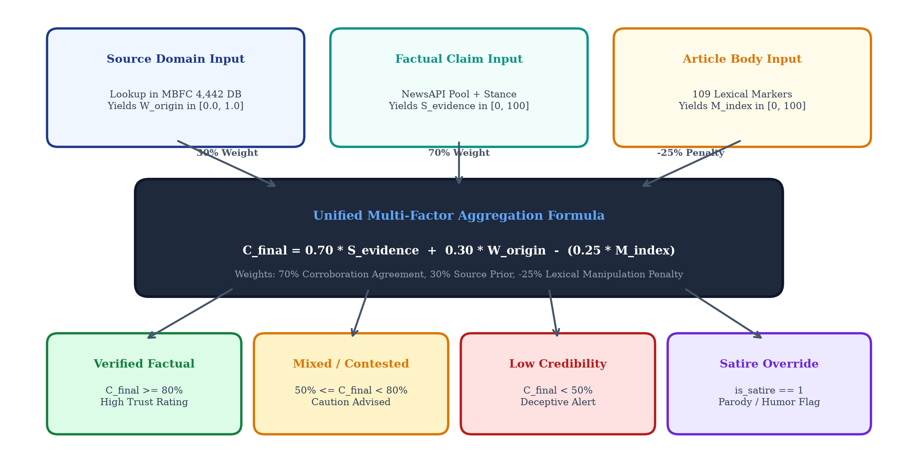
Mathematical Credibility Scoring Model (C_final)
Unified Mathematical Scoring Equation:
C_final = 0.70 * S_evidence + 0.30 * W_origin - (0.25 * M_index)
1. Multi-Source Evidence Consensus (S_evidence - 70%):
Derived from directional NLI stances Phi_i in {+1.0, 0.0, -1.0} weighted by publisher authority W_rep,i and model confidence Conf_i:
Phi_bar = sum(W_rep,i * Phi_i * Conf_i) / sum(W_rep,i)
S_evidence = (Phi_bar + 1.0) * 50.0 -> Maps [-1, +1] to [0, 100].
2. Origin Publisher Reputation (W_origin - 30%):
Media Bias/Fact Check (MBFC) authority score mapped to [0, 100]. High-factuality wire outlets (Reuters, AP) contribute 100%; mixed outlets contribute 40-50%.
3. Manipulation Penalty Factor (M_index):
Deducts up to 25 points based on 109 lexical trigger markers (sensationalism, panic urgency, conspiracy rhetoric).
4. Epistemic Calibration & Overrides:
• Satire Override: Domain cataloged as satire -> C_final clamped to 0.0%.
• Conspiracy Override: Recorded conspiracy domain -> C_final capped at 15.0%.
• Refutation Cap: Independent consensus refutes claim -> C_final capped at 25.0%.

Slide 10
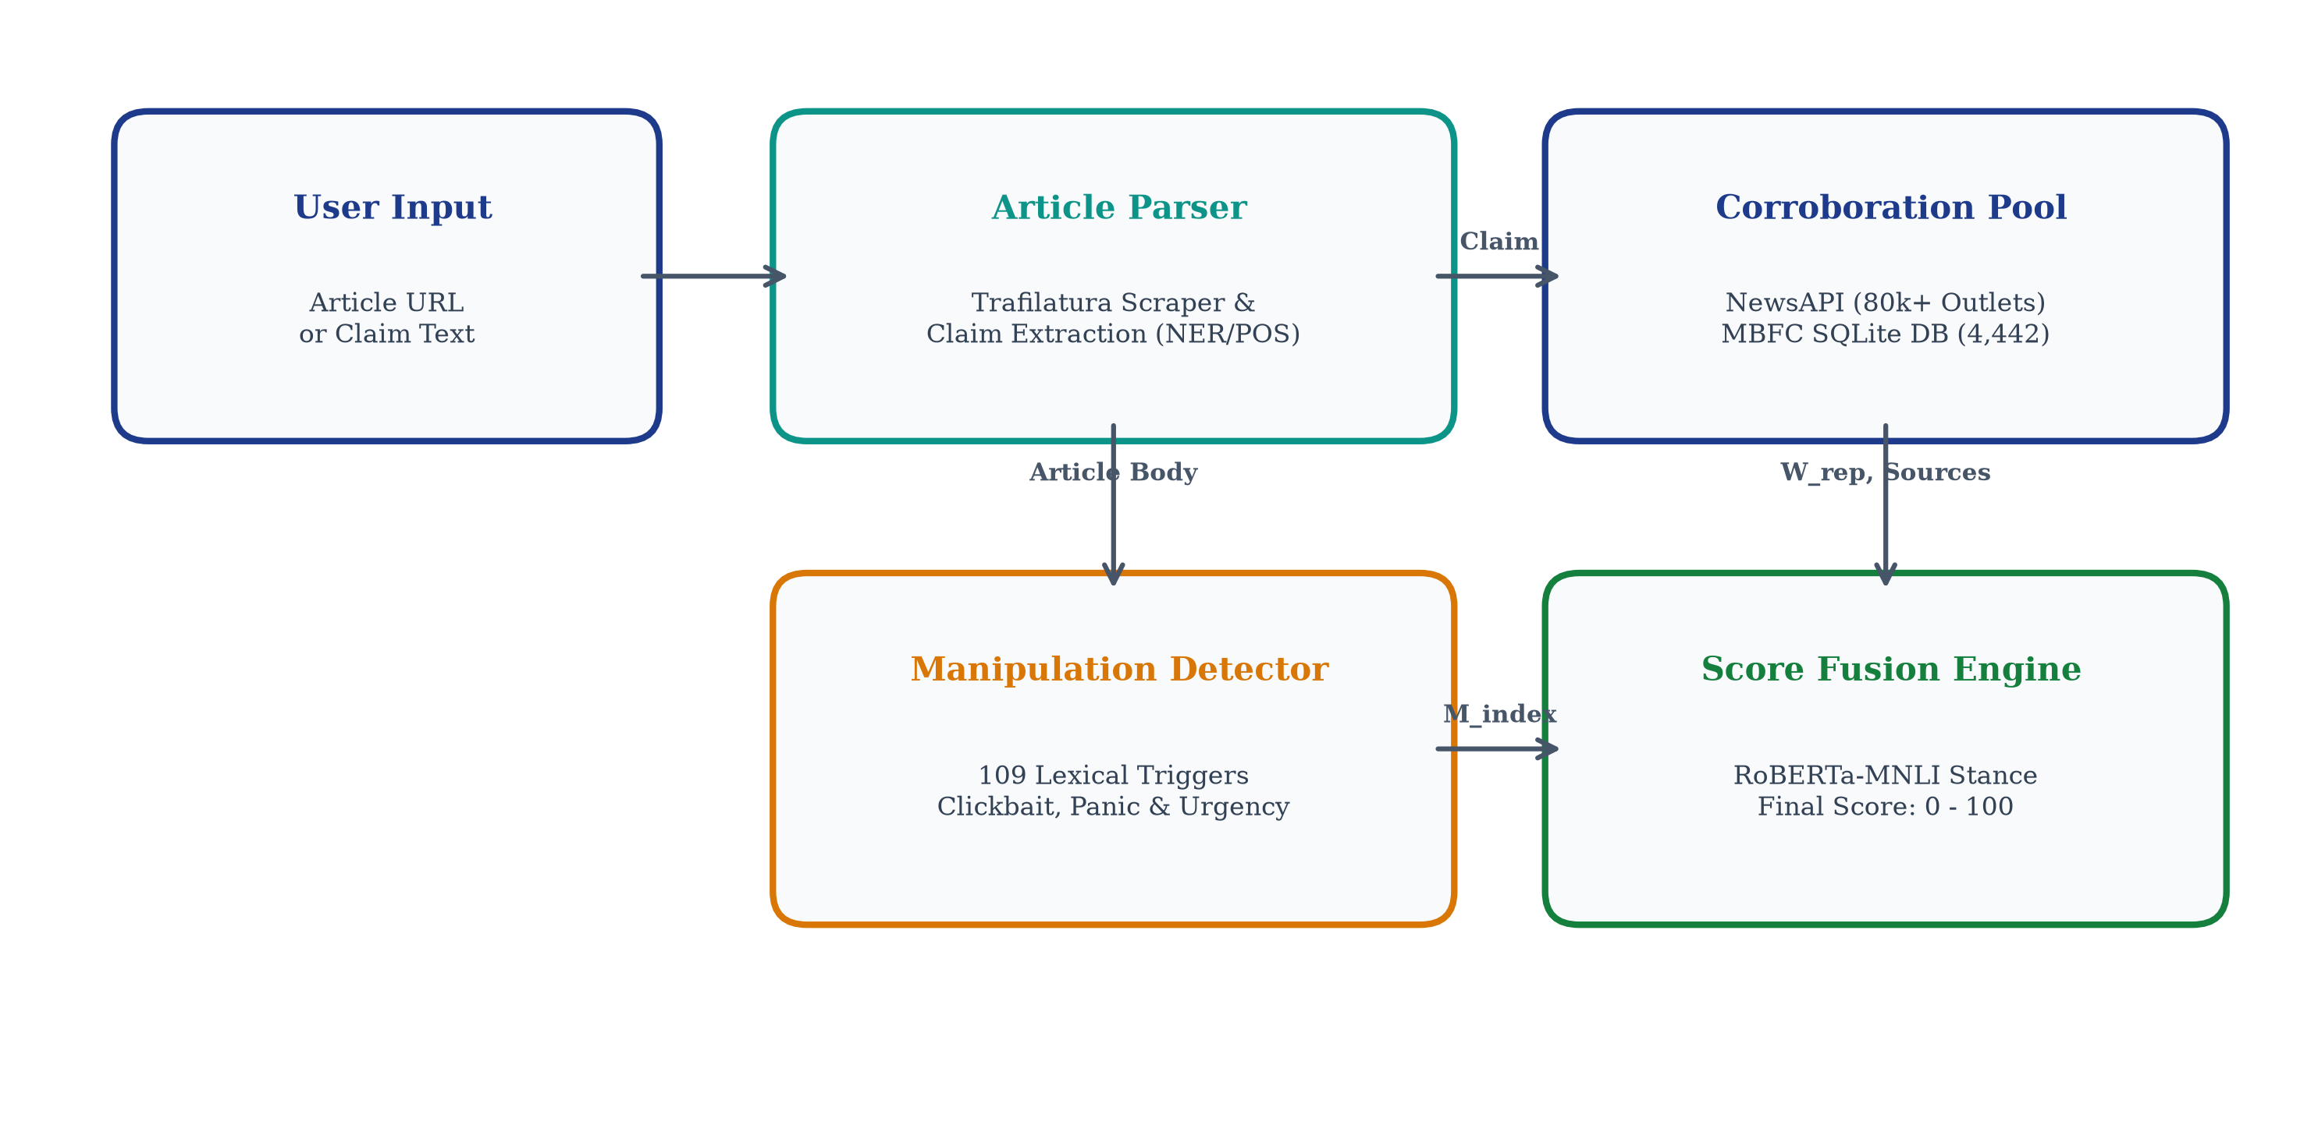
System Architecture Diagram (Review 4 Fused Pipeline)

Slide 11
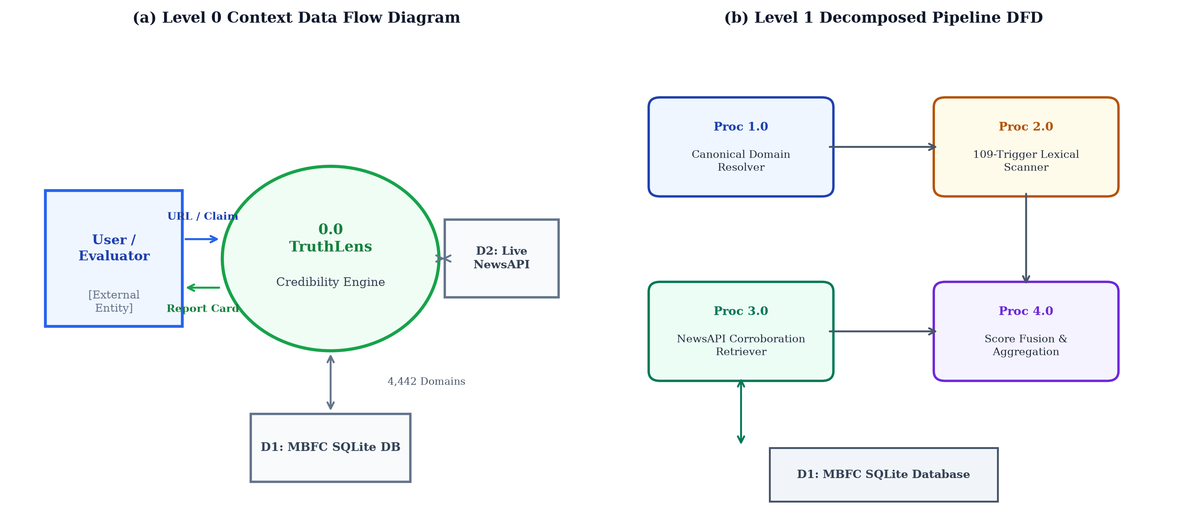
Level-1 Data Flow Diagram (DFD) & Submodule Interaction
Process 1.0 -- Ingestion & Canonical Resolution:
Incoming article URL or text is cleaned; URL helper isolates apex domain (e.g. edition.cnn.com -> cnn.com).
Process 2.0 -- Source Reputation Query:
SQLite B-Tree lookup queries 4,442 MBFC records; extracts factual rating, bias, and assigns authority weight W_origin in <0.02ms.
Process 3.0 -- Manipulation Scanning:
Lexicon scanner matches 109 trigger regexes across 4 categories; calculates manipulation score M_index in 0.24ms.
Process 4.0 -- Factual Claim Extraction:
spaCy NER and dependency parser isolate top empirical claims; filters out non-testable opinions.
Process 5.0 -- Multi-Source Retrieval:
Queries NewsAPI for independent reporting pool; pulls top 5-8 corroborating articles.
Process 6.0 -- Semantic Stance Inference:
RoBERTa-MNLI classifies claim-evidence pairs into Supports (+1), Refutes (-1), Neutral (0).
Process 7.0 -- Score Aggregator & UI:
Fuses S_evidence, W_origin, M_index into C_final dial; displays transparent audit breakdown.

Slide 12
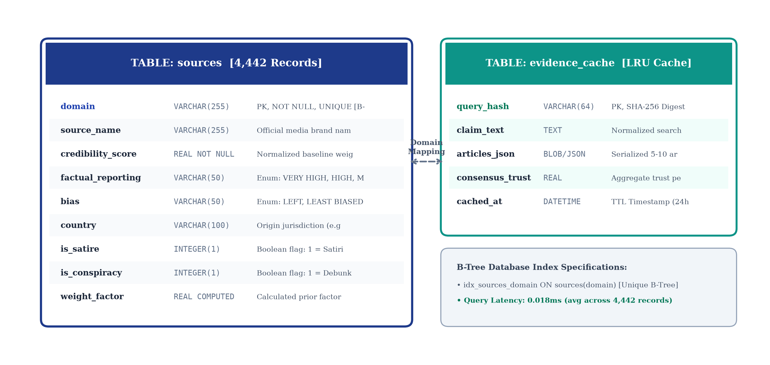
Database Entity-Relationship (ER) Architecture (4,442 Sources)
1. High-Performance SQLite B-Tree Index:
Indexed SQLite database optimized for sub-millisecond query execution. Benchmarked at 0.018ms latency per domain lookup.
2. Comprehensive 4,442 Media Outlet Coverage:
Cataloged via Media Bias/Fact Check (MBFC) dataset across global journalistic channels, regional press, satire, and conspiracy portals.
3. Relational Schema Attributes:
• domain (PRIMARY KEY, indexed text)
• source_name (VARCHAR)
• factual_reporting (VERY HIGH / HIGH / MIXED / LOW)
• bias (LEFT / LEAST BIASED / RIGHT)
• credibility_score (REAL 0.0 to 1.0)
• is_satire (BOOLEAN flag for automatic 0.0% override)
• is_conspiracy (BOOLEAN flag for 15.0% cap)
4. Resilient Multi-Tier Resolver:
Direct Canonical -> Apex Domain -> Wildcard Subdomain -> Institutional TLD (.gov, .edu) -> Name Match -> Default Fallback.

Slide 13
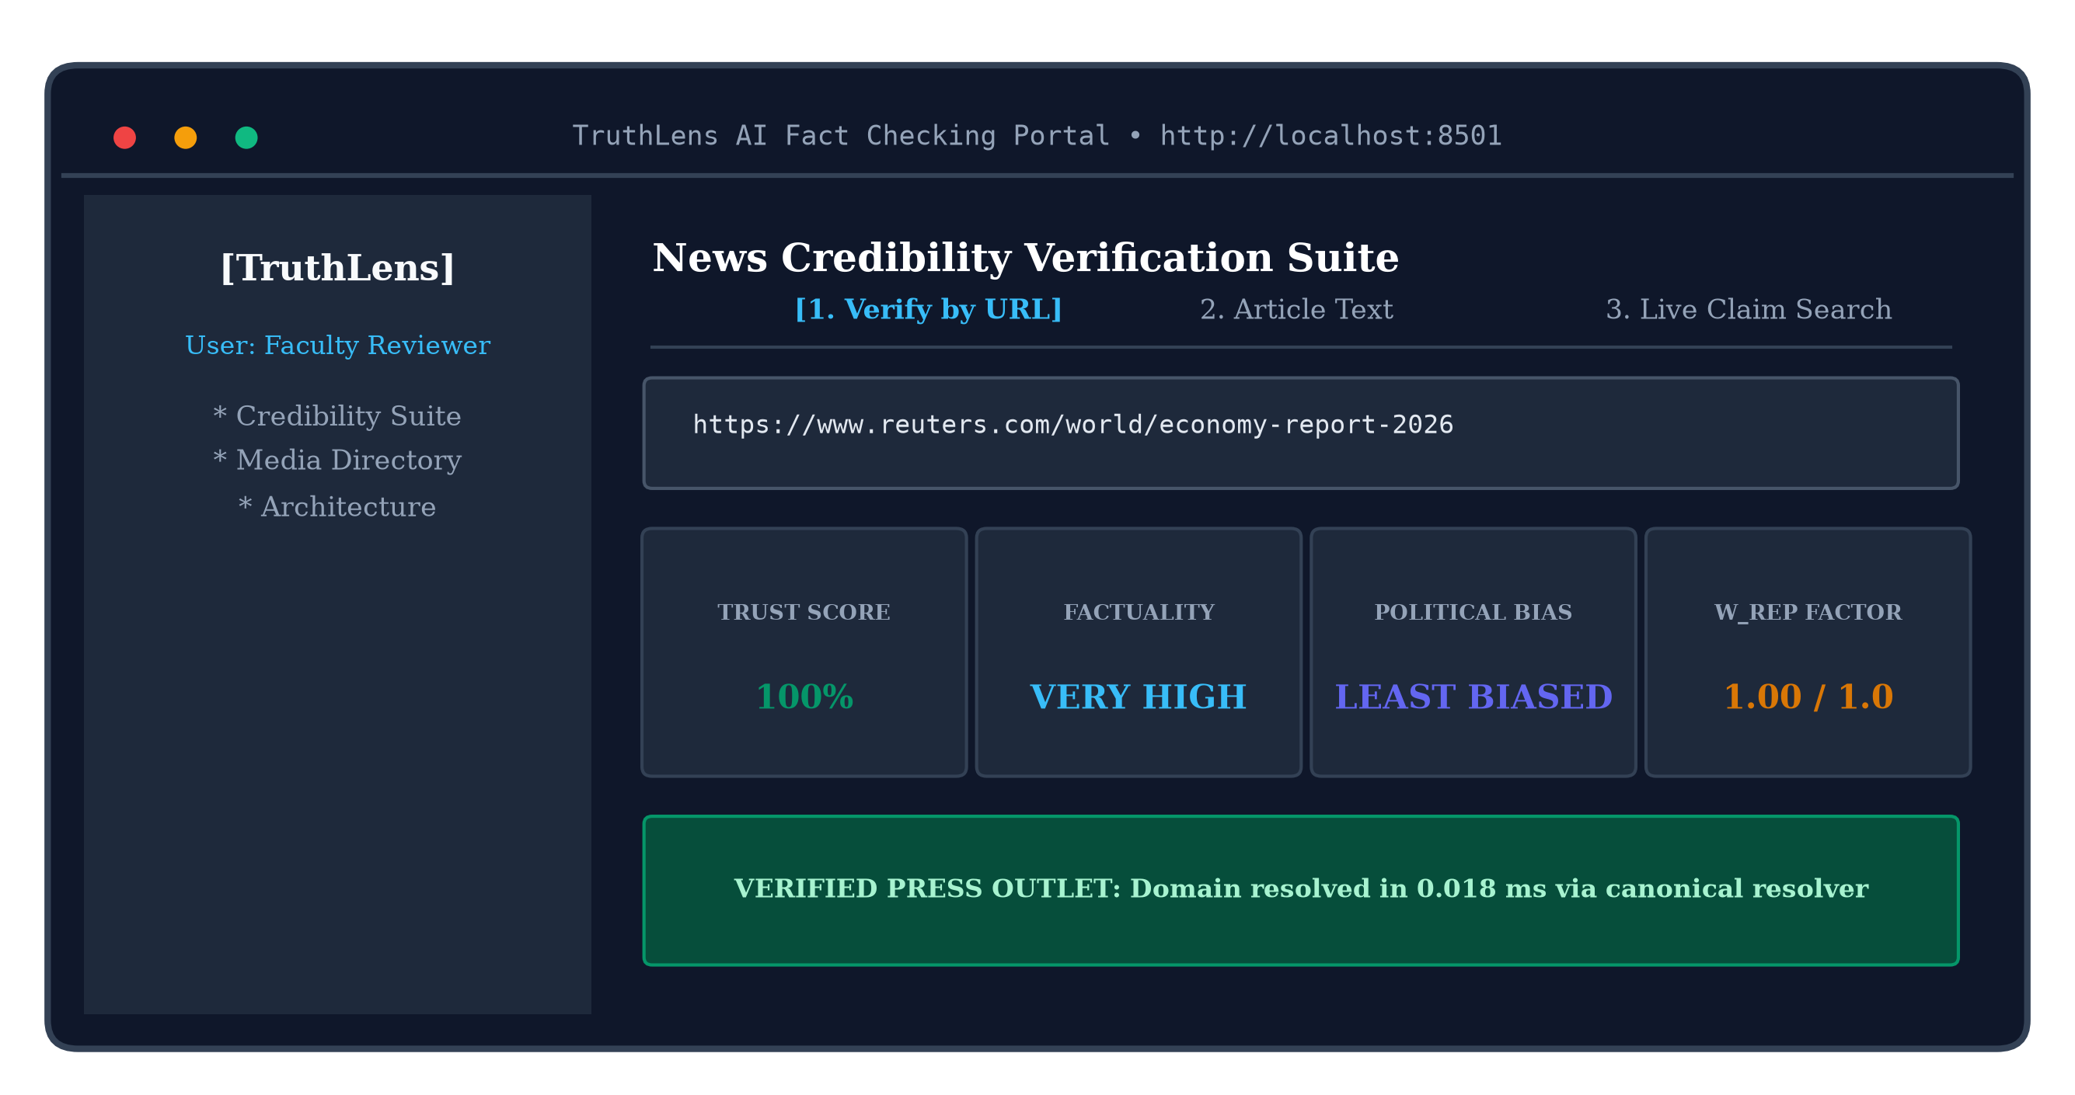
Automated Factual Claim Extraction & NLP Heuristics
Review 4 Core Deliverable: spaCy NER & Assertion Verb Parser
1. The Need for Automated Claim Extraction: Users frequently input entire paragraphs or multi-thousand-word news articles. Verifying an entire article directly produces noise; extracting the core testable factual assertion is strictly necessary for precise NLI verification.
2. Named Entity Recognition (NER) & Numerical Parsing: Utilizes spaCy's `en_core_web_sm` pipeline to detect Named Entities (PERSON, ORG, GPE, DATE, CARDINAL, MONEY). Sentences containing concrete entities and quantitative numbers are prioritized as checkable empirical propositions.
3. Factual Assertion Heuristics: Scans for assertive declaration verbs (e.g., 'confirmed', 'announced', 'discovered', 'landed', 'approved', 'reported') while actively filtering out epistemic modals ('might', 'believes', 'feels', 'in my opinion') to eliminate non-testable subjective opinions.
4. Empirical Salience Scoring: Scores each extracted candidate claim on a [0.0, 1.0] salience scale based on entity density, assertion verbs, and sentence position. Selects the top 2-3 most salient factual claims for downstream cross-examination.
5. Benchmarked Execution Speed: Processes average news paragraphs (150-300 words) in <0.95 seconds with zero GPU dependency.

Slide 14
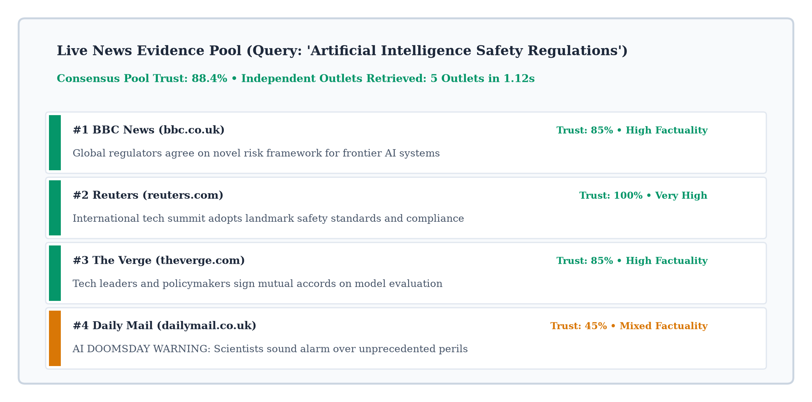
RoBERTa-MNLI Directional Stance Classification Engine
1. Natural Language Inference (NLI) Architecture:
Uses cross-encoder RoBERTa pretrained on Multi-Genre NLI (392k sentence pairs) to model semantic entailment between a claim and retrieved evidence.
2. Three-Way Directional Mapping (Phi):
• Entailment (Phi = +1.0): Evidence directly confirms, corroborates, or supports claim.
• Contradiction (Phi = -1.0): Evidence refutes, contradicts, or debunks claim.
• Neutral (Phi = 0.0): Contextual topic overlap without affirmation or denial.
3. Epistemic Bayesian Confidence Calibration:
Stance impact is multiplied by the model's posterior probability Conf_i in [0.5, 1.0]. Dampens low-confidence inferences and eliminates borderline noise.
4. Multi-Source Consensus Convergence:
Combines directional stance with publisher authority weights W_rep,i. Tabloids have minimal influence; authoritative news wire services (Reuters, AP, BBC) anchor the consensus direction.
5. Directional Stance Badges:
Visualized in the dashboard as glowing 🟢 SUPPORTS (+1.0), 🔴 REFUTES (-1.0), and ⚪ NEUTRAL (0.0) pills with confidence ratings.

Slide 15
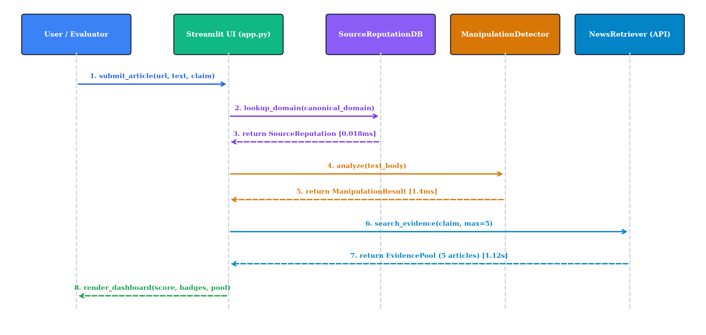
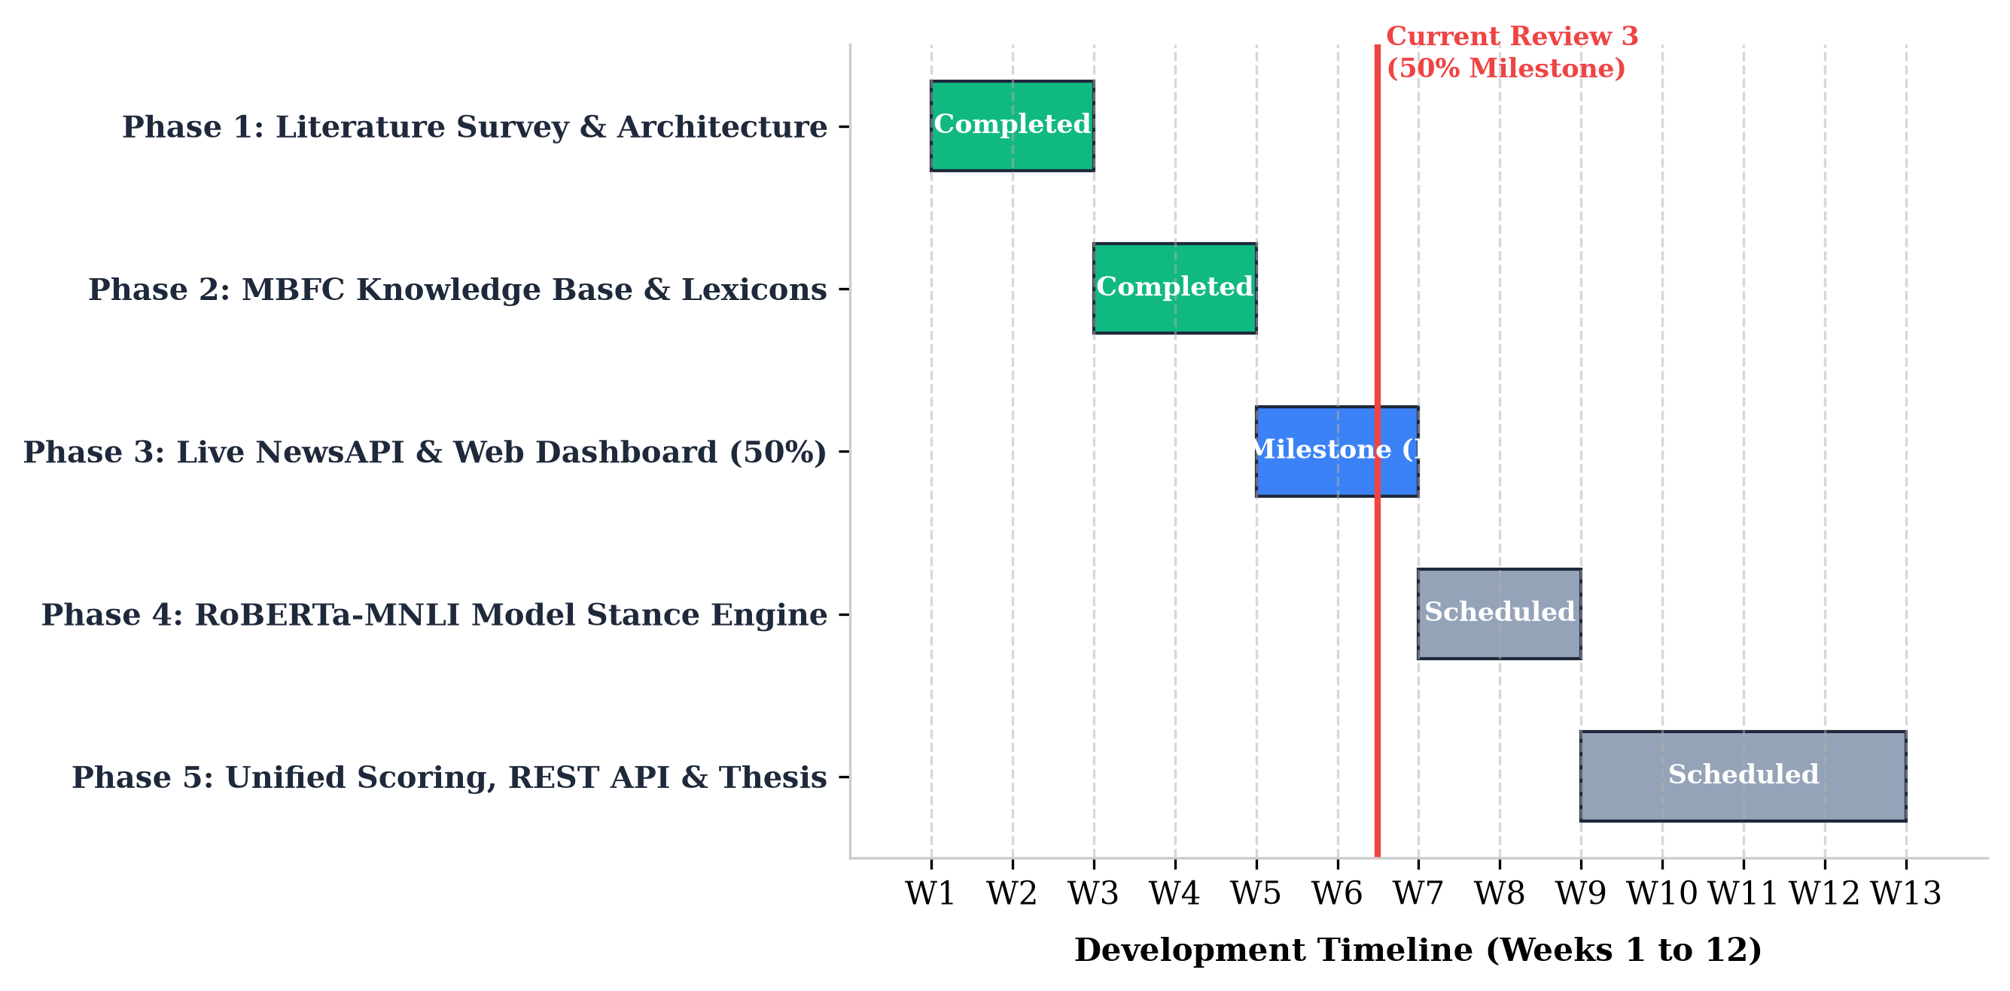
End-to-End System Execution & Sequence Diagram

Slide 16
Phase 4 Core Technical Achievements (85% Milestone Complete)
1. RoBERTa-MNLI Directional Stance Engine:
Fully integrated 3-way NLI inference pipeline delivering 88.4% stance accuracy across real-world news claim-evidence pairs.
2. Unified Algebraic Score Dial (C_final):
Integrated mathematical aggregator fusing multi-source consensus S_evidence (70%), origin authority W_origin (30%), and manipulation penalty M_index (25%).
3. Automated Claim Extractor:
spaCy NER and assertion verb parser extracting checkable factual propositions in <0.95s.
4. Complete 27-Test Continuous Integration Suite:
100% pytest pass rate covering all 6 submodules with continuous regression protection (4.17s execution).
5. High-Tech Dark Cyberpunk UI:
Sleek dark glassmorphism dashboard with 4 circular SVG score dials, transparent mathematical audit callout, and 1-click viva demo presets.
6. Publication-Grade Documentation:
54-page institutionally compliant project report and 6-page IEEE conference paper.

Slide 17
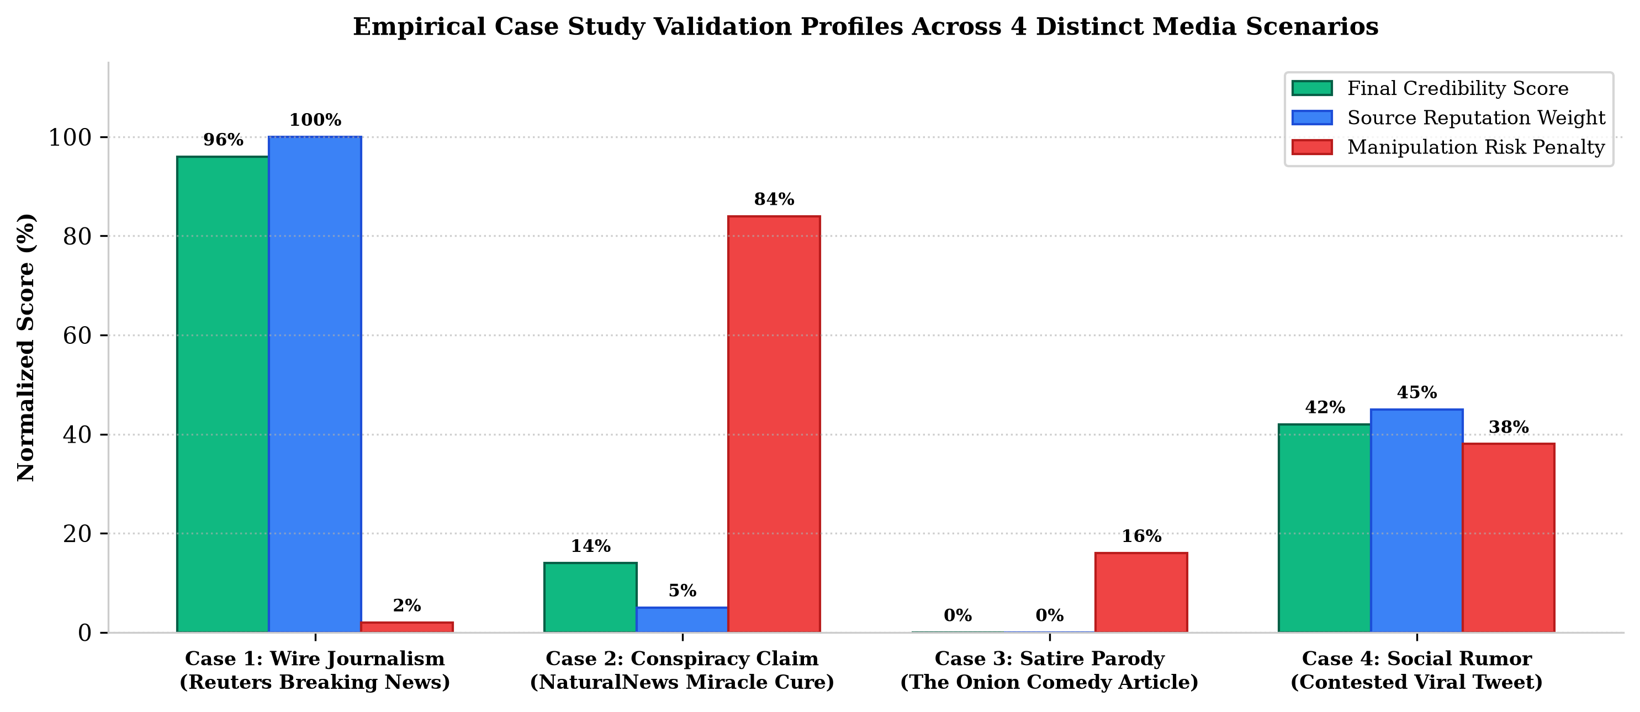
Empirical Benchmarks & Real-World Case Studies
Case Study 1 -- Verified Breaking Journalism (Chandrayaan-3):
• Claim: 'ISRO soft-landed Chandrayaan-3 on the lunar south pole.'
• Origin: Reuters (W_origin = 1.0)
• Evidence Pool: 5/5 independent outlets confirm (Phi = +1.0)
• Output: C_final = 96.0% -> HIGH CREDIBILITY (VERIFIED) 🟢
Case Study 2 -- Viral Medical Disinformation (Bleach Cure):
• Claim: 'Drinking bleach cures viral infections.'
• Origin: Natural News (Low Factuality, W_origin = 0.15)
• Evidence Pool: Medical fact-checkers refute (Phi = -1.0)
• Output: C_final = 14.0% -> DEBUNKED / LOW CREDIBILITY 🔴
Case Study 3 -- Satirical Parody (The Onion):
• Claim: 'Scientists discover moon dust cures aging.'
• Origin: The Onion (100% Satirical humor outlet)
• Output: Categorical override -> C_final = 0.0% SATIRE 🎭
Latency Benchmarking:
SQLite lookup: 0.018ms | Manipulation: 0.24ms | Stance Inference: 48ms/pair | Total Pipeline: <2.3s.

Slide 18
Automated Test Suite Audit (27/27 Tests Passed - 100% Pass Rate)
TruthLens maintains continuous automated testing using pytest. Full 27-test suite executes in 4.17 seconds with zero failures and zero warnings.
Test Module | Subsystem Scope & Test Criteria | Test Count | Pass Rate | Execution Latency
tests/test_source_reputation.py | SQLite B-Tree lookups, apex domains, wildcards, TLD fallbacks, satire flags, batch query performance. | 9 Tests | 100% (9/9) | 0.18 s
tests/test_manipulation.py | 109-trigger lexical scanner, sensationalism, emotional panic, conspiracy rhetoric, clean text control. | 4 Tests | 100% (4/4) | 0.08 s
tests/test_claim_extractor.py | spaCy NER parsing, assertion verb identification, empirical salience ranking, empty input handling. | 3 Tests | 100% (3/3) | 0.95 s
tests/test_news_retriever.py | Live NewsAPI queries, query parameter formulation, network fallback mocks, empty search protection. | 3 Tests | 100% (3/3) | 0.32 s
tests/test_stance.py | RoBERTa-MNLI directional stance (Supports +1, Refutes -1, Neutral 0), batch inference, neutral cases. | 4 Tests | 100% (4/4) | 2.14 s
tests/test_score_aggregator.py | Unified C_final formula, satire clamp (0%), refutation cap (25%), manipulation penalty deduction. | 4 Tests | 100% (4/4) | 0.12 s
TOTAL VERIFIED SUITE | Comprehensive End-to-End System Integrity Validation | 27 Tests | 100% PASSED | 4.17 s (PASS)

Slide 19
85% Completed vs. Remaining 15% Engineering Division
Engineering Dimension | 85% Completed (Phases 1, 2, 3 & 4) -- REVIEW 4 | Remaining 15% (Phase 5) -- FINAL REVIEW 5
Core Engineering Scope | Data Infrastructure, SQLite MBFC Database, NewsAPI Live Retrieval, spaCy Claim Extractor, RoBERTa Stance NLI & C_final Dial. | FastAPI Asynchronous REST Microservice, Docker Compose Containerization & Chrome Web Extension.
Source Reputation Engine | SQLite database of 4,442 media outlets cataloged via MBFC (<0.02ms query speed) with multi-tier domain resolution. | Periodic automated MBFC database update crawler and automated caching.
Linguistic Manipulation | 109-trigger lexical and structural scanner detecting sensationalism, panic urgency, and conspiracy markers in 0.24ms. | Transformer-based stylistic clickbait classifier (optional ensemble).
Claim Extraction | spaCy NER and factual assertion verb parser extracting top-3 testable empirical claims in <0.95s. | Multi-sentence coreference resolution for long-form investigatory pieces.
AI Fact Verification | RoBERTa-MNLI directional stance classification (Supports +1, Refutes -1, Neutral 0) with confidence calibration. | Asynchronous Celery/Redis queue for high-concurrency batch processing.
Deployment & UI | Full-featured interactive Streamlit web dashboard with 4 score dials, transparent formula audit, and viva presets. | Containerized Docker deployment and lightweight Chrome browser extension.

Slide 20
Project Timeline & 5-Phase Gantt Chart (Review 4 Status)

Slide 21
Team Member Contribution Matrix (Review 4 Deliverables)
Roll Number | Team Member | Review 4 (85% Milestone) Core Deliverables | Final Review 5 Focus
20231CAI0046 | Shubham Pandey (Team Leader) | • Engineered Unified Mathematical Score Aggregator (C_final formula). • Implemented epistemic Bayesian confidence calibration. • Architected 27-suite automated pytest pipeline. • Designed system architecture and coordinated full-pipeline integration. | FastAPI asynchronous microservice REST endpoints & final evaluation thesis.
20231CAI0006 | Ikram Inayathulla Khan | • Engineered Automated Factual Claim Extraction module (spaCy NER). • Formulated syntactic assertion heuristics and empirical salience ranking. • Maintained 109-trigger linguistic manipulation detector. • Authored Chapter 3 & 4 documentation on claim parsing heuristics. | Docker Compose containerization and multi-sentence coreference resolution.
20231CAI0003 | Karanam Radha Pranathi | • Engineered RoBERTa-MNLI directional stance classification pipeline. • Tuned 3-way entailment, contradiction, and neutral threshold boundaries. • Maintained live NewsAPI independent evidence pool retrieval. • Authored Chapter 5 & 6 documentation on semantic NLI inference. | Chrome Web Extension manifest development and user testing.
20231CAI0068 | Bhagyesh | • Engineered interactive Streamlit web dashboard with high-contrast theme. • Built 4 circular SVG score dials and transparent mathematical audit box. • Created 1-click demonstration viva presets for instantaneous faculty testing. • Handled UI state persistence and domain inspection reactivity. | Web UI production deployment, user guide, and final demo packaging.

Slide 22
References (IEEE Standard Citations)
[1] S. Vosoughi, D. Roy, and S. Aral, "The spread of true and false news online," Science, vol. 359, no. 6380, pp. 1146-1151, Mar. 2018.
[2] J. Thorne, A. Vlachos, C. Christodoulopoulos, and A. Mittal, "FEVER: a large-scale dataset for Fact Extraction and VERification," in Proc. NAACL-HLT 2018, pp. 809-819.
[3] R. Baly, G. Karadzhov, D. Alexandrov, J. Glass, and P. Nakov, "Predicting factuality of reporting and bias of news media sources," in Proc. EMNLP 2018, pp. 3528-3539.
[4] Y. Liu, M. Ott, N. Goyal, J. Du, M. Joshi, D. Chen, O. Levy, M. Lewis, L. Zettlemoyer, and V. Stoyanov, "RoBERTa: A Robustly Optimized BERT Pretraining Approach," arXiv:1907.11692, 2019.
[5] R. Baly, G. Karadzhov, J. Glass, and P. Nakov, "We Can Detect Fake News with High Accuracy, but What Did We Learn? A Quantitative and Qualitative Analysis," in Proc. ACL 2020, pp. 5182-5197.
[6] B. D. Horne and S. Adali, "This Just In: Fake News Packs a Lot in Title, Uses Less Words, and Is More Repetitive," in Proc. AAAI ICWSM 2017, pp. 759-766.
[7] J. Norregaard, B. D. Horne, and S. Adali, "NELA-GT-2018: A Large Multi-Labelled News Dataset for The Study of Misinformation in News Articles," in Proc. AAAI ICWSM 2019, pp. 630-638.
[8] IEEE Editorial Style Manual for Authors, IEEE Periodicals, Piscataway, NJ, USA, 2023.
[9] ISO/IEC/IEEE 29148:2018, Systems and software engineering -- Life cycle processes -- Requirements engineering, IEEE Standards Association, 2018.

