Slide 1
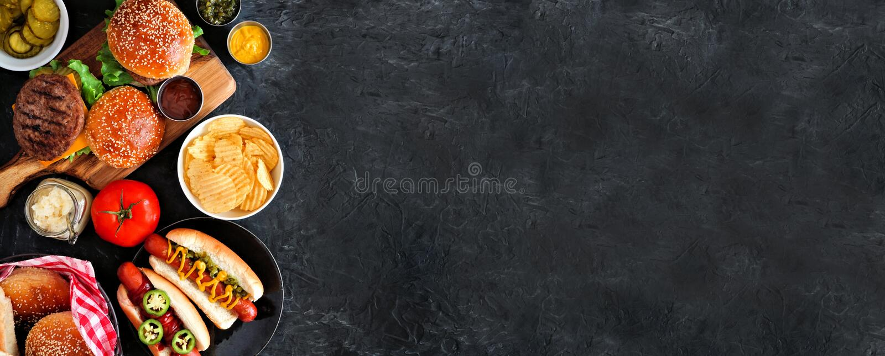
Welcome to Delhi-16
S. No. | Item | Price ($) | HP Gain
1 | Veg Thali | 40 | 40
2 | Butter Chicken | 60 | 65
3 | Energy Drink | 30 | 25
Press S. No. of the item you want to buy!

Slide 2
Welcome to Masala-Mix
S. No. | Item | Price ($) | HP Gain
1 | Paneer Tikka | 60 | 65
2 | Chilli Chicken | 70 | 75
3 | Chocolate Shake | 40 | 40
Press S. No. of the item you want to buy!

Slide 3
Welcome to Staff Cafeteria
S. No. | Item | Price ($) | HP Gain
1 | Samosa | 15 | 15
2 | Chole Bhhature | 30 | 35
3 | Bottled Water | 10 | 10
Press S. No. of the item you want to buy!

