Slide 1



Hardware IP
Dispute Verification
PROJECT PRESENTATION | PHASE-I
Zero-overhead biometric watermarking with asymmetric verification using Pedersen commitments and RSA-2048
Shubham Saurav (24U020005) • Manish Kumar (24U020039)
Supervisor: Dr. Rahul Chaurasia, Assistant Professor, CSE
B.Tech CSE, IIIT Bhopal
November 2026
Github Repository Link: https://github.com/shubhamsaurav15107-art/minor_project

Slide 2





The Problem: Hardware IP Piracy
IP cores are shared as RTL code
A dishonest firm copies the design
Sold under their brand, no licence fee
Why traditional watermarking falls short
Wastes chip resources
The “Inspection Paradox”
Extra gates and dummy circuits hold the watermark, so the chip becomes larger, slower and more power hungry.
The same secret key that embeds the mark is needed to prove ownership. Showing it in a dispute lets anyone remove the watermark.

Slide 3


Our Solution & Key Contributions
Biometric Watermark
Zero-Overhead Embedding
Unique points from a fingerprint, face or retina scan become a digital signature that cannot be guessed.
The signature decides how variables share registers during High Level Synthesis: no extra gates or wires.
Safe Public Verification
Working Web Platform
Private embedding, public checking. Auditors use the public key and commitment, never the secret.
Vendor portal to register and sign designs, auditor portal to verify a suspect chip instantly.

Slide 4


Literature Review
ZKP authentication: Schnorr and SRP logins prove knowledge of a secret without sending it.
17+
Biometrics + commitments: LocalVault rebuilt fingerprint secrets in 92% of attempts in under 1 second.
research papers on zero-knowledge proofs, biometrics and authentication (2012–2026)
Blockchain & web apps: Healthcare, identity, e-voting and asset-proof systems keep data private yet verifiable.
Hardware & limits: FPGA speed-ups exist, but costs and interaction remain challenges.
Gap: no established practice for proving a hardware watermark in zero knowledge

Slide 5



Proposed Architecture
Vendor Environment
Register Server
Verifier Dashboard
Biometric scan creates a secret bitstream
Generate RSA-2048 key pair
Compute Pedersen commitment
Sign netlist hash with private key
Validates the signature
Stores public key and commitment
Keeps a timestamped registry record in database.json
Select registered design ID
Input suspect register bitstream
Enter commitment and blinding factor r
Run verification, get verdict

Slide 6
Proposed Algorithm
Stage 1: Key & Watermark Generation
Stage 2: Dispute Resolution
Derive secret bitstream from the vendor’s biometric template
Create RSA-2048 key pair; register the public key
Lock the watermark with a Pedersen commitment
Hash the netlist with SHA-256 and sign it
Embed bits as register-conflict edges during HLS
Structural analysis: recover the bitstream from the suspect’s register allocation table
Cryptographic verification: check the signature and the commitment using public credentials
Verdict: infringement confirmed only if both match
Commitment: C = h·G + r·H Signature check: Verify_PuK( Hash ‖ Bitstream, Signature )

Slide 7
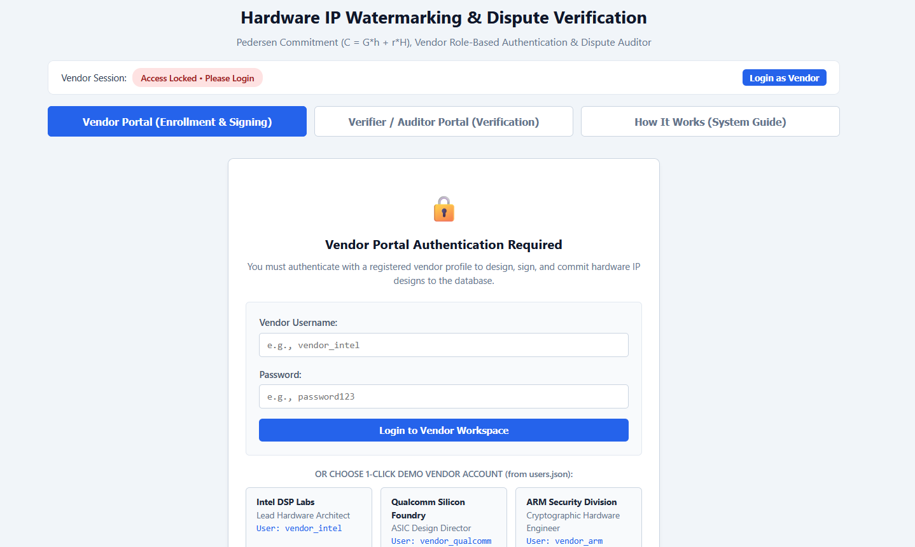
Technology Used
Component | Technology | Role
Backend | Python 3.9+ | Server logic, cryptographic evaluation
Web server | Flask ≥ 2.0.0 | API and routing
Asymmetric crypto | RSA, 2048-bit | Private / public key for verification
Hash engine | SHA-256 | Netlist integrity and payload hashing
Data storage | Local JSON | Demo IP loaded from database.json
Frontend UI | HTML5 / CSS3 / JS | Interactive vendor and auditor portal
Figure: Outer look of the platform
Python handles the maths (commitment, signing); Flask connects it to the HTML/CSS/JS frontend.

Slide 8



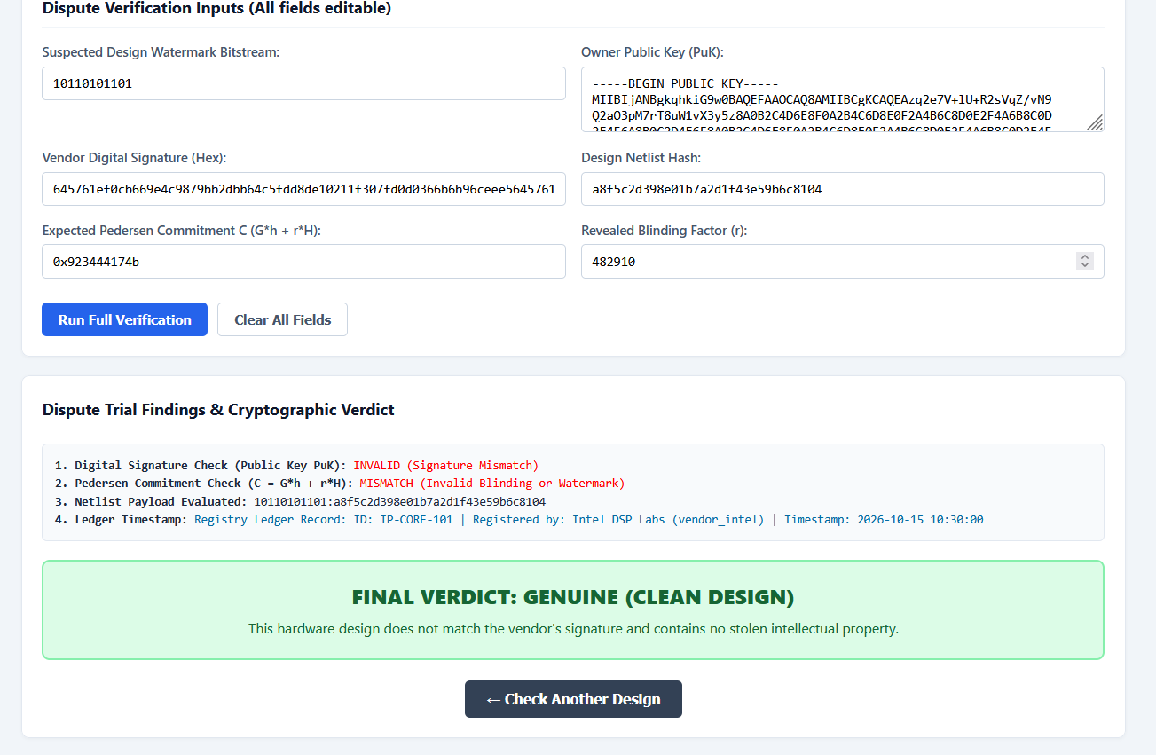
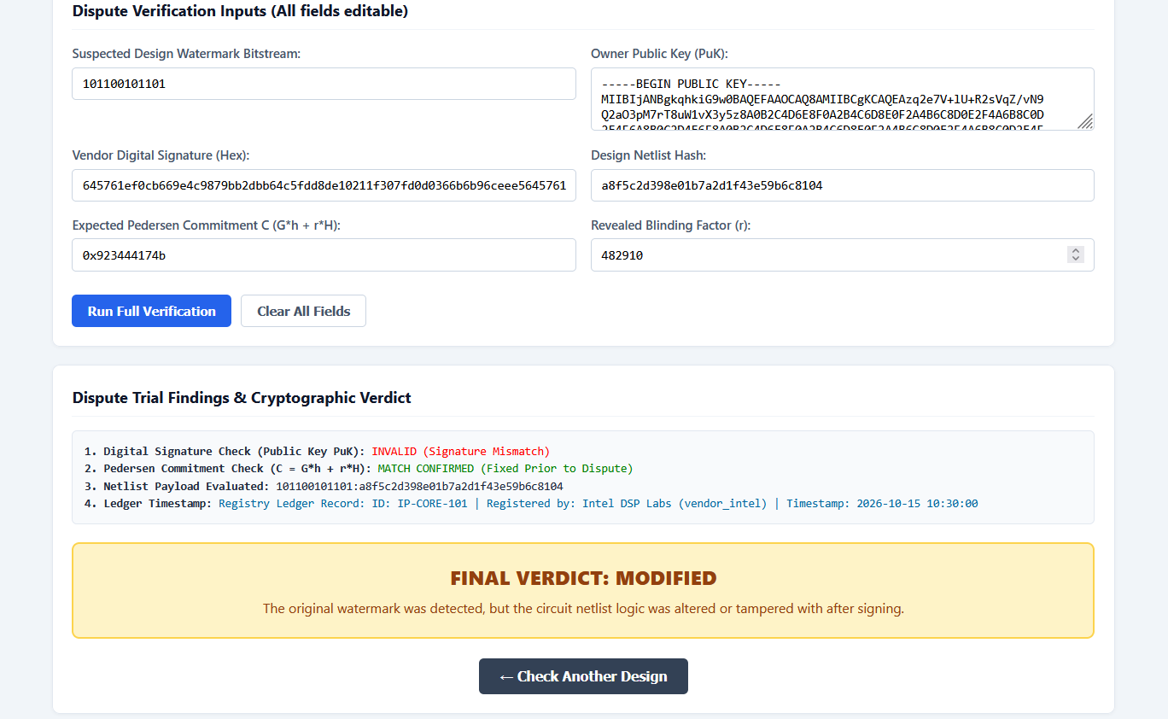
Dispute Verdicts in Action
GENUINE
Clean, independently designed core
PIRATED
Watermark and signature both match
MODIFIED
Watermark found, netlist altered after signing
Figure: Verification of clean design
Figure: Verification of modified design

Slide 9
Results & Analysis
≈ 0
< 1 ms
3
Hardware overhead. Speed and accuracy unchanged (at most 1–2 extra registers in some cases)
Verification time, so the website gives an instant verdict
Real-world dispute scenarios tested successfully
Dispute testing
Key benefits
Stolen chip: same watermark and hash, so declared pirated
Tampered chip: hash changes, signature fails
Fake claim: guessing the mark or key fails the maths
Private key is never shared
Pre-registered commitment proves the mark existed before the dispute
Simple web dashboard for back-to-back checks

Slide 10


Conclusion & Future Scope
Future scope
Conclusion
zk-SNARKs
Blockchain
Biometric watermark adds no area, delay or power cost
Public key and Pedersen commitment verify ownership without exposing secrets
Web platform detects pirated and tampered designs
Prove hidden rules are correct
Public notarization of hashes
Post-quantum
Netlist parser
Swap RSA for ML-DSA
Auto-read VHDL registers
Thank you

Slide 11
Reference
[1]A.Kumar, V.M. Shrimal and R.Rubbina, “Analysing security and efficiency in a qunatum resistant decentralised E-voting system using blockchain, homomorphic encryption and zero knowledge proofs,” in Proc. 2nd Int. Conf. Res. Methodologies Knowl. Manage., Artif. Intell. Telecommun. Eng. (RMKMATE), Chennai, India,2025,pp.1-5,doi: 10.1109/RMKMATE64874.2025.11042466.
[2]D.Naidu, B.Wanjari, R.Bhojwani, S.Suchak,R.Baser, and N.K.Ray, “Efficient smart contract for privarcy preserving authentication in blockchain using zero knowledge proof,” in Proc. OITS Int. Conf. Inf. Technol. (OCIT), Raipur, India, 2023, pp. 969-974, doi: 10.1109/OCT59427.2023.10430710.
[3]S.Mishra and R.K. Dwivedi, “Securing records in healthcare IoT using zero knowledge proof based blockchain,” in proc. 3rd Int. Conf. IoT,Commun. Authom. Technol.(ICICAT), Gorakhpur, India,2025, pp. 1-5,doi: 10.1109/ICICAT68430.2025.11414459.
[4]P. Baptista, B. Pacheco, F. Apolinario, J.Silveria, N.Escravana, and C. Riberiro, “Zero knowledge programming cerifications,” in Proc. IEEE Int. Conf. Distrib. Ledger Technol. (ICDLT), Pune, India, 2025, pp. 1-5, doi: 10.1109/ICDLT66400.2025.11466848.
[5]N. Datta, “Zero knowledge one time digital signature scheme,” in Proc. IEEE Int. Conf. Comput. Intell. Comput. Res., Coimbatore, India, 2012, pp. 1-4, doi:10.1109/ICCIC.2012.6510192.
[6]A. Abraham, M. Hiremath, and F.H. Pohrmen, “Privacy preserving authentication using zero knowledge proofs,” in Proc. IEEE 17th Int. Conf. Comput. Intell. Commun. Netw. (CICN), Goa, India, 2025, pp. 1003-1008, doi: 10.1109/CICN67655.2025.11368139.
[7]R. Akash, B. Bafna, A. Raghavan, R.T. Jose, P.B. Honnavalli, and I.Radhakrishnan, “LoaclVault: Zero- knowledge fingerprint authentication without biometric storage,” in Proc. 8th Int. Conf. Comput. Commun. Internet (ICCCI), Okayama, Japan, 2026,pp, 238-243, doi:10.1109/ICCCI70321.2026.11666520.
[8]V. Bobade, S. Ladwan, P. Waghmare, L.Ghai, P. Chaudhari, and C.puri, “A paradigm shift in digital trust: A cybersecurity analysis of zero- knowledge proofs,” in Proc. Int. Conf. Modern Sustain. Syst. (CMSS), Shah Alam, Malaysia, 2026, pp. 1573-1576, doi: 10.1109/CMSS69636.2026.11689222.
[9]P. Singhal and N. Joshi, “Zero-knowledge proofs for privacy- preserving agricultural yield verification: A blockchain-based incentive system for sustainable farming methods,” in Proc. 17th Int. Conf. Contemp. Comput. (IC3), Noida, India, 2025, pp. 1-6, doi:10.1109/IC366947.2025.11290217.
[10]X.Wang, “Research on the recovery strategy of federated learning model base on zero-knowledge proof,” in Proc. Int. Conf. Algorithm, Artif. Intell. Comput. Vis. (AAICV), London, U.K., 2025, pp. 194-198, doi: 10.1109/AAICV66571.2025.00042.
[11]S.A. Butt et al., “if-ZKP: Intel FPGA-based acceleration of zero knowledge proofs,” in Proc. IEEE 32nd Annu. INt .Symp. Field-Programmable Custom Comput. Mach. (FCCM), Orlando, FL, USA,2024, p.212, doi: 10.1109/FCCM60383.2024.00033.
[12]J. Kuriakose, P.S Sisodia, Amruth V, D.K. Shah, and S.More, “Comparative study of diverse zero- knowledge argument systems,” in Proc. Int. Conf. Data Mining adv. Comput. (SAPIENCE), Ernakulam, India,2016,pp. 284-293, odi: 10.1109//SAPIENCE.2016.7684134.
[13]V.K. Polisetti, A. Bhattacharjee, A. Gupta, and S.Vollala, “zkSHIELD- A web based cross chain zero knowledge asset proof,” in Proc.15th Int. Conf. Comput. Commun. Netw. Technol. (ICCCNT), Kamand, India,2024, pp. 1-5, doi: 10.1109/ICCCNT61001.2024.10726106.
[14]M. Chen, X. Qu, J. Cao, Z. Yang, and G.Sun, “Digital identity management based on blockchain and zero knowledge proof under the PIPL,” in Proc. 29th Int. Conf. Comput. Supported Cooperative Work Design (CSCWD),Fuzhou, China, 2026, pp. 340-345, doi: 10.1109/CSCWD68734.2026.11582607.
[15]V. Quach, R.Dantu, S. Talapuru, S.Zaman, and A. Pokharel, “ZCube: A zero-trust, zero-knowledge, and zero-memory platform for privacy and yet secured access,” in Proc. IEEE 6th Int. Conf. Trust, Privacy Secur. Intell. Syst. Appl. (TPS_ISA), Washington, DC, USA, 2024, pp. 166-175, doi: 10.1109/TPS-ISA62245.2024.00028.
[16]P.L. S.Kumari and A. Damodaram, “An alternative methodology for authentication and confidentality based on zero knowledge protocols using Diffe-Hellman key exchange,” in Proc. Int. Conf. Inf. Technol., Bhubneswar, India,2014, pp. 368-373, doi:10.1109/ICIT.2014.39.
[17]A. Pathak, T.Patil, S.pawar, P.Raut, and S. Khairnar, “Secure authentication using zero knowledge proof,” in Proc. Asian Conf. Innov. Technol. (ASIANCON), Pune, India, 2021, pp. 1-8, doi: 10.1109/ASIANCON51346.2021.9544807.
[18]M. Harikrishnan and K.V. Lakshmy, “Secure digital service payment using zero knowledge proof in distributed network,” in Proc. 5th Int. Conf. Adv. Comput. Commun. Syst. (ICACCS). Coimbatore, India, 2019, pp. 307-312, doi:10.1109/ICACCS.2019.8728462.
[19] M. Hao, C. Shang, S.Wang, W.Jiang, and J.Nie, “UAV- assisted zero knowledge model proof for generative AI: A multiagent deep reinforcement learning approach,” IEEE Internet Things J., vol.. 12, no. 10. pp. 13441-13454, May 2025, doi: 10.1109/JIOT.2025.3531914.
[20]P. Jagwani and S. Kaushik, “Defending location privacy using zero knowledge proof concept in location based services,” in Proc. IEEE 13th Int. Conf. Mobile Data Manage., Bengaluru, India, 2012, pp. 368-371, doi: 10.1109/MDM.2012.23.
[21] G.L.de Oliveira, F. A. Mendonca, and R.V. Ramos, “Zero knowledge protocol in a radio over fiber network,” in Proc. SBMO/IEEE MTT-S Int. Microw. Optoelectron. Conf.. (IMOC), Belem, Brazil, 2009, pp. 834-837, doi:10.1109/IMOC.2009.5427462.
[22]S. Liu, “Privacy protection revolution: Zero-knowledge proof,” in Proc. Int. Conf. Data Anal., Comput. Artif. Intell. (ICDACAI), Zakopane, Poland, 2022, pp.394-397, doi: 10.1109/ICDACAI57211.2022.00084
[23] A.M. Allam, I.I. Ibrahim, A.Ali, and A.E.H. Elsawy, “Effiecient zero-knowledge identification scheme with secret key exchange ,” in Proc. 46th Midwest Symp. Circuits Syst., Cairo, Egypt, 2003, vol. 1, pp. 516-519, doi: 10.1109/MWSCAS.2023.1572331.
[24]A. Sengupta and Rahul Chaurasia, “Retinal biometric for securing JPEG-Codec hardware IP core for CE systems”, IEEE Transactions on Computer Electronics, vol.69, pp. 441-457, Aug. 2023, doi: 10.1109/TCE.2023.3264669.

