Slide 1
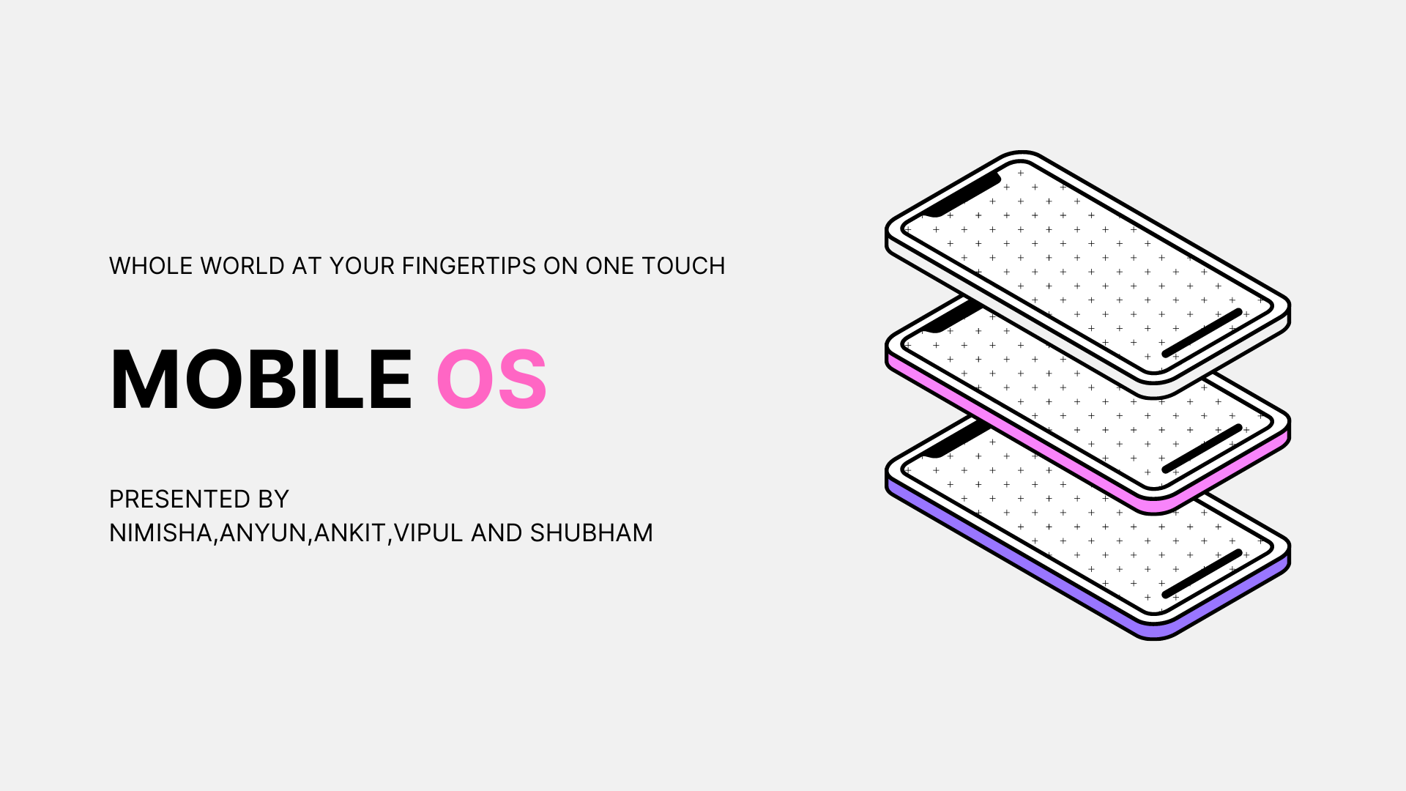

Slide 2
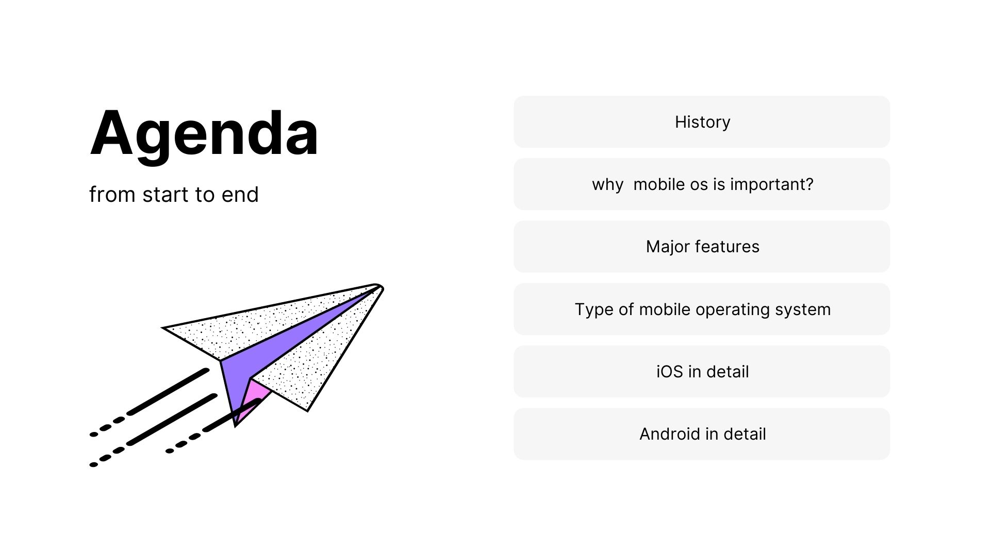

Slide 3
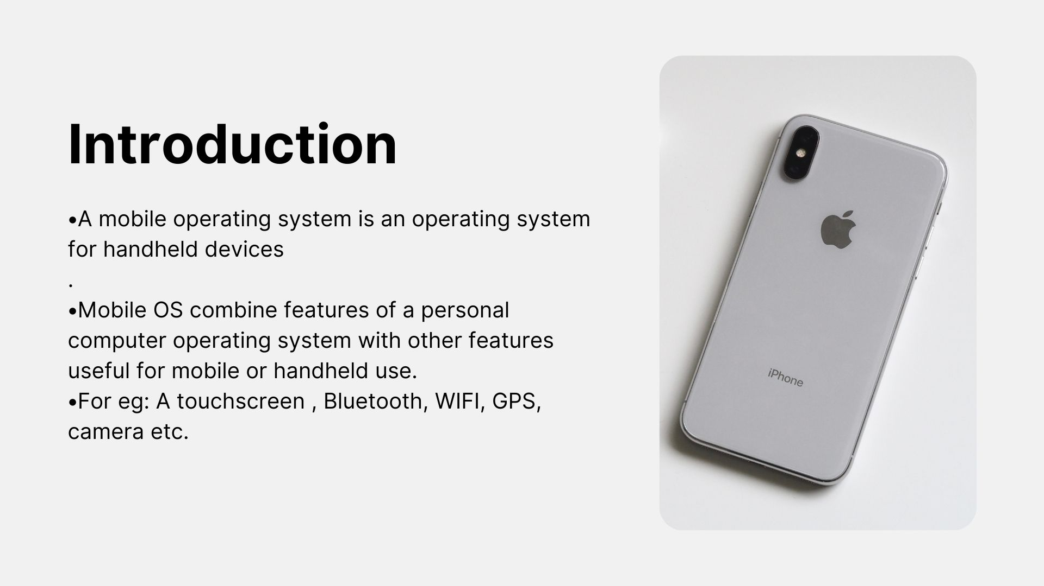

Slide 4
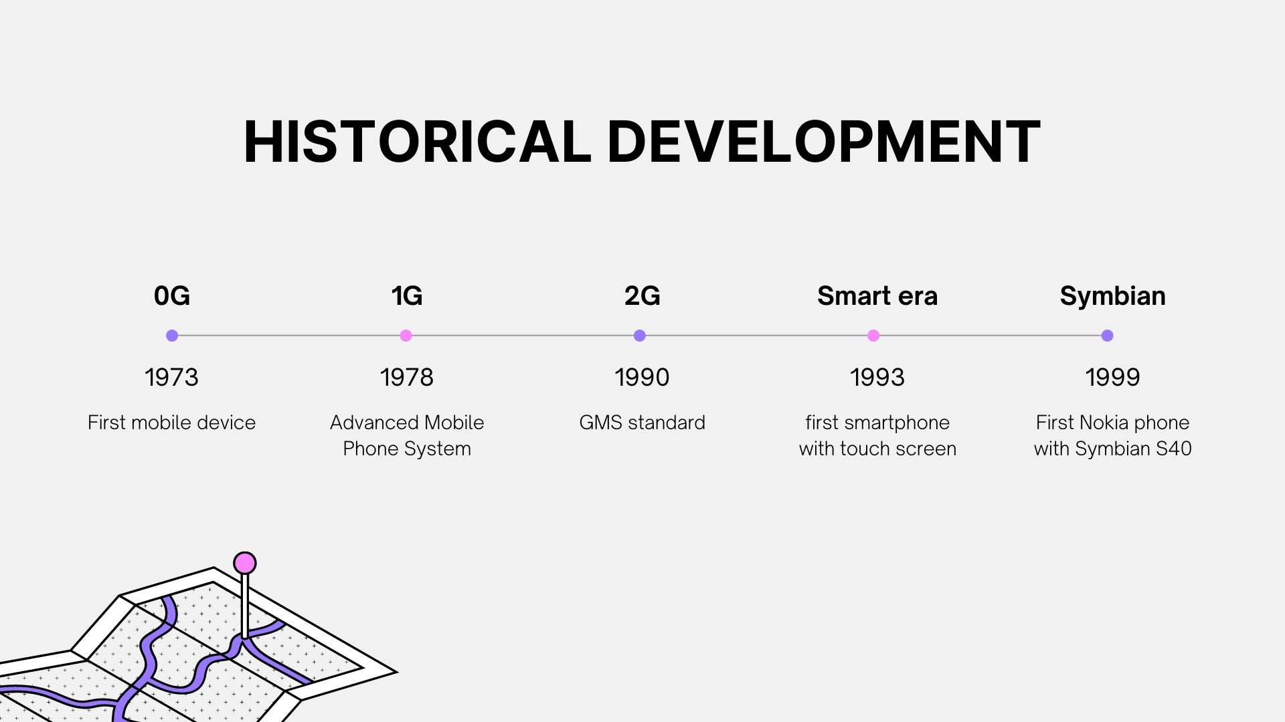

Slide 5
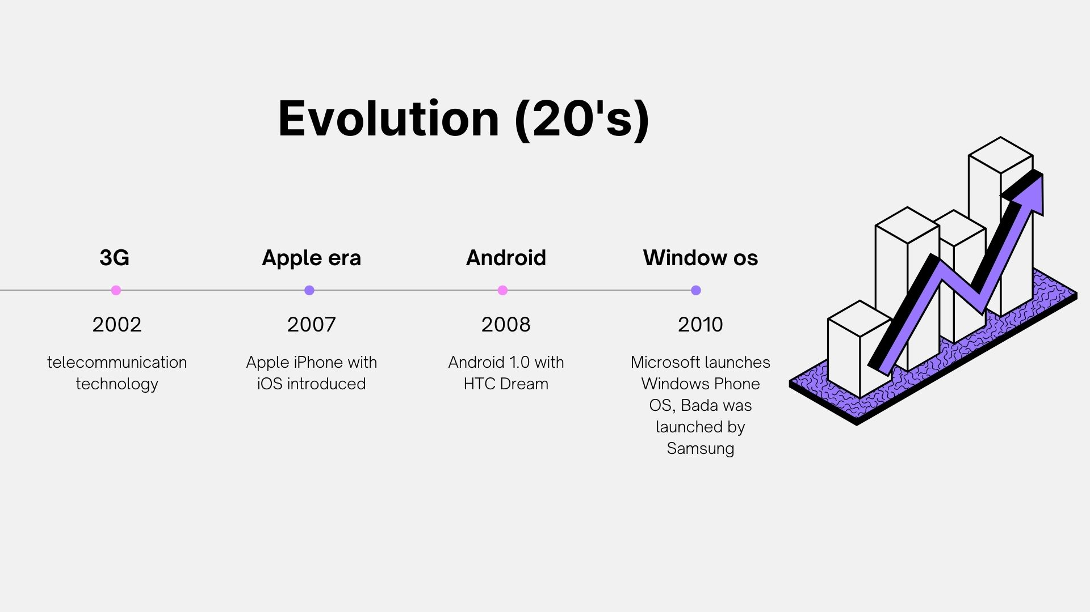

Slide 6
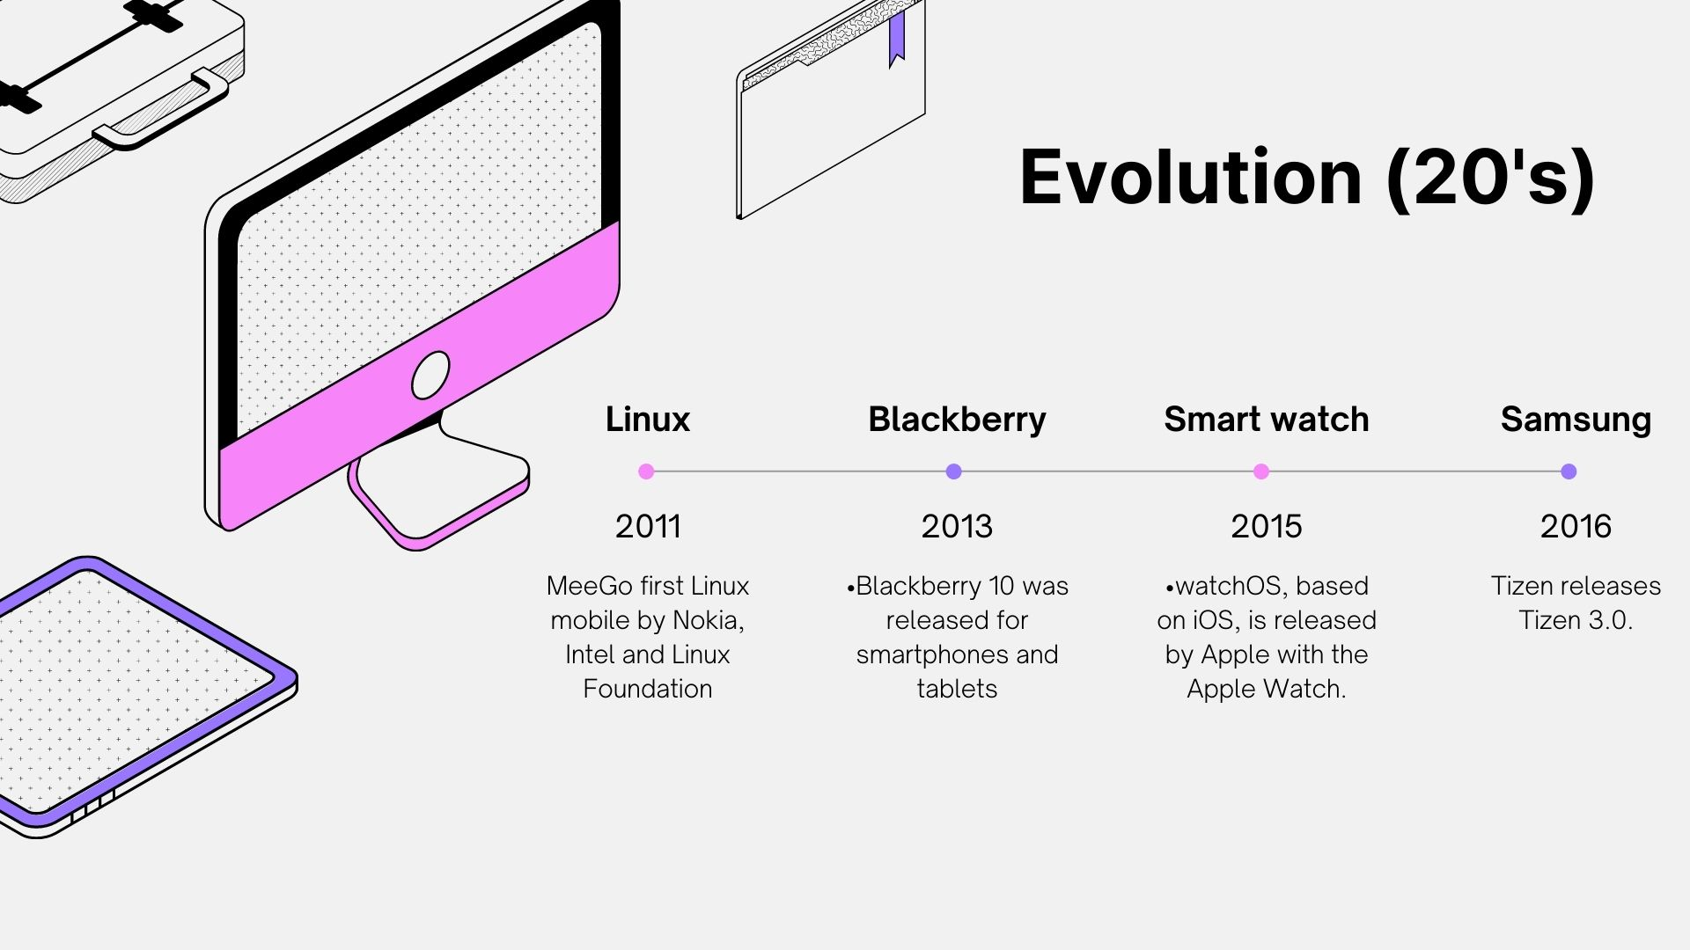

Slide 7
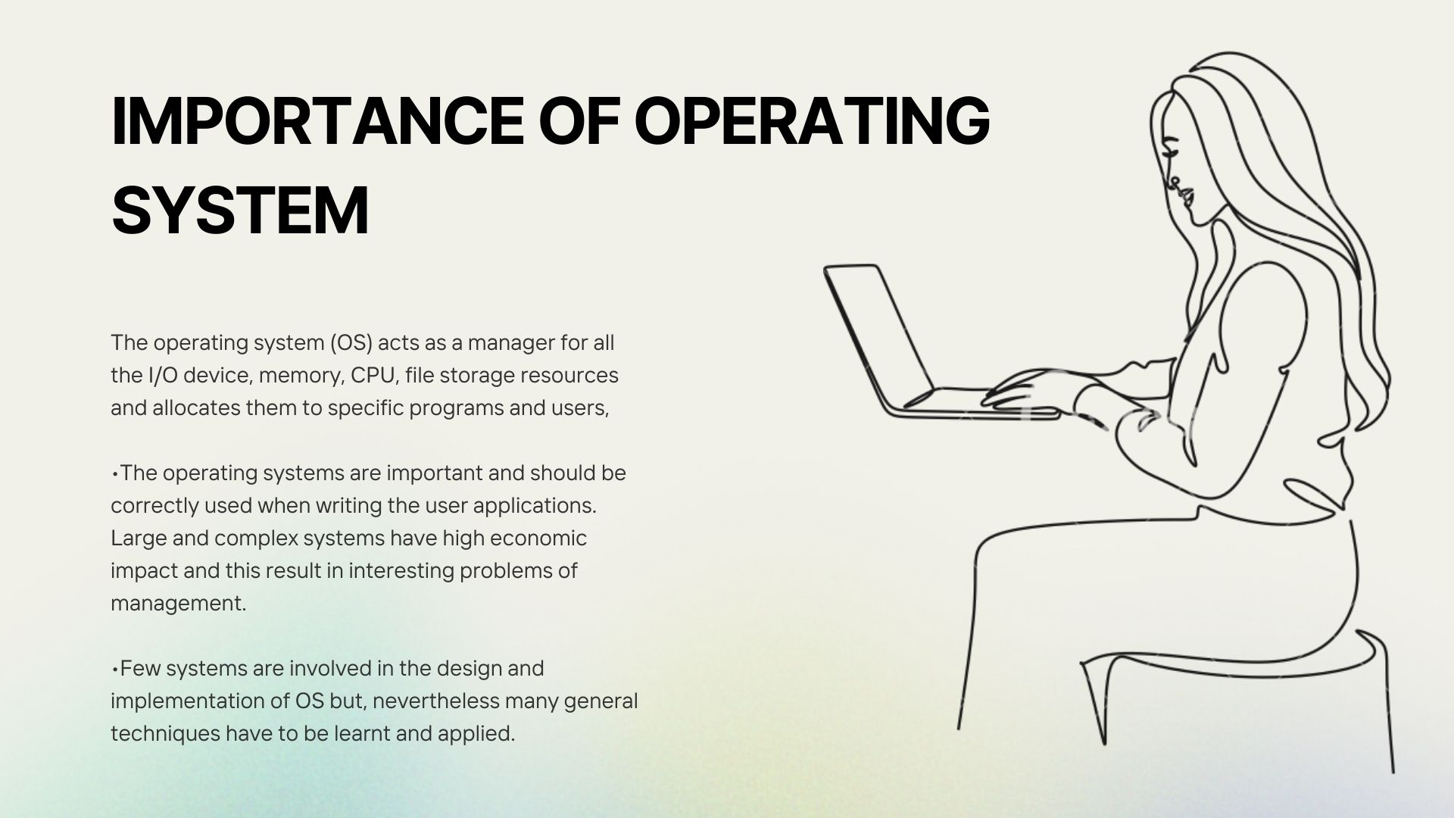

Slide 8
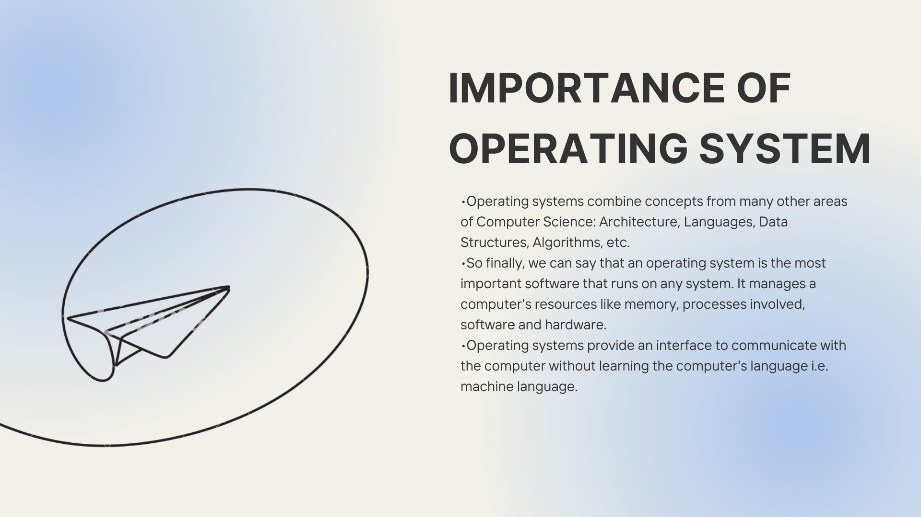

Slide 9
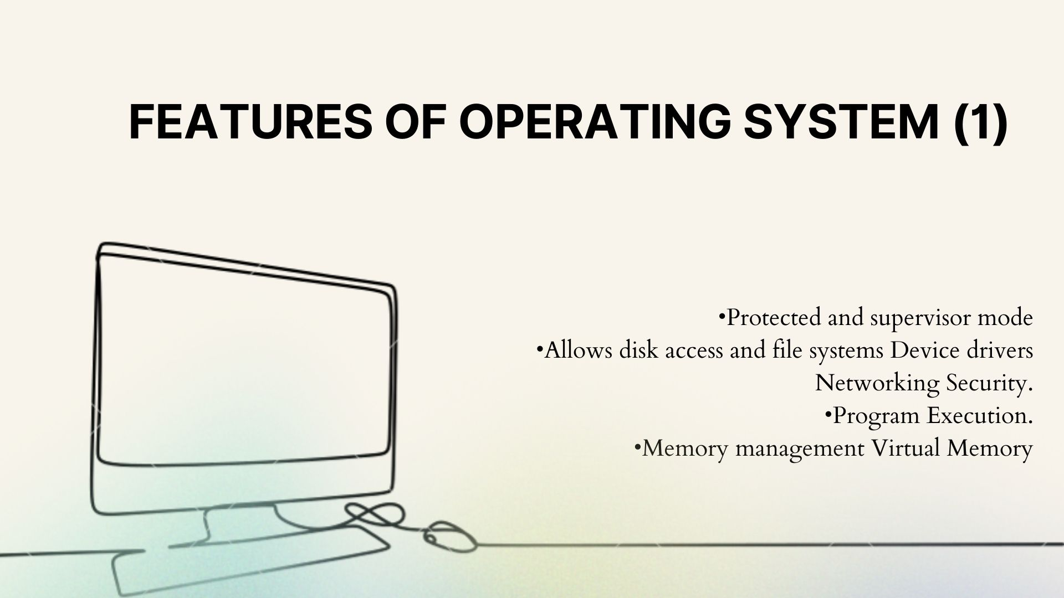

Slide 10
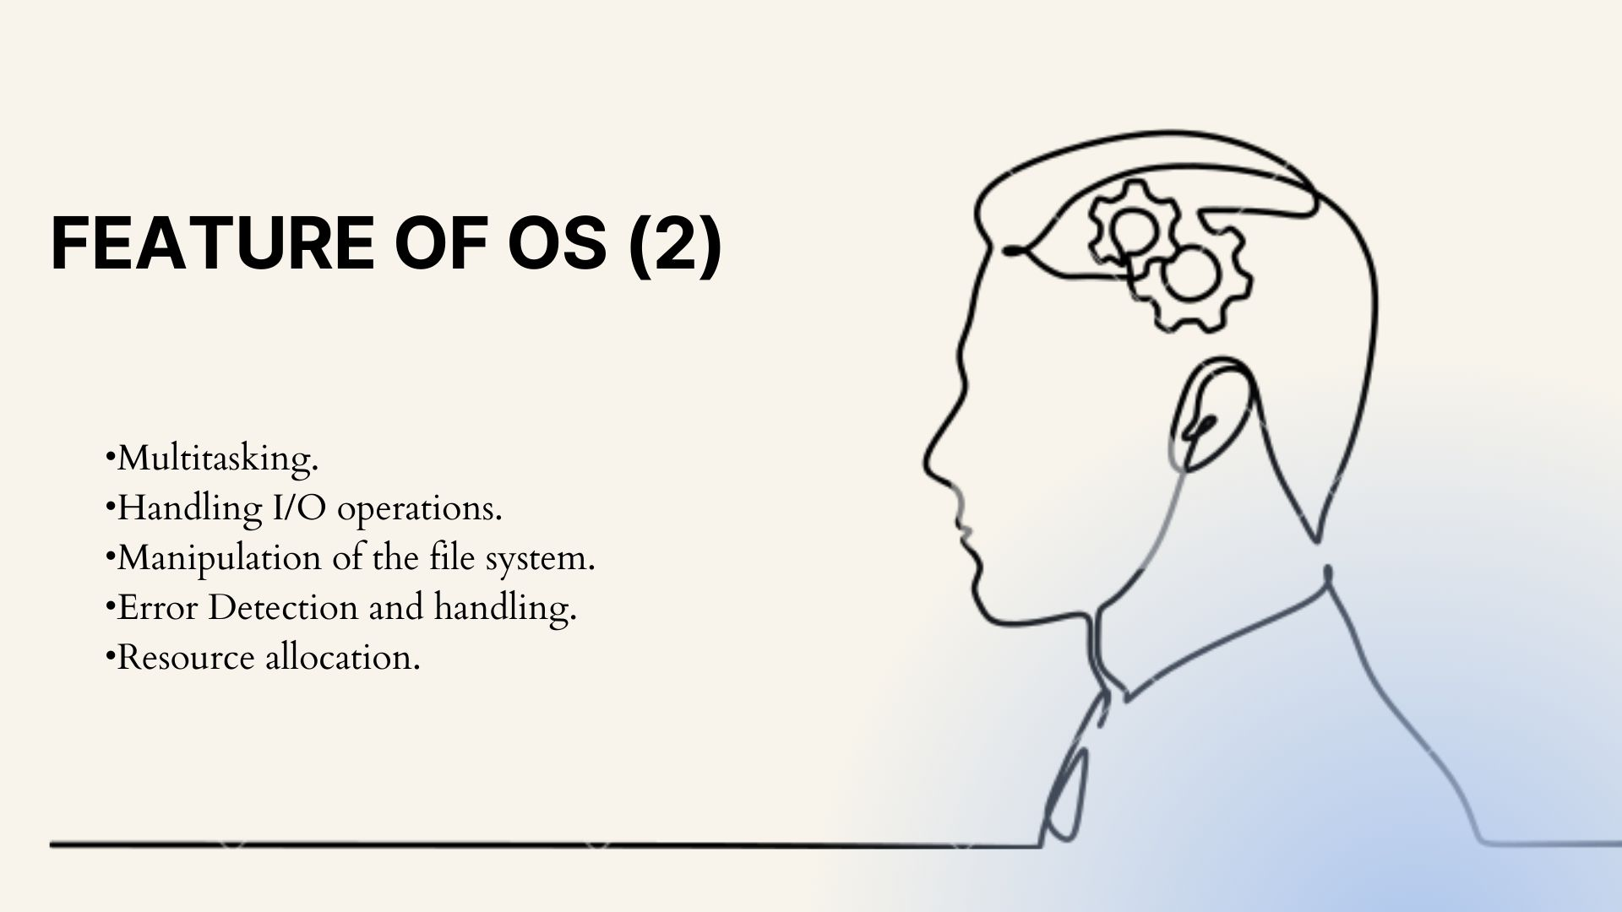

Slide 11
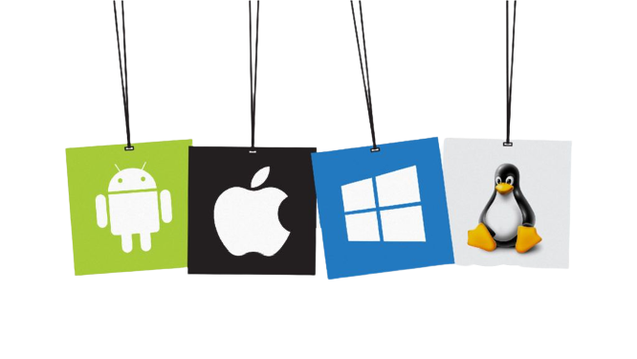
Types of Operating System in Mobile ?
Window phone OS
Symbian
BlackBerry
Samsung (Bada)
iOS
Android

Slide 12
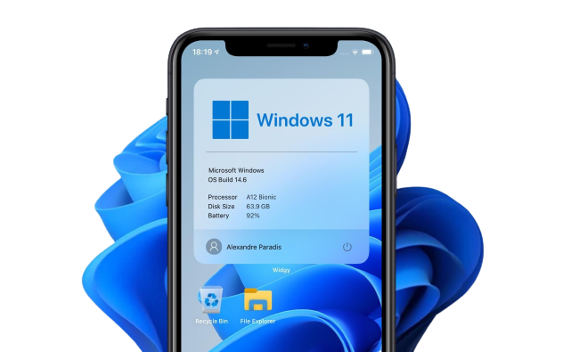
Window Phone OS?
Developed by : Microsoft
First Launch : October 2010
Windows Phone introduced a new design language, previously called Metro UI.

Slide 13
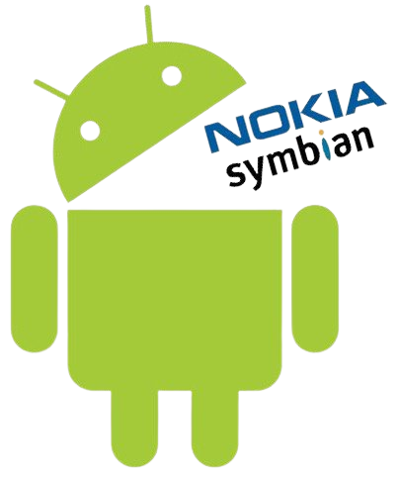
Symbian OS?
Developed by : Symbian Ltd.
First Launch : June 1997
Symbian was the leading smartphone platform up from 2003 up until 2010.
Major issue : apps written for one of these platforms were not compatible with the other directly.

Slide 14
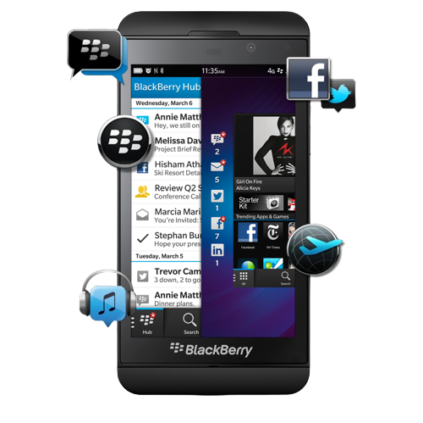
Blackberry OS?
Developed by : BlackBerry
First Launch : January 1999
The BlackBerry OS is designed for smartphone environments and is best known for its robust support for push Internet email.

Slide 15
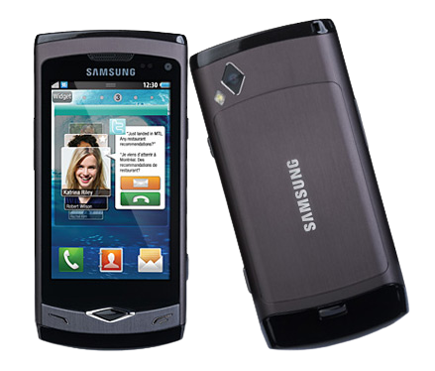
Samsung (bada) OS?
Developed by : Samsung
First Launch : 2010
It supports a number of advanced smartphone features, including multitouch, sensors, Flash, 3-D graphics, enhanced user interfaces and an application download source.

Slide 16

Android
Android => An open source light weight
Project for arm chips.
Developed by => Andy Rubin
Developed in => 2003
Maintained by => Google
Acquired by google => 2007

Slide 17
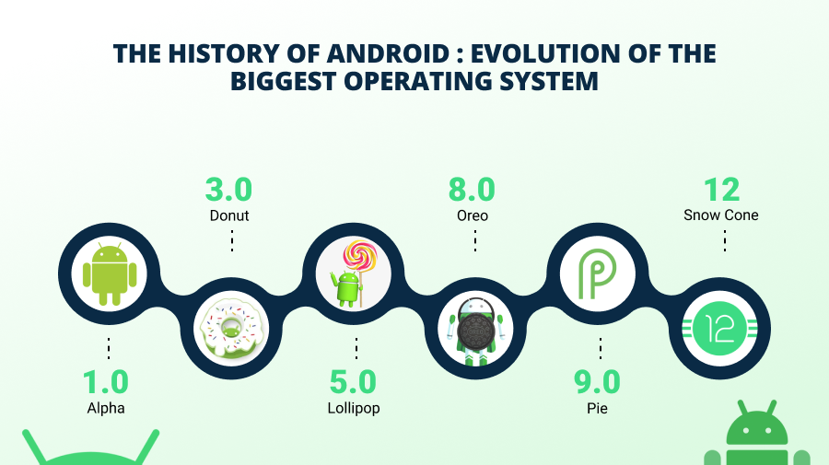

Slide 18
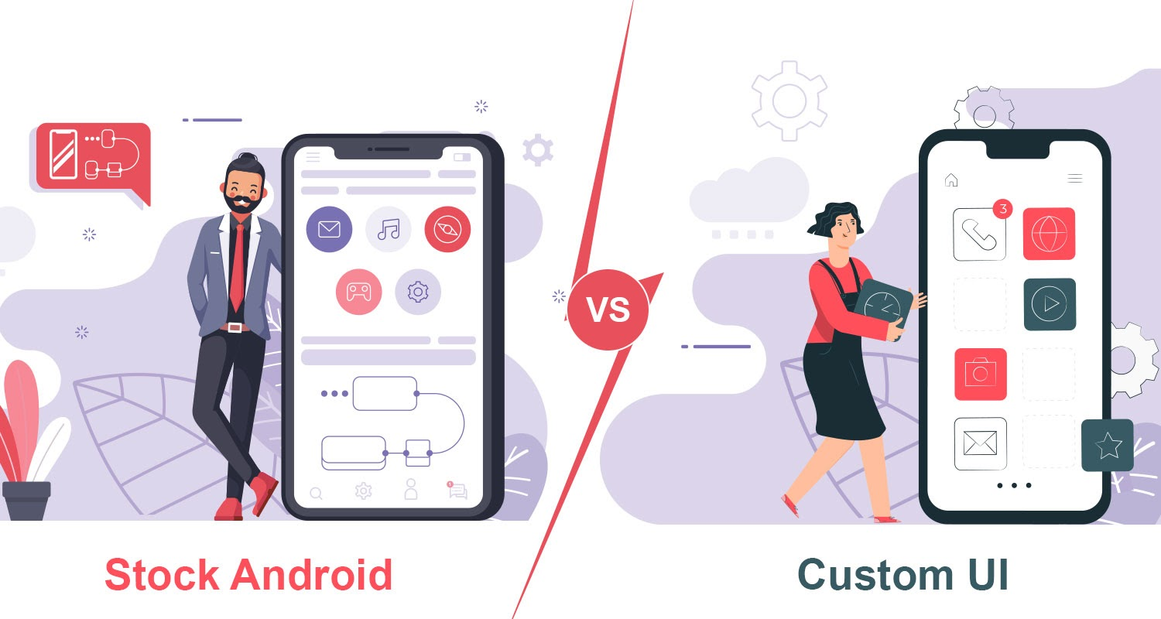
What is stock ,custom-skinned and custom android?

Slide 19
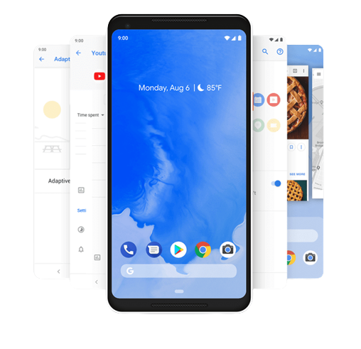
Stock Android ?
The purest version of Android is known as AOSP.
This version of the operating system is its “default” state, with no Google apps, no customizations, and no extra features. Generally, all versions of Android are based on this release.

Slide 20
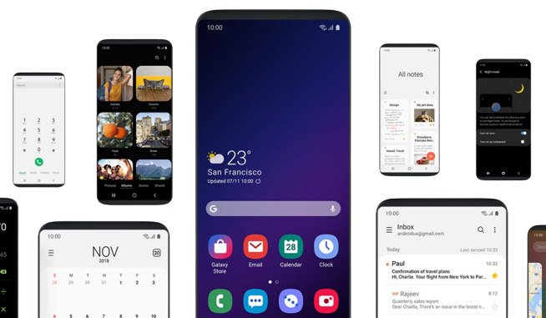
Customs skinned android?
An Android skin is a modified version of stock Android.
Many manufacturers that produce Android devices use their own custom “skins” to make the operating system look unique.

Slide 21

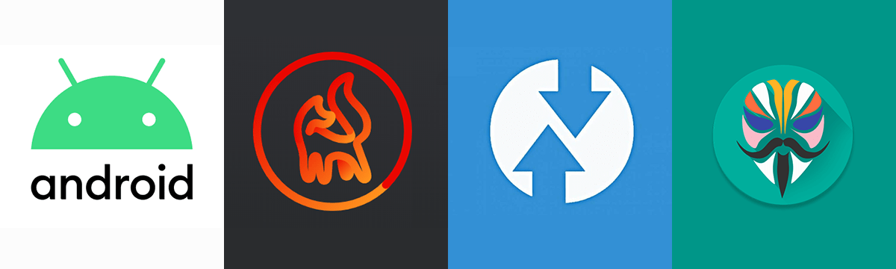
Customs android / customs rom?
Google has made Android open-source, it means the source code of the operating system (OS) itself is available to developers, and anyone can make their own version of Android if they know what they are doing.

Slide 22

How to develop android by own ?
Requirement
Android sources code.
Device tree, kernel tree.
(device drivers)
Basic java knowledge.
A healthy brain.

Slide 23


