Slide 1

Introduction
In this presentation, we will explain Maven's lifecycle, goals, and explore its advantages in Java development.
Maven is a software project management and build tool.
It provides a standardized way to build, test, package, and deploy software projects.
It is a powerful build automation tool primarily used for Java projects.
Maven simplifies the building and management of Java projects by providing a consistent way to manage dependencies, build processes, and project structures.

Slide 2
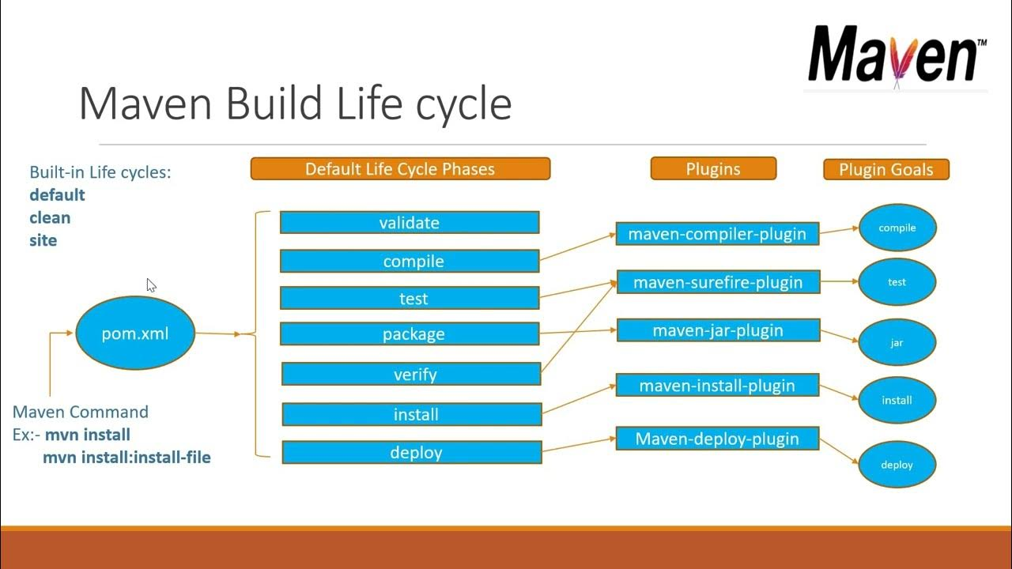
What are Maven Lifecycles?

Slide 3
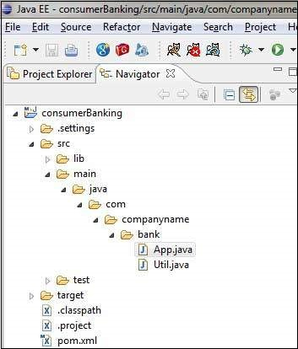
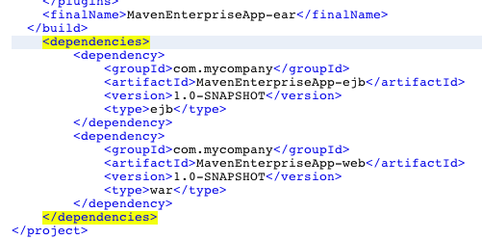
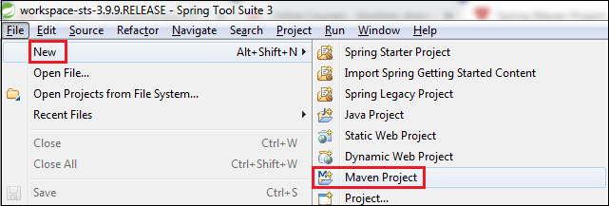
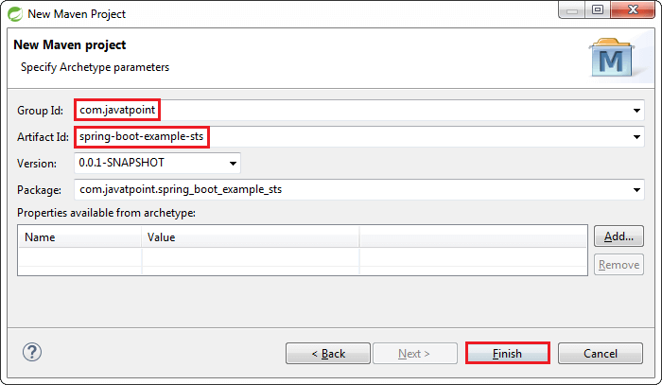
Usage of Maven
Creating a Maven Project: Developers can create a new Maven project using Maven archetypes or by manually configuring a POM file.
Defining Dependencies: Maven's POM file allows developers to specify project dependencies, including their versions and scopes.
Building Projects: Maven simplifies the build process with commands and installs it into the local Maven repository.

Slide 4
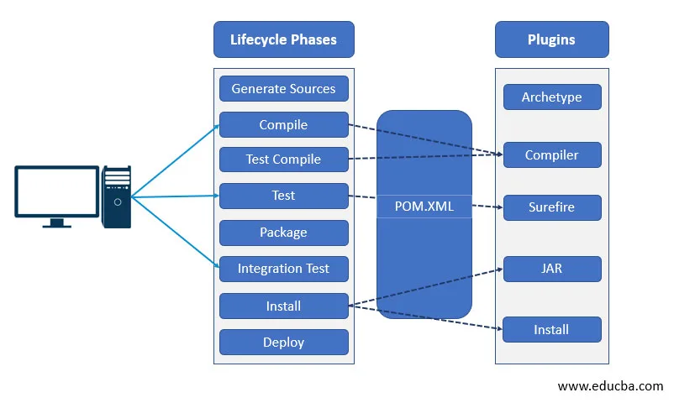
What are Maven Goals?
Maven goals are tasks that can be executed during the build process.
- Common Maven goals include clean, compile, test, package, install, and deploy.
- Developers can customize build processes by configuring and invoking different goals..

Slide 5
Advantages of Using Maven
Dependency Management: Maven simplifies dependency management by automatically resolving and downloading project dependencies from repositories.
Consistent Project Structure: Maven enforces a standardized project structure, making it easier for developers to understand and navigate projects.
Build Automation: Maven automates the build process, reducing manual effort and ensuring consistency across different environments.
Plugin Ecosystem: Maven has a vast ecosystem of plugins that extend its functionality, allowing developers to customize and enhance the build process.
Integration with IDEs: Maven integrates seamlessly with popular Integrated Development Environments (IDEs) like Eclipse, IntelliJ IDEA, and NetBeans.
Centralized Repository: Maven Central Repository serves as a centralized location for hosting project dependencies, making it convenient for developers to access and share libraries.
Dependency Scope: Maven allows developers to define dependency scopes (compile, test, runtime, provided, etc.), enabling better control over dependency inclusion in different phases of the build process.

