Slide 1
Airline Price Analysis
By Project Team 10

Slide 2
Team Members
Shubham Shah
Jeel Patel
Manjusha Dondeti
Rama Sri Saladi

Slide 3
Agenda
Motivation
Data & Task
Visual Encoding (UI Example)
Data Modeling Plan and Prediction
Conclusion

Slide 4
Motivation

Slide 5
Project Goal
Our goal is to analyze the prices of the fare for different source, destination, coupons, number of passengers, month, distance, ticket career, airline, etc.
We will also train the Machine Learning model based on the available dataset and will predict the price for the future month.

Slide 6
Question of Interest
What is the relation between ticket price and distance in miles? (line graph)
Are ticket prices decreases if we buy more tickets ? (bar/line chart)
Which airline is more expensive for different source and destination considering average price? (Average of price with bar chart)
When is the best time to book the travel ticket based on average price? (price versis quarter bar chart)

Slide 7
Question of Interest
Which attributes have the most influence on the price of a plane ticket? (feature importance bar chart)
What is the effect of contiguous vs non-contiguous flights in the price ? (average price versis Itinerary type bar chart)
Which two airports are not connected ? (Network Graph)

Slide 8
Data & Task

Slide 9
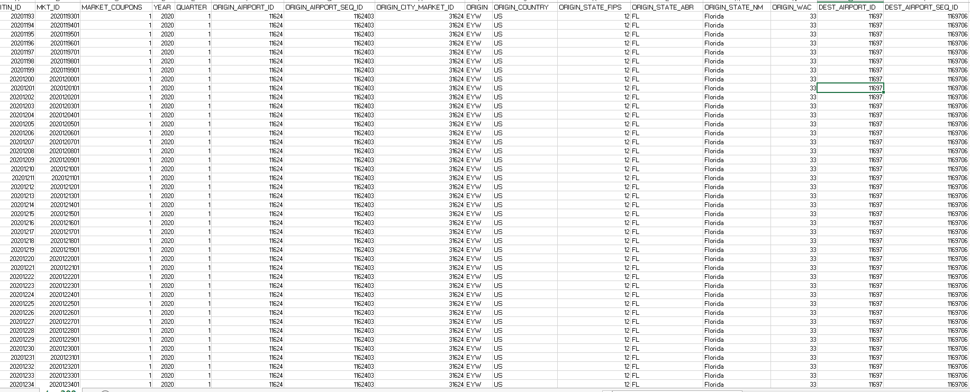
Dataset snapshot

Slide 10
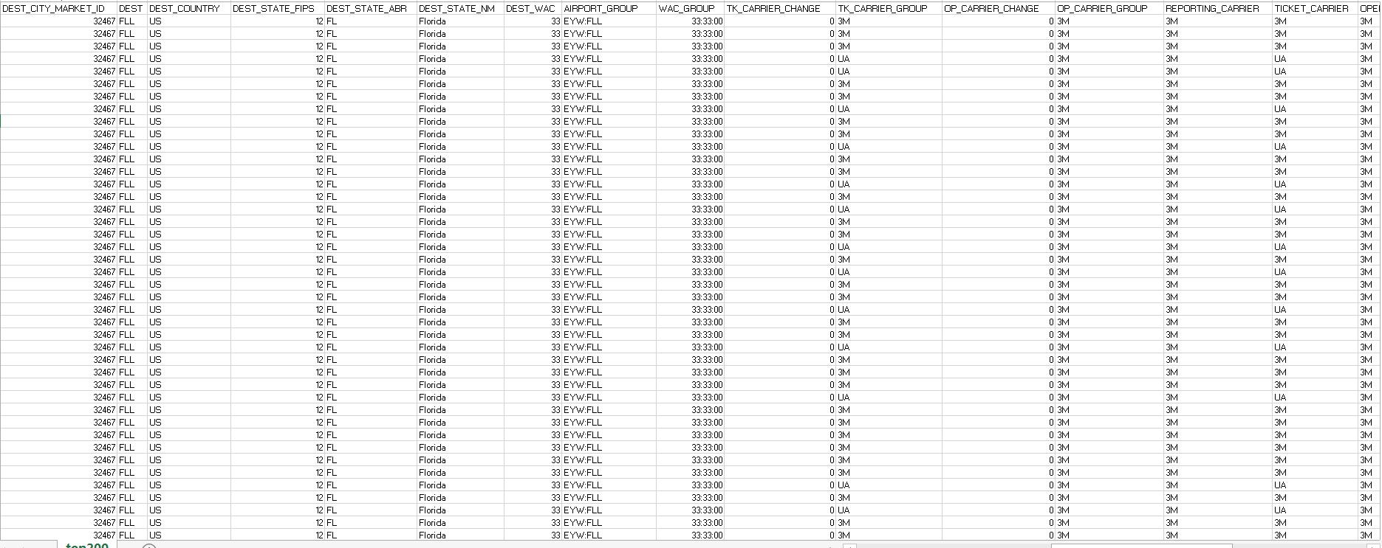
Dataset snapshot

Slide 11
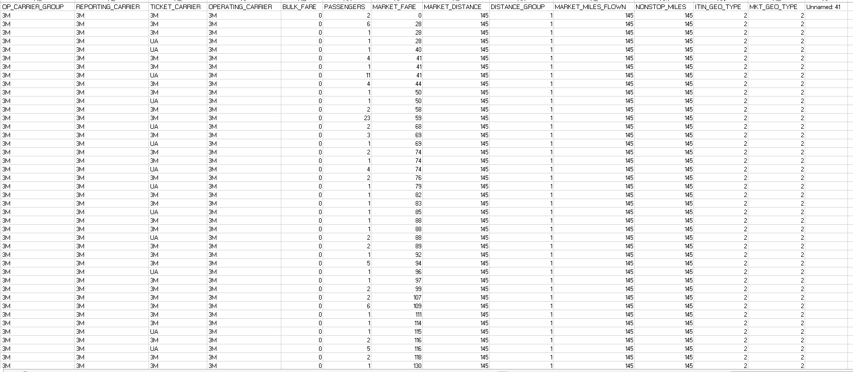
Dataset snapshot

Slide 12
Dataset Introduction
Air travel price data is for the year of 2020.
There are 12257491 number of records or transactions and 42 columns.
There are multiple attributes which concludes the same will be removed according to the correlation matrix.

Slide 13
Column Description
Field Name | Description
ItinID | Itinerary ID (Unique)
MktID | Market ID (Unique)
MktCoupons | Number of Coupons in the Market (Numeric)
Year | Year
Quarter | Quarter (1-4)
OriginAirportID | Origin Airport, Airport ID. An identification number assigned by US DOT to identify a unique airport. Use this field for airport analysis across a range of years because an airport can change its airport code and airport codes can be reused.
OriginAirportSeqID | Origin Airport, Airport Sequence ID. An identification number assigned by US DOT to identify a unique airport at a given point of time. Airport attributes, such as airport name or coordinates, may change over time.
OriginCityMarketID | Origin Airport, City Market ID. City Market ID is an identification number assigned by US DOT to identify a city market. Use this field to consolidate airports serving the same city market.
Origin | Origin Airport Code (Categorical)
OriginCountry | Origin Airport, Country Code (Categorical)
OriginStateFips | Origin Airport, State FIPS Code (Categorical)
OriginState | Origin Airport, State Code (Categorical)
OriginStateName | Origin State Name (Categorical)
OriginWac | Origin Airport, World Area Code (Categorical)
DestAirportID | Destination Airport, Airport ID. An identification number assigned by US DOT to identify a unique airport. Use this field for airport analysis across a range of years because an airport can change its airport code and airport codes can be reused. (Categorical)
DestAirportSeqID | Destination Airport, Airport Sequence ID. An identification number assigned by US DOT to identify a unique airport at a given point of time. Airport attributes, such as airport name or coordinates, may change over time. (Categorical)

Slide 14
Column Description
DestCityMarketID | Destination Airport, City Market ID. City Market ID is an identification number assigned by US DOT to identify a city market. Use this field to consolidate airports serving the same city market. (Categorical)
Dest | Destination Airport Code (Categorical)
DestCountry | Destination Airport, Country Code (Categorical)
DestStateFips | Destination Airport, State FIPS Code (Categorical)
DestState | Destination Airport, State Code (Categorical)
DestStateName | Destination State Name(Categorical)
DestWac | Destination Airport, World Area Code (Categorical)
AirportGroup | Airport Group (Categorical)
WacGroup | World Area Code Group (Categorical)
TkCarrierChange | Ticketing Carrier Change Indicator (1=Yes) (Categorical)
TkCarrierGroup | Ticketing Carrier Group (Categorical)
OpCarrierChange | Operating Carrier Change Indicator (1=Yes) (Categorical)
OpCarrierGroup | Operating Carrier Group (Categorical)
RPCarrier | Reporting Carrier Code(Categorical)
TkCarrier | Ticketing Carrier Code for On-line Itineraries (otherwise equal to 99) (Categorical)
OpCarrier | Operating Carrier Code for On-line Itineraries (otherwise equals to 99) (Categorical)
BulkFare | Bulk Fare Indicator (1=Yes) (Categorical)
Passengers | Number of Passengers (Numeric)
MktFare | Market Fare (ItinYield*MktMilesFlown) (Numeric contiguous)
MktDistance | Market Distance (Including Ground Transport) (Numeric)
MktDistanceGroup | Distance Group, in 500 Mile Intervals (Categorical)
MktMilesFlown | Market Miles Flown (Track Miles) (Numeric)
NonStopMiles | Non-Stop Market Miles (Using Radian Measure) (Categorical)
ItinGeoType | Itinerary Geography Type(Categorical)
MktGeoType | Market Geography Type(Categorical)

Slide 15
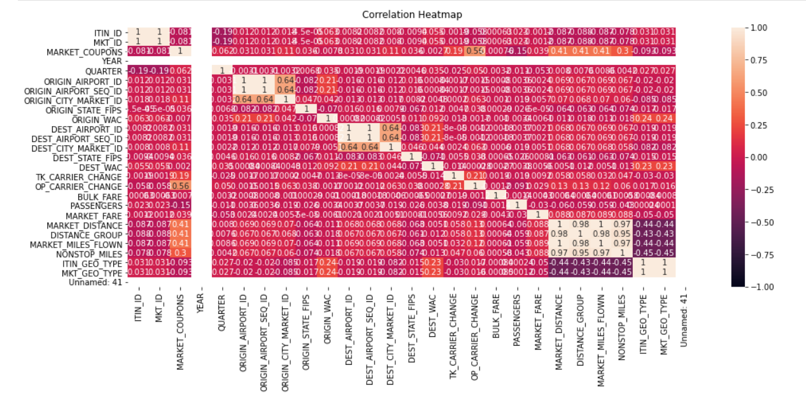
Correlation Matrix

Slide 16
Removing unnecessary columns
Based on correlation matrix, we will drop the not required columns.
ITIN_ID and MKT_ID are highly correlated so we can remove one of them.
ORIGIN_AIRPORT_ID,ORIGIN_AIRPORT_SEQ_ID, ORIGIN_CITY_MARKET_ID are highly correlated.
DEST_AIRPORT_ID, DEST_AIRPORT_SEQ_ID, DEST_CITY_MARKET_ID are highly correlated.
Unnamed: 41 is not needed column.
ITIN_GEO_TYPE, MKT_GEO_TYPE are highly correlated.
MARKET_DISTANCE, DISTANCE_GROUP, MARKET_MILES_FLOWN, NONSTOP_MILES are highly correlated.

Slide 17
Removing unnecessary columns
The travelled miles should be equal to the flown miles. After giving this filter we can remove any of MARKET_MILES_FLOWN and MARKET_DISTANCE as they are same.
BULK_FARE is a categorical variable suggesting multiple tickets bought or not. Which is same as number of PASSENGERS. So we can remove one of both.
We are good with one reference of origin and destination so removing extra columns suggesting same. Which are ORIGIN_COUNTRY, ORIGIN_STATE_FIPS, ORIGIN_STATE_ABR, ORIGIN_STATE_NM, DEST_COUNTRY, DEST_STATE_FIPS, DEST_STATE_ABR, DEST_STATE_NM.

Slide 18
Removing unnecessary columns
Ticketing, Operating and Reporting carrier should be same as we can ignore the customers, who changed the carrier. And there should not be any career change. Hence TK_CARRIER_CHANGE and OP_CARRIER_CHANGE should be 0 and then we can remove both the columns.
We can also drop carrier groups for ticketing, operating and reporting. Hence, TK_CARRIER_GROUP and OP_CARRIER_GROUP can be dropped.

Slide 19
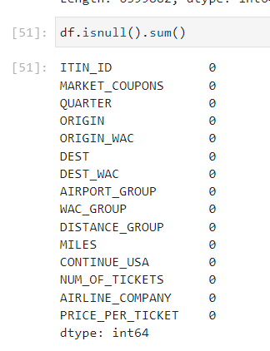
Missing Value Handling
There are no missing values after data filtering.

Slide 20
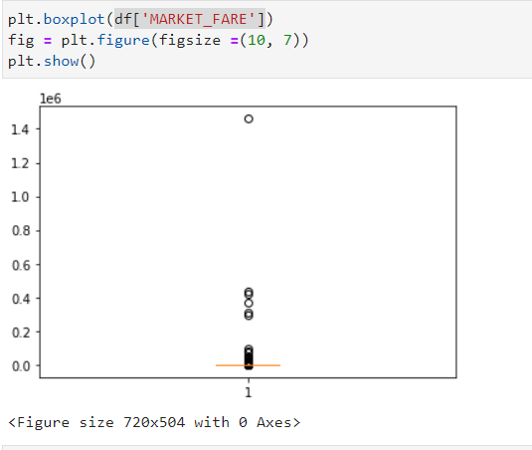
Handling Outliers
As per the boxplot we can remove the values less than 50 and above 1000 for fare price.

Slide 21
Visual Encoding

Slide 22
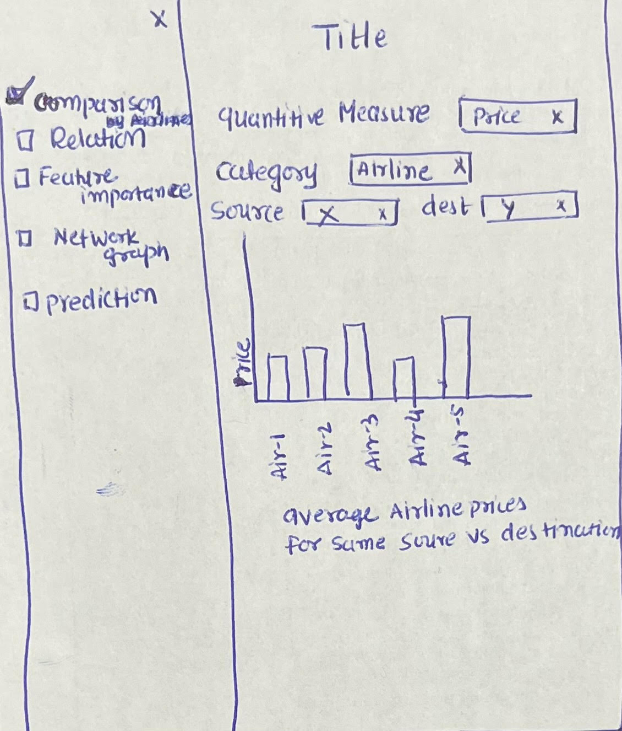
Sample UI 1

Slide 23
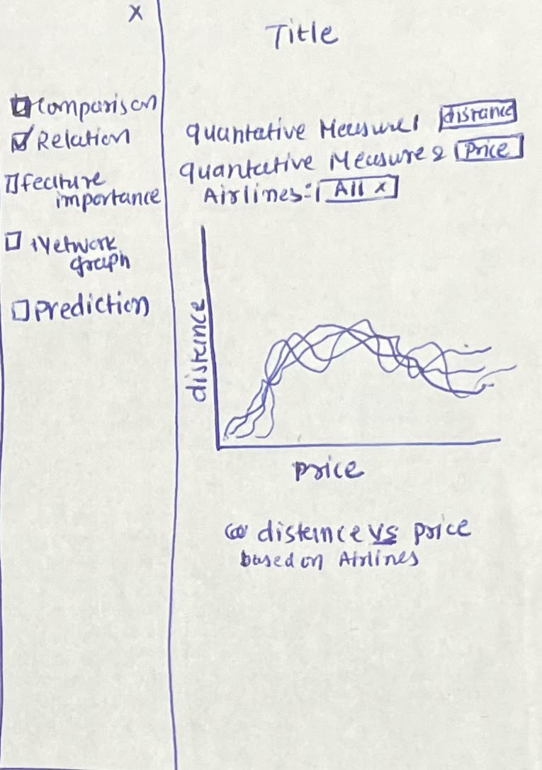
Sample UI 2

Slide 24
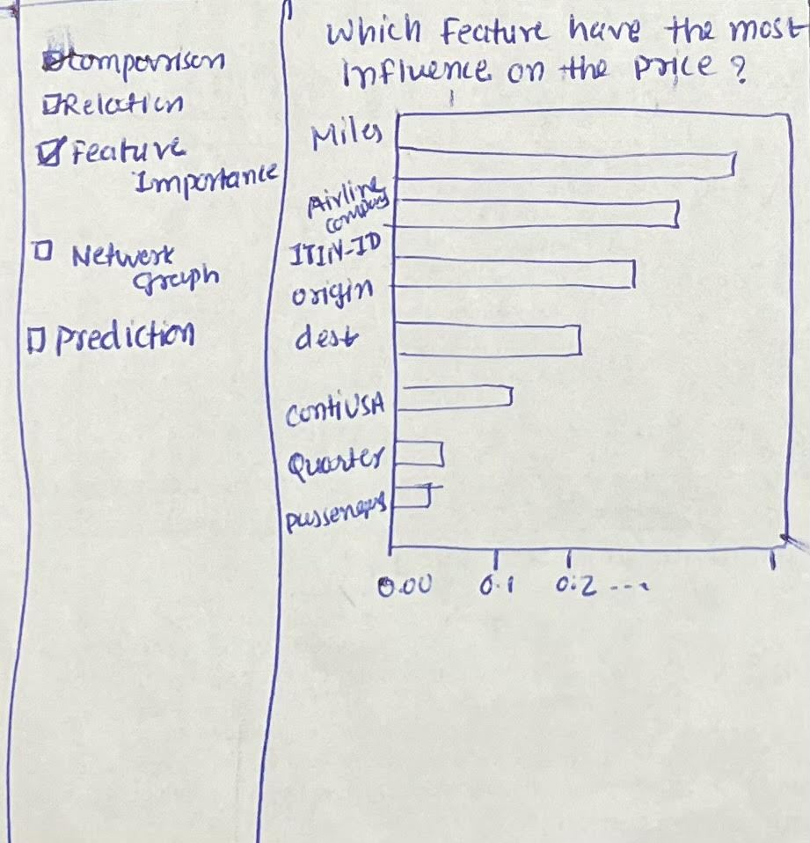
Sample UI 3

Slide 25
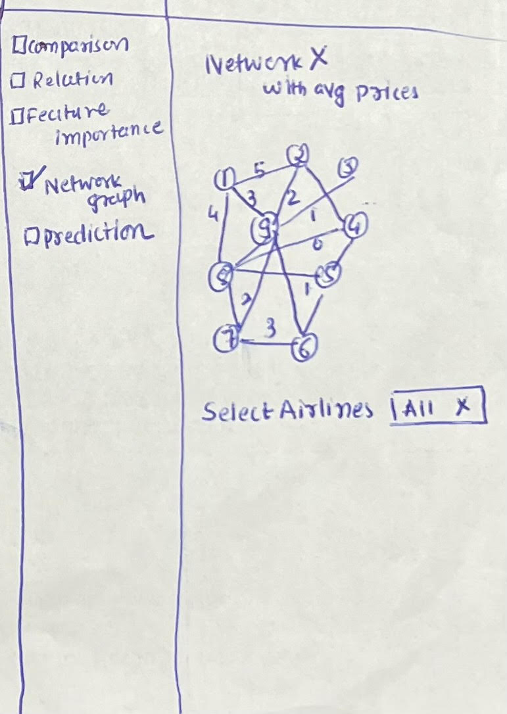
Sample UI 4

Slide 26
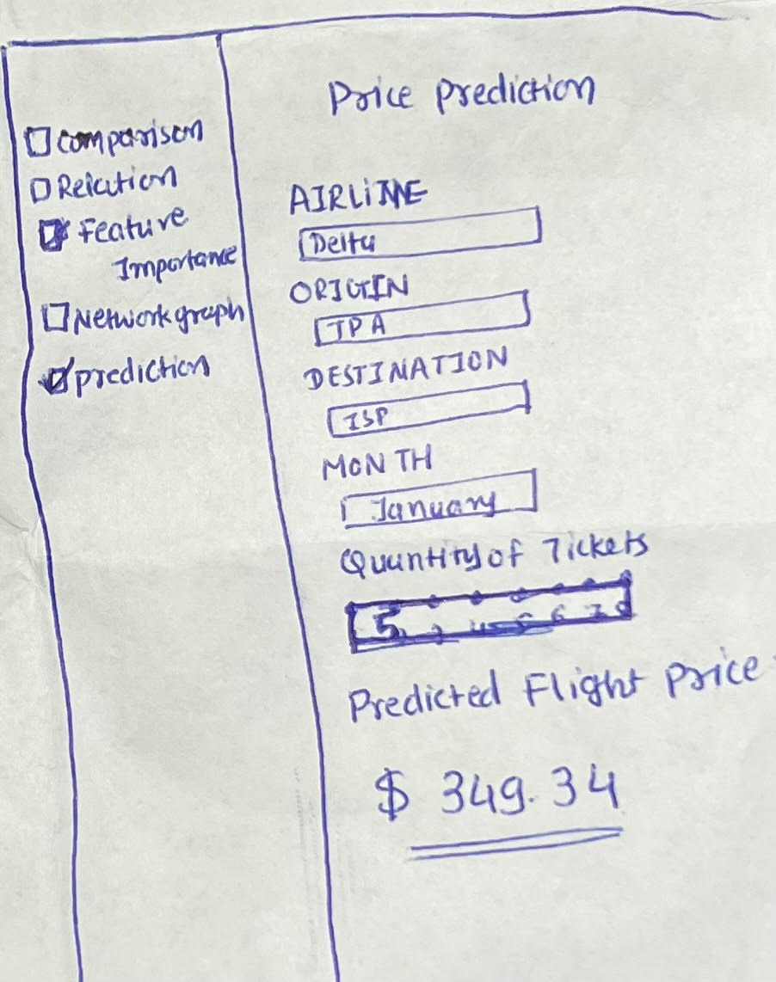
Sample UI 5

Slide 27
Additional Screen
We are also planning to add pandas profiling report as a separate screen which will be using the raw data set.

Slide 28
Data Modeling Plan and Prediction

Slide 29
Data Modeling
We will be dividing data into two parts, one for training the model and other for the testing.
We will be using logistic regression and random forest regression models to train and predict the data.
Based on the accuracy, we will select the most efficient model for predicting the prices based on the parameters given.

Slide 30
Conclusion

Slide 31
Conclusion
We will follow the plan mentioned above and if required add additional functionalities based on the requirements.
The app will not look exactly like the given format but we are sure that we will add more than what we have committed in this presentation.
We will host our application on herokuapp.com and will update our code and dataset on github.
This project can be used to implement the system where prices of the air travel needs to be predicted, where user can see prices for different future time and based on that they can plan the journey or vacation. For example, booking.com can implement this model to predict the estimated price.

Slide 32
Question Answer
Feel free to contact any of us with your questions if you have any query or doubts.
Below are our mail ids.
sshah107@uncc.edu
jpate146@uncc.edu
mdondeti@uncc.edu
rsaladi1@uncc.edu

Slide 33
Thank You

