Slide 1
CUSTOMER CHURN PREDICTION
greatlearning
Team Members
Harshit Agrawal
Hrishikesh Gupta Shubham Sharma
Sanket Wakalkar
Vamsi Krishna
Mentor
Mr. Jatinder Bedi
`

Slide 2


WHAT IS CUSTOMER CHURN ?
greatlearning

Slide 3
PROBLEM STATEMENT
greatlearning
The telecommunications industry experiences an average of 1.9% monthly and 22% annual churn rate. (SOURCE: GOOGLE)
We know that it costs 5-10 times more to acquire a new customer than to retain an existing one, customer retention has now become even more important than customer acquisition.
To reduce customer churn, telecom companies need to predict which customers are at high risk of churn. In this project, we will Analyze customer-level data of a leading telecom firm, build predictive models to identify customers at high risk of churn.
Here our goal is to build a machine learning model that is able to predict churn of customers based on the features provided for their usage.

Slide 4
FLOWCHART
greatlearning
DATA EXTRACTION
DATA PREPROCESSING
EXPLORATORY DATA ANALYSIS
raw data into an understand
Analyzing data sets to summarize their main
characteristics
Procuring data
from
a given source
Transforming raw
data into an understandable
format
DATA PREPARATION
Preparing
Data for Model Building
Application of
model
for prediction
Understanding model’s
performance using
different Metrics
Training and Testing data, Checking for Significant features
MODEL DEPLOYMENT
MODEL EVALUATION
MODEL BUILDING

Slide 5
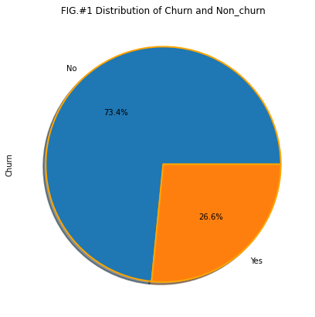
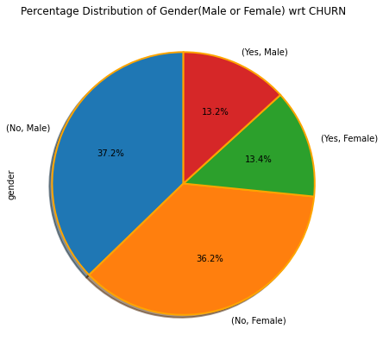
EXPLORATORY DATA ANALYSIS
greatlearning
Fig#1: Pie chart here depicts the distribution of the target variable CHURN. Ratio of NO:YES is nearly 73:27
Fig#2: Depiction of gender distribution w.r.t CHURN. Gender w.r.t CHURN is equally distributed.

Slide 6
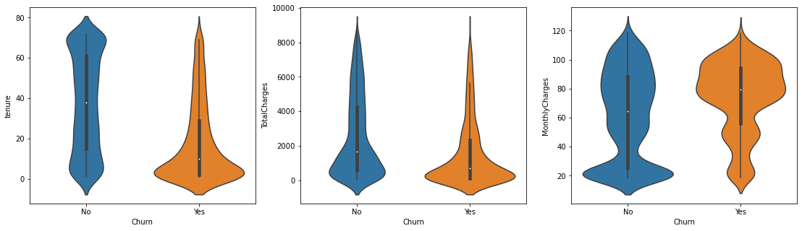
EXPLORATORY DATA ANALYSIS
greatlearning
Longer the association, more loyal the customer
As total charge increases, customer becomes more associated with the company
As monthly charge increases , customer terminate the services

Slide 7
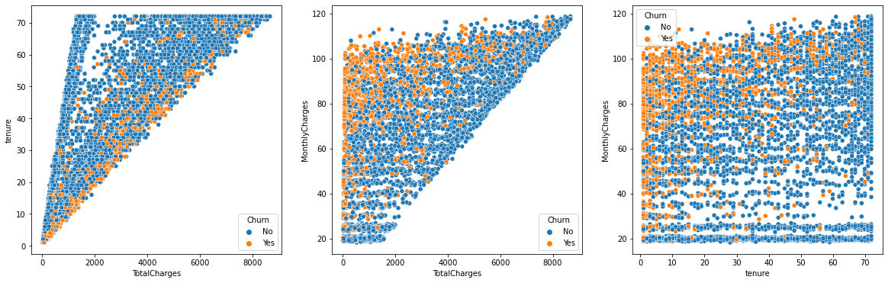
EXPLORATORY DATA ANALYSIS
greatlearning
- The lower the total charges and tenure, the higher the churn.
- Churn is higher for higher bands of monthly charges.
- If tenure is less, and monthly charges are more , customer is more likely to churn

Slide 8

EXPLORATORY DATA ANALYSIS
greatlearning
The dataset does not have any outliers
HEATMAP shows a very high relation between tenure and total charges
There were 11 null values in TotalCharges variable
Independent variables 17 categorical and 3 continuous
The data is imbalanced with ratio of NO:YES as 73:27
Gender distribution is equal for male and female w.r.t churn
Some columns had extra class which were not relevant
Most of the customers are young people with 84% as contribution

Slide 9

PREPROCESSING
greatlearning
Scaling of Numerical variables
Label Encoding of the Target variable
Dummy Encoding of the categorical variables
(N-1 encoding)
Splitting of the train and test set for the further analysis
Removed rows with the missing values
Dropped irrelevant column like CustomerID and also dropped Gender as it is non significant variable
Balancing of the data using AdaSyn

Slide 10

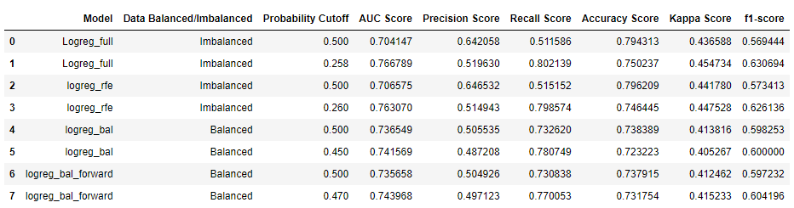
LOGISTIC REGRESSION
greatlearning
Logistic regression for both balanced and imbalanced data set is performed.
The idea behind applying logistic regression here is to get an insight of how the data set is behaving towards the classification algorithm.
Data being balanced or imbalanced, we can surely say here that accuracy of not more than 0.79 is achieved.
Also in imbalanced data accuracy is not reliable metric so we can look to the recall score. Maximum of 0.80 is the recall score that is achieved.
For balanced data accuracy achieved is near about 0.74

Slide 11

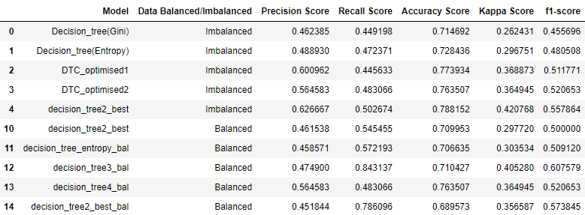
DECISION TREE
greatlearning
Further the data is subjected to Decision tree modelling
As compared to a 0.74 accuracy in balanced data in previous algorithm, here we were able to enhance the accuracy to about 0.763.
But again a model with good accuracy and a good recall score is not achieved in decision tree modelling.
Recall of 0.84 is achieved but with lower accuracy score (0.71).

Slide 12

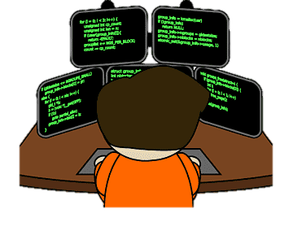
RANDOM FOREST
greatlearning
We were keen on getting a better classification so we did try some ensemble method. Random Forest being our first choice for the same
We further were able to enhance the accuracy to 0.77.
But recall score deteriorated further.

Slide 13
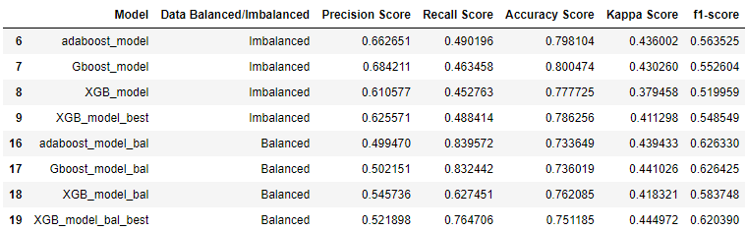
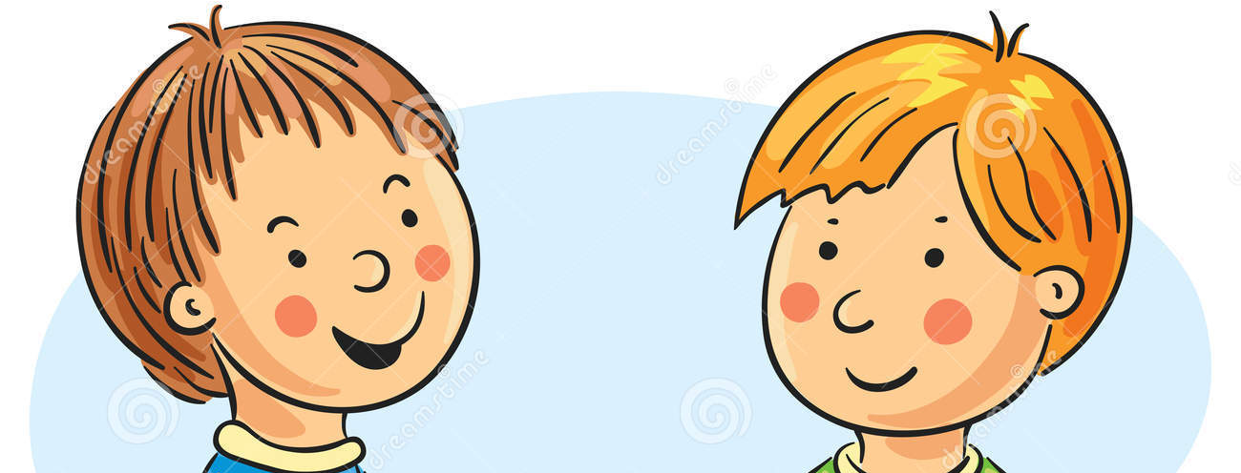
BOOSTING
greatlearning
As it determines how well our model classifies the customers who are more likely to leave.
Why Recall score is important here?
Boosting techniques like ADABOOST, GBOOST and XGBOOST are used here for classification.
The best model are highlighted.

Slide 14
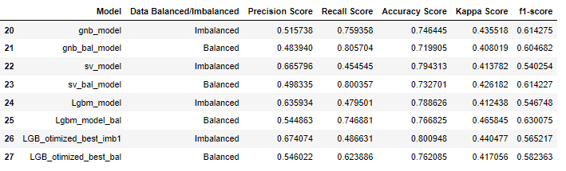

SOME MORE ALGORITHMS....
greatlearning
Different models applied here are Naïve Bayes, Support vector machine and Light gradient Boosting Model.
For the balanced data a good accuracy is required along with the good recall score. This is achieved in the LGBM balanced model as highlighted.
Surprisingly this model gives us the kappa score which is best among all the models fitted earlier.

Slide 15
CONCLUSION
greatlearning
We started by cleaning the data and analysing it with visualization. Then, to be able to build a machine learning model, we transformed the categorical data into numeric variables (feature engineering). After transforming the data, we tried different machine learning algorithms using default parameters.
Finally, we concluded that the accuracy that we are getting in applying different algorithms is near about 0.77.
The best set of metrics achieved is in LGBM model with balanced data. Having good accuracy score, recall as well as kappa score.
This accuracy is subjected to the fact that there is no over-fitting or under-fitting.
So, this model can be deployed in the classification of customers. That is they will remain associated with the company or terminate the services.
Balancing of data was important here because then we were confident over the accuracy achieved.
Our aim was to build a model centered around the data provided to accurately classify the customers which are likely to terminate the services soon. This model can achieve the objective with 77% confidence.
The data provided is for certain period of time. If more observations are added with longer time period then surely there will be more information on churn rate.

Slide 16

FINAL RECOMMENDATIONS
greatlearning
On the basis of the EDA and various model built after data analysis following recommendations are given to the telecommunication company:
New customers are likely to leave company early so try to retain the new customers with lower charges and better services.
Introduction of packages for whole family is much needed so that the customer gets the value for money.
Company is not able to gain trust of new customers but once a customer is associated with the company for more time then for sure it remains with the company for a longer period.
Model which is built can predict the customers which are likely to churn out with an accuracy of 77%. So it can be used by the PR team to bring some perks and packages for them in order to retain them.
Considering the fact that customers using fibre optics are more likely to terminate the services. This is may be due to the fact that service is liked by people but it is not economical. So economical plans with better service is must to retain the customers.

Slide 17
greatlearning
Thank you…

