Slide 1


B.Tech Project
(COCSC22)
Mid-Semester Evaluation
Stock market forecasting using financial graph network and deep learning techniques
Under the supervision
of
Dr. Preeti Kaur
Submitted by:
Adarsh Kumar- 2020UCO1663
Rohit Sharma- 2020UCO1697
Shubham Sharma- 2020UCO1705

Slide 2

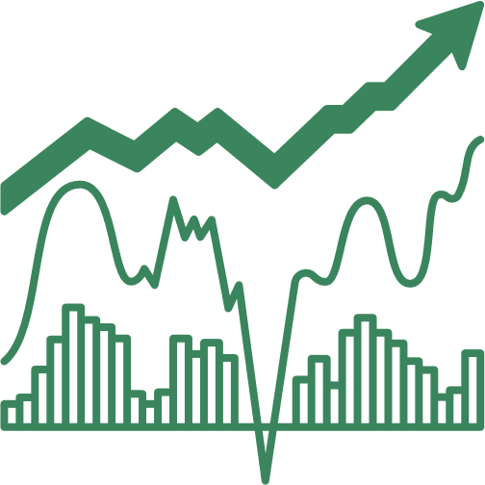
Contents
Introduction
Contributions
Literature Survey
Problem Statement
Theory
Work Flow
Dataset
Methodology
Future Work
References

Slide 3
Introduction
Stock market prediction has become a distinct field of research. Traditionally, market studies focused on manual data analysis and pattern identification in price fluctuations to forecast future market behavior.
However, the introduction of artificial intelligence has revolutionized this approach.
While applying machine learning and deep learning techniques to stock prices may seem straightforward, the manner in which they are applied can greatly influence the results.

Slide 4
Introduction
The research area in which we are going to delve is that of graphs and networks.
The research in this domain is interesting in the sense that people find general classification strategies to be much more effective in terms of stock market.
The motivation behind our study is not to accurately predict the stock market for next few days but rather predict the behavior which it “might” show in the near future based on historical data.

Slide 5
Introduction
This becomes a classification task as one needs to only consider whether the market will go up or down.
The best parameter to consider in this regard is the volatility parameter which calculates the dispersion of share price values.
It is going to be the center of this study and will significantly affect the results.

Slide 6
Contributions
The major contributions of this research include–
To experiment with various classification techniques in machine learning to predict the pattern in which the market will behave.
To have two separate classification methods, one to predict the pattern for a particular day and one to predict the behaviour of the entire graph.

Slide 7
Literature Survey
S.No | Title | Author | Description | Technology
1 | Factors Affecting Stock Prices in the UAE Financial Markets | Hussein A. Hassan et. al. | Aims to identify the key factors influencing stock prices in this emerging market. Earning per share(EPS), Money supply and GDP exhibit positive coefficient. Consumer price index demonstrates a significant negative relationship. | Regression
2 | An innovative neural network approach for stock market prediction | Tae Kyun Lee et.al., | The paper proposes two models, one time series model of LSTM with an embedded layer and the other one with an automatic encoder. The models are applied to the Shanghai A-share composite index and Sinopec. The LSTM model with the encoder gives better performance than a stochastic forecast. | Neural Network
3 | Forecasting stock crash risk with machine learning | Laurens Swinkels et. al. | This paper experiments with various features in order to find out which feature is responsible towards the financial distress of a stock. It also sheds light on the use of NLP techniques in order to extract data from news articles and find the features of stock market which has the highest variability in its SHAP score. It also uses distance-to-default parameter. It mainly focuses on news articles and business news in order to predict the directions of stock market and look for crashes. | NLP

Slide 8
Literature Survey
S.No | Title | Author | Description | Technology
4 | Novel Method of Identifying Time Series Based on Network Graphs | Vanessa Freitas Silva et. al., | This study experiments with various types of time series data and then converts them into graphs. Each time series results in a separate kind of graph. The constant time series turns into a complete graph. The periodic time series like a sine graph turns into a regular graph and so on. The properties of the graph such as their centrality measures, clustering coefficient etc. gives information about the time series. | Graphs
5 | A hybrid supervised semi-supervised graph-based model to predict one-day ahead movement of global stock markets and commodity prices | Arash Negahdari Kia et. al., | This paper uses a semi-supervised approach by building a network of stock indices in the same time zone. The supervised portion of the model predicts the movement of stock market which then sends these results into the network. The research compares its results with the traditional classification methods such as KNN, SVM and Random Forests etc. with their model of HyS3 and Kruskal based graph construction. | KNN, SVM and Random Forests
6 | A method for automatic stock trading combining technical analysis and nearest neighbour classification | Rodrigo C. Brasileiro et. al., | This paper uses a nearest neighbour classifier and checks whether considering only historical data can be feasible in analysis of stock market or not. It uses technical indicators such as stop loss, stop gain, RSI filter as parameters for its own trading strategy. It compares the results of the traditional buy-and-hold strategy with its own. The variable to analyse here was profit which turned out to be better than the buy-and-hold strategy’s profit. | Nearest neighbor classifier

Slide 9
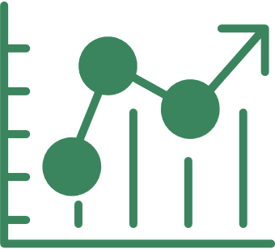
Problem Statement
To classify stock price variation patterns using various machine learning techniques and evaluate them on real data.

Slide 10
Theory
In order to understand various aspects of the project, one needs to understand the following algorithms and concepts.
Floyd-Warshall algorithm
Floyd-Warshall algorithm is used to find the shortest distances between all pairs of nodes in a graph. The way it works is that in order to find the shortest distance between the nodes u and v, it has to go through an intermediate node k. The idea is to consider each node from 1 to N as an intermediate node and try with every one of them.

Slide 11
Theory
K-nearest Neighbors or KNN
K-nearest neighbors’ or KNN classifier is a supervised machine learning classification algorithm which is used to locate clusters or groups of similar points. Its supervised nature is due to the fact that the labels for the training samples are already known and sorted. Whenever, a new sample point comes, the algorithm will classify it based on its nearest neighbors and will conclude that if K of its nearest neighbor have a particular label, then this new point must also have the same label.
The parameters required to judge the “nearness” of the neighbors is based on various distances such as Euclidean distance, Manhattan distance etc.

Slide 12
Theory
Logistic regression
Logistic regression is a supervised machine learning algorithm used for classification tasks. It particularly solves the problem of binary classification by considering a sigmoid function which results into a probability value of a data point having a particular label.
Decision Tree Classifier
Decision Tree is a supervised learning classification algorithm which uses a tree like structure where each internal node is a feature classification which sets rules for the next classification to take place. At the final level, the label is decided based on all the internal nodes. At each level of nodes, information is gained about the final label.

Slide 13
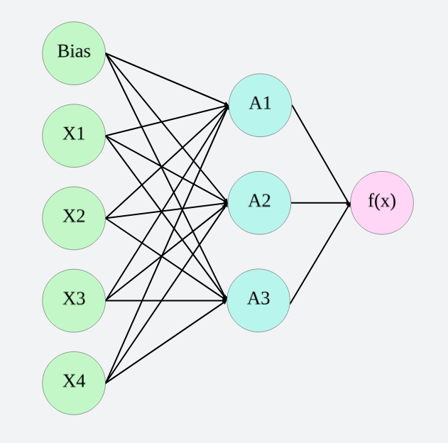
Theory
Multi-layer Perceptron classifier
Multi-layer Perceptron classifier is a supervised learning algorithm which converts a set of features into a classification. It is a very simple type of neural network which has an input layer, one or more non-linear layers called the hidden layers and the output layer. In the figure, we can see that the first layer (green) is the layer of features along with a bias, the next layer is a hidden layer and the final one is the output layer which in our case is a classification function.
Figure 2.1: Multi-layer perceptron

Slide 14
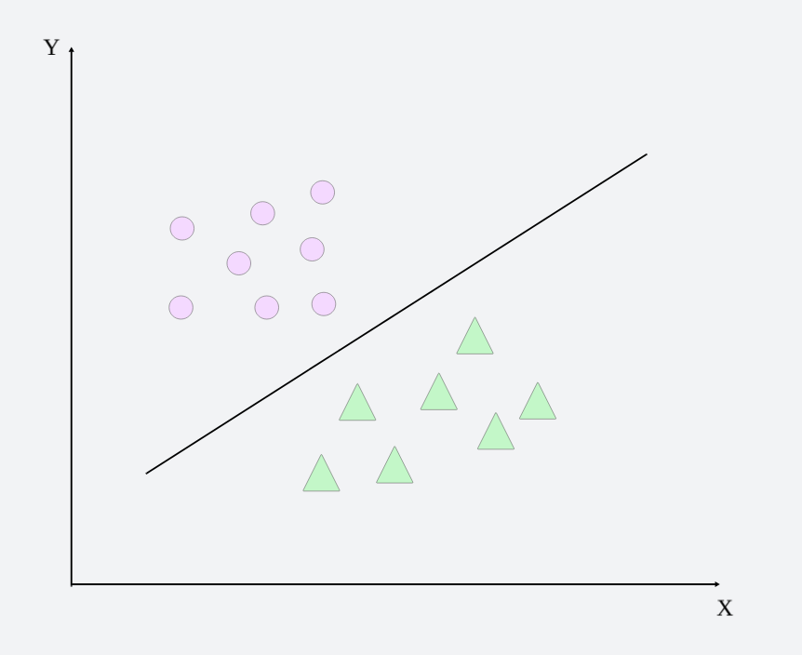
Theory
Support Vector Machine or SVM
Support Vector Machine or SVM is a supervised machine learning regression and classification algorithm which works on the principle of dividing the space using a hyperplane. The type of hyperplane depends upon the number of features in consideration. If there are only 2 features then the hyperplane is a simple line (or curve). Similarly, if we have 3 features then the hyperplane is a plane. The objective of SVM is to keep the margin between the closest points of separate classes as large as possible. The hyperplane divides these classes into their respective labels.
Figure 2.2: Support Vector Machine Classification

Slide 15
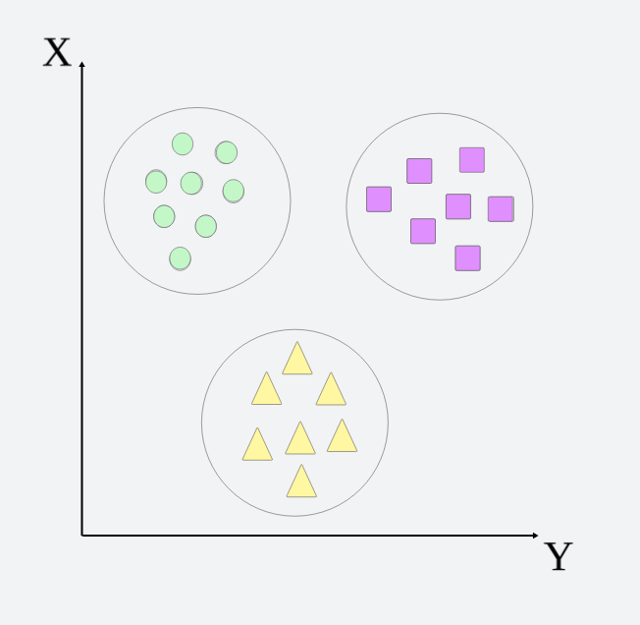
Theory
K-means Clustering
K-means Clustering is an unsupervised machine learning algorithm which clusters similar unlabeled data points together using various distances. Initially, it randomly assigns the point a cluster. After that the centroids of the clusters are found and then the point is reassigned to a cluster due to change in distance. This process is repeated several times and stops when no change takes place in cluster assignment.
Figure 2.3: K-means Clustering

Slide 16
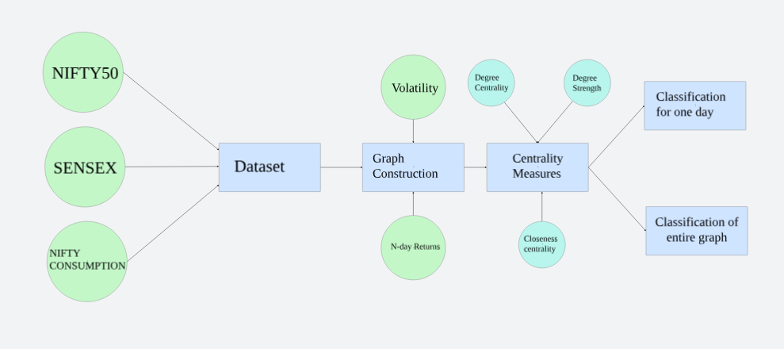
Workflow of research

Slide 17
Dataset
The dataset used in this research consists of the closing prices of 3 stock indices of India namely SENSEX, NIFTY50 and NIFTY Consumption every day from 01-01-2014 to 31-12-2023 (10 years).
SENSEX is a free-float market capitalization consisting of 30 most traded and relatively liquid stocks which contribute towards the balance of the country’s equity market.
NIFTY50 on the other hand is a benchmark index of 50 companies. NIFTY Consumption reflects the performance of companies in the domestic consumption sector.
The data for SENSEX and NIFTY50 is taken from MarketWatch and NIFTY Consumption is taken from Yahoo Finance.

Slide 18
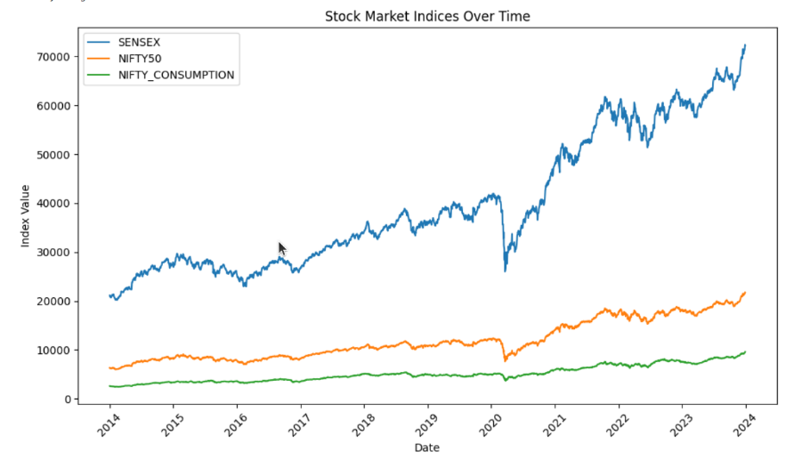
Dataset

Slide 19

Creating the Graph
The graph is constructed using the study of Cao, Lin et. al. who uses N-day volatility V, and N-day return R in order to divide the movement of stock index in 4 separate variations.
t refers to the current day in consideration
N refers to the number of continuous trading days
Close(t) refers to the closing price of the stock index on tth day

Slide 20



Creating the Graph
In order to find out V, we need to find one-day return which is r which is given by
After calculating r, we can calculate V for N days is given by
Where S.D. r1,r2, …rN refers to the standard deviation of r1,r2, …rN.
We can now calculate the average Volatility of the entire stock
index in question by simply averaging over the entire time series.

Slide 21
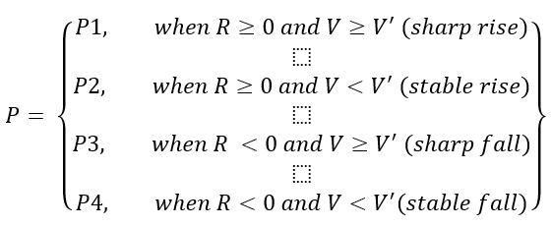
Creating the Graph
Now, we can classify the changes in any stock index on the basis of these parameters in the following way –
The classification is done for all the 3 indices and the combination of the patterns formed represents a node of a graph. Since the total number of combinations can be 43 = 64, we used a 4-base number system as nodes u and v for the graph.
The graph is constructed for 60 days although experimenting with other window sizes is still a future prospect of this research.

Slide 22
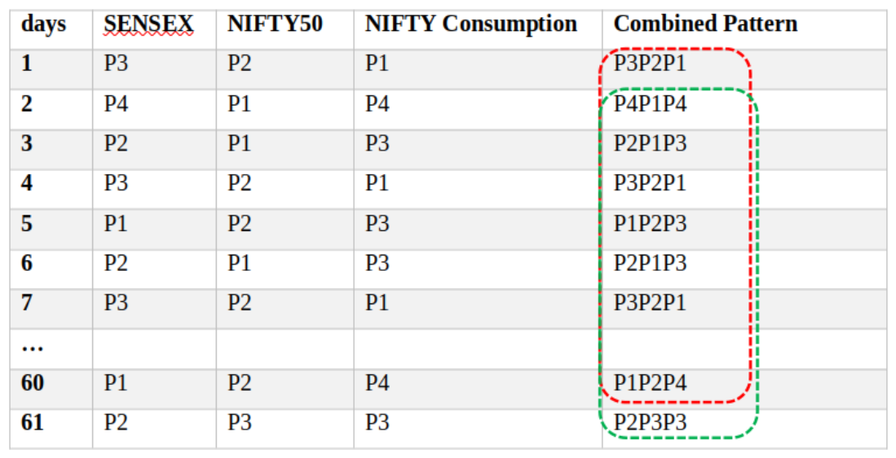
Creating the Graph
Table 1: Sample patterns for 7 days of data of SENSEX, NIFTY50 and NIFTY Consumption

Slide 23
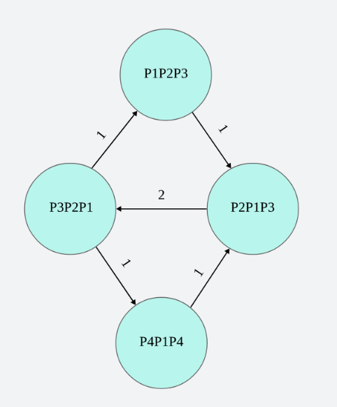
Creating the Graph
Figure 2: Example Weighted pattern graph for the data mentioned in Table 1 for the first 7 days

Slide 24
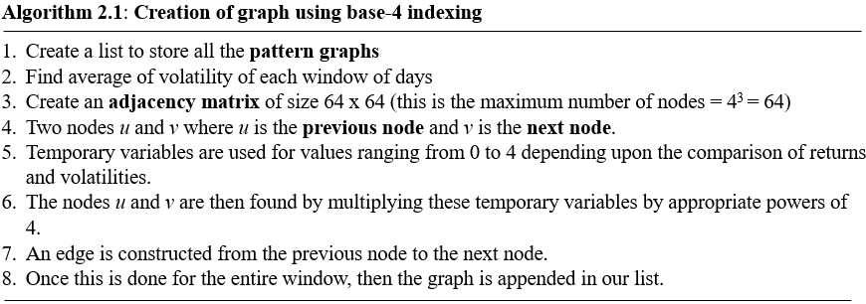
2. Algorithm

Slide 25
3. Centrality measures as input variables
The significance of this graph is that the denser this graph is, more is the dispersion and hence more care needs to be taken by investors while investing. Hence, we consider certain centrality measures in order to feed them as characteristics of our graph for classification on unseen data.
The measure we are considering for this research are degree centrality, strength (as described by Cao, Lin et. al.), closeness centrality and betweenness centrality. So far, we have applied the KNN algorithm for degree centrality and strength of the network.

Slide 26
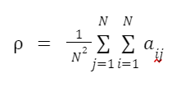
3. Centrality measures as input variables
3.1 Network Average Degree Centrality
In undirected networks, the average degree centrality of the network reflects the level of connection between one node and other nodes in the network, that is, whether one node is connected with the other nodes or not [17]. The formula is as follows:

Slide 27
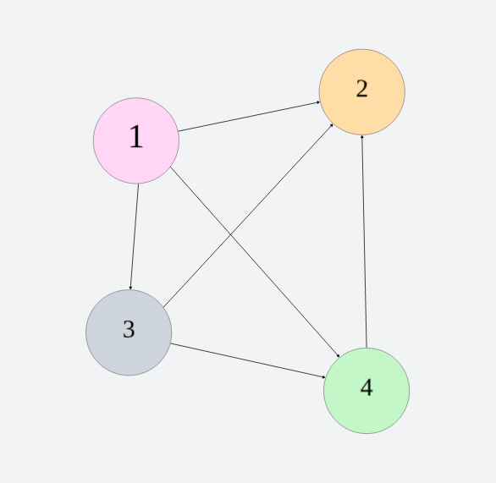
3. Centrality measures as input variables
3.1 Network Average Degree Centrality
We connect the nodes in time order so that the in-degree
and the out-degree are the same except for the first node
and the last node. Therefore, we only select the in-degree
for analysis, and calculate the average in-degree centrality
as follows:

Slide 28
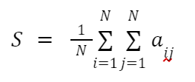
3. Centrality measures as input variables
3.2 Degree Strength
In a network, the strength of the connection from node to node is the weight of the directed edge from node to node. Similar to the in-degree and out-degree of the directed network, the strength of the directed weighted network can also be divided into in-strength and out-strength. In this study, we describe average out-strength as average network strength:
The greater the average strength of the network, the fewer the number of network nodes, the simpler the composition of the price volatility patterns, the smaller the complexity of the network, and the higher the frequency of the same node. The simpler price patterns reflect the fact that the consistency of price changes of different stocks is stronger and lasts for longer.

Slide 29

3. Centrality measures as input variables
3.3 Closeness Centrality
Closeness centrality denotes how “close” a particular node is to other nodes. Mathematically, it is calculated as the inverse of the summation of all closest distances of nodes from the node in consideration.
N represents the total number of nodes in the graph and d_{ij} represents the shortest distance between nodes i and j.
In order to calculate the shortest distance d_{ij}, we need to create a matrix using the famous Floyd Warshall algorithm in order to construct a matrix of shortest distances.

Slide 30
Research Forward
After this the research is mainly divided into two parts –
Pattern Recognition for One-day - In one phase of the project, we treat the window of N days as a training portion which we use to classify N^{th} day closing price. This generally corresponds to a “buy-and-hold” strategy in which the time period for which the share is being held corresponds to the window size of N days.
Pattern Recognition for the entire graph - Second phase of the project will cater to the short-term investment where we classify the graphs constructed using these windows of N days and investors will look at the behavior of the market and will act according to the corresponding graph constructed.

Slide 31
1. Pattern Recognition for One-day
In order to recognize the pattern for a single day, we considered the window as a training sample and the label of the day in consideration (N^{th} day in this case for a window of N days). The centrality measures of the graph constructed for 30 days acts as input variables to supervised classification algorithms where we already have the direction of closing price on the N^{th} day. The algorithms considered here include KNN, SVM, Logistic Regression, etc.
The way in which we achieved this was by creating a pandas dataframe with the features as degree centrality, degree strength and closeness centrality.
The target variables are considered one-by-one for all three indices namely SENSEX, NIFTY50 and NIFTY Consumption.

Slide 32
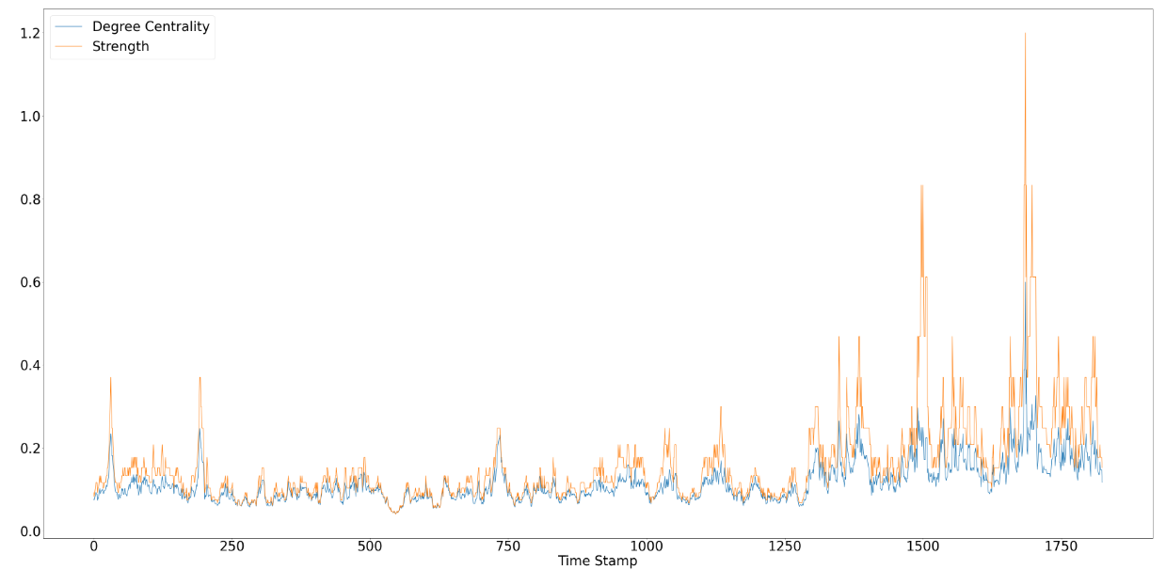
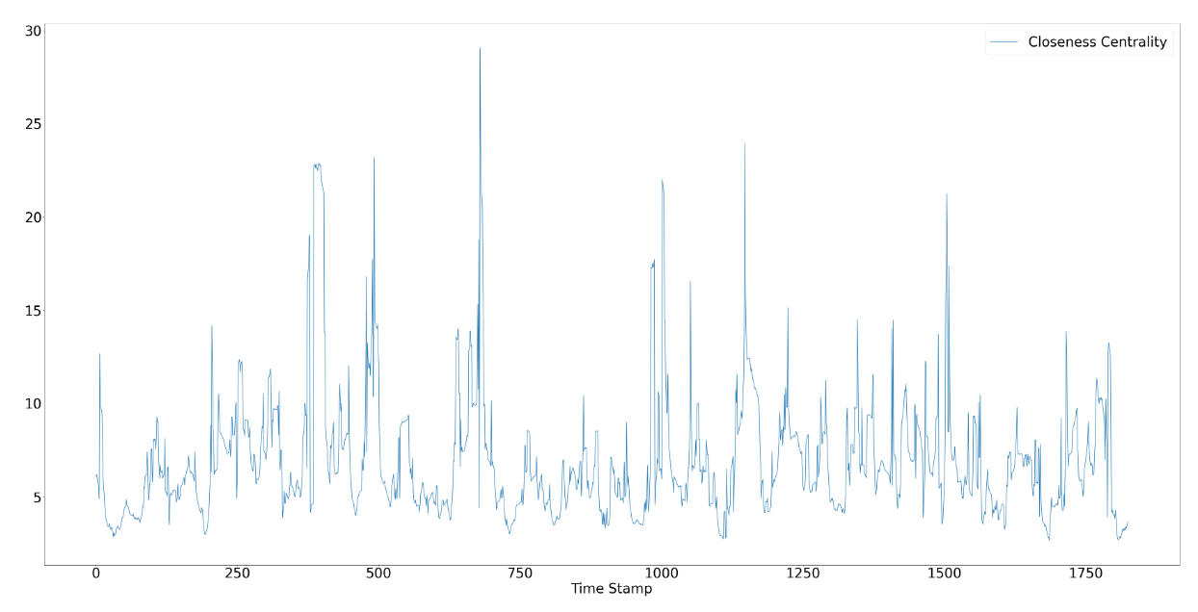
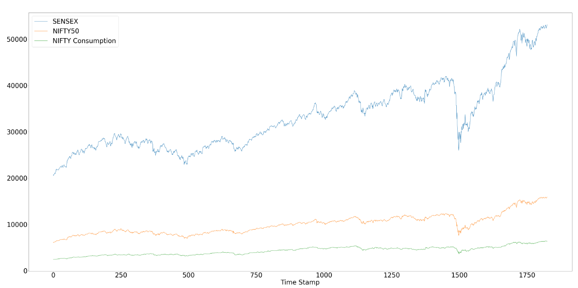
1. Pattern Recognition for One-day
Figure 2.7: (i) shows the line graph for degree centrality and degree strength (ii) shows the curve for closeness centrality and (iii) shows the trend of the three stock indices

Slide 33
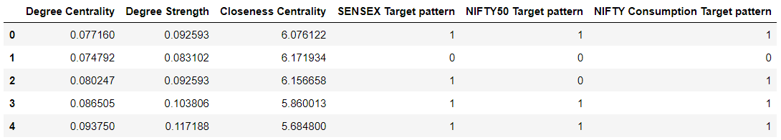
Data Frame Constructed for classification
Figure 2.8: Data frame constructed for classification
The SENSEX Target pattern, NIFTY50 Target pattern and NIFTY Consumption Target pattern denotes whether the price of the went down after the window of days was over or did it go up. If it went up, the value is 1 and if it went down or remained constant the value is 0.

Slide 34
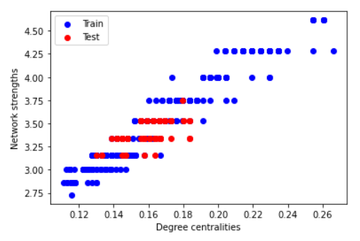
2. Pattern Recognition for Entire Graph
Pattern recognition for the entire graph is done by clustering similar graphs together. In order to do this, only two centrality measures were considered namely – degree centrality and degree strength as both of them show a strong correlation with each other.
Figure 2.9: Graph showing the correlation between network strengths and degree centralities
In order to predict for the entire graph, all the graphs with the same strength were considered together and a hybrid graph (considered by taking XOR of all weights) was constructed of these graphs. After this the edges in the testing graph of the same strength and the hybrid graph are compared for their weights.

Slide 35
Results: Pattern Recognition for One-day
The results for the classification for a window size of 30 days without any fine tuning of the algorithms is given below.
Algorithms | Parameters | SENSEX | NIFTY50 | NIFTY Consumption
KNN | Accuracy | 0.70 | 0.72 | 0.70
 | Precision | 0.63 & 0.77 | 0.63 & 0.79 | 0.61 & 0.76
 | Recall | 0.70 & 0.71 | 0.70 & 0.72 | 0.68 & 0.71
SVM | Accuracy | 0.54 | 0.54 | 0.57
 | Precision | 0.42 & 0.67 | 0.46 & 0.59 | 0.51 & 0.60
 | Recall | 0.45 & 0.55 | 0.45 & 0.55 | 0.49 & 0.55
Logistic Regression | Accuracy | 0.54 | 0.54 | 0.57
 | Precision | 0.42 & 0.67 | 0.47 & 0.60 | 0.51 & 0.60
 | Recall | 0.45 & 0.54 | 0.46 & 0.43 | 0.52 & 0.45
Multi-layer perceptron | Accuracy | 0.54 | 0.54 | 0.57
 | Precision | 0.42 & 0.67 | 0.51 & 0.60 | 0.51 & 0.60
 | Recall | 0.45 & 0.54 | 0.52 & 0.45 | 0.49 & 0.55
Decision Tree | Accuracy | 0.51 | 0.51 | 0.51
 | Precision | 0.45 & 0.56 | 0.43 & 0.58 | 0.44 & 0.57
 | Recall | 0.47 & 0.54 | 0.46 & 0.54 | 0.44 & 0.57
Table 3.1: Results for supervised classification of one day based on the window size of 30 days

Slide 36
Results: Pattern Recognition for Graph
Since the problem of clustering the entire graph was not a problem of supervised classification, its evaluation can simply be done by comparing how many edges in our hybrid graph have the same weight as our testing graph.
In our case out of the total 573 positively weighted edges, the weights of 504 of them were equal to each other.

Slide 37
Conclusion
The final take of the research is that predicting the stock price is not a simple machine learning task. One has to innovate with other ideas in order to build a foolproof system to correctly predict the stock market.
The combination of graphs and their parameters with machine learning techniques introduced a lot of new aspects.
Higher values of centrality measures in the research indicate the pattern in the market is repeating and hence a clear prediction can be made for such a time series. Lower values of centrality measures indicate that the market is not that predictable and we can skip such periods from our data frames.
We see that deep learning technique of Multi-layer perceptron is the best in actually classifying the pattern. Since predicting patterns is a relatively simpler task than actually predicting the price, the research gives a new direction for future.

Slide 38
Future Work
As with every research, there are future prospects associated with this one as well. The way we leveraged the idea of graphs in our research still requires more refining.
The advent of graph neural networks is more prominent for stock price prediction which can be integrated with this idea. Better implementation of models by fine tuning them or combining them with other models in order to improve results is also a future prospect of this research.
Integrating these machine learning and deep learning models with some real-life investment strategies such as buy-and-hold, value investing or quality investing can also be done in order to validate the results even further.
The models can be integrated with these strategies in order to build an application which can act as a “Investment companion” for investors.

Slide 39
References
[1] Lucas Lacasa, Bartolo Luque, Fernando Ballesteros, Jordi Luque and Juan Carlos Nun. From time series to complex networks: The visibility graph
[2] Yung-Keun Kwon, Sung-Soon Choi and Byung-Ro Moon. Stock Prediction based on Financial Correlation.
[3] Ying Li, Hongduo Cao and Yong Tan. Novel Method of Identifying Time Series Based on Network Graphs. Department of Management Science, Business School, Sun Yat-Sen University, Guangzhou 510275, China
[4] Minggang Wang, Ying Chen, Lixin Tian, Shumin Jiang, Zihao Tian, Ruijin Du. Fluctuation behaviour analysis of international crude oil and gasoline price based on complex network perspective. Accepted at Elsevier, May 2016.
[5] Michel Ballings, Dirk Van den Poel, Nathalie Hespeels, Ruben Gryp. Evaluating multiple classifiers for stock price direction prediction. Accepted at Elsevier, May 2015.
[6] Lamartine Almeida Teixeira, Adriano Lorena Inácio de Oliveira. A method for automatic stock trading combining technical analysis and nearest neighbour classification. Accepted at Elsevier.
[7] Hongduo Cao, Tiantian Lin, Ying Li, and Hanyu Zhang. Stock Price Pattern Prediction Based on Complex Network and Machine Learning. Accepted at Wiley, May 2019
[8] Arash Negahdari Kiaa, Saman Haratizadeha, Saeed Bagheri Shourakib. A hybrid supervised semi-supervised graph-based model to predict one-day ahead movement of global stock markets and commodity prices. Accepted at Expert Systems with Applications, March 2018
[9] Jan Grudniewicz, Robert Slepaczuk. Application of machine learning in algorithmic investment strategies on global stock markets. Accepted at Elsevier, July 2023.
[10] Tae Kyun Leea, Joon Hyung Chob, Deuk Sin Kwonb, So Young Sohnb. Global stock market investment strategies based on financial network indicators using machine learning techniques. Accepted at Expert Systems with Applications, September 2018.
[11] Hussein A. Hassan Al-Tamimi, Ali Abdulla Alwan & A. A. Abdel Rahman. Factors Affecting Stock Prices in the UAE Financial Markets. Accepted at Transnational Management, March, 2011.
[12] Kathleen McKendrick. The Application of Artificial Intelligence in Operations Planning
[13] Vangipuram Radhakrishna,C.Srinivas, Dr.C.V.Guru Rao. Document Clustering using Hybrid XOR Similarity function for Efficient Software Component Reuse.
[14] Weiwei Jiang. Applications of Deep learning in Stock Market prediction: Recent progress. Expert Systems with Applications, June 2021.
[15] Xiongwen Pang, Yanqiang Zhou et. al. An innovative neural network approach for stock market prediction. Springer, January, 2018

Slide 40


THANK YOU
Contact us: kumar.adarsh0042@gmail.com
Presented by Adarsh Kumar, Rohit Sharma, Shubham Sharma

