Slide 1
Hackathon – Hack the Stack Team Id # 131 FNOL USE CASE
January 2018

Slide 2
Table of Contents
1 | Use Case
2 | Solution
3 | Technical Design
4 | Innovation
5 | Business Value
6 | Domain Relevance
7 | Reusability
8 | Technology
9 | Value
10 | Savings

Slide 3
Use Case
The ‘First Notice of Loss’ solution is intended to facilitate help insured (policy holder) to intimate insurance company about the accident/loss that has happened. This can be done over the phone, mobile app or an email to the insurance company’s Claims department. The insurance company can then initiate a detailed investigation on the loss occurred, validation of policy and its coverage limits before the claim is actually settled. The “FNOL” process also helps insurance company to adjust its Loss Reserves.
Use case Scope
The application should take below inputs from the Insured: o Name of the Insured o Phone numbers (Landline / Mobile) o Loss details (Auto, Home), date, time, description o Policy Number (optional) o Local police/fire dept investigation report (optional)
FNOL application should be able to check whether the policy is “in-force” at the time when loss occurred. This can be done by querying the policy database in check the policy expiry date. For valid policies, FNOL app can generate a unique Claim Tracking Number and forward the details to Claim Dept. Also, notify respective teams (roadside assistance, local police and fire department) about the event.
Insurance company’s Claim department should be able to see information about the policyholder details (name, phone number), details about the loss that has occurred and any other details that are shared by the insured.
FNOL Application should have the facility of uploading images of the loss (damaged auto, home etc.)
Insured should receive a notifications (Email, SMS) for the Loss Reported along with the Claim Tracking Number

Slide 4
Business Solution
We have created solution for providing info to company for accident/loss as well as policy can be claimed by end user. below points are captured in solution:
User can register himself as user admin, customer and agent.
User can login by his emailed and password created.
Admin can see all the existing user details with all details.
Admin can also see all the claim policy with all the details.

Slide 5
Innovation
Online Claim solution will help customer to report Loss easily and instantly
Claim registration process has been simplified with concise information.
Single interface catering the need of policy holder and claim department
Capability to search policy information and raise claim against valid policy.
Provision to instantly report claim information to respective stakeholders/departments
Ability to capture Images of Loss and Investigation reports.
Ability to track the claim status

Slide 6
Business Value
What will be the potential size of the opportunity if the solution wins us a project?
Saving the time
It will be useful for web/mobile
User Friendly Architecture
Secure and Robust

Slide 7
Reusability
The Online Claim Solution is a Web Application and it can handle multiple users simultaneously.
The multiple users can access the Application and can request for the claim.
It can be used by any Insurance Company

Slide 8
Technology
We have used Asp.net which is platform independent and light weight to the server.
Secondly we used XML as database for storing users and policy claim details.
We have used Bootstrap to create responsive and good looking interface.

Slide 9
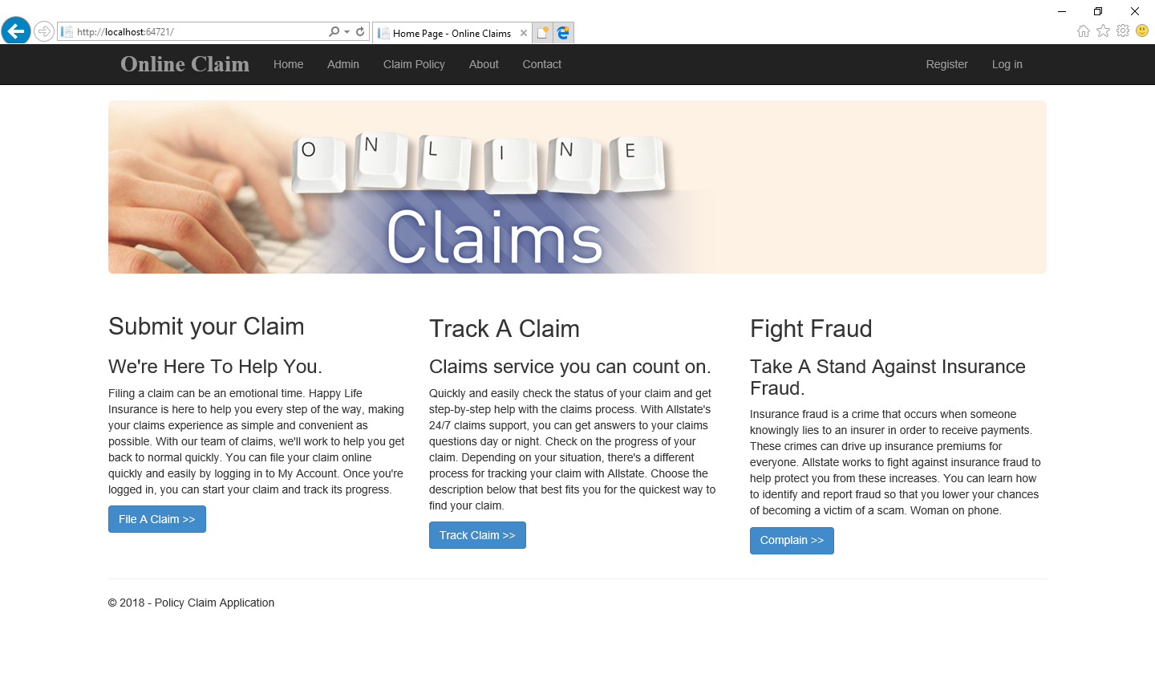
Screen Shots

Slide 10
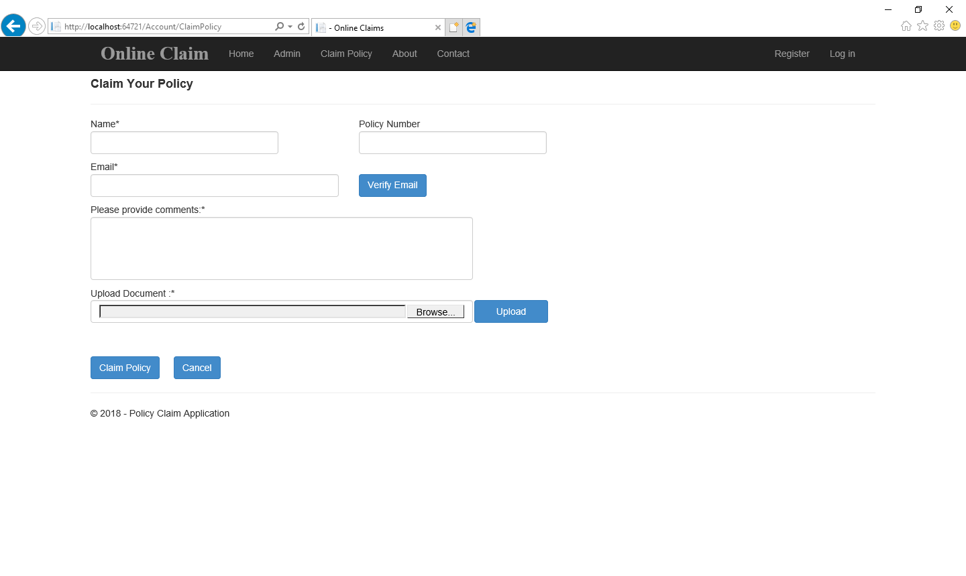

Slide 11
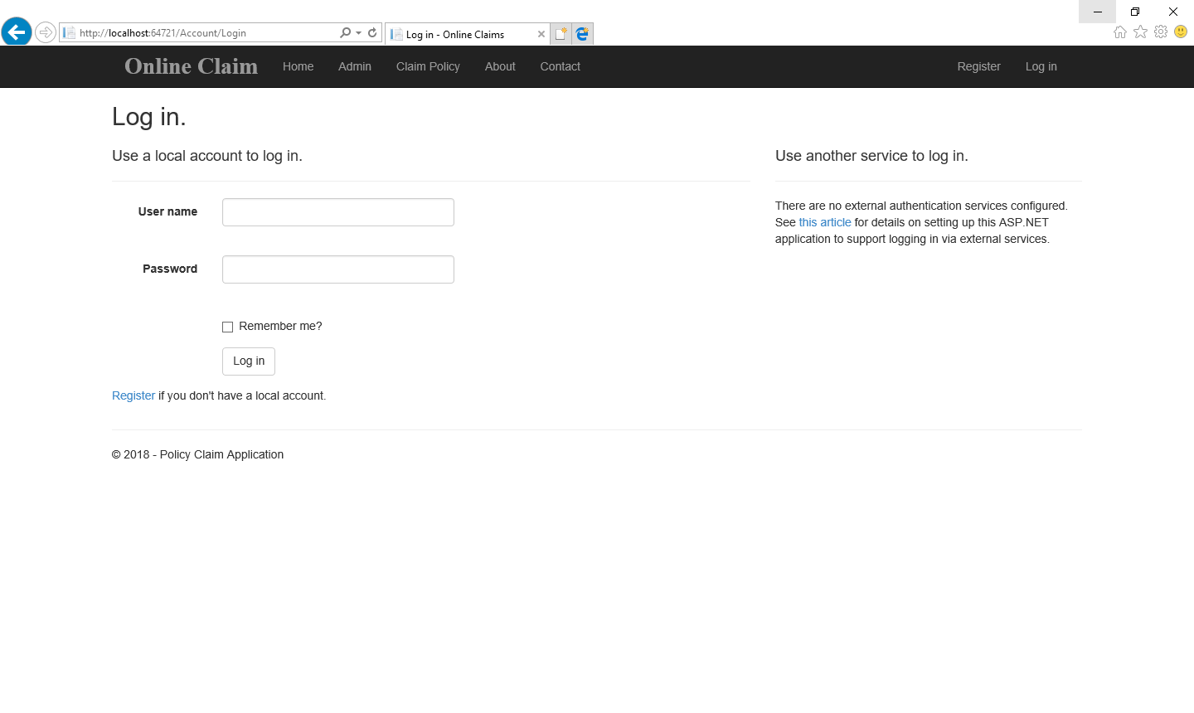

Slide 12
Thank You!

