Slide 1

Intelligent Post-Lockdown
Management System for Public Transportation

Slide 2
Team Name: Arceus
Team Members:
Raj Mesta
Shubham Shinde
Prasad Mistary
Shalaka Thorat

Slide 3
Problem Statement
Creation of an intelligent app to schedule the timings of transportation, avoiding the over-occupancy of public transport / bus stations / railway stations.

Slide 4
Proposed Solution
A web-app is built that will be an integrated hub for all 3 transport services: Bus, Train and Metro.
The app will assist user in selecting the required transport service, choose source, destination, passenger count.
The required routes will be shown and after choosing the route, user will be assessed and provided with a unique QR code which will be verified while boarding, this will ensure minimal contact with the user.
The over-occupancy and social distancing criteria will be followed and accordingly seats will be allotted.

Slide 5
Services Used
IBM Node-RED
IBM Cloudant DB
IBM Watson Assistant
IBM Cloud

Slide 6
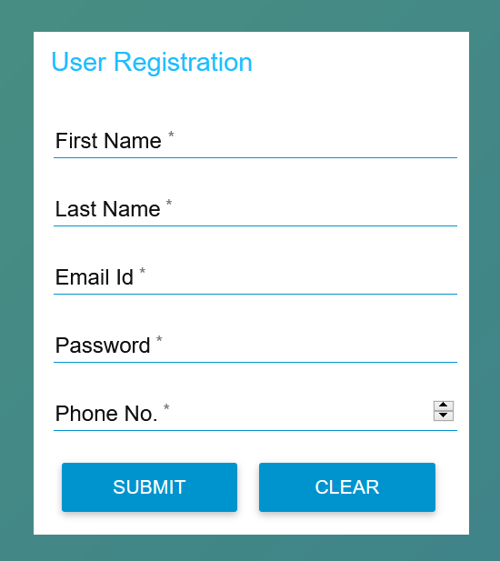
Registration, Verification
User has to fill the registration form that includes Name, Phone Number, Email and Password. After submitting it, the email address is compared with the user_login database whether it already exists. If already registered, user is redirected to Login. Else, a random 4-digit verification code is generated consisting of digits 0-9. This is sent through mail and user is required to enter that code, the code is checked and if correct, user is registered and directed to Login.

Slide 7
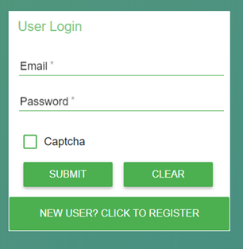
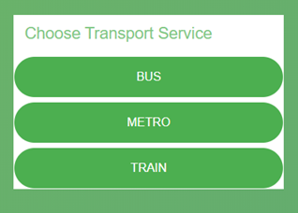
Login, Mode of Transport
User has to enter the registered email and password, tick the captcha, the email entered is checked with user_login database whether it exists and if yes, password is checked. Depending on that, user is directed to Choose Transport Service if login is successful. User needs to select Transport service i.e. Bus, Metro or Train and he then has to choose Source, Destination.

Slide 8
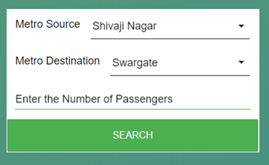
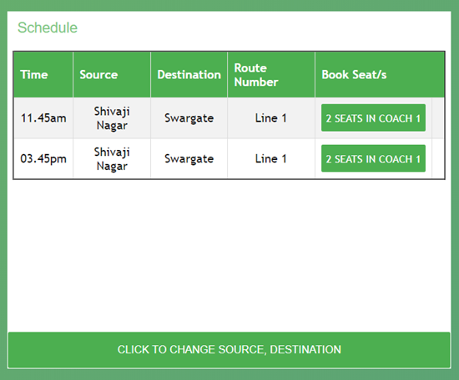
Choose Location, Time-slot Booking
User needs to enter Source, Destination, Passenger Count, then by retrieving the relevant records from bus_schedule/metro_schedule/train_schedule database, the amount and time from the source are calculated. If no route exists, user is redirected to choose source, destination. Route Number, Source, Destination, Time and Seats Available/Not are shown in tabular format depending on number of routes. For metro and train, coach number is also mentioned. After selecting seats, user is directed for Assessment.

Slide 9
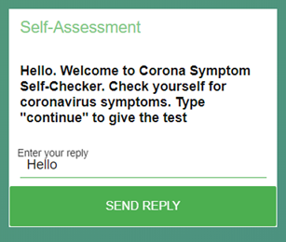
Symptom Checker Bot, Payment
If passenger count is 1, user interacts with Symptom-Checker bot. User should enter hello and then continue to start assessment. Gender, Age, Whether passenger has any symptoms/diseases, all these questions are asked and depending on the answers, risk is calculated and user is directed to Payment. User has to choose payment option: Debit/Credit Card, NetBanking, Pass, then he is provided with QR Code.

Slide 10
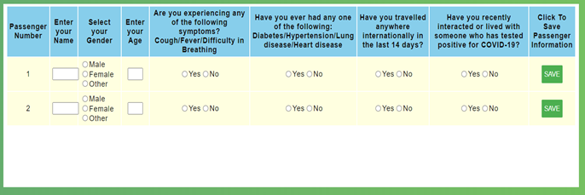
Symptom Checking Form, Result of Assessment
For more than 1 passenger, user has to fill the form containing same questions that were asked by the bot, number of rows depends on passenger count. All this information is gathered, analyzed and risk of passengers is evaluated. User is then directed to payment.

Slide 11

QR Code Generation
After clicking 'Generate QR Code' button, a unique QR code generated with email and timestamp is created and shown to the user. User can download the QR Code. The available seats count is updated in bus_schedule/metro_schedule/train_schedule database. Exact seat number and coach number incase of metro and train, is calculated.

Slide 12
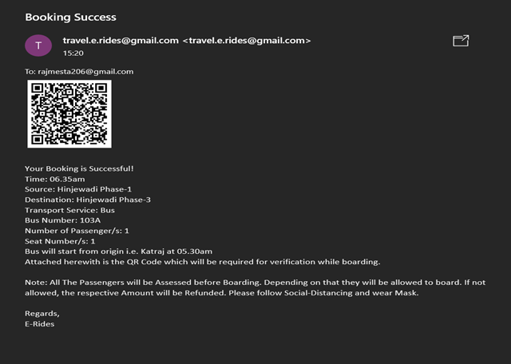
Booking Confirmation
All the information: source, destination, transport type, amount, passenger count, time, route number, seat and coach number, timestamp and risk is stored in booking database. Also, this information with the attached QR Code is mailed to the user.

Slide 13
Conclusion
The web-app has been built that will cater the needs of customers using public transport and avoid over-occupancy, follow social distancing criteria which will be beneficial in the current pandemic situation.
The web-app is available at the following link:
https://node-red-arceus.eu-gb.mybluemix.net/ui/

Slide 14
Thank You….

