Slide 1

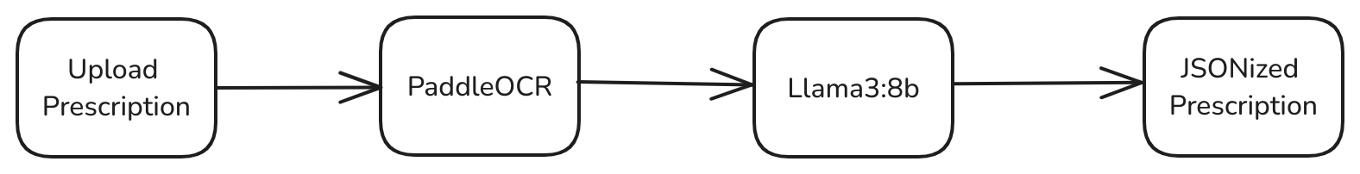


Pill Chime
Never miss a dose
Team: Alice in Tensorland
PRIMARY CONTROL FLOW
THE MIRACLE OF PLWF

Slide 2
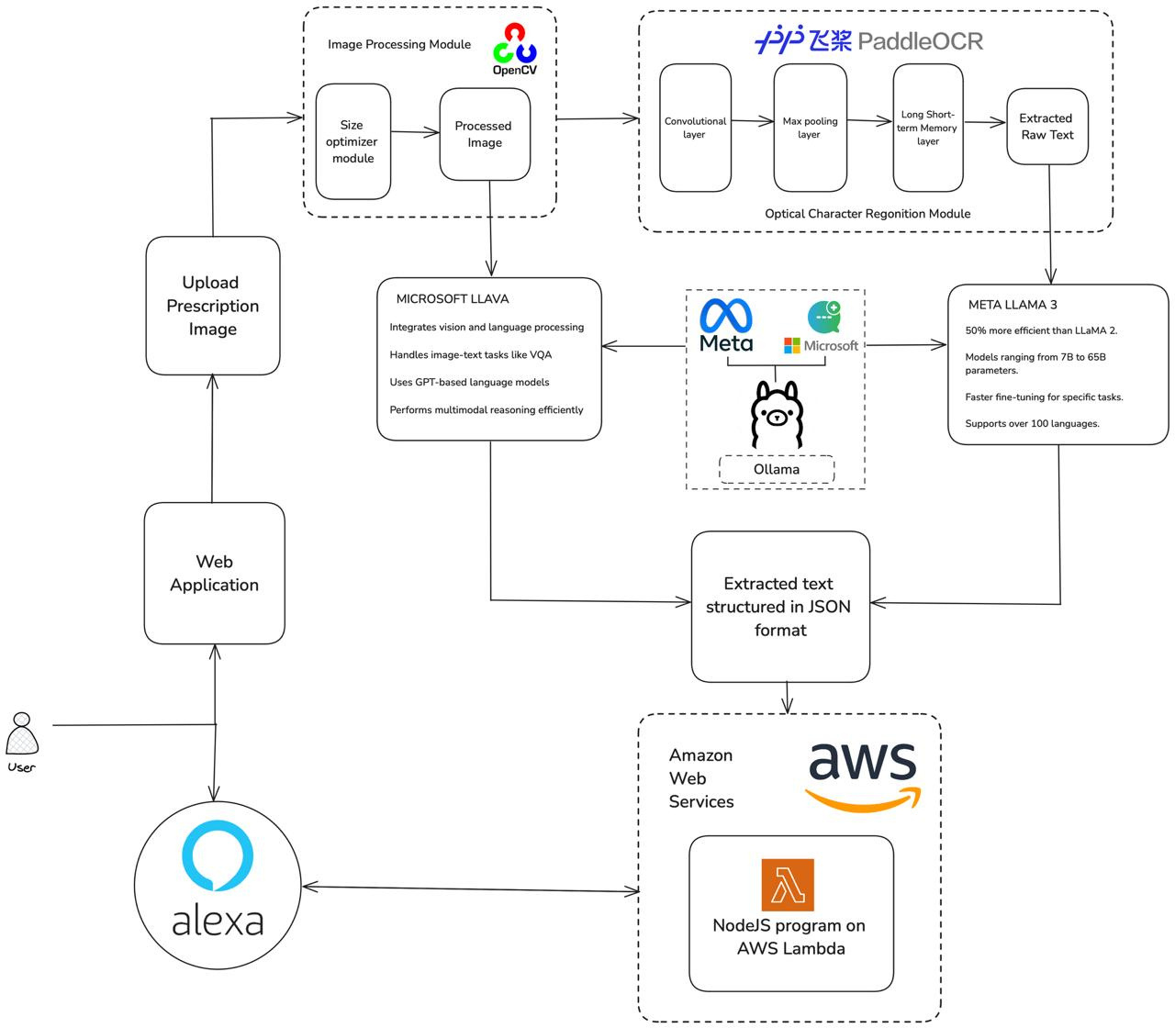


Architechture Key Points
OpenCV and PaddleOCR for accurate text extraction.
Llama 3(8b) : Advanced models for structured prescription parsing.
Alexa Automation: Auto-schedules medication reminders via AWS Lambda.

Slide 3
