Slide 1
MALIGNANT COMMENTS CLASSIFIER PROJECT
Submitted by :
SHUBHAM SHUKLA

Slide 2
INTRODUCTION

Slide 3
BUSINESS PROBLEM FRAMING
The proliferation of social media enables people to express their opinions widely online. However, at the same time, this has resulted in the emergence of conflict and hate, making online environments uninviting for users. Although researchers have found that hate is a problem across multiple platforms, there is a lack of models for online hate detection.
Online hate, described as abusive language, aggression, cyberbullying, hatefulness and many others has been identified as a major threat on online social media platforms. Social media platforms are the most prominent grounds for such toxic behavior.
Our goal is to build a prototype of online hate and abuse comment classifier which can used to classify hate and offensive comments so that it can be controlled and restricted from spreading hatred and cyberbullying.

Slide 4
CONCEPTUAL BACKGROUND OF THE DOMAIN PROBLEM
In the past few years its seen that the cases related to social media hatred have increased exponentially. The social media is turning into a dark venomous pit for people now a days. Online hate is the result of difference in opinion, race, religion, occupation, nationality etc. In social media the people spreading or involved in such kind of activities uses filthy languages, aggression, images etc. to offend and gravely hurt the person on the other side. This is one of the major concerns now.
The result of such activities can be dangerous. It gives mental trauma to the victims making their lives miserable. People who are not well aware of mental health online hate or cyber bullying become life threatening for them. Such cases are also at rise. It is also taking its toll on religions. Each and every day we can see an incident of fighting between people of different communities or religions due to offensive social media posts.

Slide 5
MOTIVATION FOR THE PROBLEM UNDERTAKEN
The project is provided to me by FlipRobo as a part of the internship programme. The exposure to real world data and the opportunity to deploy my skillset in solving a real time problem has been the primary objective. However, the motivation for taking this project was that it is relatively a new field of research. Here we have many options but less concrete solutions. The main motivation is to build a prototype of online hate and abuse comment classifier which can used to classify hate and offensive comments so that it can be controlled and restricted from spreading hatred and cyberbullying.

Slide 6
ANALYTICAL PROBLEM
FRAMING

Slide 7
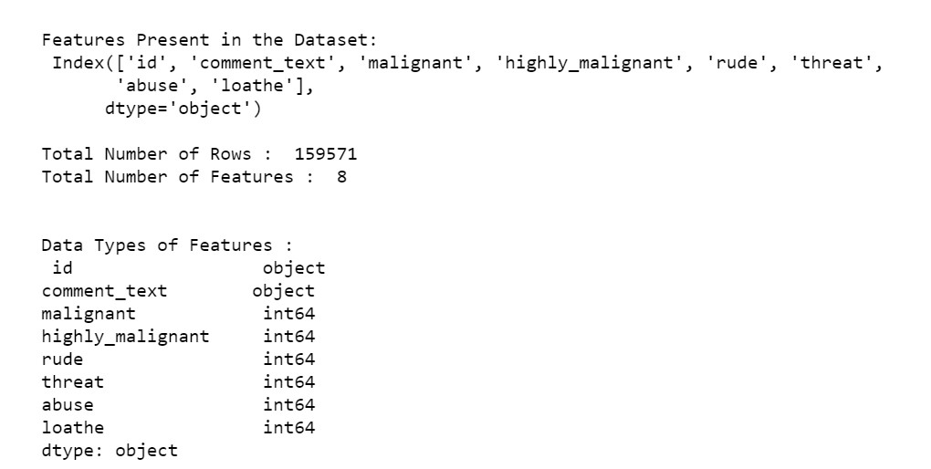
DATA SOURCES AND THEIR FORMATS
The data was provided by FlipRobo in CSV format. After loading the training dataset into Jupyter Notebook using Pandas and it can be seen that there are eight columns named as: id, comment_text, malignant, highly_malignant, rude, threat, abuse and loathe.

Slide 8
DATA PREPROCESSING
For Data pre-processing we did some data cleaning, where we used wordNet lemmatizer to clean the words and removed special characters using Regexp Tokenizer and filter the words by removing stop words and then used lemmatizers and joined and return the filtered words.
Used TFIDF vectorizer to convert those text into vectors, and split the data and into test and train and trained various Machine learning algorithms.

Slide 9
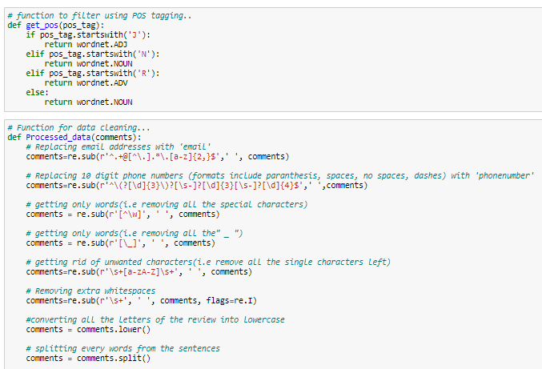
DATA PREPROCESSING

Slide 10
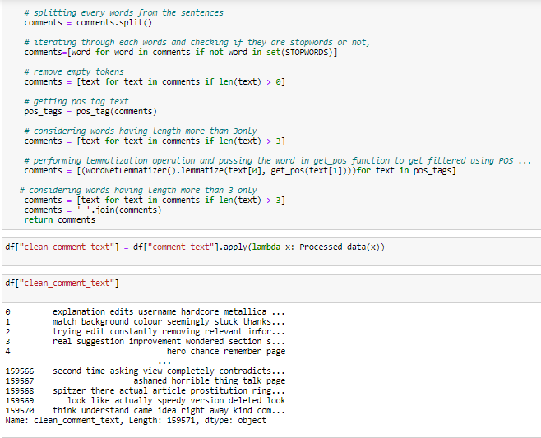
DATA PREPROCESSING DONE

Slide 11
HARDWARE AND SOFTWARE REQUIREMENTS AND TOOLS USED
SOFTWARE:
Jupyter Notebook (Anaconda 3) – Python
Microsoft Office 365

Slide 12
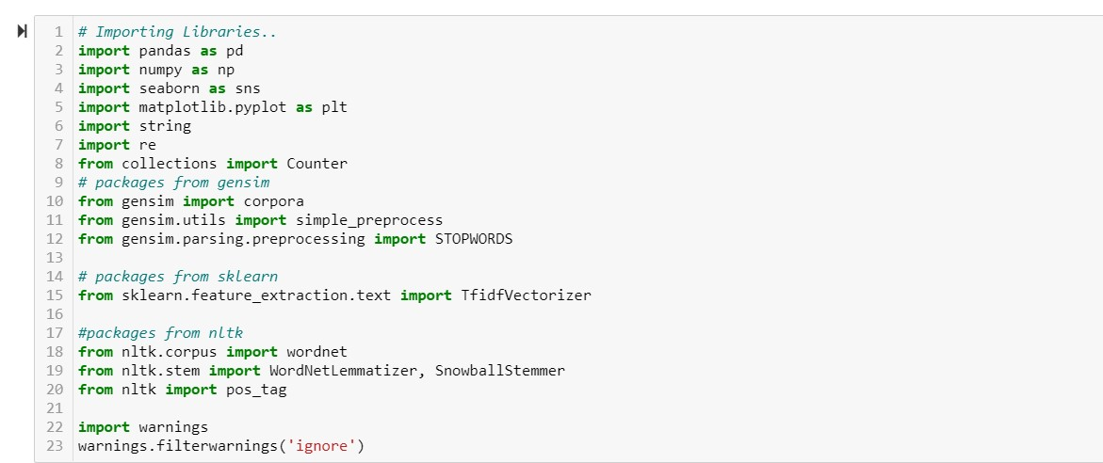
LIBRARIES-:

Slide 13
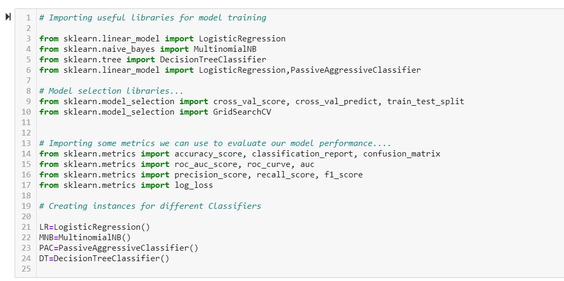

Slide 14
MODEL/S DEVELOPMENT
AND
EVALUATION

Slide 15
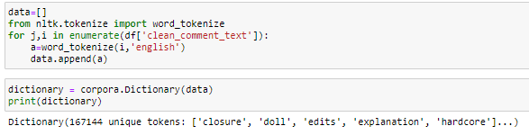
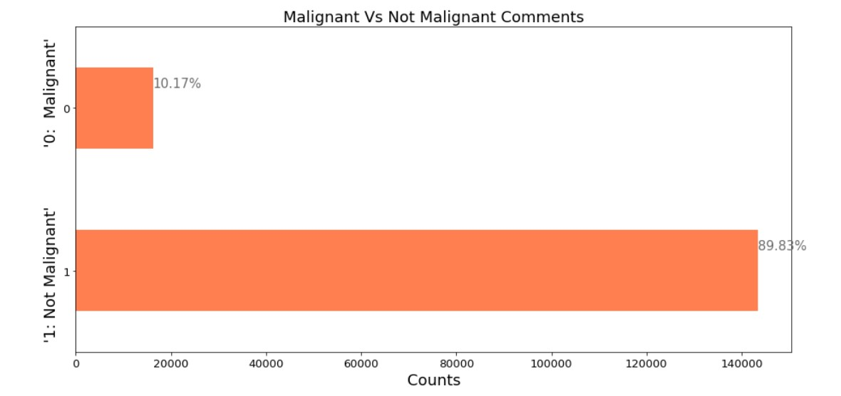
IDENTIFICATION OF POSSIBLE PROBLEM-SOLVING APPROACHES (METHODS)

Slide 16
TESTING OF IDENTIFIED APPROACHES (ALGORITHMS)
The algorithms we used for the training and testing are as follows:-
Logistic Regression
Decision Tree Classifier
Multinomial NB
Passive Aggressive Classifier

Slide 17
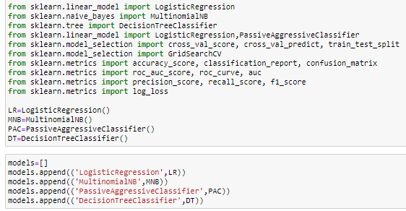
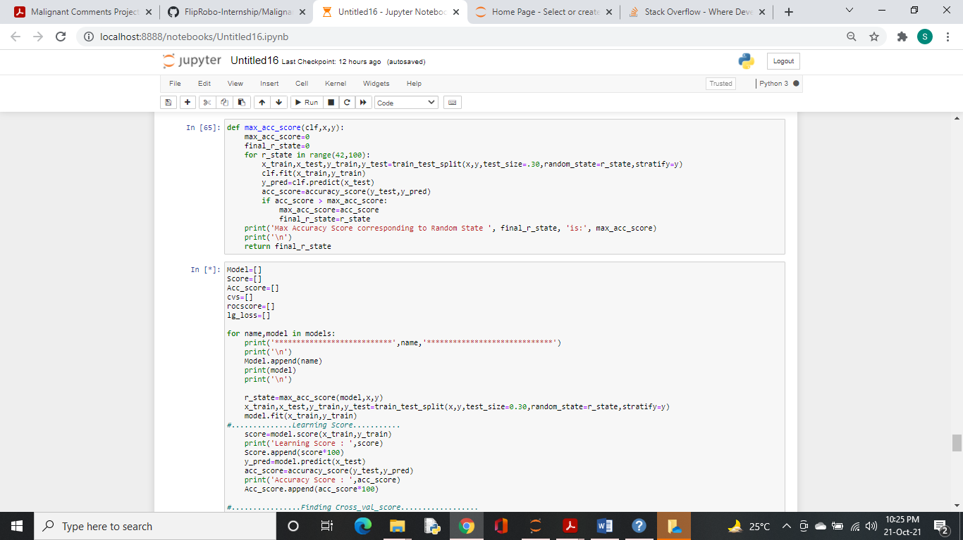
MODEL BUILDING

Slide 18
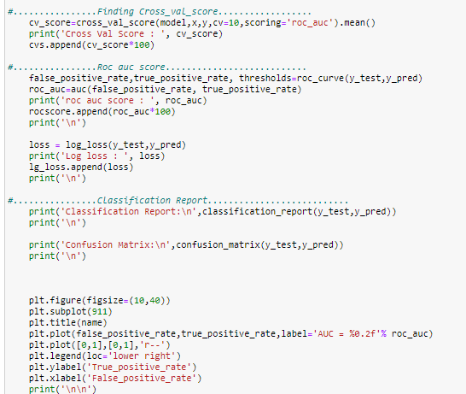

Slide 19
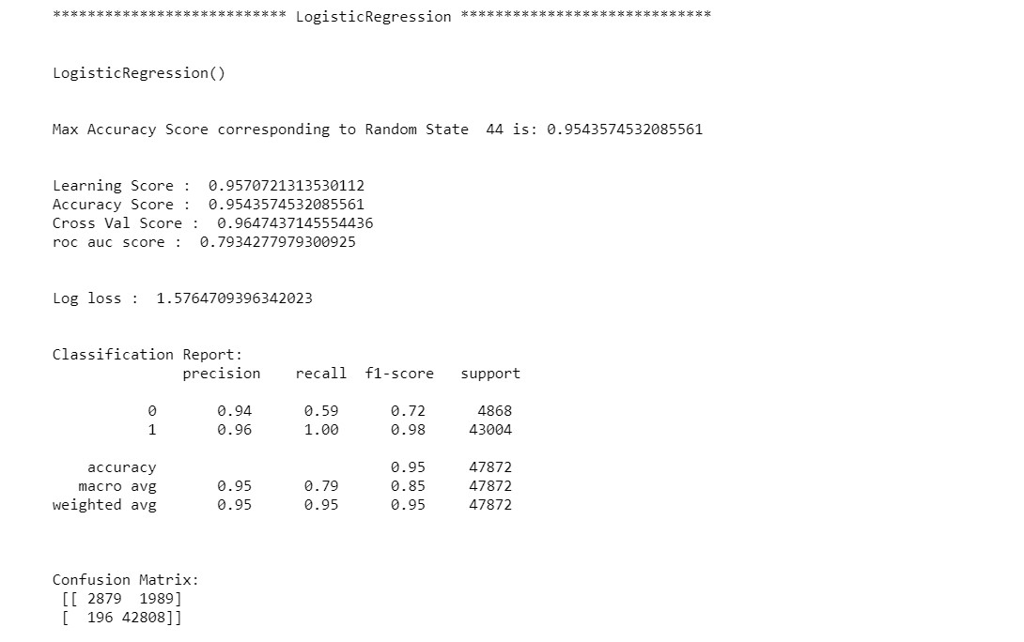

Slide 20
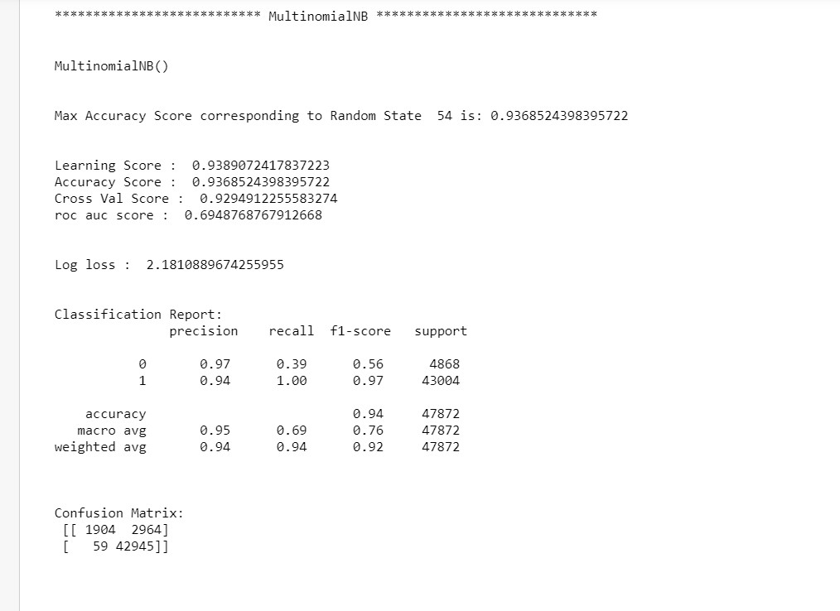

Slide 21
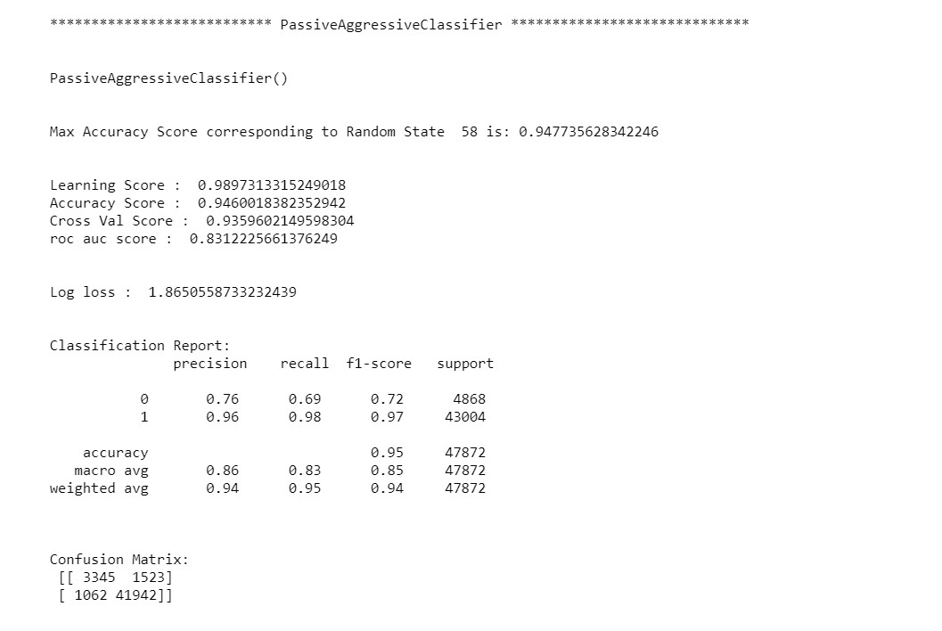

Slide 22
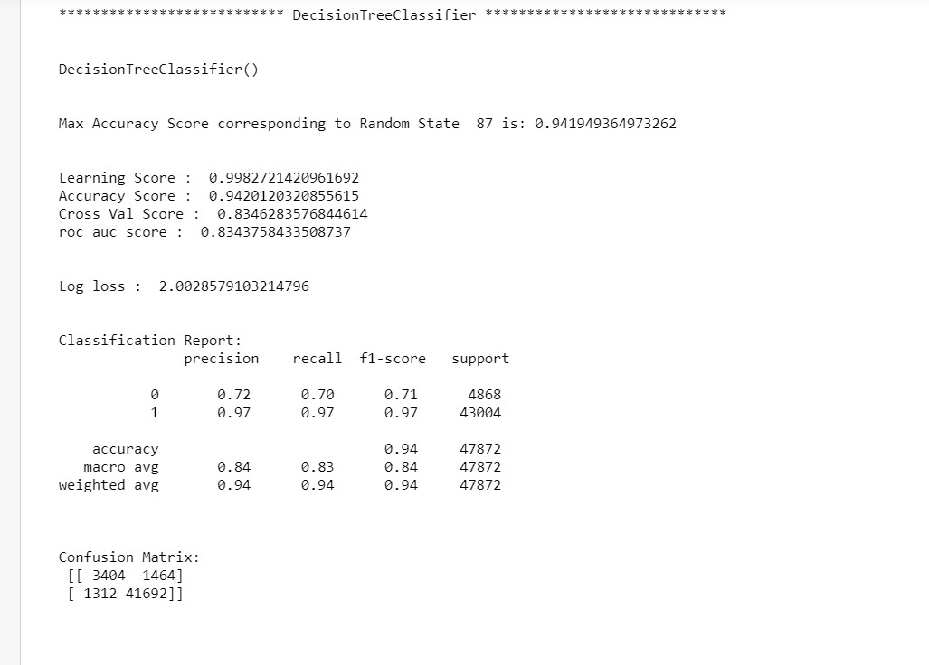

Slide 23
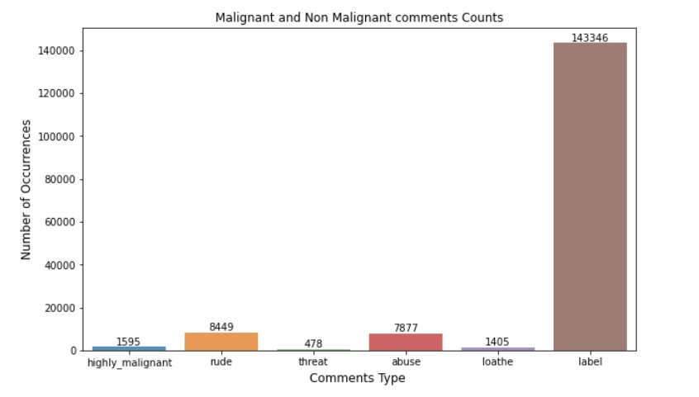
VISUALIZATIONS

Slide 24
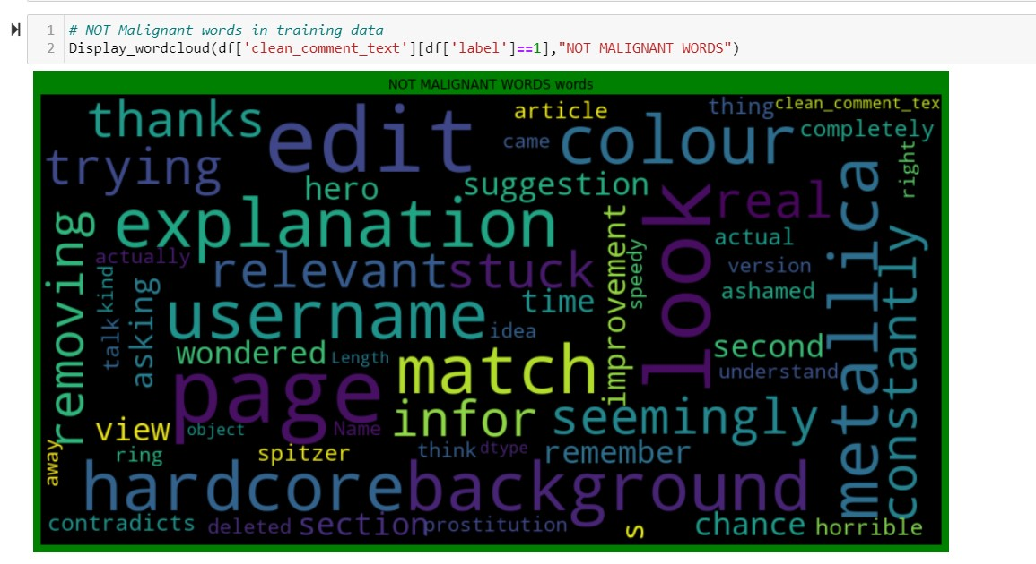
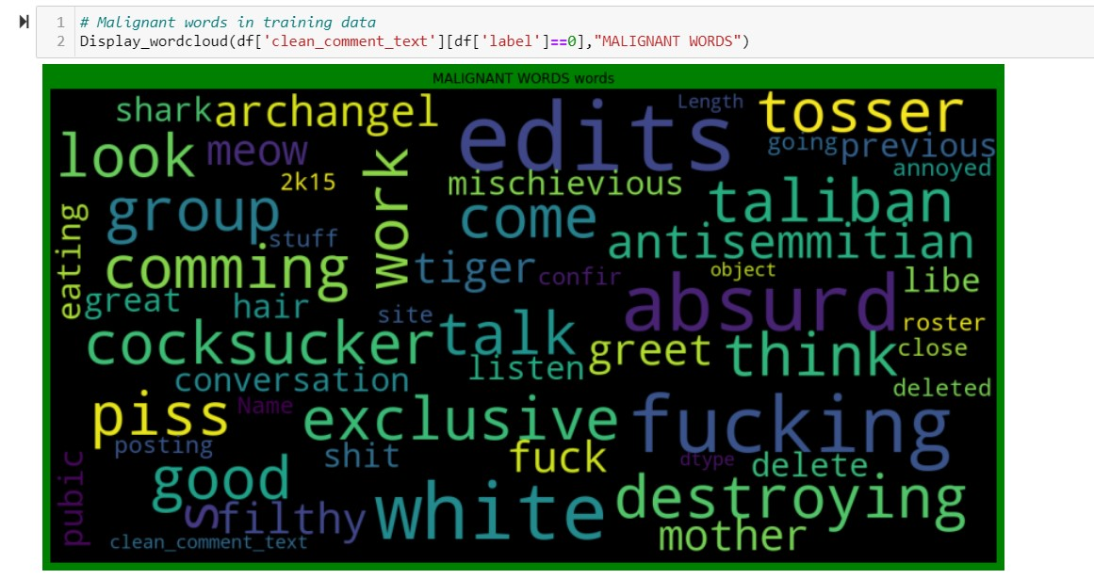

Slide 25
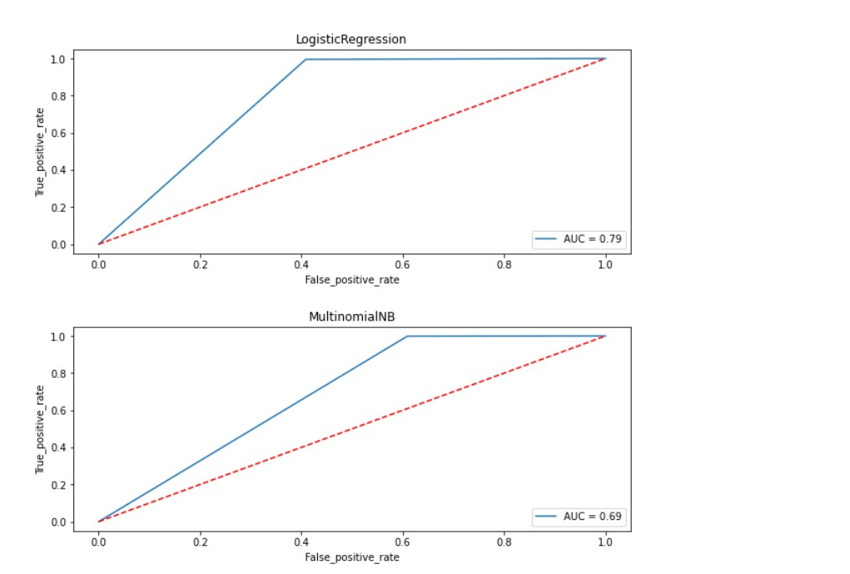

Slide 26
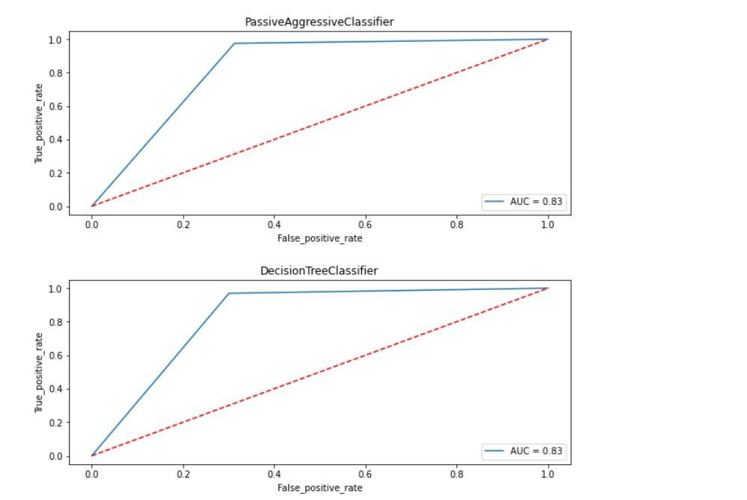

Slide 27
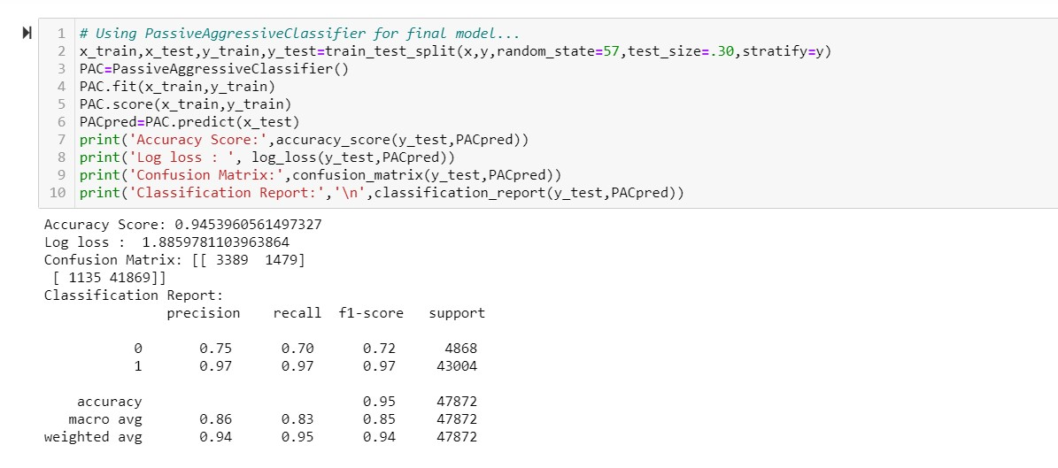
OBSERVATION
From the above visualization and matrices found that the Passive Aggressive Classifier performed the best AUC_ROC_SCORE.

Slide 28
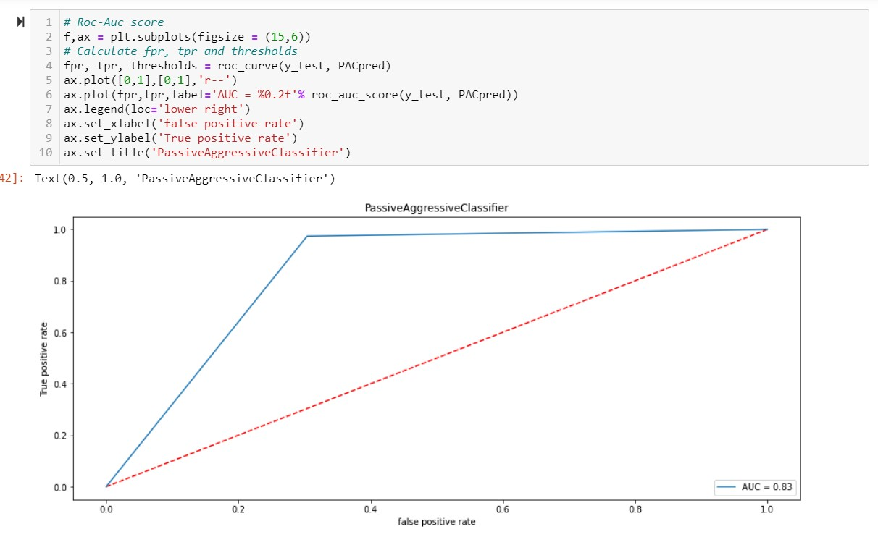
OBSERVATION

Slide 29
CONCLUSION

Slide 30
KEY FINDINGS AND CONCLUSIONS OF THE STUDY
Online hate, described as abusive language, aggression, cyberbullying, hatefulness and many others has been identified as a major threat on online social media platforms. Social media platforms are the most prominent grounds for such toxic behaviour.
From the above analysis the below mentioned results were achieved which depicts the chances and conditions of a comment being a hateful comment or a normal comment. With the increasing popularity of social media, more and more people consume feeds from social media and due differences they spread hate comments to instead of love and harmony. It has strong negative impacts on individual users and broader society.

Slide 31
LEARNING OUTCOMES OF THE STUDY IN RESPECT OF DATA SCIENCE
It is possible to classify the comments content into the required categories of Malignant and Non Malignant. However, using this kind of project an awareness can be created to know what is good and bad. It will help to stop spreading hatred among people.

Slide 32
LIMITATIONS OF THIS WORK AND SCOPE FOR FUTURE WORK
Machine Learning Algorithms like Decision Tree Classifier took enormous amount of time to build the model and Ensemble techniques were taking a lot more time thus I have not included Ensemble models.
Using Hyper-parameter tuning would have resulted in some more accuracy.
Every effort has been put on it for perfection but nothing is perfect and this project is of no exception. There are certain areas which can be enhanced. Comment detection is an emerging research area with few public datasets. So, a lot of works need to be done on this field.

Slide 33
THANKYOU

