Slide 1


Slide 2
What is AppScale
Framework that provides Open source Cloud Computing Platform(PaaS)
Offers platform for Google App Engine applications
Provides mechanisms to debug and profile applications as needed
AppScale is developed and maintained by AppScale Systems, Inc., based in Santa Barbara, California

Slide 3
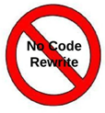
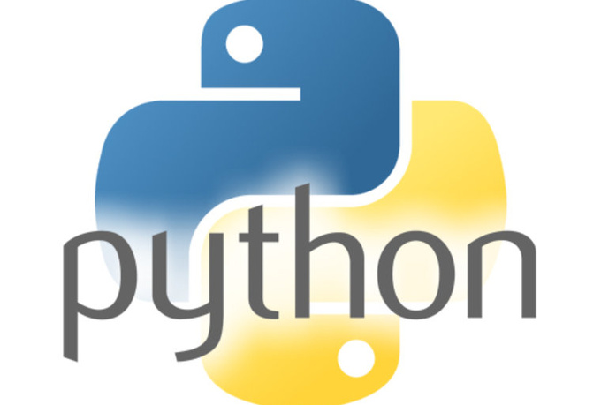
API-compatible with GAE
    Execute python, Java, Go, GAE applications without modification.

Slide 4
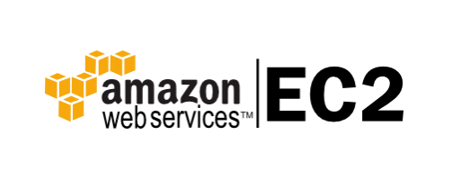

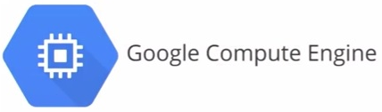
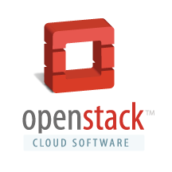
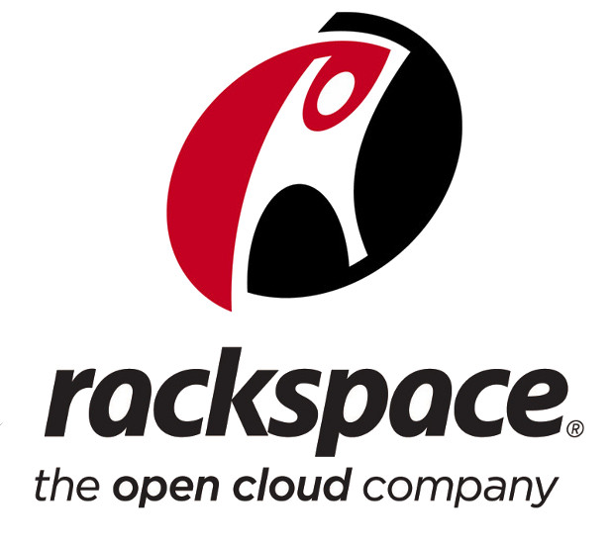

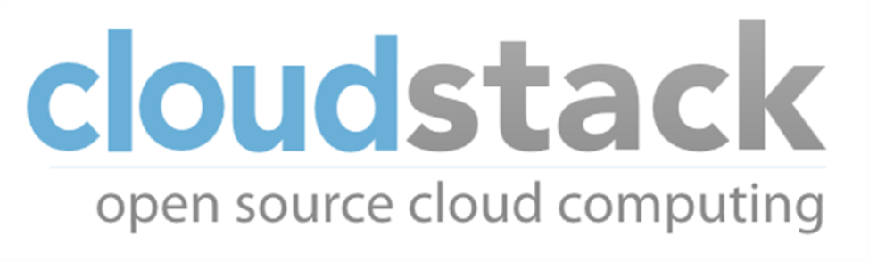
RUNS OVER CLOUDS

Slide 5

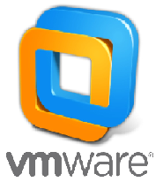

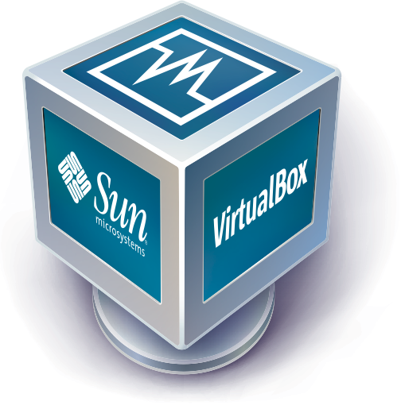
ALSO ON..

Slide 6
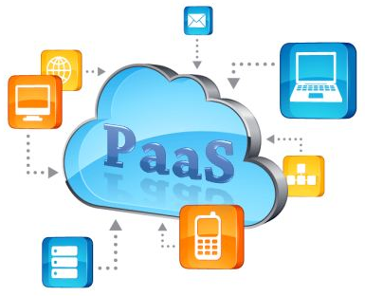
Some other platform as a service (PAAS) to check out
ownCloud
Appistry's CloudIQ
gCloud3
OpenStack
Vmware vCloud Suite

Slide 7

Appscale tools
A set of command-line tools that can be used to interact with AppScale
Automates the installation and manipulation of the AppScale system

Slide 8


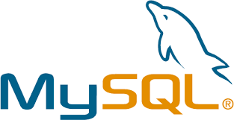

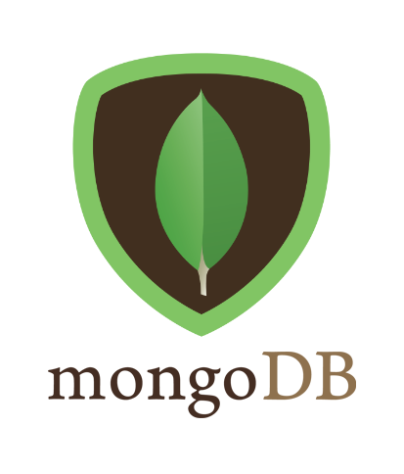
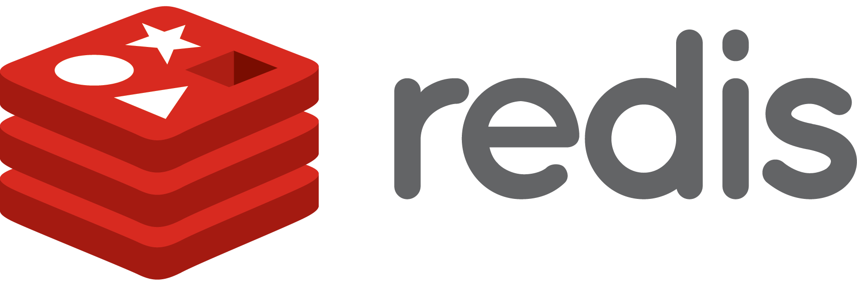
Database support

Slide 9
Starting AppScale

Slide 10
Basic requirements:
A virtual machine for deploying apps
  Used VirtualBox
Appscale tools
  For using appscale
A google app
A database connection

Slide 11
Steps
About AppScale: https://github.com/AppScale/appscale/wiki
Running appscale on virtualbox: https://github.com/AppScale/appscale/wiki/AppScale-on-VirtualBox
STEP 1: Install virtualbox
  sudo apt-get install virtualbox
STEP 2: Install vagrant (computer software for creating and configuring virtual development environments)
  Go to http://www.vagrantup.com/downloads and download the compatible version
  Run: sudo dpkg -i vagrant_1.7.2_x86_64.deb
  Check if installed: vagrant –v

Slide 12
STEP 3: Register the image with Vagrant
  mkdir -p ~/appscale
  cd ~/appscale
  vagrant init appscale/releases
STEP 4: Start your virtual machine
  Run: vagrant init
  Places Vagrantfile in your directory
STEP 5: Edit the Vagrantfile
  Uncomment: config.vm.network :private_network, ip: "192.168.33.10“
  Uncomment:
config.vm.provider :virtualbox do |vb|
vb.customize ["modifyvm", :id, "--memory", "3072"]
end
  Do not change if the syntax is different in the documentation (website), use the syntax in the Vagrantfile

Slide 13
give local path for downloading vbox
  edit Vagrantfile and modify:
config.vm.box = "file:///path to appscale-2.2.0-vbox.box“
STEP 6: Start the AppScale virtual machine
  vagrant up
  vagrant ssh (now you're in the VM as the "vagrant" user)
  sudo -s passwd (change the root password)
  exit (exit out of the VM and back to your local machine)

Slide 14
STEP 7: Deploy AppScale over the VM
  https://github.com/AppScale/appscale-tools/wiki/Installing-the-AppScale-Tools-on-Ubuntu-Precise
  Download and place it in a folder.
  Run commands:
    sudo su
    unzip appscale-tools-2.1.0.zip
    cd appscale-tools-2.1.0/debian
    bash appscale_build.sh
  export PATH=$PATH:/usr/local/appscale-tools/bin

Slide 15
STEP 8: Create an AppScalefile
  Run command: appscale init cluster
  It should put an Appscalefile in your directory
STEP 9: Modify the AppScalefile
  ips_layout:
master : 192.168.33.10
appengine: 192.168.33.10
database: 192.168.33.10
zookeeper: 192.168.33.10
STEP 10: Start AppScale
  Run command: appscale up
STEP 11: Deploy an app
  Run command: appscale deploy ~/path-to-your-app

Slide 16
Database connectivity

Slide 17
NDB
Upload via GUI:
Login to appscale
Upload app button
Cloud status; click on the app
Done!

Slide 18
Database connectivity
ssh into the virtual machine
  Vagrant ssh
Install mysql-client and mysql-server into the virtual machine
Install interface “python-mysqldb”
For the app provided by us:
  Create database DatabaseLab
  Create tables info and marks
Deploy the app from the host machine

Slide 19
THE END!

