Slide 1


Slide 2
What is AppScale
Framework that provides Open source Cloud Computing Platform(PaaS)
Offers platform for Google App Engine applications
Provides mechanisms to debug and profile applications as needed
AppScale is developed and maintained by AppScale Systems, Inc., based in Santa Barbara, California

Slide 3
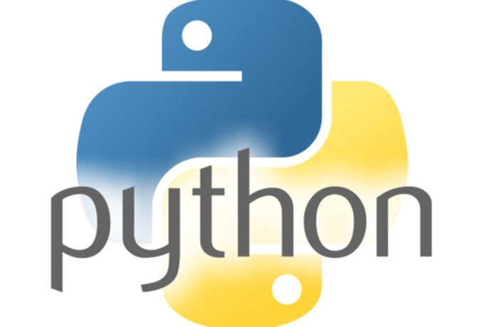
API-compatible with GAE
Execute python, Java, Go, GAE applications without modification.

Slide 4
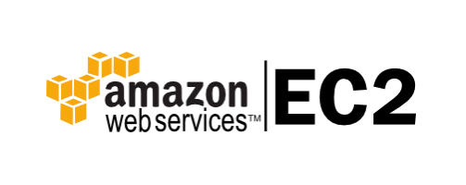

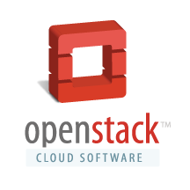
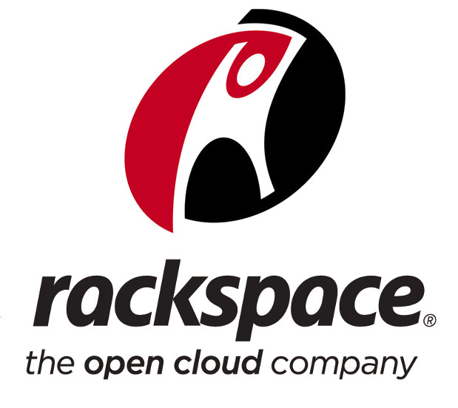

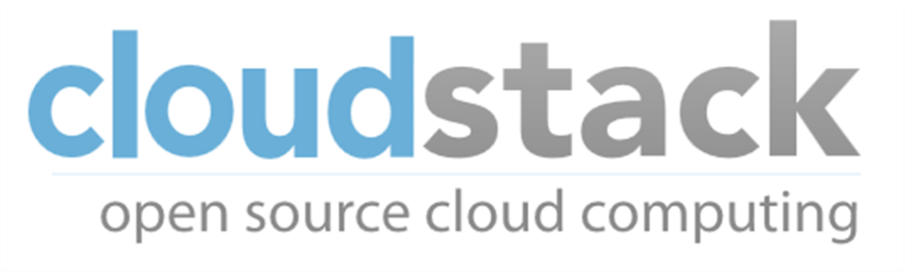
RUNS OVER CLOUDS

Slide 5

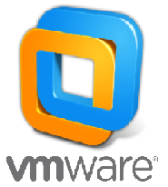
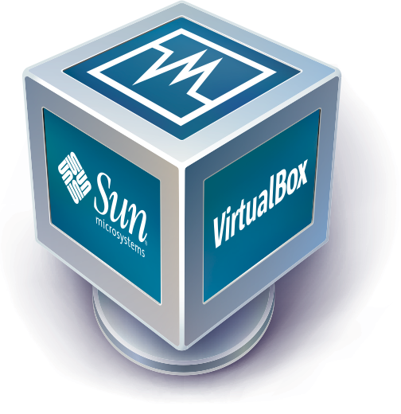
ALSO ON..

Slide 6
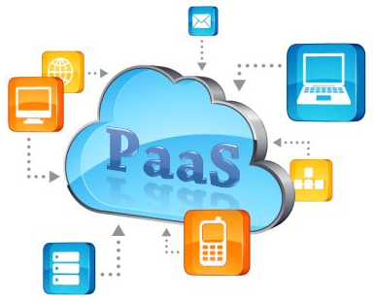
Some other platform as a service (PAAS) to check out
ownCloud
Appistry's CloudIQ
gCloud3
OpenStack
Vmware vCloud Suite

Slide 7

Appscale tools
A set of command-line tools that can be used to interact with AppScale
Automates the installation and manipulation of the AppScale system

Slide 8

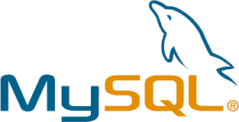

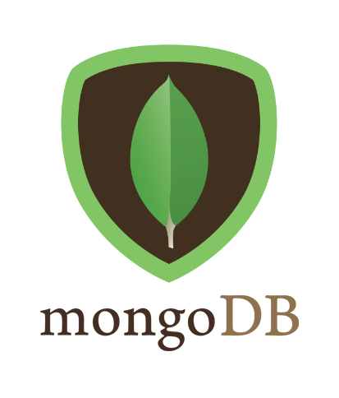
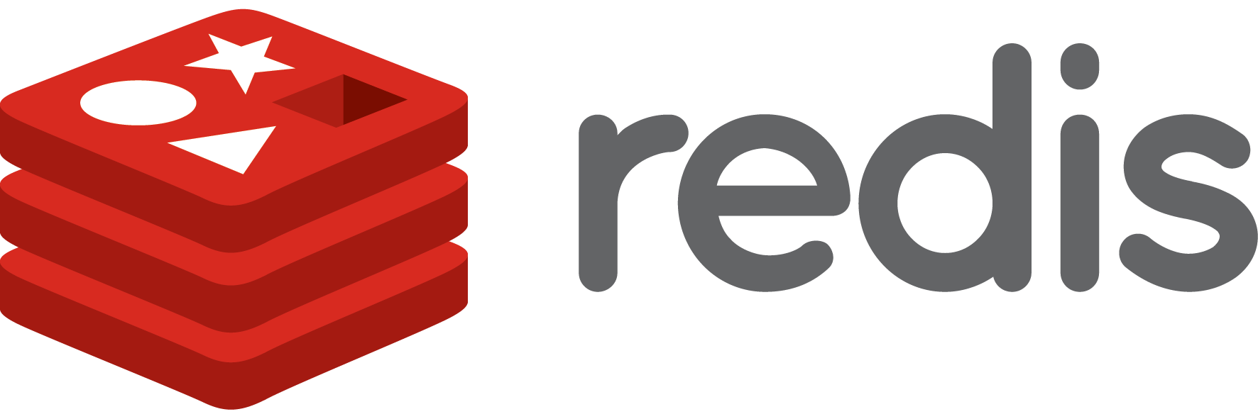
Database support

Slide 9
Starting AppScale

Slide 10
Basic requirements:
A virtual machine for deploying apps
Used VirtualBox
Appscale tools
For using appscale
A google app
A database connection

Slide 11
Steps
About AppScale: https://github.com/AppScale/appscale/wiki
Running appscale on virtualbox: https://github.com/AppScale/appscale/wiki/AppScale-on-VirtualBox
STEP 1: Install virtualbox
sudo apt-get install virtualbox
STEP 2: Install vagrant (computer software for creating and configuring virtual development environments)
Go to http://www.vagrantup.com/downloads and download the compatible version
Run: sudo dpkg -i vagrant_1.7.2_x86_64.deb
Check if installed: vagrant –v

Slide 12
STEP 3: Register the image with Vagrant
mkdir -p ~/appscale
cd ~/appscale
vagrant init appscale/releases
STEP 4: Start your virtual machine
Run: vagrant init
Places Vagrantfile in your directory
STEP 5: Edit the Vagrantfile
Uncomment: config.vm.network :private_network, ip: "192.168.33.10“
Uncomment:
config.vm.provider :virtualbox do |vb|
vb.customize ["modifyvm", :id, "--memory", "3072"]
end
Do not change if the syntax is different in the documentation (website), use the syntax in the Vagrantfile

Slide 13
give local path for downloading vbox
edit Vagrantfile and modify:
config.vm.box = "file:///path to appscale-2.2.0-vbox.box“
STEP 6: Start the AppScale virtual machine
vagrant up
vagrant ssh (now you're in the VM as the "vagrant" user)
sudo -s passwd (change the root password)
exit (exit out of the VM and back to your local machine)

Slide 14
STEP 7: Deploy AppScale over the VM
https://github.com/AppScale/appscale-tools/wiki/Installing-the-AppScale-Tools-on-Ubuntu-Precise
Download and place it in a folder.
Run commands:
sudo su
unzip appscale-tools-2.1.0.zip
cd appscale-tools-2.1.0/debian
bash appscale_build.sh
export PATH=$PATH:/usr/local/appscale-tools/bin

Slide 15
STEP 8: Create an AppScalefile
Run command: appscale init cluster
It should put an Appscalefile in your directory
STEP 9: Modify the AppScalefile
ips_layout:
master : 192.168.33.10
appengine: 192.168.33.10
database: 192.168.33.10
zookeeper: 192.168.33.10
STEP 10: Start AppScale
Run command: appscale up
STEP 11: Deploy an app
Run command: appscale deploy ~/path-to-your-app

Slide 16
Database connectivity

Slide 17
NDB
Upload via GUI:
Login to appscale
Upload app button
Cloud status; click on the app
Done!

Slide 18
Database connectivity
ssh into the virtual machine
Vagrant ssh
Install mysql-client and mysql-server into the virtual machine
Install interface “python-mysqldb”
For the app provided by us:
Create database DatabaseLab
Create tables info and marks
Deploy the app from the host machine

Slide 19
THE END!

