Slide 1
SYSTEM SIMULATION SS2020
SIR MODEL (COVID-19 analysis in R)
PRESENTED BY:
SHUBHAM SINHA (28344)

Slide 2
Overview
Introduction
Aggregated Data
Most infectected countries
Growth Rate
Live Map
SIR Model
GitHub repository Link

Slide 3
R
R is a programming language and free software environment for statistical computing and graphics supported by the R Foundation for Statistical Computing.
Packages are collections of R functions, data, and compiled code in a well-defined format. Package Used: covid19.analytics (JHU CCSE repository)

Slide 4
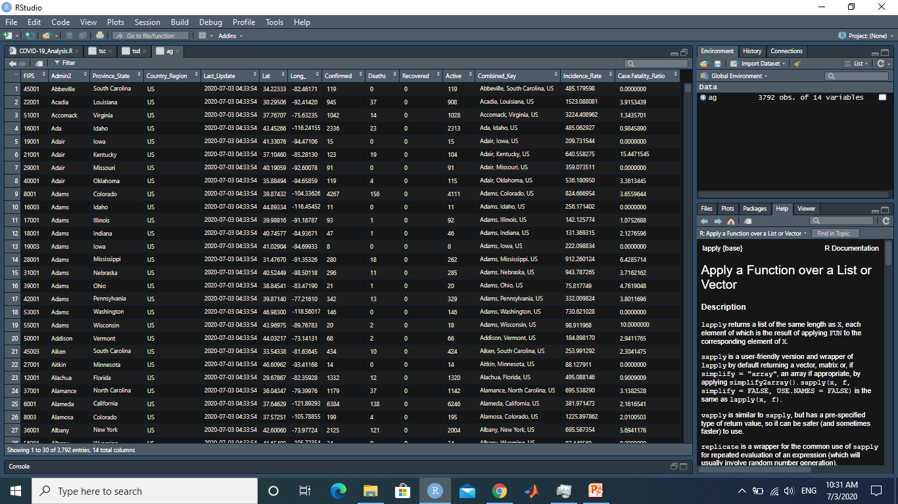
Aggregated data
ag <- covid19.data(
case = 'aggregated')

Slide 5
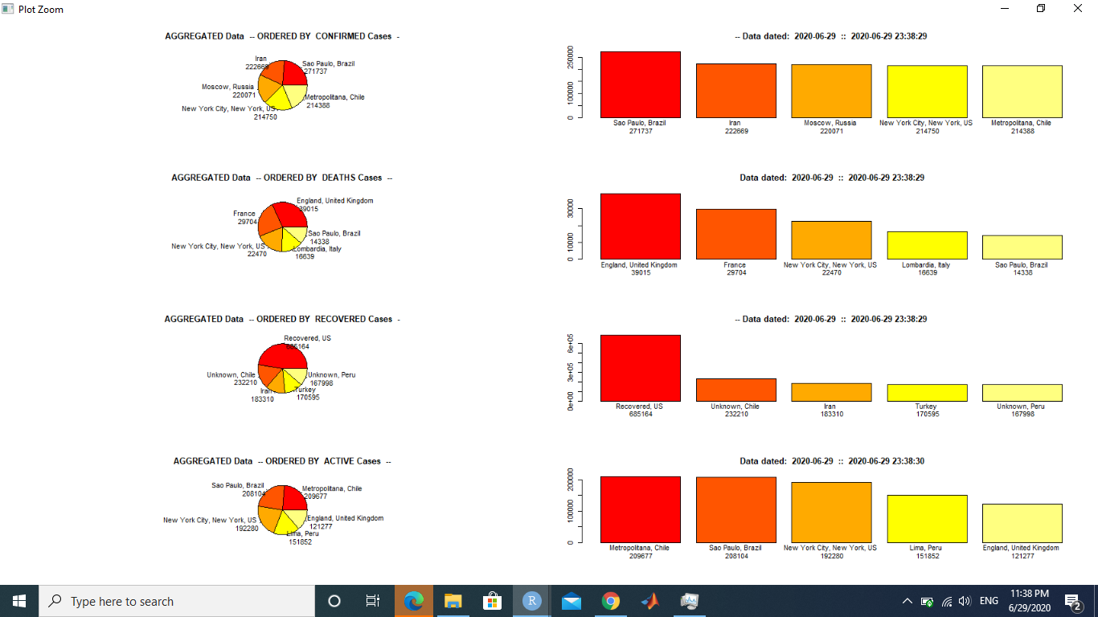
Most Infected Countries
tsc <- covid19.data(case = 'ts-confirmed') -> Reading data from https://raw.githubusercontent.com/CSSEGISandData/COVID-19/master/csse_covid_19_data/csse_covid_19_time_series/time_series_covid19_confirmed_global.csv Data retrieved on 2020-06-29 23:32:06 || Range of dates on data: 2020-01-22--2020-06-28 | Nbr of records: 266
report.summary(Nentries = 5,
graphical.output = T)

Slide 6
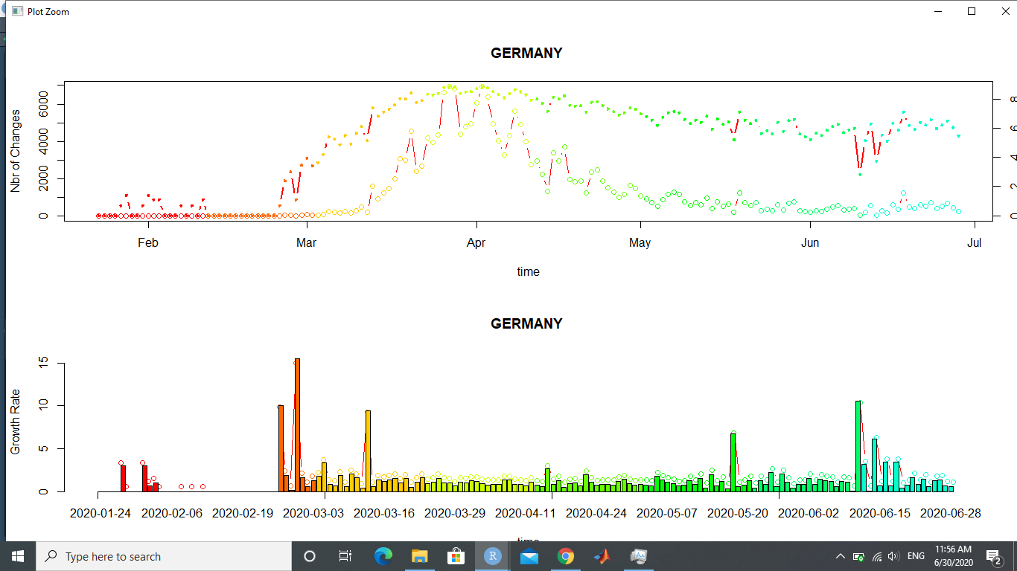
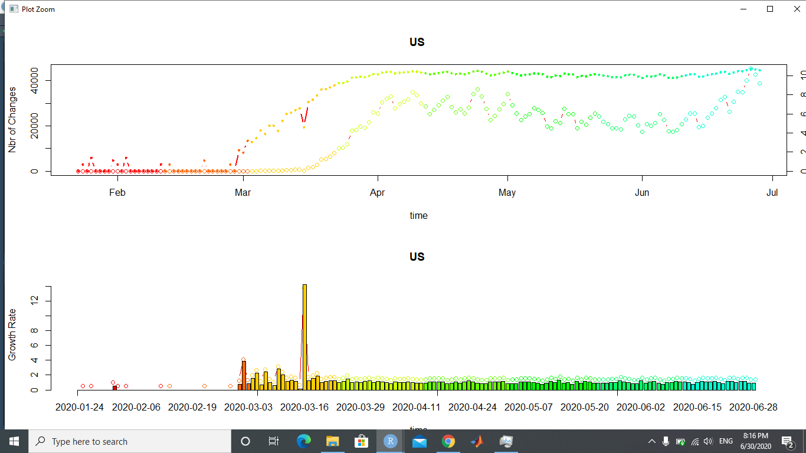
Growth Rate
growth.rate(tsc, geo.loc = 'Germany')
growth.rate(tsc, geo.loc = 'US’)

Slide 7
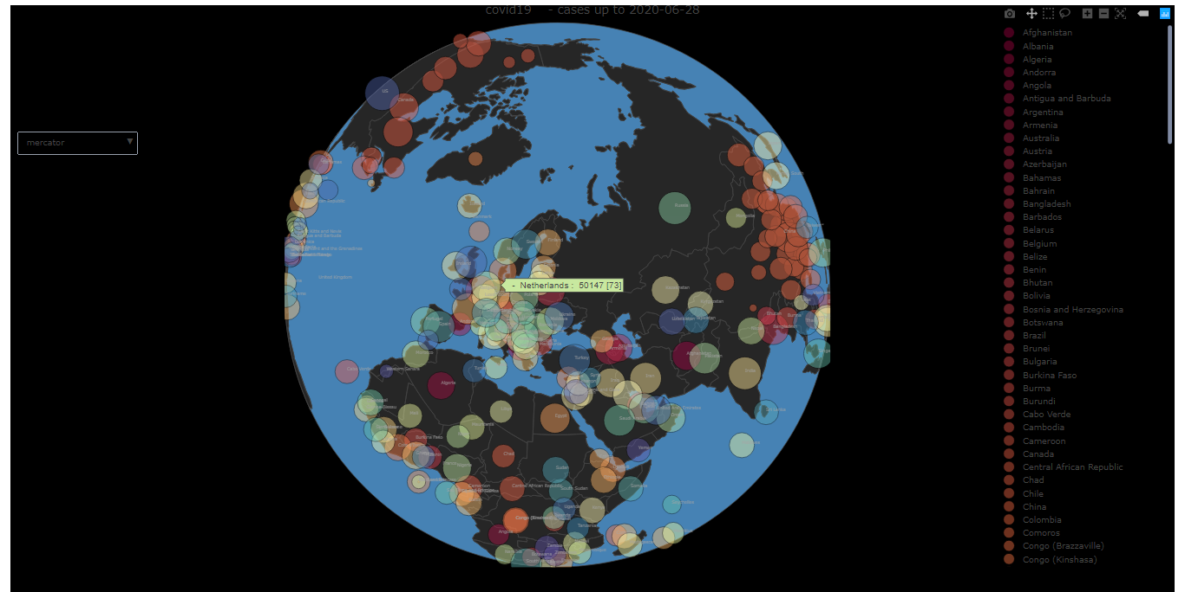
Live Map
live.map(tsc)

Slide 8
SIR analysis
An SIR model is an epidemiological model that computes the theoretical number of people infected with a contagious illness in a closed population over time.
S: Not infected yet, but are vulnerable to infection.
I: The number of infectious individuals and are capable of infecting susceptible individuals.
R for the number of removed (and immune) or deceased individuals.
Ref: https://mathworld.wolfram.com/SIRModel.html
https://en.wikipedia.org/wiki/Compartmental_models_in_epidemiology#:~:text=12%20External%20links-,The%20SIR%20model,The%20number%20of%20susceptible%20individuals.

Slide 9
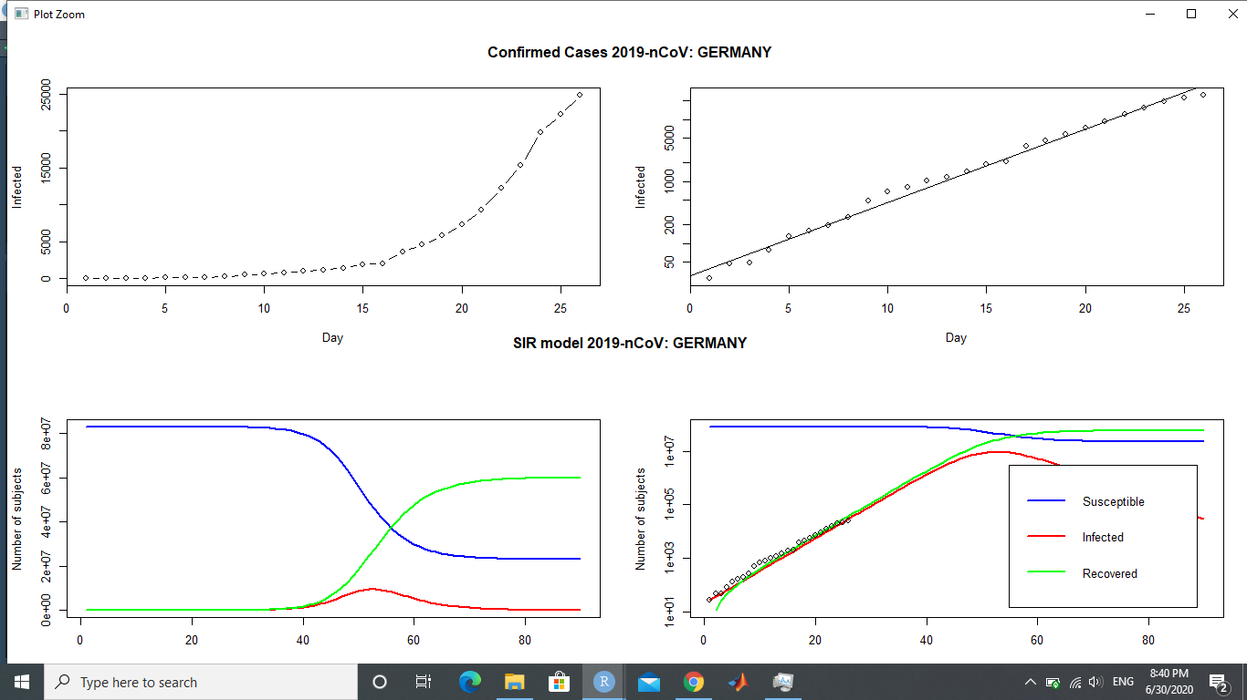
SIR analysis GERMANY
generate.SIR.model(tsc,
'Germany',
tot.population =
83000000)

Slide 10
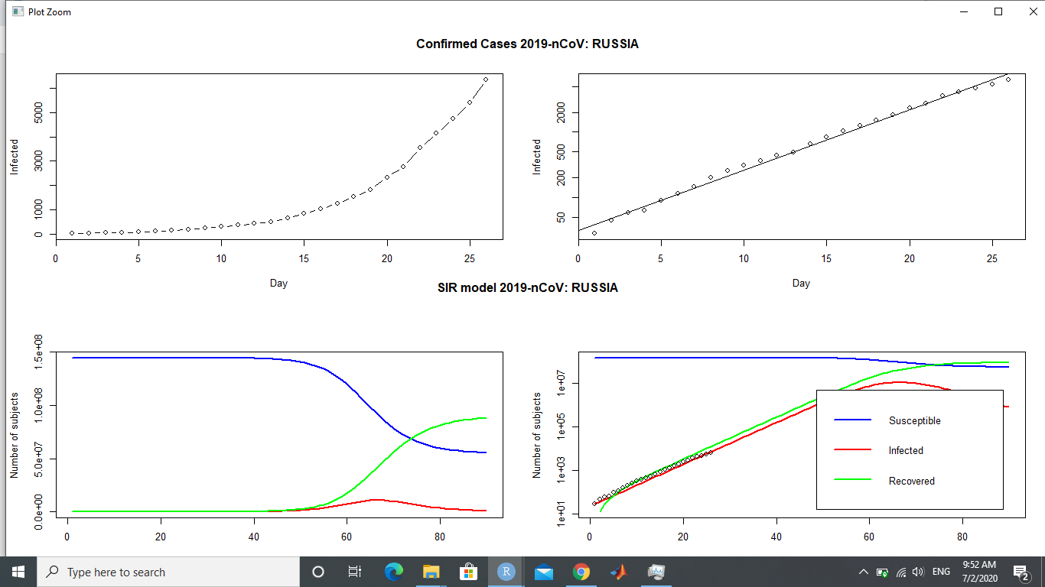
SIR analysis - RUSSIA
generate.SIR.model(tsc,
'Russia', tot.population
= 144500000)

Slide 11
GitHub Repository
The source file can be accessed via the below given link
https://github.com/shubhamsinha-127001/SystemSimulation

