Slide 1
SWIGGY BUSINESS INSIGHTS ANALYSIS (SQL + Power BI Project)
Name: Shubham Vivek Solse
Tools Used:
MySQL
Power BI
Excel
Date: 03/06/2026

Slide 2
Objective:
Analyze Swiggy food delivery data to identify:
Revenue trends
Customer ordering patterns
Restaurant performance
Dish performance
Geographic demand
Business recommendations
Tools Used | Purpose
Excel | Initial Data Review
SQL | Data Cleaning & Analysis
Power BI | Dashboard Development

Slide 3
Dataset Summary:
Table | Description
Orders | Transaction Data
Restaurants | Restaurant Details
Dishes | Dish Information
Dates | Date Dimension
Location | Geographic Data
Dataset Statistics:
197,240 Orders
993 Restaurants
28 Cities
243 Dates
Multiple Food Categories

Slide 4
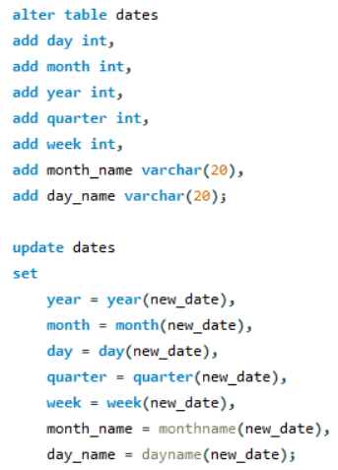
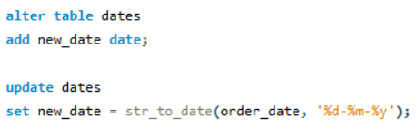
Data Cleaning:
Fixed inconsistent date formats and added new columns.

Slide 5
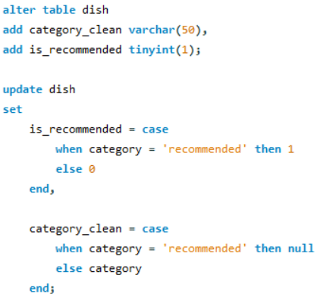
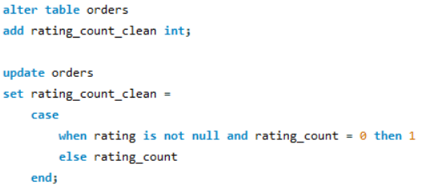
Data Cleaning:
Data Cleaning & Standardization:
Corrected inconsistent rating counts.
Separated recommendation flags from product categories.
Created standardized category values.
Generated binary recommendation indicators for analysis.

Slide 6
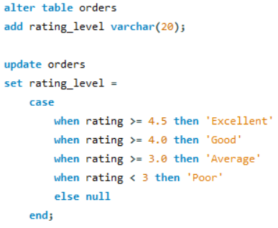
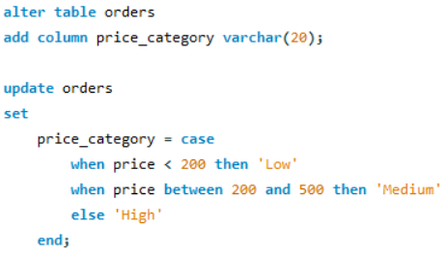
Data Transformation:
Created derived columns (Price Category and Rating Level) using business rules to enable segmentation and analysis.

Slide 7
SQL Business Questions Solved:
Business Questions:
Top Restaurants by Revenue
Top Dishes by Revenue
Growing Cities
Highest Order Density Areas
Restaurant Segmentation
Revenue vs Ratings
Churn Analysis
Recommendation Strategy
35+ SQL business questions solved using joins, aggregations and case statements.

Slide 8
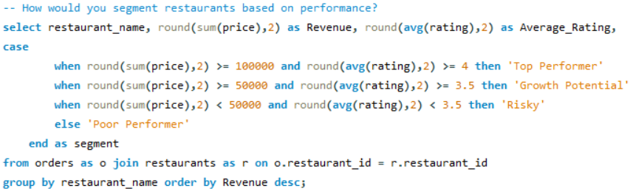
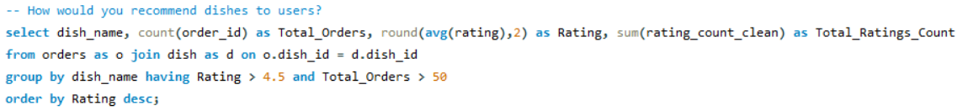
SQL Queries:

Slide 9
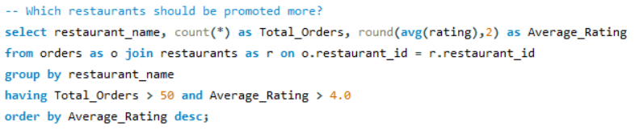
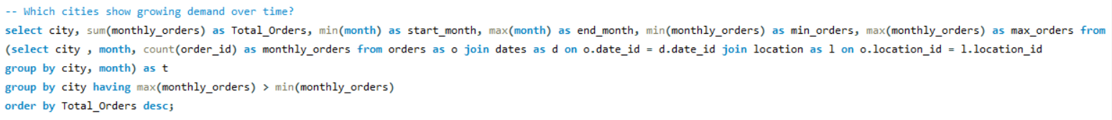
SQL Queries:

Slide 10
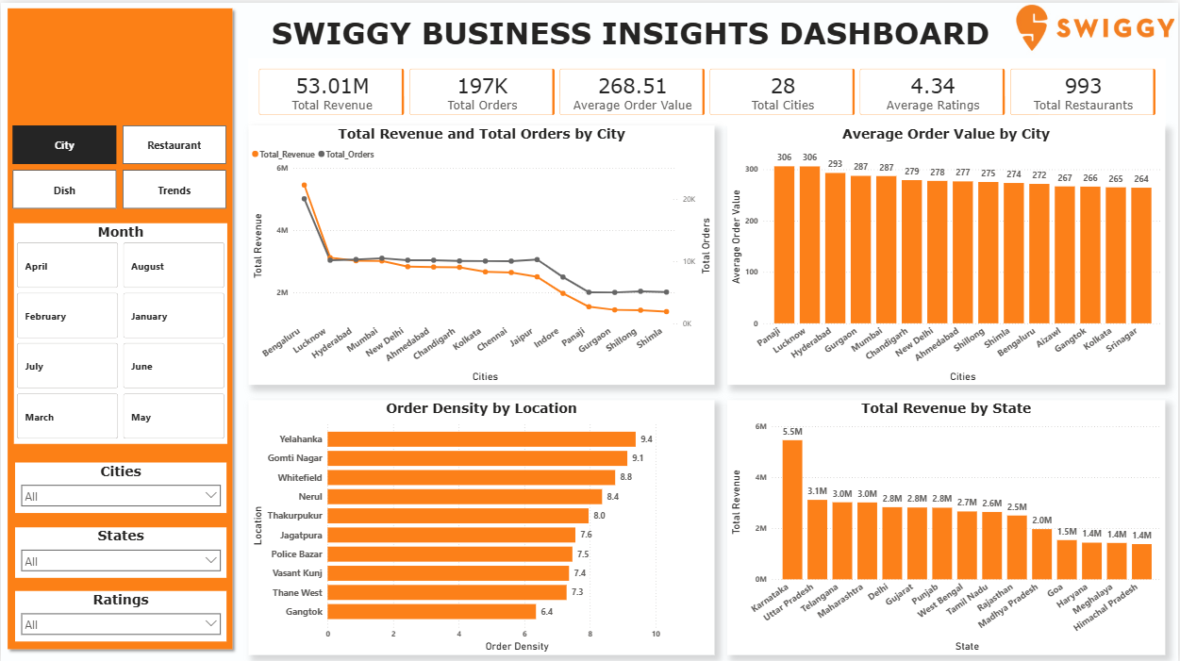
City Analysis Dashboard:

Slide 11
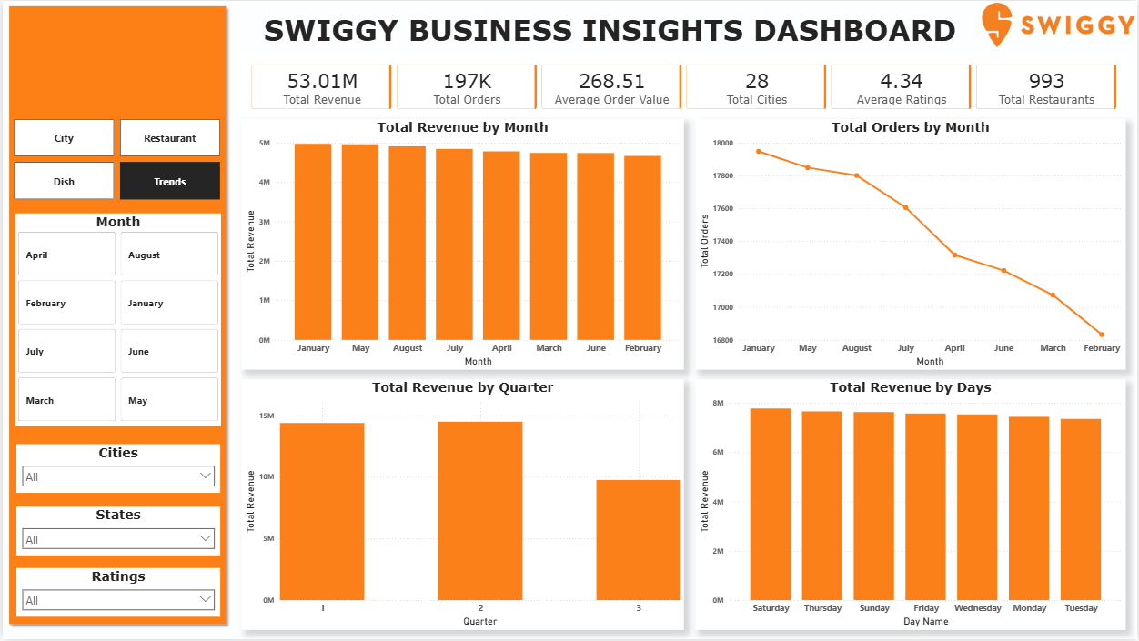
Trend Analysis Dashboard:

Slide 12
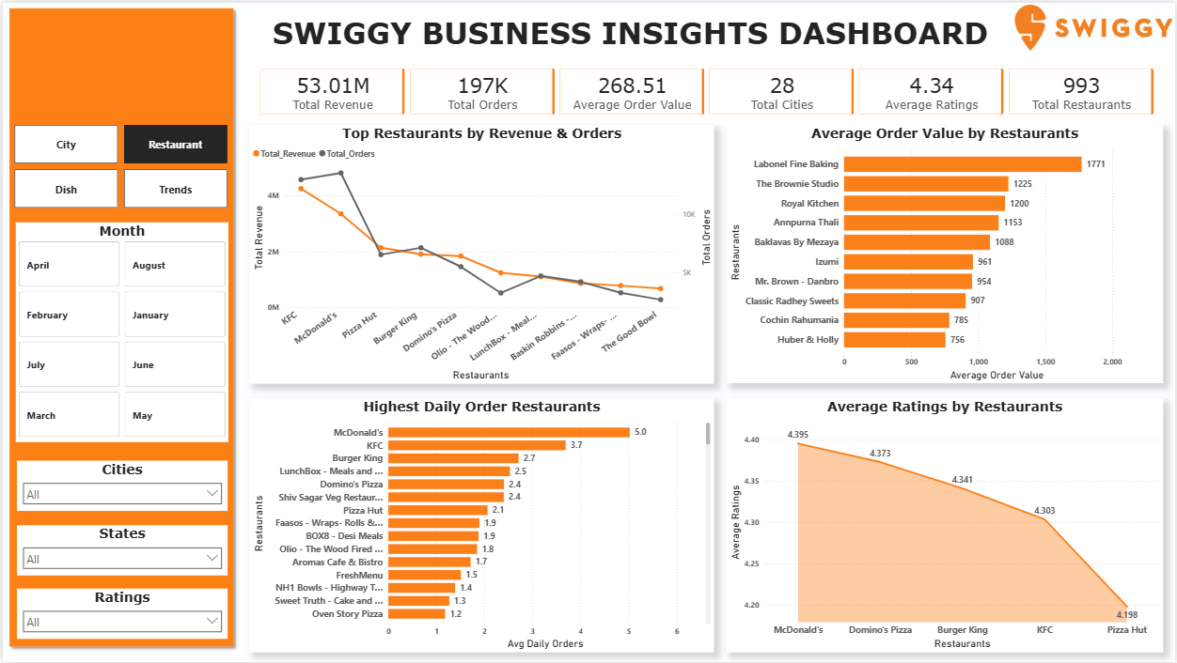
Restaurant Analysis Dashboard

Slide 13
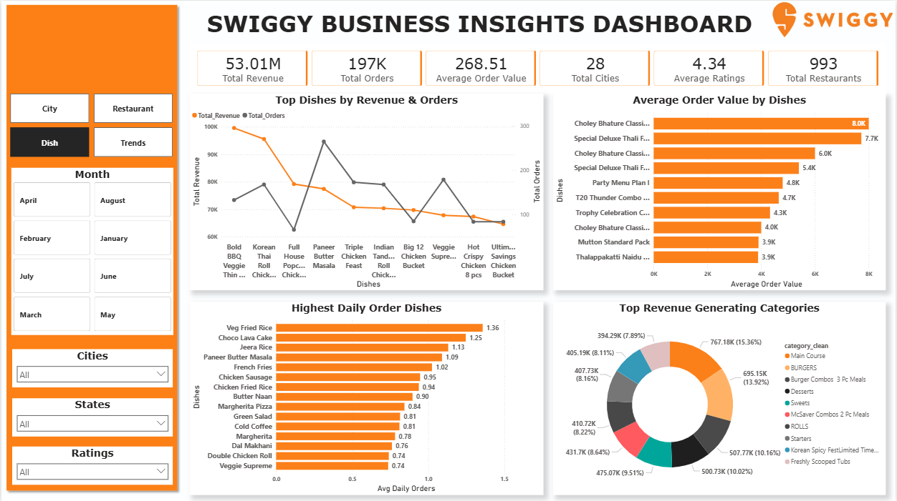
Dish Analysis Dashboard:

Slide 14
Business Recommendations:
Recommendations:
Promote high-rated low-order restaurants.
Focus marketing on high-density locations.
Expand successful restaurant partnerships.
Prioritize top-performing food categories.
Create campaigns in lower-performing cities.
Use recommendation engine based on ratings and order volume.

Slide 15
Project Conclusion:
Key Learnings:
SQL Data Cleaning
Joins and Aggregations
Business KPI Analysis
Power BI Dashboarding
Data Storytelling
Outcome:
Developed an end-to-end Food Delivery Analytics Solution using SQL and Power BI to support business decision-making.

