Slide 1
Exploring trends using Topic Modelling
Bachelor’s of Technology Project under the supervision of : Professor Akhilesh Kumar
(Department of Industrial and System Engineering)
By: Shubham Sonal (16NA10028)
(Department of Ocean Engineering and Naval Architecture)

Slide 2
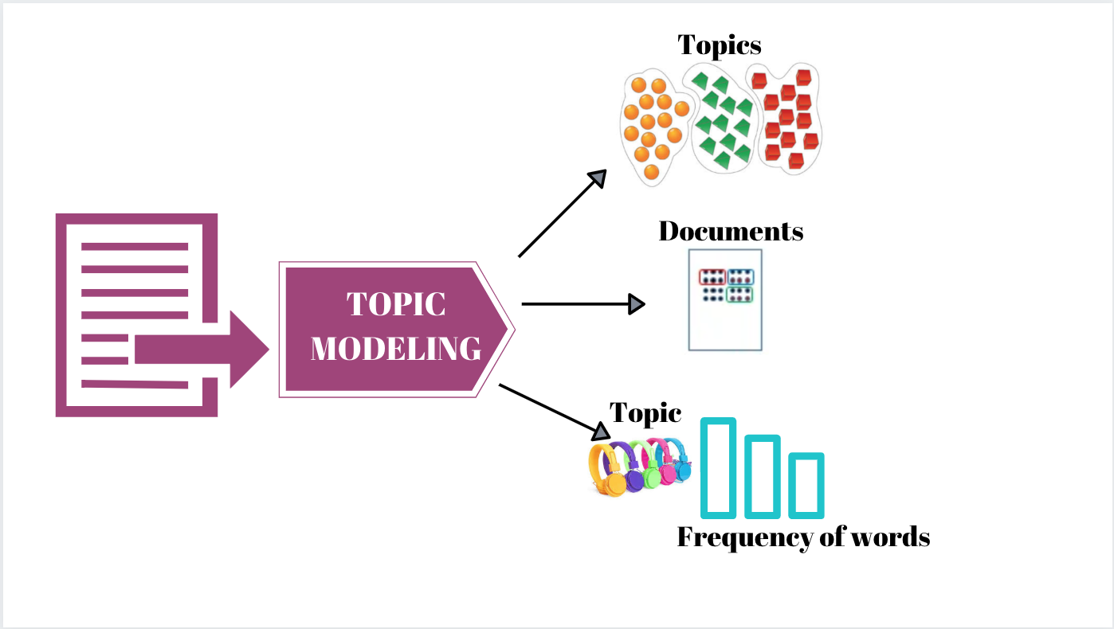
INTRODUCTION
Topic modelling is an unsupervised machine learning technique that’s capable of
scanning a set of documents, detecting word and phrase patterns within them, and automatically
clustering word groups and similar expressions that best characterize a set of documents.

Slide 3
TOPIC MODELLING
Topic Modelling methods tries to figure out which topic are present in the documents of the corpus and how strong its presence is.
Topic modelling refers to the process of dividing a corpus of documents in two:
A list of topic covered by the documents in the corpus.
Several sets of documents from the corpus grouped by the topic they cover.

Slide 4
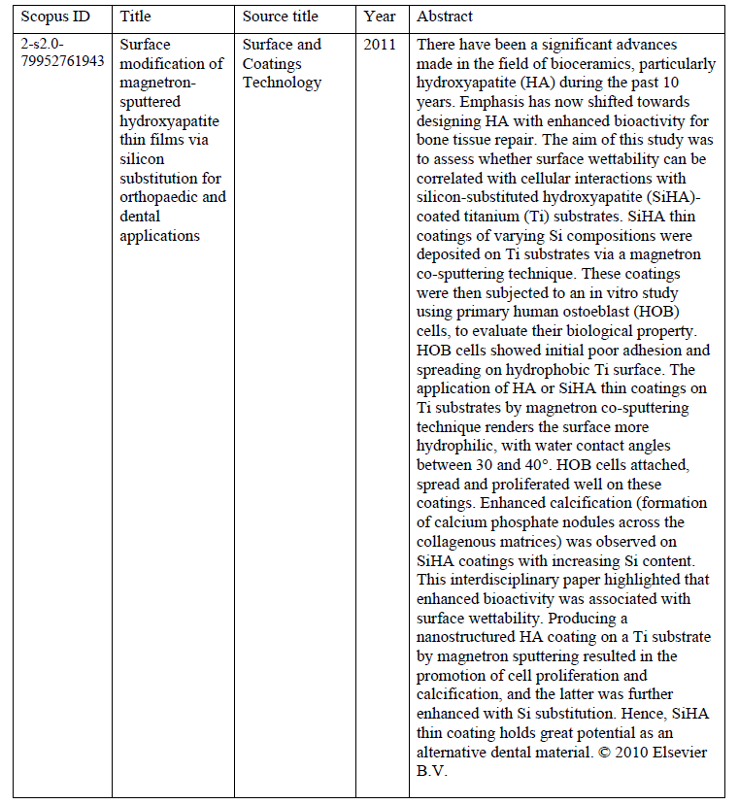
DATASET:
Data for this project is extracted using Scopus API. We have extracted data of 20,000 research papers
from different journals.
6 Variables in the dataset are:
1) Scopus ID
2) Title
3) Source title
4) Year
5) Abstract

Slide 5
Pre- Processing:
Lowercase all the alphabets in the abstract
Removal of punctuations {@ # $ % & ( ) > < ? / ; : “ ‘ | \ = -}
Removal of stop words.
Remove all non-keyboard characters.
Divide the text data into sentence tokens. And those sentence tokens will further be divided into word tokens.
Lemmatize the token

Slide 6
Feature Extraction:
Bag of words (Bow)
N-grams:
Means sequence of n-words
1-gram for tokens
2-gram for token pairs
TF-IDF: Term frequency and Inverse Document frequency.
TF-IDF is the measure of how important a term is.
Term frequency TF = (No. of term t in the document)/ (No. of term in the document)
IDF = log(number of documents/number of documents with term t)
TF-IDF = TF * IDF

Slide 7
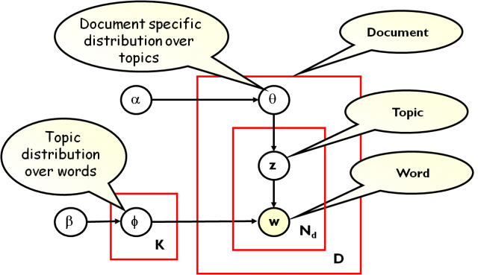
LDA- Latent Dirichlet Allocation model:

Slide 8
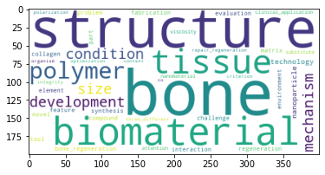
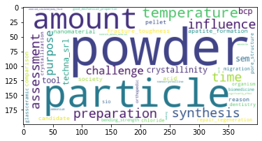
RESULT:
Perplexity: -14.751029581005083
Coherence Score: 0.4026414013401591

Slide 9
THANKYOU

