Slide 1

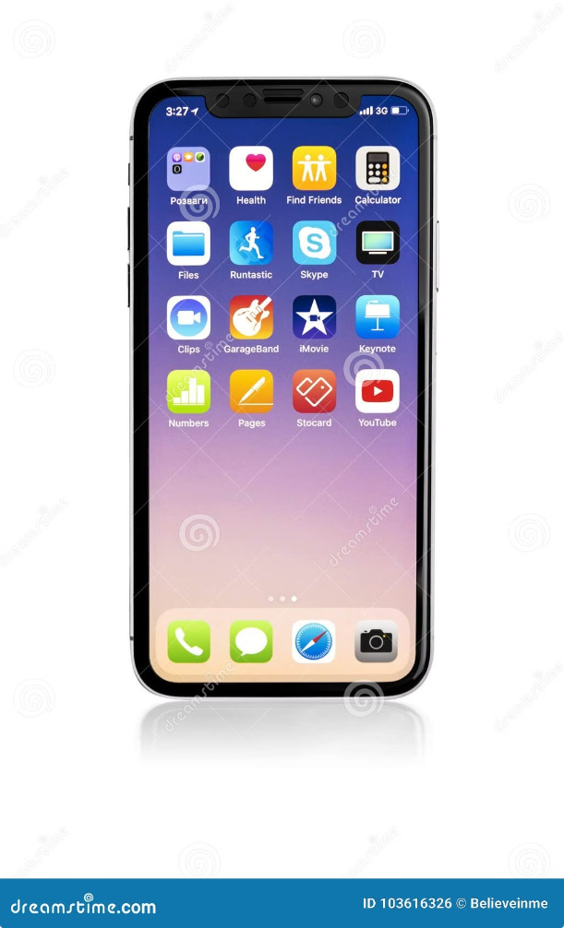
KNN for Predicting iPhone Purchases
This presentation details a comprehensive project utilizing the K-Nearest Neighbors (KNN) algorithm to predict the likelihood of customers purchasing iPhones. The model leverages demographic data, such as gender, age, and salary, to identify potential buyers and enhance marketing strategies. This project showcases the power of data analysis and machine learning in driving business outcomes.

Slide 2


Project Objective
1
Predicting iPhone Purchase Likelihood
The primary goal is to develop a robust model that accurately predicts the probability of a customer purchasing an iPhone based on their demographic characteristics.
2
Understanding Customer Behavior
By analyzing the data, we aim to uncover patterns and insights into customer purchasing behavior, enabling the identification of key factors influencing iPhone purchase decisions.
3
Targeted Marketing Strategies
The insights derived from the model will inform the development of targeted marketing strategies, ensuring that promotional efforts reach the most receptive audience segments.
4
Business Growth and Optimization
Ultimately, the project aims to contribute to business growth and optimization by improving conversion rates and driving revenue through more effective marketing campaigns.

Slide 3
KNN Algorithm: The Solution
Algorithm Selection
Data Preparation & Analysis
Model Building & Evaluation
The K-Nearest Neighbors (KNN) algorithm was chosen for its simplicity and effectiveness in classification tasks. KNN works by identifying the "k" nearest neighbors to a data point based on its features and assigning the data point to the class that is most prevalent among its neighbors.
The dataset consisted of features such as gender, age, salary, and purchase history. Exploratory Data Analysis (EDA) was performed to understand data distributions, identify potential outliers, and prepare the data for modeling. Data cleaning and preprocessing techniques were applied to ensure data integrity and model accuracy.
The KNN model was built and evaluated using metrics such as accuracy, precision, and recall. These metrics assess the model's ability to correctly classify iPhone buyers and identify potential buyers, respectively. The model's performance was iteratively optimized by adjusting the value of "k" and other hyperparameters.

Slide 4
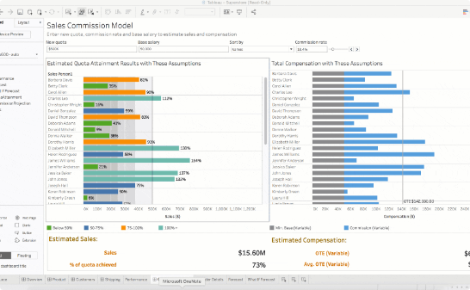
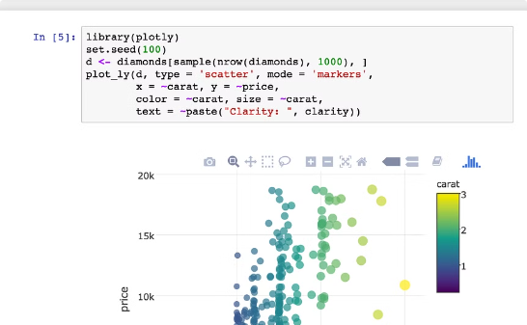

Visualizing Results and Insights
Tableau Dashboards
Python Notebooks
Word Reports
Interactive dashboards were created using Tableau to visualize the model's performance and key insights. These dashboards allowed for easy exploration of the data and provided clear visual representations of the model's accuracy, precision, and recall across different customer segments.
Python notebooks were used to document the code, analysis steps, and model training process. These notebooks served as a comprehensive record of the project and facilitated collaboration among team members.
Formal reports were prepared using Microsoft Word to summarize the project's findings, methodology, and conclusions. These reports presented the results in a clear and concise manner for stakeholders and decision-makers.

Slide 5


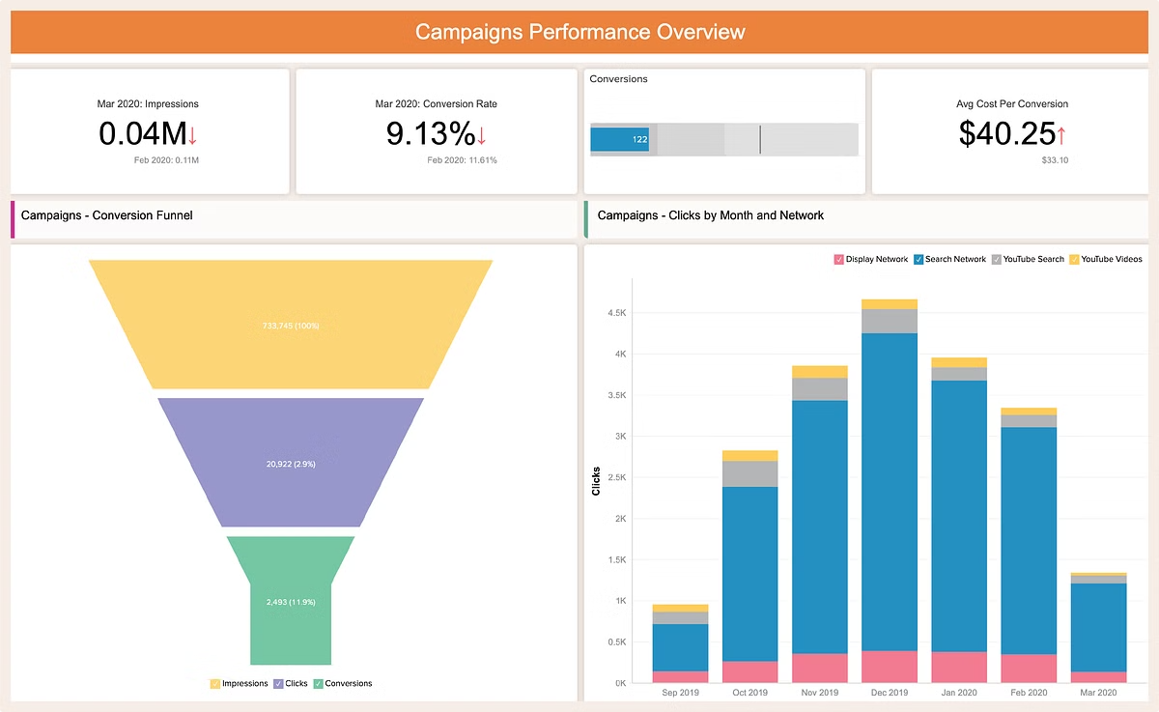



Impact on Business Operations
Improved Marketing Effectiveness
By accurately identifying potential iPhone buyers, the model enabled businesses to focus marketing efforts on the most receptive audience segments, resulting in improved conversion rates and increased ROI on marketing campaigns.
Personalized Customer Engagement
The model's insights allowed for the personalization of marketing campaigns, tailoring offers and promotions to individual customer needs and preferences. This personalized approach enhanced customer engagement and satisfaction.
Enhanced Customer Loyalty
By anticipating customer needs and providing relevant promotions, the model fostered customer loyalty. This resulted in repeat purchases and increased lifetime value for each customer.
Increased Sales and Revenue
The combination of improved marketing effectiveness, personalized customer engagement, and enhanced customer loyalty ultimately led to increased sales and revenue for the business.

Slide 6


Project Collaboration and Access
Project Repository
GitHub
Collaboration & Updates
Accessible for team members to contribute and update the model as new data becomes available.
Transparency and Reproducibility
Provides a transparent and traceable record of the project's development, ensuring that the model is reproducible and auditable.

Slide 7

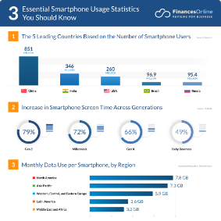
Future Directions and Enhancements
Expand Data Features
Explore Advanced Machine Learning Techniques
Real-Time Predictions
Incorporate additional data features, such as location, browsing history, and app usage, to further improve the model's accuracy and provide more granular insights into customer behavior.
Develop a system that enables real-time predictions, allowing businesses to adapt marketing strategies and promotions based on dynamic customer behavior and market trends.
Investigate more advanced machine learning algorithms, such as deep learning or decision trees, to potentially achieve even higher prediction accuracy and explore more complex patterns in the data.

Slide 8


Conclusion
This project demonstrates the power of data analysis and machine learning in optimizing business operations. The KNN model provides valuable insights into customer purchasing behavior, enabling businesses to personalize marketing campaigns and improve customer engagement. By leveraging the model's predictions, businesses can achieve significant improvements in conversion rates, customer loyalty, and overall revenue. The project's success underscores the importance of data-driven decision-making in today's competitive landscape.

