Slide 1

Bank Marketing – Classification
of Term Deposit Subscription
Group 27
• Abuthahir Alauvdeen (480543989)
• Ananda Aziz Hardjanto (470469051)
• Anthony Guo (470394395)
• Gaurav Singh (440354745)
• Rathna Ganesh Gopalarathnam (490616279)
• Subham Prakash Srivastava (500299300)
• Sukrit Vashist (490366547)

Slide 2

Problem definition
• Bank campaign dataset – To predict whether the client will subscribe to a
bank’s term deposit product or not.
• Solving this problem will reduce the customer pool and hence increase
efficiency by only targeting the clients who have a high probability of
subscribing to a term deposit.
• It is binary classification problem
The University of Sydney
Page 2

Slide 3

About Data
• Demographic: This dataset was acquired from Kaggle. The data is
related with direct marketing campaign of Portuguese banking
institution.
• 41,189 observations, 20 predictors and 1 response variable (Yes or No)
• Four broad categories of the predictors –
• Client – age, job, marital status, education, etc.
• Campaign – communication type, duration, etc.
• Other attributes – days since last contact, how many times contacted before, etc
• Socio-economic attributes – employment variation rate, CPI, etc.
The University of Sydney
Page 3

Slide 4
Data exploration and pre-processing
• Class imbalance – 88.7% belongs to class “no” and 11.3% belongs to class “yes”
• Univariate analysis on each of 20 predictors – to pass only relevant predictors
for modelling
• Outliers are present in campaign predictor
• Strong correlation between features – especially socio-economic variables
confirmed after performing multivariate analysis and correlation plot
• Missing values – 6 out of 20 predictors has at least one missing value
The University of Sydney
Page 4

Slide 5
Insights from univariate analysis
Performed univariate analysis on each of the 20 predictors and important observations are
shown below,
• Default – This predictor doesn’t have any variability. Only 3 clients answered “yes” (~0%),
rest answered “no” (79.3%) or “unknown” (20.7%)
• Duration – The duration variable will not be known before making a call, this variable
cannot be used for prediction.
• Clients with higher education, married are more likely to subscribe term deposit.
• Clients who have subscribed earlier are most likely to subscribe again if reconnected.
• The clients responded through a cellular phone has subscribed 5 times more compared
to telephone responders.
The University of Sydney
Page 5

Slide 6
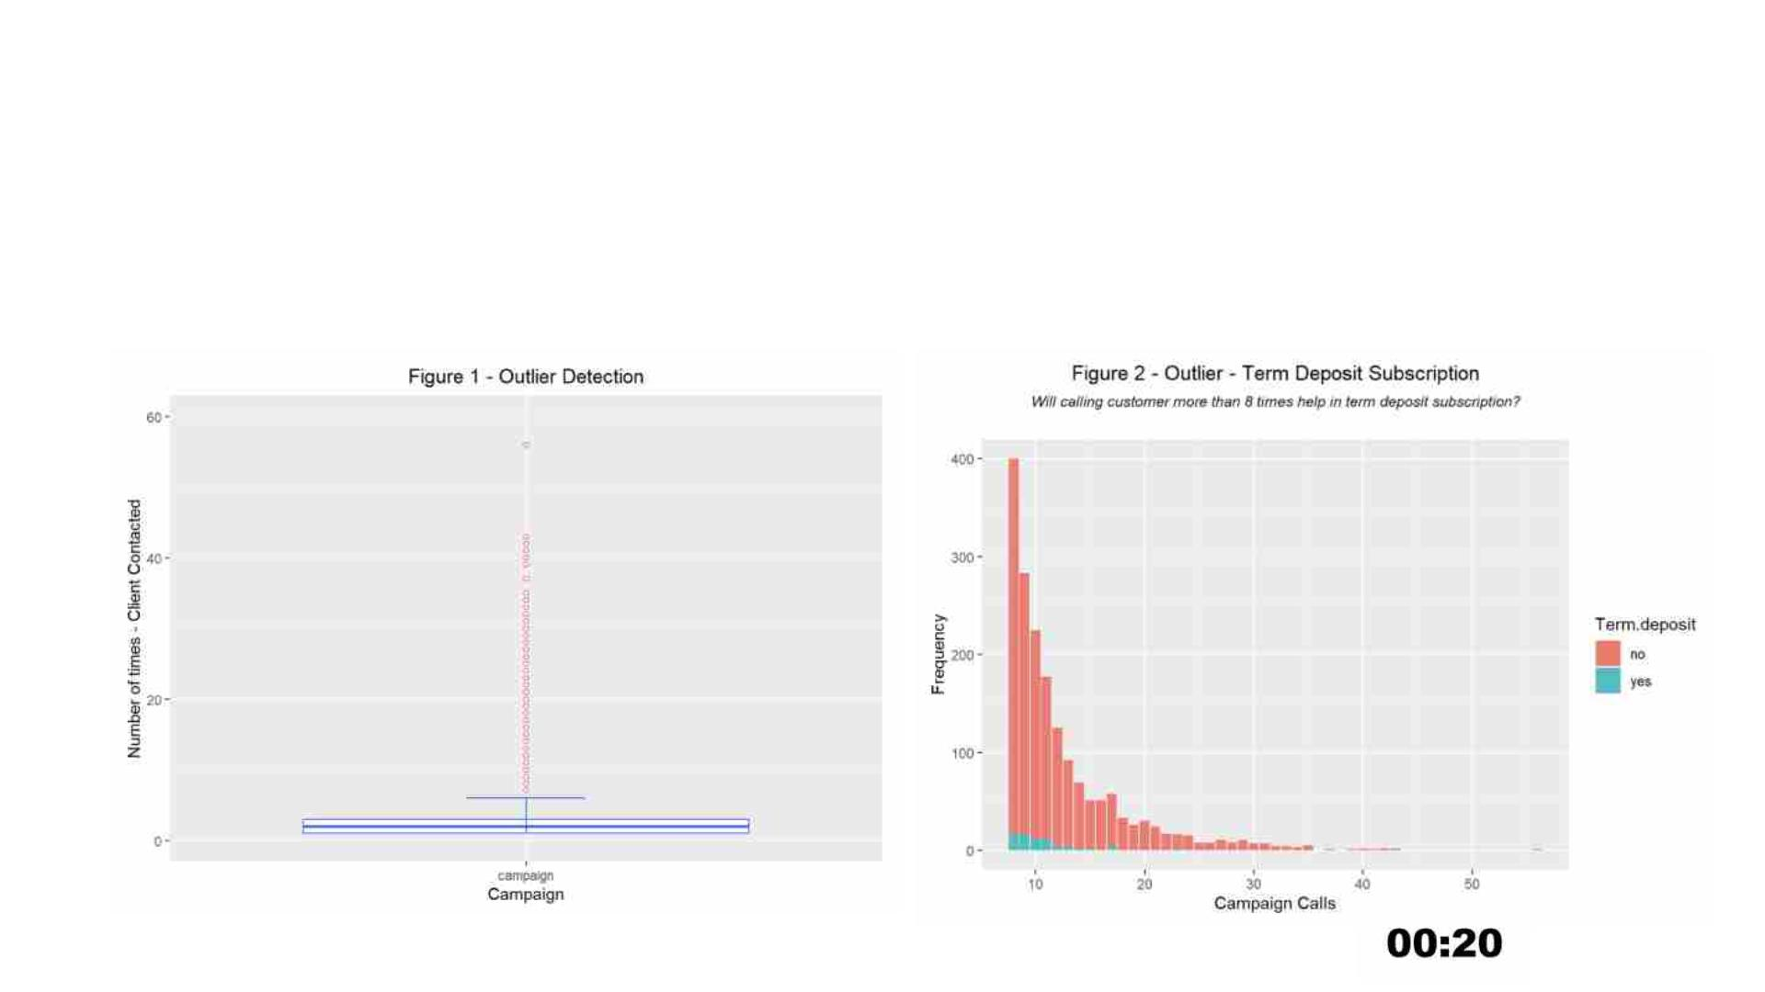
Outliers
• Box plot (Figure 1) shows that there were outliers (calling a client more than 8 times ) in
campaign variable.
• Bar chart indicates that calling a client beyond 12 times will not help in getting a term
deposit (Figure 2)
The University of Sydney
Page 6

Slide 7
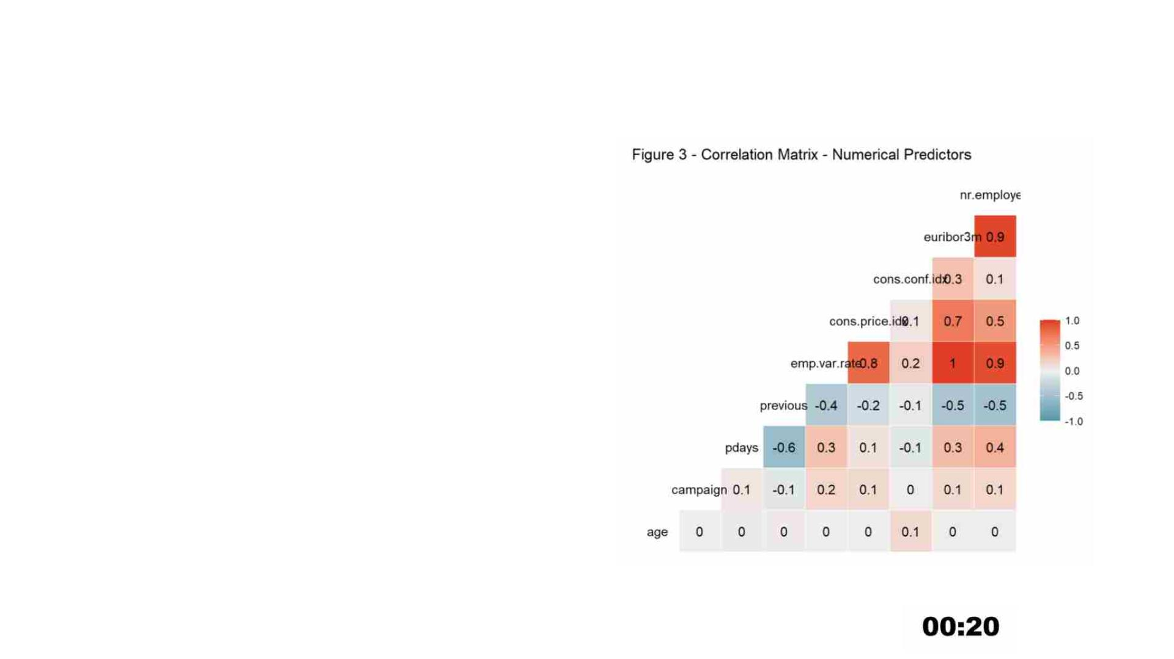
Feature correlation
• There are five numerical predictors
representing social and economic
indicators
• From the plot, we could conclude the
below variables are highly correlated and
share redundant information.
Øemployment variation rate
Øeuribor 3 month rate
Ønumber of employees
The University of Sydney
Page 7

Slide 8
Relationship of categorical/numerical predictors
with response
Performed Pearson’s Chi-squared test on all categorical variables to check
their association with response variable.
• Housing – At 95% confidence level, we can confirm that there is no
association of housing variable to predict term deposit subscription.
• Loan - At 99% confidence level, we can confirm that there is no association
of loan variable to predict term deposit subscription.
Performed ANOVA test for allfive socio-economic numerical variables.
• Based on the results it looks like all the five variables are significant in
predicting the term deposit subscription.
The University of Sydney
Page 8

Slide 9
Missing values
6 out of 20 predictors has at least one missing values. Response
variable looks good.
• Default - This predictor doesn’t have any variability. 79.3% (no), 20.7%
(unknown), 0% (yes)
• Housing and loan - failed Pearson’s Chi-squared test.
• Education, job and marital status – Missing values contributed only 4.8% of
overall dataset
The University of Sydney
Page 9

Slide 10
EDA Conclusion
Removed four variables from the datasets
• Default – Lack of variability.
• Housing – Lack of information
• Loan – Lack of information
• Duration – Lack of availability
• Removed missing values which are of 4.8% of overall observations
• Used SMOTE to synthetically up sample class “yes”
The University of Sydney
Page 10

Slide 11
Approach
1.Feature Scaling
– Performed both Normalisation & Standardisation techniques for
the numerical predictors due to the different scale of values
2. One Hot encoding
– Performed for all the categorical predictors for further model
performance
3. Data Split - 80% of training & 20% of testing
4. Perform Cross-validation to train multiple folds of data and do hyper
parameter tuning
5. Train the models to evaluate the measures using its best parameters
6. Test the trained model with the test data response variable
7. Compare and contrast the Accuracy, Sensitivity and Specificity of the models to
choose the final best model
The University of Sydney
Page 11

Slide 12
Model Selection
Following models were selected to solve this supervised classification
problem –
• Logistic Regression – easy to train, computationally inexpensive
• Naïve Bayes – highly scalable, robust and fast converging
• Random Forest – ensemble of decision trees, less expensive
• XG Boost – another ensemble of decision trees but uses gradient
boosting framework
The University of Sydney
Page 12

Slide 13
Model Evaluation
Three methods will be used in the model evaluation -
• Nested Cross-Validation – k fold cross validation resampling method
• Confusion Matrix - These are effective in visualizing important predictive
analytics measures like sensitivity, specificity, precision, and recall.
• ROC curve - Next step we are planning to compare different models’
accuracy using the ROC curves. This is simply a plot that represents the
trade-off between sensitivity and specificity.
The University of Sydney
Page 13

Slide 14
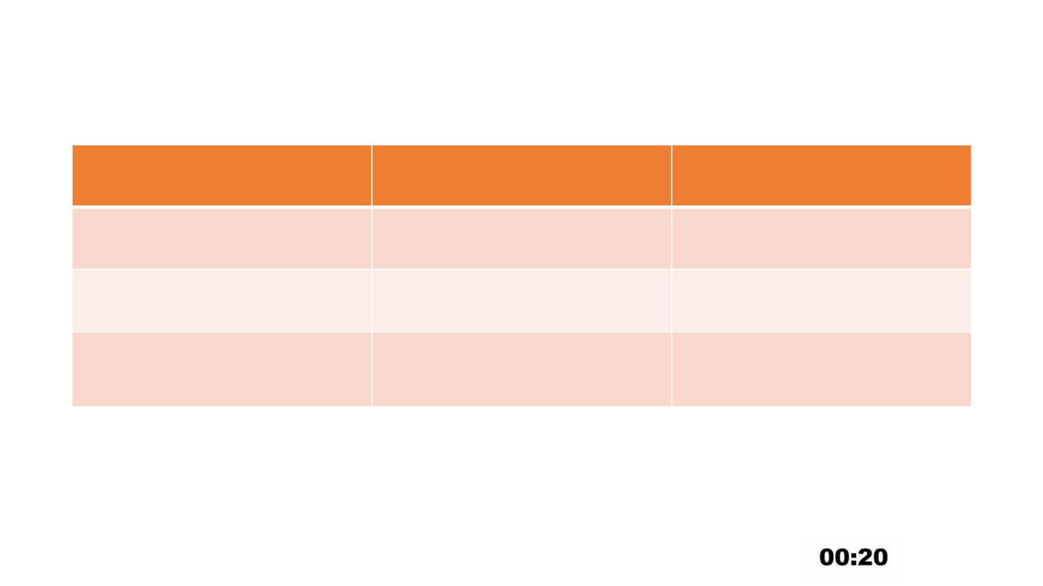
Logistic Regression
Measures
Accuracy
Training set
0.7542
Test set
0.7539
0.6125
0.8777
Sensitivity
Specificity
0.6188
0.8730
The University of Sydney
Page 14

Slide 15
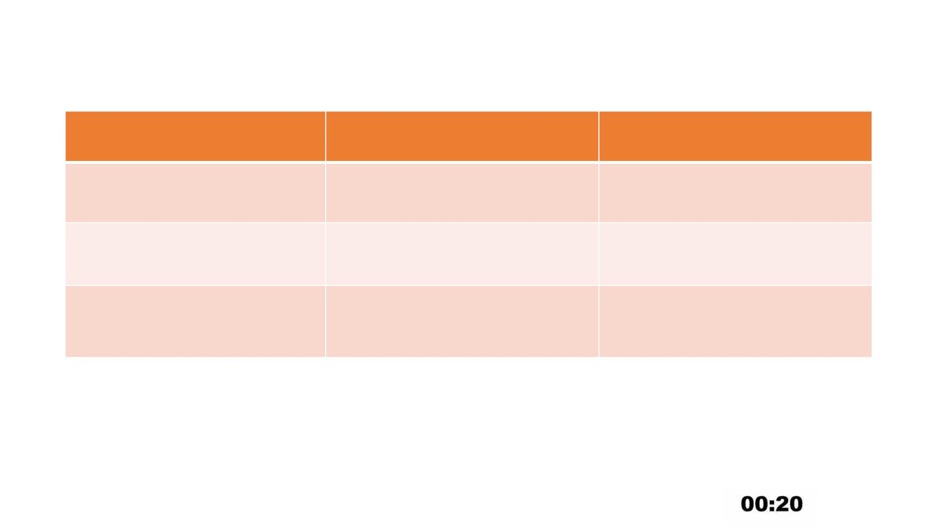
Naïve Bayes
Measures
Accuracy
Training set
Test set
0.841
0.849
Sensitivity
Specificity
0.22761
0.89837
0.22871
0.90408
The University of Sydney
Page 15

Slide 16
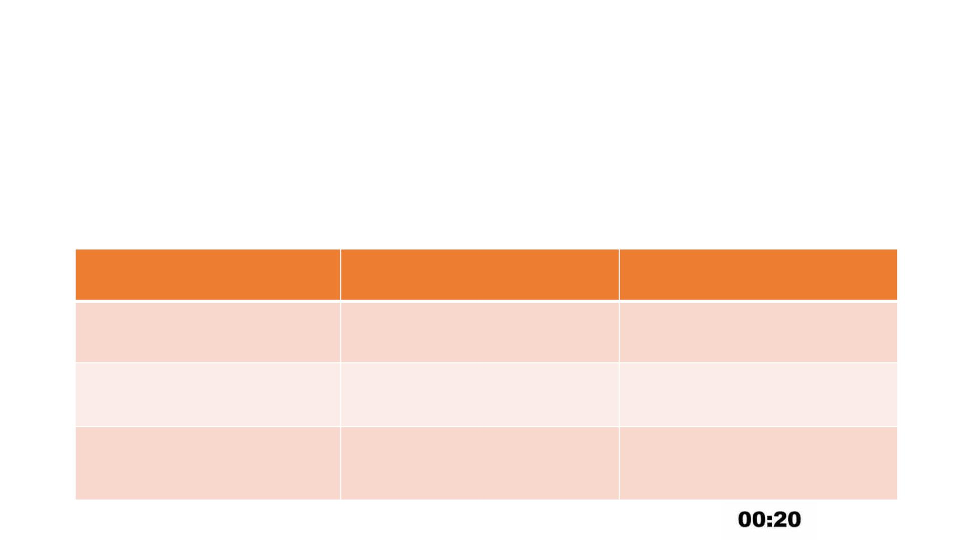
Random Forest
The best parameters are
• num.trees = 500
• mtry= 15
• splitrule = ‘gini’
• min.node.size = 1
Measures
Accuracy
Training set
Test set
0.982
0.9669
0.9953
0.9355
Sensitivity
Specificity
0.9088
0.9590
The University of Sydney
Page 16

Slide 17
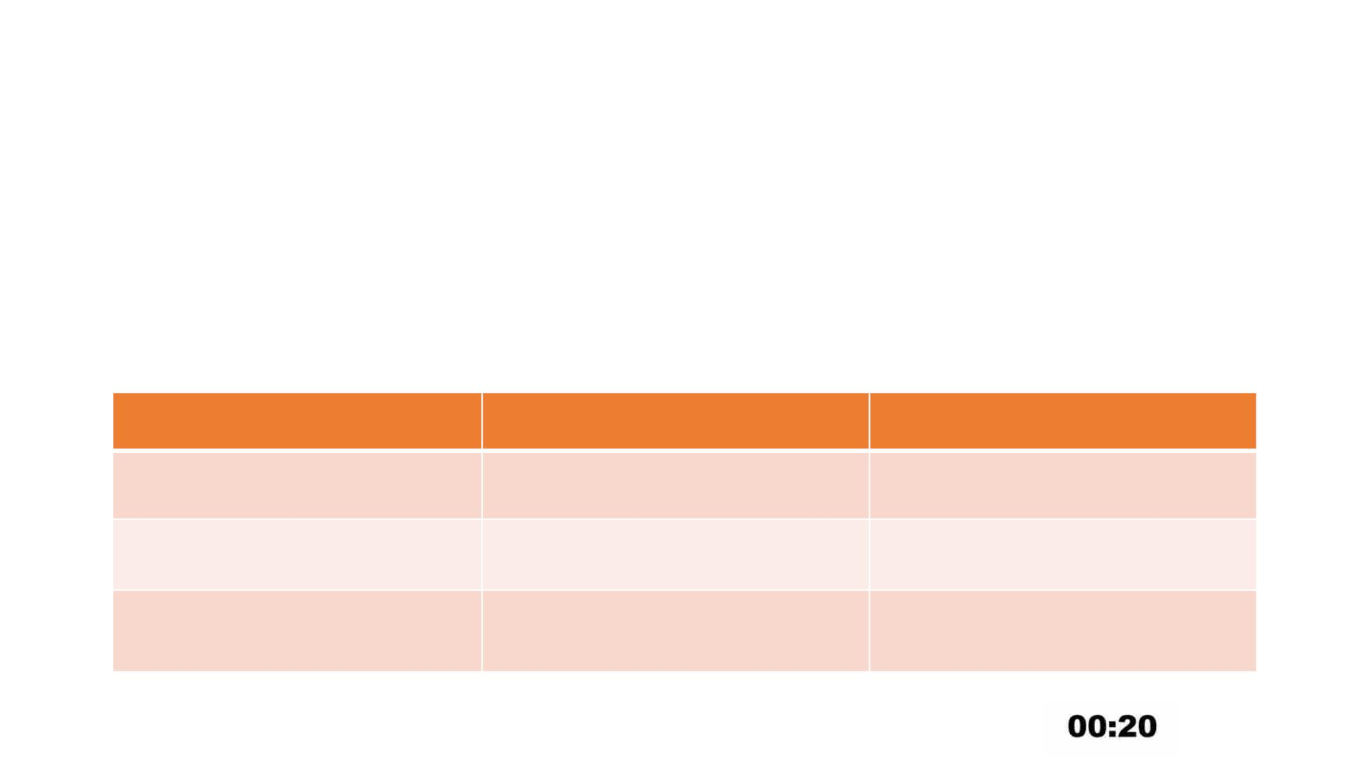
XG Boost
The best parameters are
• nrounds = 200
• max_depth = 5
• eta = 0.3
• colsample_bytree = 1
• min_child_weight = 1
• subsample = 1
• gamma = 0
Measures
Accuracy
Training set
Test set
0.9531
0.9149
0.9866
0.9373
Sensitivity
Specificity
0.8986
0.9713
The University of Sydney
Page 17

Slide 18
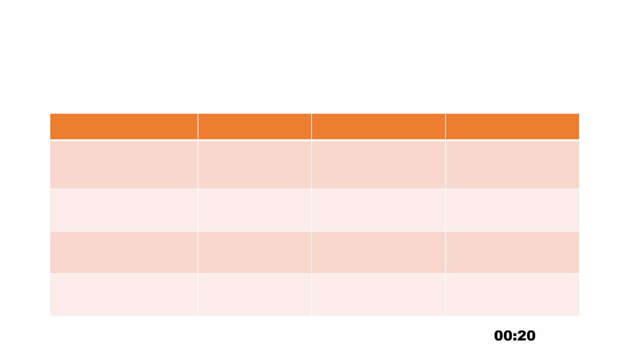
Model Comparison
The Positive class is yes
Model Name
Accuracy
Sensitivity
Specificity
Logistic
Regression
0.7539
0.6125
0.8777
Naïve Bayes
0.849
0.22871
0.9088
0.8986
0.90408
0.9590
0.9713
Random Forest 0.9355
XGBoost
0.9373
The University of Sydney
Page 18

Slide 19
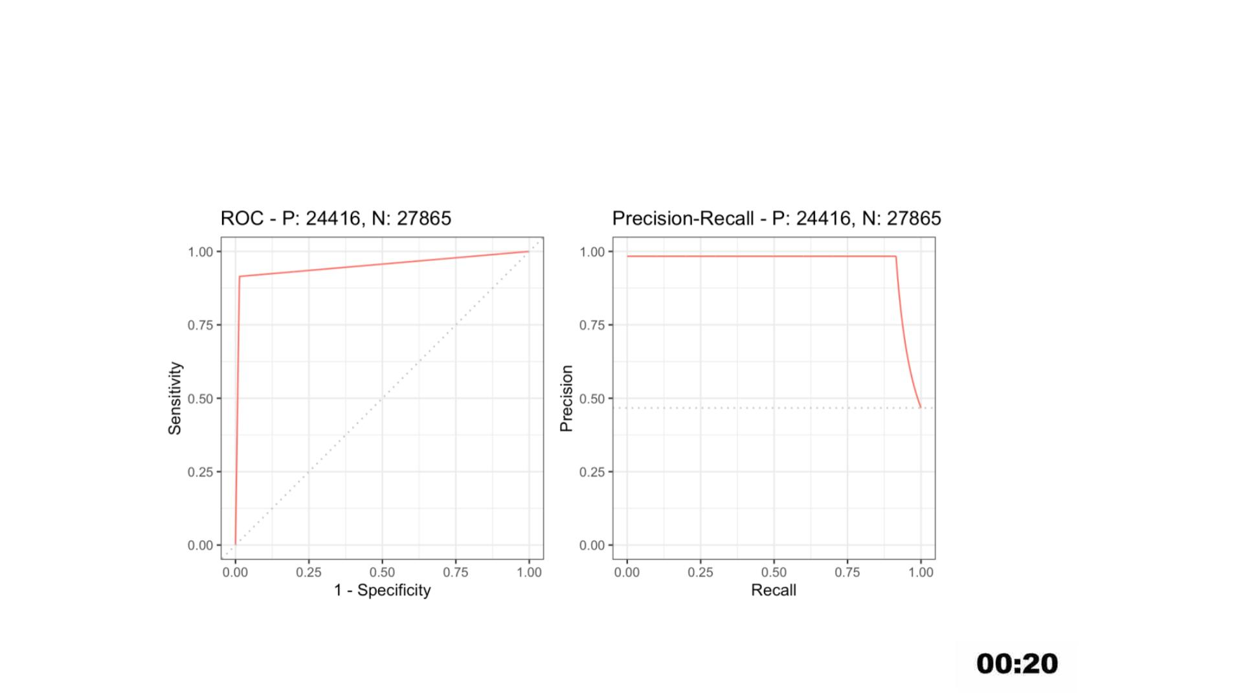
Best Model – XGBoost - ROC
The University of Sydney
Page 19

Slide 20
Caveats and Further improvements
• The XGBoost and Random forest models could be further tuned with
more hyper parameters using repeated cross-validation to achieve
better and more reliable results.
• The dataset is highly imbalanced with 88.7% of samples belongs to
class “no” and 11.3% belongs to class “yes”. Hence we used SMOTE to
synthetically upsample class “yes”. That said, If we could have more
real samples for class “yes”, then the results would be more realistic.
The University of Sydney
Page 20

