Slide 1



Bank Marketing – Classification of Term Deposit Subscription
Group 27
Abuthahir Alauvdeen (480543989)
Ananda Aziz Hardjanto (470469051)
Anthony Guo (470394395)
Gaurav Singh (440354745)
Rathna Ganesh Gopalarathnam (490616279)
Subham Prakash Srivastava (500299300)
Sukrit Vashist (490366547)

Slide 2
Problem definition
Bank campaign dataset – To predict whether the client will subscribe to a bank’s term deposit product or not.
Solving this problem will reduce the customer pool and hence increase efficiency by only targeting the clients who have a high probability of subscribing to a term deposit.
It is binary classification problem
Notes:
Cold calling is the process in which salespeople contact potential customers with no prior interest with the product. As such, these calls are estimated to convert to a sale very rarely; about 2% of the time according to marketer Charlie Cook [1]. The purpose of this task is to determine whether a customer will subscribe to a bank deposit from a Portuguese bank, given certain information about that customer. This problem falls under the branch of binary classification; given a feature vector of information from a particular customer, the goal is to output either yes or no. This problem is interesting as it would help improve the performance of ‘cold calling’. By solving the classification problem, we are able to reduce the customer pool and hence increase efficiency by only calling the customers who have a high probability of subscribing to a term deposit.

Slide 3
About Data
Demographic: This dataset was acquired from Kaggle. The data is related with direct marketing campaign of Portuguese banking institution.
41,189 observations, 20 predictors and 1 response variable (Yes or No)
Four broad categories of the predictors –
Client – age, job, marital status, education, etc.
Campaign – communication type, duration, etc.
Other attributes – days since last contact, how many times contacted before, etc
Socio-economic attributes – employment variation rate, CPI, etc.
Notes:
Even mix of 10 categorical and 10 numeric features – challenging to select relevant features prior to modelling
6 categorical features have missing data
Found strong correlation in between features especially those belonging to socio-economic category – might need to address collinearity problem
36548 (88.7 %) belongs to class “no” and 4640 (11.3%) belong to “yes” – need to address class imbalance problem
Outlier in feature “Number of times – Client contacted”

Slide 4
Data exploration and pre-processing
Class imbalance – 88.7% belongs to class “no” and 11.3% belongs to class “yes”
Univariate analysis on each of 20 predictors – to pass only relevant predictors for modelling
Outliers are present in campaign predictor
Strong correlation between features – especially socio-economic variables confirmed after performing multivariate analysis and correlation plot
Missing values – 6 out of 20 predictors has at least one missing value
Notes:
Missing data
Analyzing the whole data, there are 12718 missing values which is 1.47% of total values. When we did a deeper look at each variable level, we found only 6 out of 20 predictors suffers at least one missing value and the response variable looks good as shown below in table 1. Based on the exploratory data analysis, we will remove default, housing and loan predictors which suffers the most missing values. By ignoring these variables, only 4.02% of the total records has missing values which will be removed from the prediction.

Slide 5
Insights from univariate analysis
Performed univariate analysis on each of the 20 predictors and important observations are shown below,
Default – This predictor doesn’t have any variability. Only 3 clients answered “yes” (~0%), rest answered “no” (79.3%) or “unknown” (20.7%)
Duration – The duration variable will not be known before making a call, this variable cannot be used for prediction.
Clients with higher education, married are more likely to subscribe term deposit.
Clients who have subscribed earlier are most likely to subscribe again if reconnected.
The clients responded through a cellular phone has subscribed 5 times more compared to telephone responders.
Notes:
We did univariate analysis on each of the 20 predictors to choose which features will work best for modelling downstream -
Default – This predictor doesn’t have any variability. Only 3 people answered “yes” (~0.0%) out of 41889 observations. Hence this variable cannot be used for prediction.
Duration – This predictor isn’t helpful as the duration of the call can’t be known before. Since the duration variable will not be known before making a call, this variable cannot be used for prediction.
Other important insights - Clients with higher education, married are more likely to subscribe term deposit. Clients who have subscribed earlier are most likely to subscribe again if reconnected. The clients responded through a cellular phone has subscribed 5 times more compared to telephone responders.

Slide 6
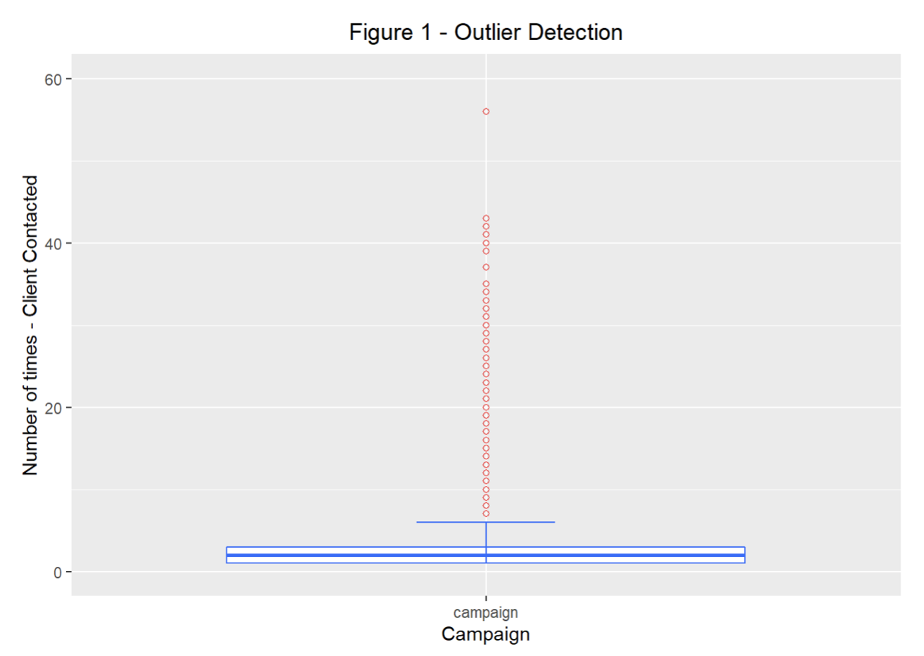
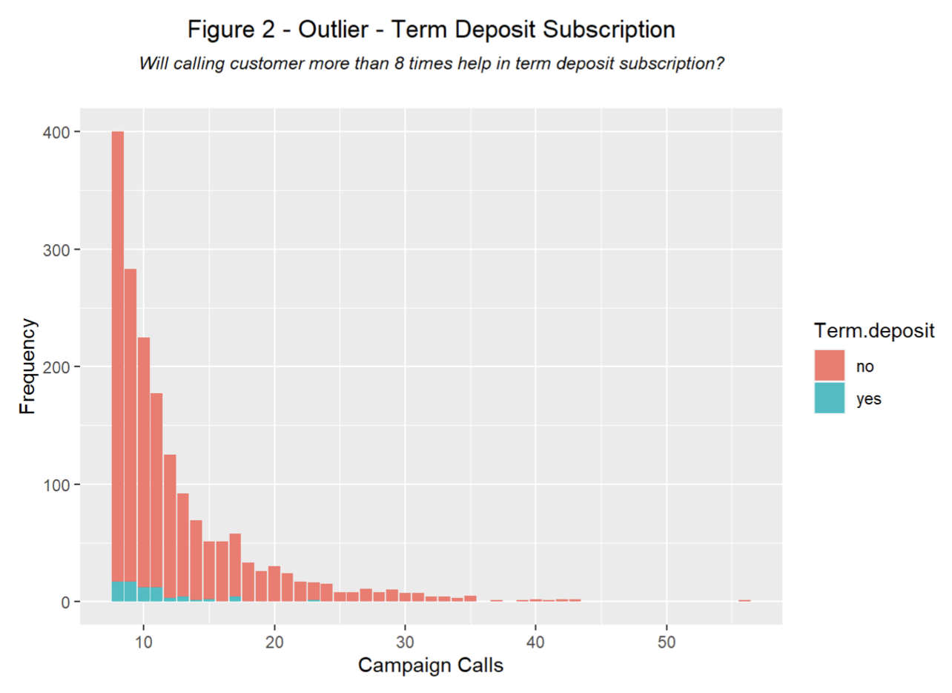
Outliers
Box plot (Figure 1) shows that there were outliers (calling a client more than 8 times ) in campaign variable.
Bar chart indicates that calling a client beyond 12 times will not help in getting a term deposit (Figure 2)
Notes:
As we all know calling a client multiple times will not help in getting a term deposit. We tried a box plot (Figure 1) to analyse the data, it shows calling a client more than 8 times is an outlier and beyond 12 times will not help in getting a term deposit as shown in the below bar chart (Figure 2). However, there are some bad samples that shows clients are called more than 40 times with maximum 56 times.
Hide

Slide 7
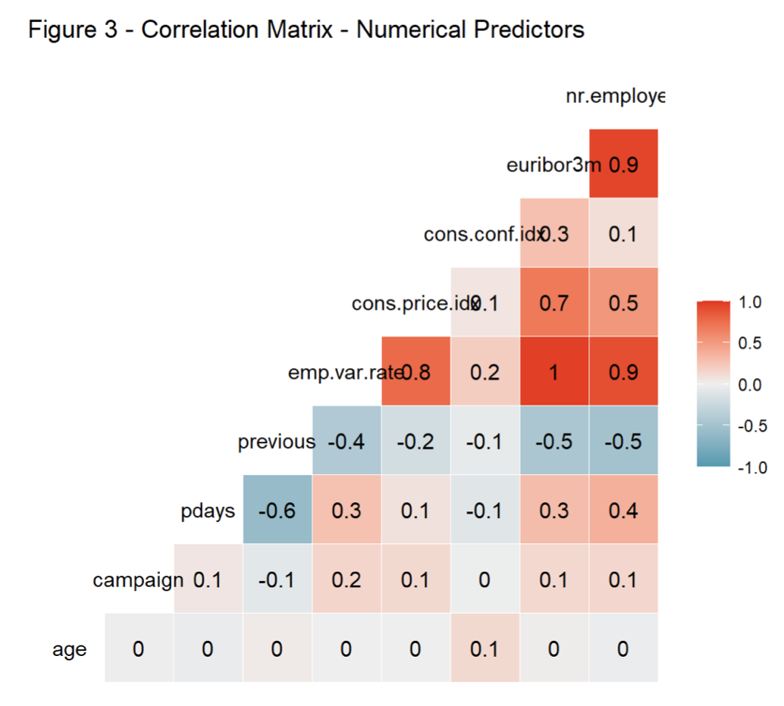
Feature correlation
There are five numerical predictors representing social and economic indicators
From the plot, we could conclude the below variables are highly correlated and share redundant information.
employment variation rate
euribor 3 month rate
number of employees

Slide 8
Relationship of categorical/numerical predictors with response
Performed Pearson’s Chi-squared test on all categorical variables to check their association with response variable.
Housing – At 95% confidence level, we can confirm that there is no association of housing variable to predict term deposit subscription.
Loan - At 99% confidence level, we can confirm that there is no association of loan variable to predict term deposit subscription.
Performed ANOVA test for all five socio-economic numerical variables.
Based on the results it looks like all the five variables are significant in predicting the term deposit subscription.
Notes:
Relationship of categorical predictors with response
We did Pearson’s Chi-squared test on all categorical variables to check their association with response variable. The below are the important observations.
Housing – The p-value for this predictor is 0.06146927. So at 95% confidence level, we can confirm that there is no association of housing loan variable to predict term deposit.
Loan - The p-value for this predictor is 0.5677161. So at 99% confidence level, we can confirm that there is no association of personal loan variable to predict term deposit.
Relationship of Numerical predictors with response
We did ANOVA test for all five socio-economic numerical variables. Based on the results it looks like all the five variables are significant in predicting the term deposit subscription.

Slide 9
Missing values
6 out of 20 predictors has at least one missing values. Response variable looks good.
Default - This predictor doesn’t have any variability. 79.3% (no), 20.7% (unknown), 0% (yes)
Housing and loan - failed Pearson’s Chi-squared test.
Education, job and marital status – Missing values contributed only 4.8% of overall dataset

Slide 10
EDA Conclusion
Removed four variables from the datasets
Default – Lack of variability.
Housing – Lack of information
Loan – Lack of information
Duration – Lack of availability
Removed missing values which are of 4.8% of overall observations
Used SMOTE to synthetically up sample class “yes”

Slide 11
Approach
Feature Scaling
– Performed both Normalisation & Standardisation techniques for
the numerical predictors due to the different scale of values
2. One Hot encoding
– Performed for all the categorical predictors for further model
performance
3. Data Split - 80% of training & 20% of testing
4. Perform Cross-validation to train multiple folds of data and do hyper
parameter tuning
5. Train the models to evaluate the measures using its best parameters
6. Test the trained model with the test data response variable
7. Compare and contrast the Accuracy, Sensitivity and Specificity of the models to
choose the final best model

Slide 12
Model Selection
Following models were selected to solve this supervised classification problem –
Logistic Regression – easy to train, computationally inexpensive
Naïve Bayes – highly scalable, robust and fast converging
Random Forest – ensemble of decision trees, less expensive
XG Boost – another ensemble of decision trees but uses gradient boosting framework
Notes:
we will use the four following models to implement to the dataset for a supervised classification problem.
Logistic Regression - Since the dataset that we have chosen has a binary target variable i.e., y - (has the client subscribed a term deposit? binary: yes, no), we plan on implementing this model. The key advantage that we would have while using this model is that it is very easy to train and interpret the results.
Random Forest - This model is immune from high dimensionality issues since each tree would only choose a small subset of the feature space. In addition, Random Forest can handle missing values and thus is a really good model to implement for our problem statement.
SVM - Concerning the optimization, we will use the Cost parameter “calculate the different possible hyperplanes & Train & predict our model on different kernels such as Radial Basis Function, Polynomial, etc. Eventually, we will consider the most effective one.
Naïve Bayes - It has a highly scalable nature. It predicts the outcome based on conditional probability, so it converges much faster than other classification algorithms such as logistics.

Slide 13
Model Evaluation
Three methods will be used in the model evaluation -
Nested Cross-Validation – k fold cross validation resampling method
Confusion Matrix - These are effective in visualizing important predictive analytics measures like sensitivity, specificity, precision, and recall.
ROC curve - Next step we are planning to compare different models’ accuracy using the ROC curves. This is simply a plot that represents the trade-off between sensitivity and specificity.
Notes:
Nested Cross-Validation - This is a resampling method that can be used to efficiently evaluate the machine learning models on a limited data sample by using all the data available for training.
Confusion Matrix - These are effective in visualizing important predictive analytics measures like sensitivity, specificity, precision, and recall. These can then be used to calculate the F-1 score.
ROC curve - Next step we are planning to compare different models’ accuracy using the ROC curves. This is simply a plot that represents the trade-off between sensitivity and specificity.

Slide 14
Logistic Regression
Measures | Training set | Test set
Accuracy | 0.7542 | 0.7539
Sensitivity | 0.6188 | 0.6125
Specificity | 0.8730 | 0.8777

Slide 15
Naïve Bayes
Measures | Training set | Test set
Accuracy | 0.841 | 0.849
Sensitivity | 0.22761 | 0.22871
Specificity | 0.89837 | 0.90408

Slide 16
Random Forest
The best parameters are
num.trees = 500
mtry= 15
splitrule = ‘gini’
min.node.size = 1
Measures | Training set | Test set
Accuracy | 0.982 | 0.9355
Sensitivity | 0.9669 | 0.9088
Specificity | 0.9953 | 0.9590

Slide 17
XG Boost
The best parameters are
nrounds = 200
max_depth = 5
eta = 0.3
gamma = 0
colsample_bytree = 1
min_child_weight = 1
subsample = 1
Measures | Training set | Test set
Accuracy | 0.9531 | 0.9373
Sensitivity | 0.9149 | 0.8986
Specificity | 0.9866 | 0.9713

Slide 18
Model Comparison
The Positive class is yes
Model Name | Accuracy | Sensitivity | Specificity
Logistic Regression | 0.7539 | 0.6125 | 0.8777
Naïve Bayes | 0.849 | 0.22871 | 0.90408
Random Forest | 0.9355 | 0.9088 | 0.9590
XGBoost | 0.9373 | 0.8986 | 0.9713

Slide 19
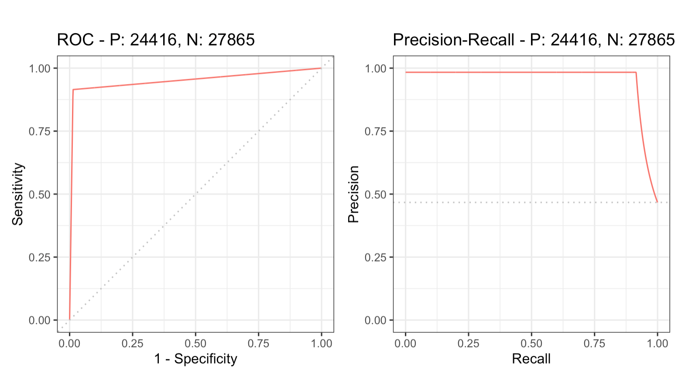
Best Model – XGBoost - ROC

Slide 20
Caveats and Further improvements
The XGBoost and Random forest models could be further tuned with more hyper parameters using repeated cross-validation to achieve better and more reliable results.
The dataset is highly imbalanced with 88.7% of samples belongs to class “no” and 11.3% belongs to class “yes”. Hence we used SMOTE to synthetically upsample class “yes”. That said, If we could have more real samples for class “yes”, then the results would be more realistic.

