Slide 1
Project
NLP for ESG Goal Extraction
March 30th, 2023

Slide 2
Introduction
To assist in the analysis process of lengthy ESG reports, I am proposing an NLP pipeline which would extract organizational goals from the piece of text provided by the user.
The core stages of the proposed pipeline:
Coreference Resolution
Named Entity Recognition
Parts-of-speech Tagging
Fine-tuned BERT Classifier
Generally, goals constitute the pattern wherein the organization(company) is an active actor with a potential futuristic timeline. The first three stages help to filter action statements large text corpus and finally the BERT classifier extracts goals from action statements.

Slide 3
Introduction
The initial 3 stages used for NLP preprocessing for ESG goal extraction would use 2 open-sourced pretrained transformer model-based pipelines.
1st stage – Coreference pipeline^{[1]}
This experimental pipeline encompasses two prime components:
a. CoreferenceResolver – An LSTM over the RoBERTa base transfomer model.
b. SpanResolver – A lightweight CNN with two output channels.
2nd and 3rd stage – English core transformer pipeline^{[2]}
It is a production-grade modular pipeline, in its basic form consist of tagger, parser,
attribute_ruler, lemmatizer and ner components.
4th stage – Fine-tuned BERT^{[3]} model
An annotated dataset was created from ESG report from multiple DAX100 companies
to fine-tune a pre-trained model.
Wir unterstützen Sie!
© urlaubsguru.de

Slide 4
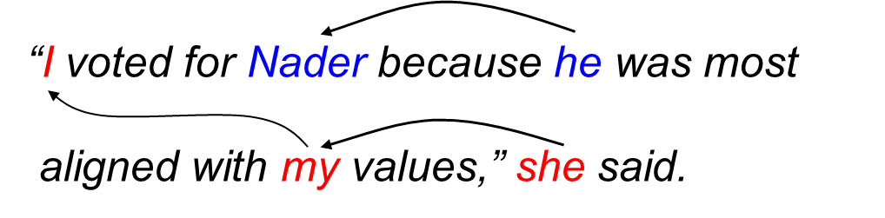
1. Coreference Resolution
For this stage of the proposed NLP pipeline, a transformer model-based pipeline authored by explosion^{[4]} is employed. The model is currently in an experimental stage with limited functionality and hence not yet published on Hugging Face.
Example of coreference resolution^{[5]}
Wir unterstützen Sie!
© urlaubsguru.de

Slide 5
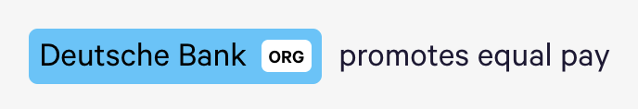
2. Named Entity Recognition
At this stage in the pipeline, English core transformer pipeline by spaCy^{[2]} is used to label entities.
This step would allow us to label the organization(company) in the provided text.
The term ‘Deutsche Bank’ is classified as an organization in the following example.
Example of Named Entity Recognition

Slide 6
3. Parts-of-speech tagging
The English core transformer pipeline by spaCy used in the last stage of the pipeline also
offers POS tagging functionality. We could label action words (verbs) with POS tagging.
The sentence ‘Monsanto investigates toxic fertilizers’ has been processed for POS tagging
in the following example.
Example of POS tagging

Slide 7

4. Fine-tuned BERT classifier
The ’bert-base-uncased’ was used as the base classifier model, it was then trained on about 4.5k annotated samples to classify goals from action statements. The Fine-tuning process adds 12 additional hidden layers on top of pre-trained BERT layers.
Description of the 4th stage

Slide 8
Pipeline example run
“At Bosch, diversity is a fundamental pillar. We ensured a diverse workforce by taking necessary measures in the past. Still, The company intends to increase workforce diversity by 40%. It would enable a healthy and balanced workforce that would be warm and welcoming for people from diverse backgrounds.”
“Still, Bosch intends to increase workforce diversity by 40 %.”

Slide 9
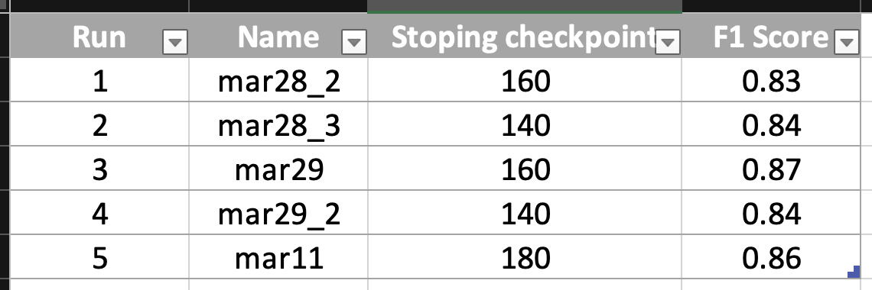
K-Folds cross validation

Slide 10
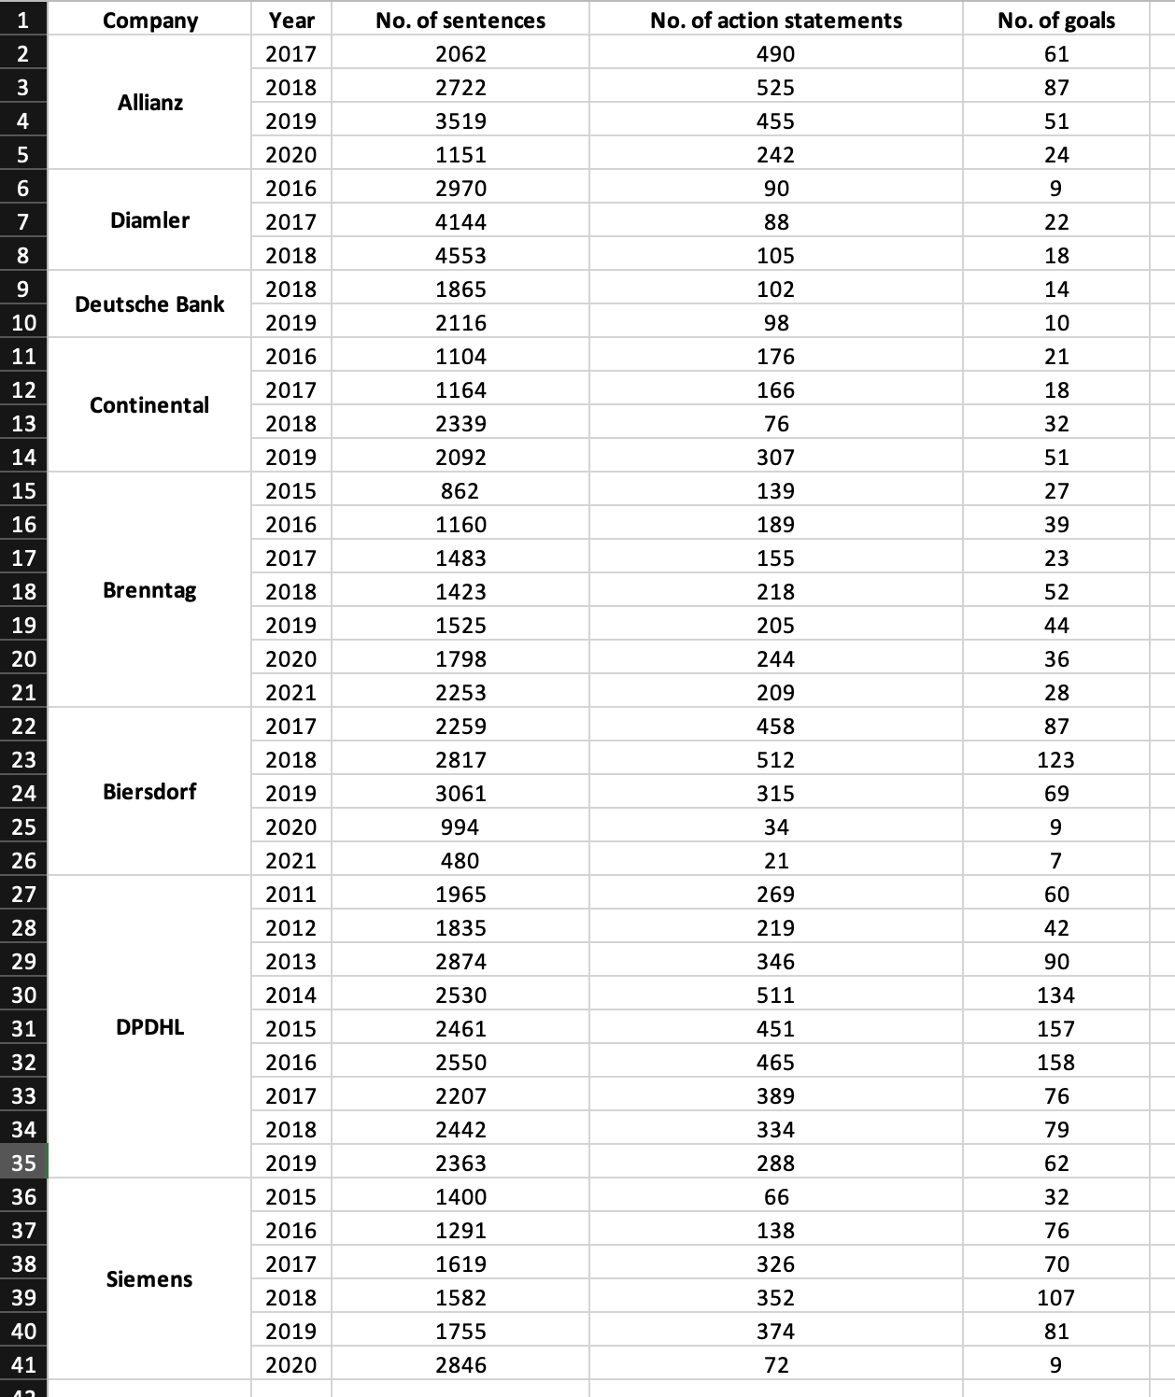
Pipeline runs

Slide 11
References
Sr. | Description | Links
1 | Github repository of explosion.ai for Coreference transformer model | link
2 | Hugging face page for core English transformer pipeline by spaCy | link
3 | BERT ReadMe | link
4 | About explosion(author of neural coref transformer model) | link
5 | Example of Coreference Resolution | link
Wir unterstützen Sie!
© urlaubsguru.de

Slide 12
Thank you

