Slide 1

School of Computer Engineering
Presentation for SY Project Implementation
AY 2025-26
IoT-Integrated Smart Rover With Live Survillence
Students Name:
Palkrutwar Onkar Ravikiran(350)
MD. Rehan MD. Gous(357)
Surywanshi Shubham Satish(371)
Hage Prem Dnyaneshwar(376)
Guide:
Mrs. Rohini Banait

Slide 2
Index
Introduction
Problem Statement
Literature Survey
Objectives and Scope
Applications
Algorithm
Design / Architecture Block Diagram
Software/Hardware Requirement
References

Slide 3
Introduction
This project involves developing an Arduino-controlled car with four main functions: line following, obstacle avoidance, Bluetooth manual control, and live video surveillance via ESP32-CAM.
Using IR and ultrasonic sensors, the car navigates autonomously; the HC-05 Bluetooth module enables remote control; and the ESP32-CAM streams live video over Wi-Fi to any browser.
The Arduino UNO serves as the main controller, managing sensors and motor operations through a motor driver.
This project demonstrates embedded system integration, automation, and robotics control, with potential applications in surveillance, delivery, and education.

Slide 4
Problem statement
Traditional remote-controlled cars rely solely on manual operation and lack automation. Existing robotic systems offering autonomous navigation are often costly and complex for beginners. Hence, there is a need for an affordable Arduino-based smart car that integrates IR sensors for line following, ultrasonic sensors for obstacle detection, Bluetooth for manual control, and an ESP32-CAM module for live video surveillance, providing a simple and efficient model for learning and automation.

Slide 5
Literature Survey
Sr.No | Title | Author(s) | Publisher | Findings
1 | Line-Following Auto cart For Customizable Transportation | Jaikaruna S; Anitha T; K. Srinivasani; Iswarya M; Mirrunalini P.S | IEEE 2025 | Developed a low-cost autonomous robot that uses IR sensors for accurate line tracking, showcasing reliable sensor-based automation for practical delivery applications.
2 | A Prototype of IoT based Remote Controlled Car for Pentesting Wireless Networks | Debajyoti Mukhopadhyay; Sushmita Karmakar; Ankita Meshram; Amita Jadhav | IEEE 2020 | Presented an IoT-enabled car with Bluetooth and Wi-Fi connectivity, enhancing remote control and automation features.
3 | Design of an Intelligent Active Obstacle Avoidance Car Based on Rotating Ultrasonic Sensors | Yun Jin; Shengquan Li; Juan Li; Hongbing Sun; Yuanwang Wu | IEEE 2019 | Showed how ultrasonic sensors can effectively detect and avoid obstacles, improving navigation in constrained environments.

Slide 6
Objectives and Scope
Objectives
To develop a car with four operating modes:
Line Following
Obstacle Avoidance
Bluetooth Remote Control
Live Video Surveillance (ESP32-CAM)
To integrate Arduino UNO, IR, Ultrasonic, Bluetooth, and ESP32-CAM modules for responsive control and live monitoring.
To design a cost-effective, educational, and expandable robotic platform.
To provide real-time control with low response time and high accuracy.
Scope
Demonstrates core robotics concepts like automation, sensor integration, and embedded programming.
Can be extended with cloud-based IoT logging, AI-based object detection, or GPS navigation features.
Useful in learning environments, robotic competitions, and small automation projects.

Slide 7
Applications
Educational Robotics – Ideal for learning embedded systems and automation.
Surveillance Vehicles – Can patrol predefined paths or restricted areas.
Delivery Systems – Autonomous movement in small areas or controlled environments.
IoT Prototypes – Future integration with Wi-Fi or GPS modules.
Research and Experimentation – Useful for testing sensors and motor control systems.

Slide 8
Algorithm
Start the system and initialize Arduino, sensors, motor driver, and Bluetooth module ,ESP32 CAM Module.
Cam module live stream the video over the web server
Read the selected mode (Line Follow / Obstacle Avoidance / Bluetooth).
Continuously read IR sensor values for line detection.
Continuously read ultrasonic sensor distance.
If Bluetooth mode is active, receive commands (F/B/L/R).
Drive the motors based on the Bluetooth command.
If an obstacle is detected within the safe distance, stop and reverse slightly.
Turn left or right to avoid the obstacle.
If in Line-Follow mode, adjust movement: left sensor → turn left, right sensor → turn right, both → move forward.
Keep updating motor signals and repeat until the mode is changed or stopped.

Slide 9
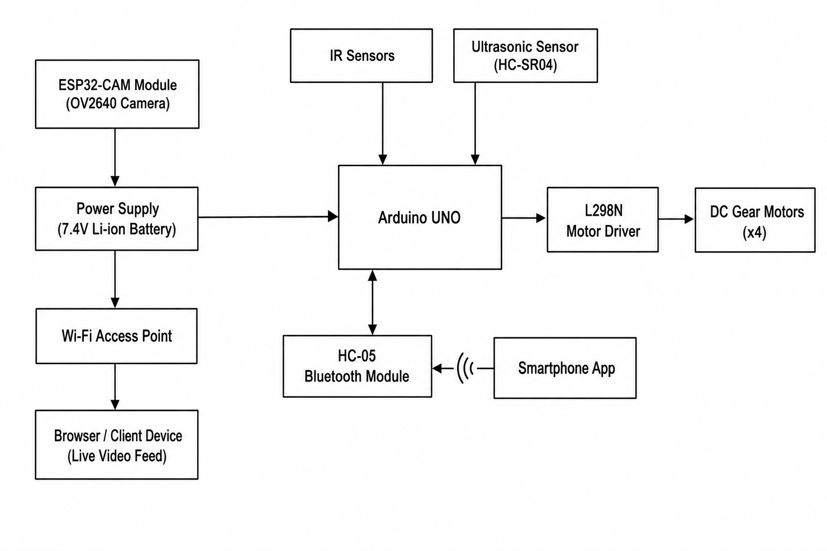
Design / Architecture Block Diagram

Slide 10
Software / Hardware Requirement
Hardware Components
Arduino UNO – Central controller
IR Sensors – For line detection
Ultrasonic Sensor (HC-SR04) – For obstacle detection
Bluetooth Module (HC-05) – For wireless control
ESP32-CAM Module – OV2640 camera, Wi-Fi streaming server
L298N Motor Driver – Controls motor direction/speed
DC Motors & Wheels – Vehicle movement
Power Supply (7.4V Li-ion Battery) – System power
Breadboard, Jumpers, LEDs – Circuit connections and indicators
Software Requirements
Arduino IDE – Programming the microcontroller
Bluetooth Controller App – For manual control via mobile
Embedded C/C++ – Coding language for Arduino
Serial Monitor (IDE) – For testing and debugging

Slide 11
References
Arduino Official Documentation, Arduino UNO Board Overview. Available at: https://www.arduino.cc/en/Main/ArduinoBoardUno
HC-SR04 Ultrasonic Sensor Datasheet, Specifications and Operating Principle. Available at: https://components101.com
L298N Motor Driver Module Documentation, H-Bridge Motor Control Guide. Available at: https://components101.com/modules/l298n-motor-driver-module
HC-05 Bluetooth Module Datasheet, Pin Configuration and AT Commands. Available at: https://components101.com/wireless/hc-05-bluetooth-module
IR Sensor Module Datasheet, Working Principle and Applications. Available at: https://components101.com/sensors/ir-sensor-module
ESP32-CAM Module Documentation, OV2640 Camera and Wi-Fi Streaming. Available at: https://docs.espressif.com/projects/esp-idf/en/latest/esp32/

Slide 12
Thank You!!
Any questions.

