Slide 1
CSC 440 Data Mining Predicting and Analysing the Viral Fragment of Songs
Shubham Shailesh tamhane
Ajeesh Ajayan nayaruparambil

Slide 2
Overview
Introduction
Problem Statement
Data Acquisition
Data Analysis
Modelling
Conclusion
Future work

Slide 3
Introduction
Nowadays, short-form video content ranging between 15-60 seconds are getting popular.
Consumption of this content has become part and parcel of everyone’s life, especially teenagers and young adults.
This has led to the boom of platforms such as Tiktok, Instagram Reels and YouTube shorts.
These videos are usually done in-the-moment, generally with a mobile phone.
All these platforms need the videos to be in vertical viewing manner.

Slide 4
Problem Statement
The aim of this project is to understand what makes some song fragments more socially popular than others.
The project also aims to predict popular fragments for newer unseen songs.
The song clips which are present in the social media platforms such as YouTube shorts are to be analysed by exploring different features of the audio files.

Slide 5
Data Acquisition
pytube and pafy library used.
Youtube data was scraped using these libraries and the most viral or viewed soundtrack was selected for both the full song and for the shorts.
The requirement was that all the file should have audio content.

Slide 6
Data Analysis
Different features of the audio files were explored.
Sampling rate used was 22050
Librosa library was used primarily for data analysis
Features explored are:
Spectral centroid
Spectral roll-off
Zero crossing rate
Spectrogram
Chromagram

Slide 7
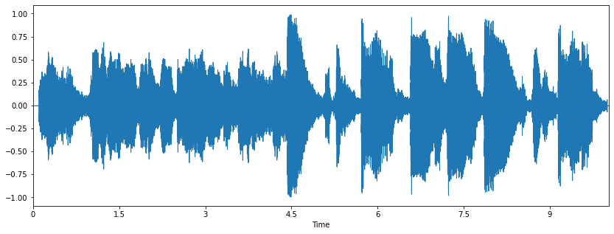
Waveplot
The waveplot shows how the audio signal looks like. It is normalized so that all audio signals can follow the same scale

Slide 8
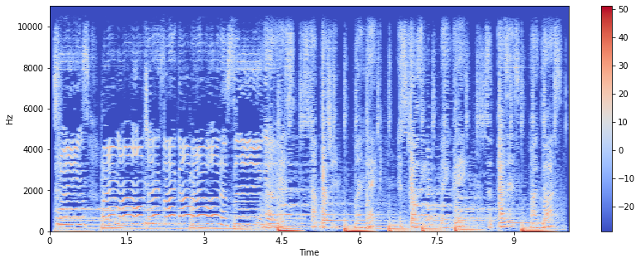
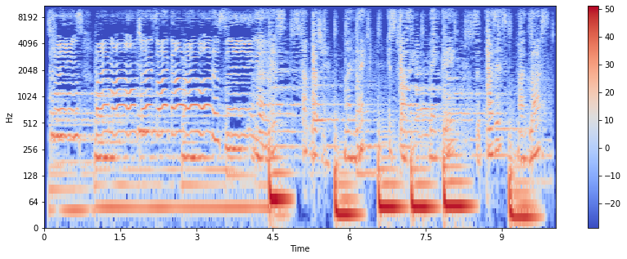
Spectrogram
A spectrogram is a visual representation of the spectrum of frequencies of a signal as it varies with time. If the spectrogram is plotted directly, not much information can be gained as the orange-reddish values lie on the bottom of the graph.
The spectrogram (left) is plotted in the form of heatmap where the vertical axis shows frequency and horizontal axis shows time.
After taking the logarithm, the values get scaled and we get a better representation of the audio file by looking at this spectrogram (right).
Spectrogram before taking log Spectogram after taking log

Slide 9
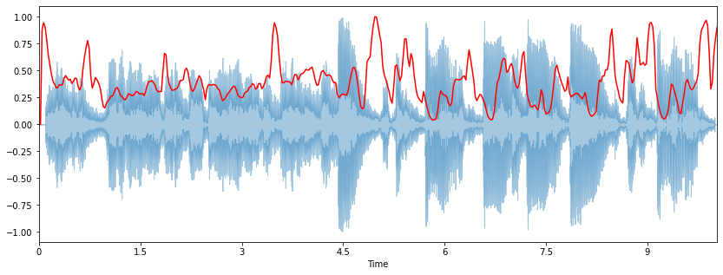
Spectral Centroid
Spectral Centroid is used to indicate the frequency at which energy of a spectrum is centered upon. It can also be considered as center of mass for sound. In the above plot we can see that there is a rise in spectral centroid after half of the audio signal.

Slide 10
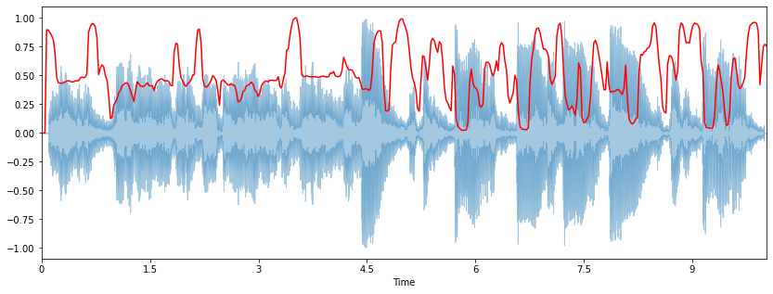
Spectral Rolloff
Spectral rolloff is used to measure the shape of the signal.

Slide 11
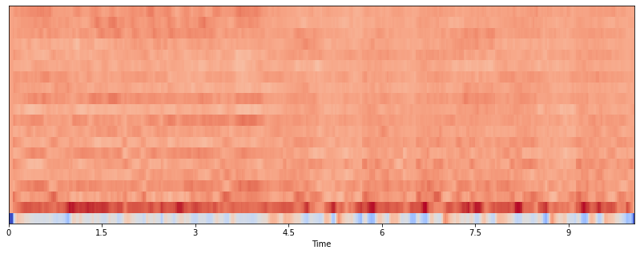
Spectrogram of MFCC values
MFCC which stands for Mel frequency cepstral coefficients represent the small set of features(20 in our case) which concisely describe the overall shape of the spectral envelope.

Slide 12
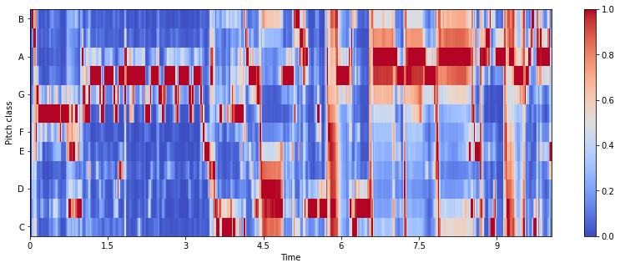
Chromagram
Chromagram represents the chroma features which typically is a 12 element feature vector indicating how much energy of each pitch class(y-axis) is present in the signal. This is often used while classifying music in different genres.

Slide 13
Modelling
For comparing similarity between two audio files, Dynamic Time Warping (DTW) was used
This was done by calculating the distance between the mfcc’s of the respective audio files.
Algorithms used are Logistic Regression, Weighted Logistic Regression, Naive Bayes, Support Vector Machines(SVM), Weighted Support Vector Machines(SVM), Random forest, SVM bagging classifier.

Slide 14
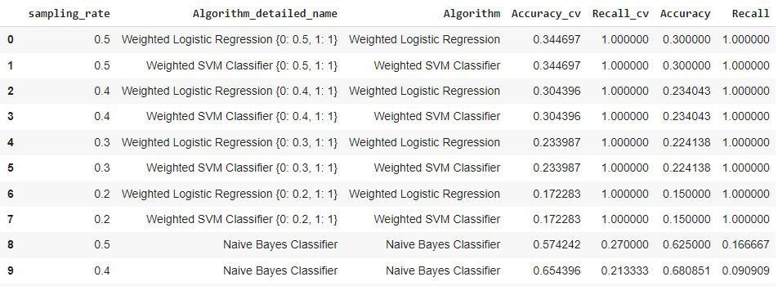
Comparison of Algorithms
These are the top 10 algorithms ordered in a descending manner by Recall and Accuracy and with lower Undersampling rate. We have to give importance to Recall as the data is imbalanced.
We can observe that Weighted Logistic Regression and Weighted SVM Classifier are the preferred models due to high Recall. But the accuracy, as you can observe, is not much favorable.

Slide 15
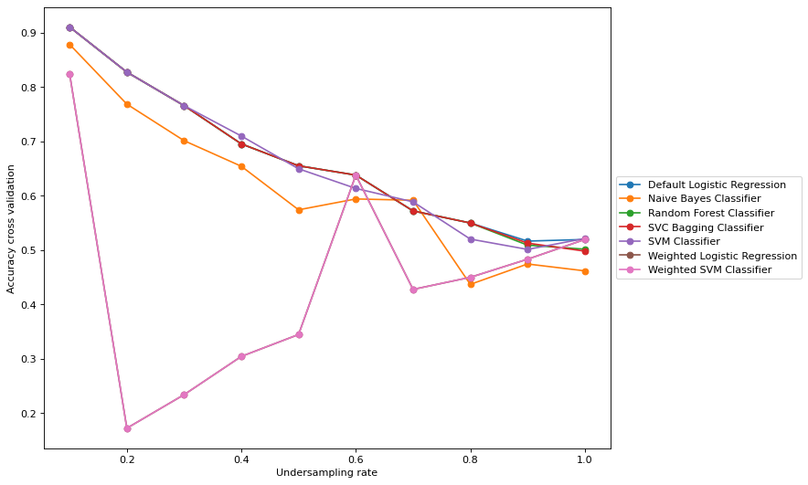
Cross Validation accuracy
The cross validation accuracy of SVC Bagging Classifier, SVM Classifier and Naïve Bayes Classifier are decent enough. But, we have to give more importance on the Recall value.

Slide 16
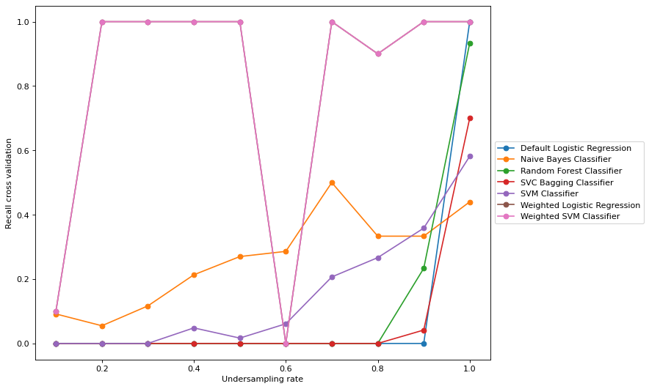
Cross Validation Recall
The cross validation Recall of SVC Bagging Classifier, SVM Classifier and Naïve Bayes Classifier are very low.
Hence, we have to tradeoff the accuracy for a better Recall.
The best possible models are Weighted Logistic Regression and Weighted SVM Classifier
Cross validation Accuracy = 34.47%
Cross validation Recall = 100%

Slide 17
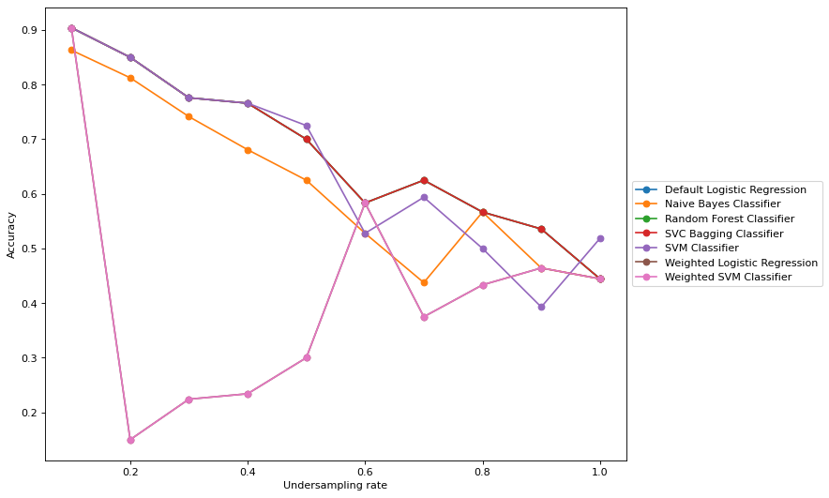
Test accuracy
Similarly, the test accuracy of SVC Bagging Classifier, SVM Classifier and Naïve Bayes Classifier are decent enough. But, we have to give more importance on the Recall value.

Slide 18
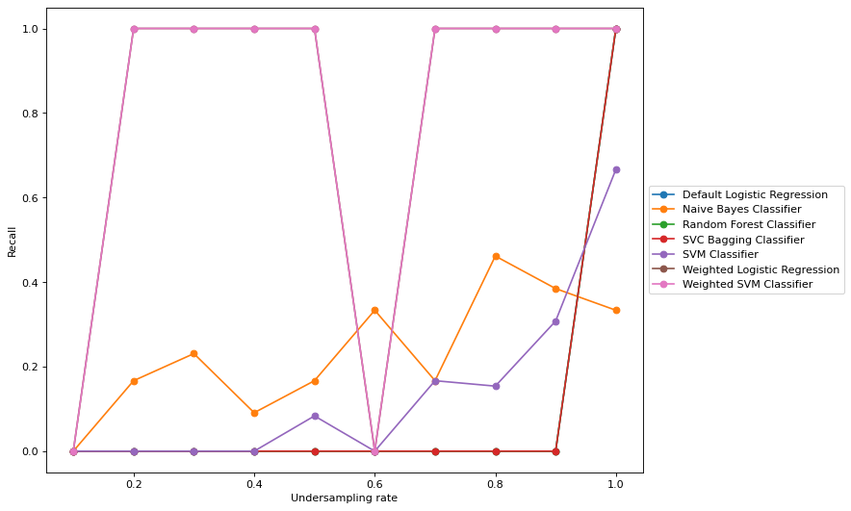
Test Recall
The test Recall of SVC Bagging Classifier, SVM Classifier and Naïve Bayes Classifier are very low.
Hence, we have to tradeoff the accuracy for a better Recall.
The best possible models are Weighted Logistic Regression and Weighted SVM Classifier
Test Accuracy = 30%
Test Recall = 100%

Slide 19
Conclusion
In this report we have discussed an approach to predict and analyze the viral fragment of songs. There are several works in the literature that deal with this problem. Our approach is unique in the way that it completely focuses on the acoustic features to isolate the viral fragment.
After extracting MFCC features from the song as well as the short and labeling them, we built seven classification models to predict the viral song fragment.
Among the proposed models, Weighted Logistic Regression and Weighted SVM Classifier gives the highest recall value (1.0) with a mediocre accuracy. Since the dataset is highly imbalanced, the recall had to be prioritized and hence the weighted algorithms worked the best.

Slide 20
Future work
More deeper analysis can be performed by exploring the spectrogram and chromagram features
Complex, pre-trained models can be used for modelling the data
Lyrics can also be used to derive the reason behind popularity of the clip

Slide 21
Thank You!

