Slide 1
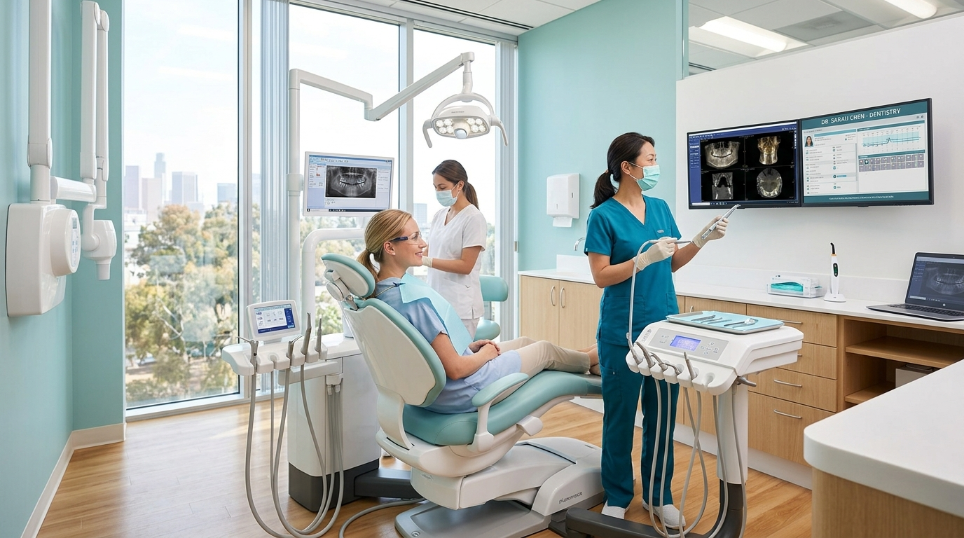
ISHA DENTAL CARE
Isha Dental Care
Modern Digital Experience for a Modern Dental Practice
Website Design & Digital Experience Presentation
A high-converting, compassionate, and trustworthy healthcare website engineered to welcome new patients, articulate dental specializations, and drive direct online appointments.
Live Website Mockup · "Your Smile. Our Care."
Presented by: Apex Healthcare Digital Studio | September 2026

Slide 2
PROJECT OVERVIEW
Project Overview
Creating a trustworthy digital front door for Isha Dental Care
"Isha Dental Care's new website has been designed to create a professional digital presence that builds patient trust, clearly communicates dental services, and makes appointment booking simple."
1. Build Patient Trust
2. Showcase Dental Services
3. Make Appointment Booking Easy
4. Create a Strong Online Presence
Alleviate dental anxiety with transparent clinic photography, verified doctor credentials, and clean sterile standards.
Clear categorization of 8 core treatments with procedure breakdowns, estimated durations, and patient benefits.
Frictionless online booking with date, time, and service selectors, plus one-tap WhatsApp and phone access.
A fast, mobile-first, and SEO-structured healthcare platform ready for local patient discovery.
Isha Dental Care · Website Design Presentation | 20-Slide Client Deck
Apex Healthcare Digital Studio

Slide 3
DESIGN STRATEGY
The Design Concept
A premium, reassuring healthcare aesthetic designed to reduce patient anxiety
Clean
Clutter-Free
Professional
Authoritative
HEALTHCARE DESIGN TOKENS
A clutter-free interface that makes dental information effortless to read and understand without visual overload.
A premium healthcare visual identity that communicates clinical competence, sterile hygiene, and doctor credibility.
Color System (60-30-10 Rule):
• 60% Dominant Canvas: Clean Medical White
• 30% Structural Elements: Slate & Soft Grays
• 10% High-Intent Accent: Clinical Medical Teal
Comfortable
Reassuring
Modern
Contemporary
Typography Pairings:
• Headings: Outfit (Modern & Confident)
• Body & Forms: Plus Jakarta Sans
Soft teal and cyan accents paired with warm welcoming imagery specifically designed to reduce patient fear.
Responsive layouts, rounded cards, smooth interactions, and modern UI patterns suitable for all age groups.
Isha Dental Care · Website Design Presentation | 20-Slide Client Deck
Apex Healthcare Digital Studio

Slide 4
CORE EXPERIENCE
Homepage Experience
Converting first-time visitors into confident patients within seconds
Clear Value Proposition
"Your Smile. Our Care." immediately communicates empathy, clinical dedication, and quality.
High-Visibility Primary CTAs
Prominent appointment booking button paired with secondary service exploration.
Immediate Trust Indicators
Checkmarks confirm experienced specialists, modern equipment, and comfortable care.
Goal: Strong 5-Second Impression
Website Homepage Hero · "Your Smile. Our Care."
Ensures patients who land from Google or social media feel confident staying on the site.
Isha Dental Care · Website Design Presentation | 20-Slide Client Deck
Apex Healthcare Digital Studio

Slide 5
SERVICES
Dental Services — Clear & Easy to Explore
Comprehensive catalog structured to guide patients toward booking
General Dentistry
Teeth Cleaning
Root Canal Treatment
Dental Implants
Routine checkups, digital diagnostics, cleanings and preventive dental care.
Ultrasonic scaling & polishing to maintain spotless teeth and healthy gums.
Rotary endodontics to gently save damaged or infected teeth pain-free.
Natural-looking titanium tooth replacement solutions with lifelong strength.
Est. 40-60m · Learn More →
Est. 30-45m · Learn More →
Est. 60-90m · Learn More →
Est. Permanent · Learn More →
Teeth Whitening
Cosmetic Dentistry
Braces & Aligners
Pediatric Dentistry
Chairside LED-activated whitening for a brighter, stain-free radiant smile.
Digital smile design, porcelain veneers, and direct aesthetic bonding.
Discreet clear aligners and ceramic solutions for straight, healthy teeth.
Gentle, cheerful, anxiety-free dental visits tailored specifically for children.
Est. 45-60m · Learn More →
Est. Custom · Learn More →
Est. 6-18 mo · Learn More →
Est. 30-40m · Learn More →
💡 Interactive Feature: Every service card opens a detailed modal with procedure steps, recovery expectations, and direct booking.
Isha Dental Care · Website Design Presentation | 20-Slide Client Deck
Apex Healthcare Digital Studio

Slide 6
VALUE PROPOSITION
Why Choose Isha Dental Care
Communicating clinical strengths before the patient even contacts the clinic
Experienced Dental Professionals
Personalized Treatment Plans
Modern Dental Technology
Qualified specialists with 10+ years combined experience in restorative, cosmetic, and pediatric care.
No one-size-fits-all treatments. Transparent discussion of clinical options and patient budgets.
Low-radiation digital radiography, intraoral high-def cameras, and rotary endodontics for gentle care.
Comfortable Clinic Environment
Transparent Pricing
Patient-First Approach
Calming ambiance, sterile operatories, ambient music, and empathetic staff who ease dental fear.
Clear, upfront fee structures with zero hidden charges. Estimates provided before treatment begins.
From flexible appointment schedules to prompt post-operative follow-up calls, patient comfort comes first.
Isha Dental Care · Website Design Presentation | 20-Slide Client Deck
Apex Healthcare Digital Studio

Slide 7
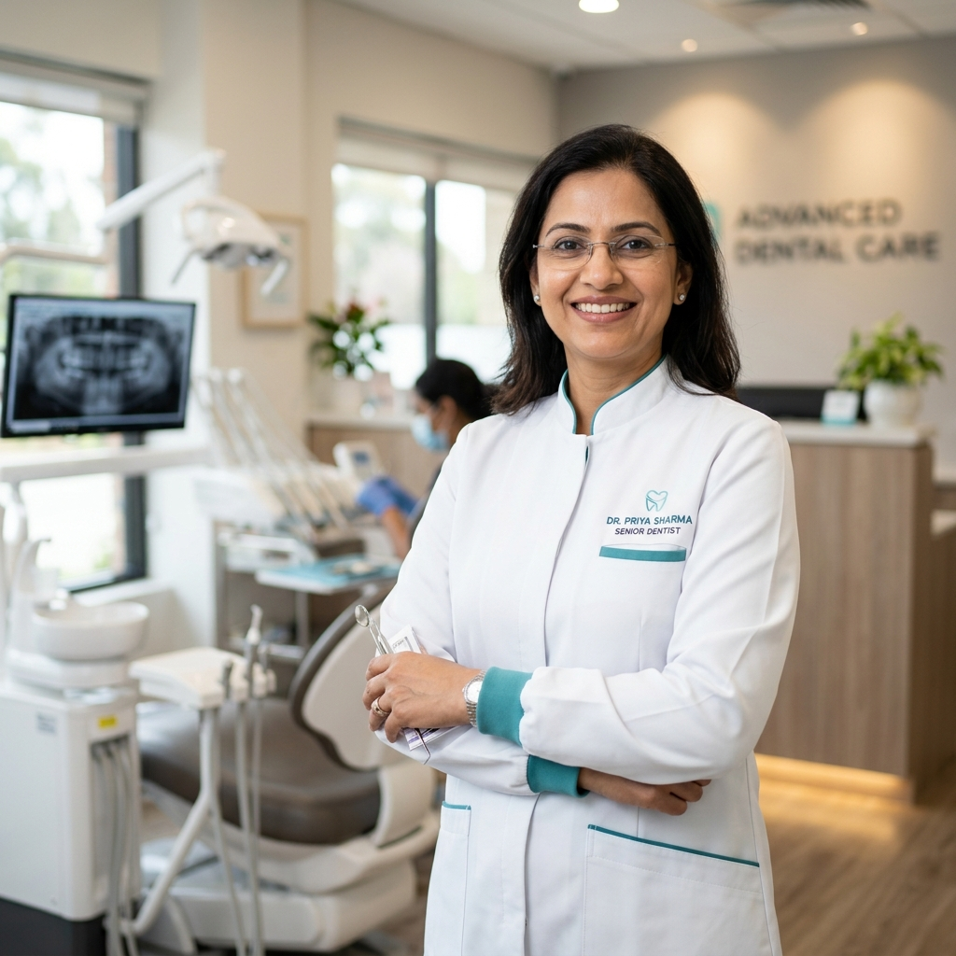
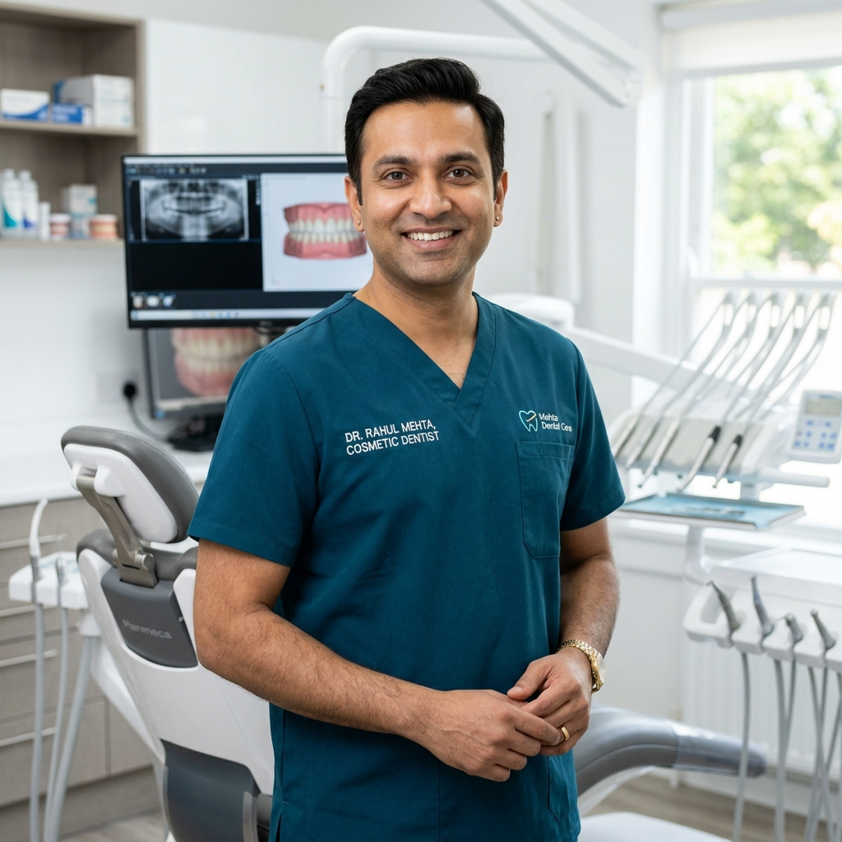
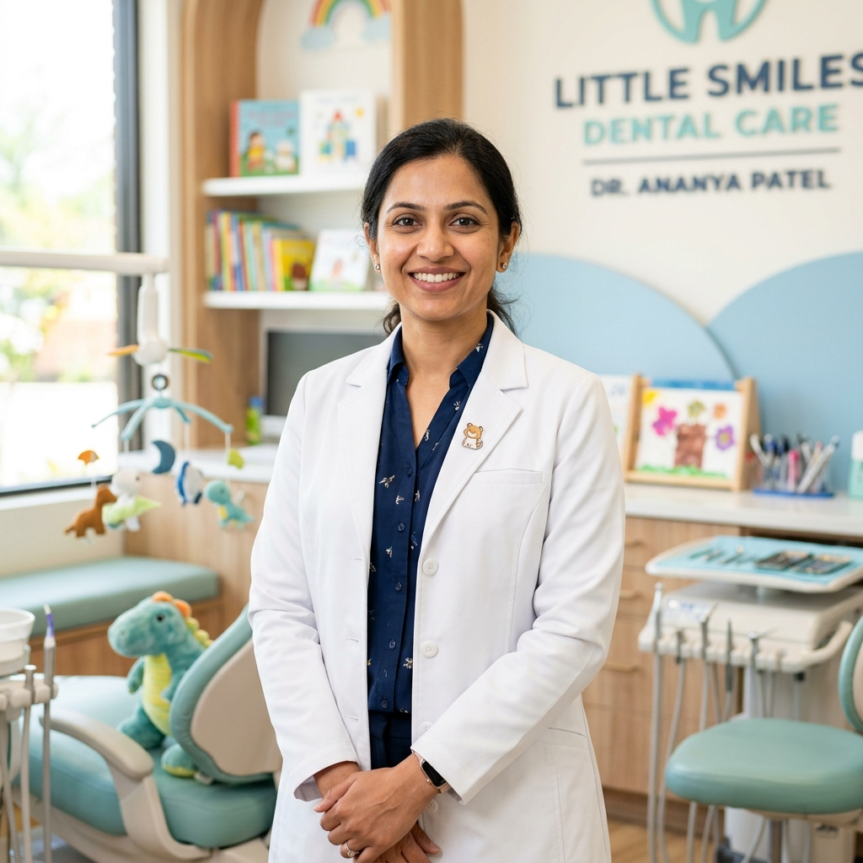
DOCTORS & CLINICAL TEAM
Introducing the Dental Experts
Humanizing clinical care with doctor qualifications and specializations
10+ Years Experience
8+ Years Experience
6+ Years Experience
Dr. Priya Sharma
Dr. Rahul Mehta
Dr. Ananya Patel
Senior Dentist & Prosthodontist
Cosmetic & Implant Dentist
Pediatric Dentist
BDS, MDS (Prosthodontics)
BDS, MDS (Conservative Dentistry)
BDS, MDS (Pedodontics)
Specialization: Full Mouth Rehabilitation & Implants
Specialization: Porcelain Veneers & Rotary Root Canals
Specialization: Child Dental Wellness & Habit Counseling
⚠️ Sample Content — Final doctor names, credentials, photographs, and consultation schedules can be updated by the clinic.
Isha Dental Care · Website Design Presentation | 20-Slide Client Deck
Apex Healthcare Digital Studio

Slide 8
CONVERSION FUNNEL
Designed to Convert Visitors into Appointments
A streamlined booking experience that eliminates patient friction
Step 1
Step 2
Step 3
Step 4
Visit Website
Explore Services
Build Trust
Book Appointment
Discovers clinic via Google or recommendation
Learns about painless procedures & doctor profiles
Checks reviews, sterilization & transparent fees
Selects date, time & submits request in <60s
FORM FIELDS & VALIDATION ARCHITECTURE
• Full Name (Required, validated)
• Phone Number (Required, formatted)
• Email Address (Optional, validated)
• Select Dental Service (Dropdown)
• Preferred Date (Datepicker with min date)
• Preferred Time Slot (09:00 AM - 08:00 PM)
• Message / Dental Concern (Optional)
• Instant Confirmation & localStorage persistence
Isha Dental Care · Website Design Presentation | 20-Slide Client Deck
Apex Healthcare Digital Studio

Slide 9
MOBILE FIRST
Mobile-First Patient Experience
70%+ of dental clinic searches occur on mobile smartphones
Responsive Layout
One-Tap Click-to-Call
Direct WhatsApp Chat
Fluid design that automatically adapts to iPhone, Android, iPad, tablet, and desktop screens.
Patients with emergency pain can call the clinic reception with a single tap on the phone number.
Floating WhatsApp button pre-fills appointment inquiries for effortless mobile communication.
Thumb-Friendly Buttons
Mobile Navigation Drawer
Fast-Loading Performance
Touch targets meet WCAG standards (>44px) so booking appointments on mobile is effortless.
Smooth animated hamburger menu providing fast access to services, doctors, and location.
Optimized image loading ensures quick page opening even on cellular 4G/5G connections.
Isha Dental Care · Website Design Presentation | 20-Slide Client Deck
Apex Healthcare Digital Studio

Slide 10
EMERGENCY & QUICK CONTACT
Quick Access When Patients Need Help
Rapid triage for acute toothaches, chipped teeth, and sudden dental trauma
EMERGENCY DENTAL ASSISTANCE
Need Urgent Dental Care?
📞 Call Now: +91 8147440264
"Don't let dental pain wait. Contact our clinic for urgent dental assistance."
📞 Click-to-Call
💬 WhatsApp Chat
📅 Floating Booking Button
Clickable directly on mobile for immediate clinic receptionist triage.
Floating emerald WhatsApp icon active across every page of the website.
Appears smoothly upon scrolling down to ensure appointment access is never lost.
Isha Dental Care · Website Design Presentation | 20-Slide Client Deck
Apex Healthcare Digital Studio

Slide 11
SOCIAL PROOF
Creating Trust Before the First Visit
Answering common doubts and building emotional safety before arrival
★★★★★
★★★★★
★★★★★
★★★★★
"Dr. Sharma and the entire team made my treatment comfortable and stress-free. Highly recommended!"
"The clinic is modern, clean and the staff is extremely friendly. My cleaning was painless."
"Very professional service and excellent dental care. Got my dental implant done with zero issues."
"One of the most comfortable dental experiences I have had. Very gentle with my child!"
— Aarav Kulkarni
— Sneha Patil
— Rohan Deshmukh
— Neha Joshi
Root Canal & Ceramic Crown
Ultrasonic Cleaning & Whitening
Titanium Dental Implant
Pediatric Checkup & Fluoride
⚠️ Note: Testimonials and reviews shown are sample demonstration content ready to be updated with genuine patient feedback upon launch.
Isha Dental Care · Website Design Presentation | 20-Slide Client Deck
Apex Healthcare Digital Studio

Slide 12
PATIENT EDUCATION
Answers Before Patients Ask
Addressing treatment doubts and cutting down repetitive phone calls
Q1: How often should I visit the dentist?
Q2: Is teeth cleaning painful?
Every 6 months for routine cleaning and preventive cavity detection.
No, modern ultrasonic scaling is generally painless with water cooling.
Q3: How long does a root canal take?
Q4: Do you treat children?
60 to 90 minutes, often completed in a single comfortable visit.
Yes! Dedicated pediatric specialist Dr. Ananya uses child-friendly techniques.
Q5: Do you provide emergency dental care?
Q6: What payment options are available?
Yes, same-day priority triage for severe toothaches and trauma.
UPI, credit/debit cards, net banking, cash, and 0% EMI plans.
Isha Dental Care · Website Design Presentation | 20-Slide Client Deck
Apex Healthcare Digital Studio

Slide 13
LOCATION & ACCESS
Easy to Find. Easy to Contact.
Guiding local patients to Coral Business Centre with clear landmarks
📍 Clinic Address
📞 Clinic Telephone
Shop No. 110-11, Coral Business Centre, Near D-Mart, Beside Mhetre Tower, Jule, Solapur-413004, Maharashtra
+91 8147440264 (Reception & Inquiries)
✉ Email Address
🕐 Operating Hours
ishadentalcare@gmail.com
Monday – Saturday: 9:00 AM – 8:00 PM
Sunday: 10:00 AM – 2:00 PM
⚠️ Note: Final clinic contact numbers, email addresses, and landmark directions to be confirmed by the client prior to launch.
Isha Dental Care · Website Design Presentation | 20-Slide Client Deck
Apex Healthcare Digital Studio

Slide 14
TECHNICAL FOUNDATION
Built for Discoverability
Structured with search visibility, accessibility, and speed in mind
Semantic HTML5 Hierarchy
Schema.org "Dentist" JSON-LD
Logical H1, H2, and H3 headings so search engine bots can easily understand treatments and services.
Embedded structured metadata for rich Google search snippets, reviews, and Google Maps Knowledge Panels.
OpenGraph & Social Share Cards
Fast-Loading Performance
Attractive link preview cards with clinic photography when shared on WhatsApp, Facebook, or LinkedIn.
Zero lag or heavy frameworks, ensuring patients on 4G/5G mobile phones experience instantaneous loading.
Isha Dental Care · Website Design Presentation | 20-Slide Client Deck
Apex Healthcare Digital Studio

Slide 15
PATIENT JOURNEY
The Patient Journey Flowchart
From initial search query to clinic appointment confirmation
1
2
3
4
5
6
7
Google / Social
Website Visit
Explore Services
Build Trust
Book Online
Clinic Triage
Clinic Visit
Searches for Solapur / Pune dental clinic
5-second strong, clean first impression
Reviews procedures, time, and benefits
Examines doctor bios & patient reviews
Submits date & service in <60 seconds
Front desk confirms slot via phone/WhatsApp
Patient arrives confident & well-informed
Isha Dental Care · Website Design Presentation | 20-Slide Client Deck
Apex Healthcare Digital Studio

Slide 16
BUSINESS VALUE
How the Website Supports the Clinic
Direct operational, reputation, and patient acquisition benefits
1. Strong Online Presence
Establishes Isha Dental Care as a premium, modern medical practice in the local region.
2. Better Patient Experience
Patients can explore treatments, study doctor credentials, and book visits at their own pace 24/7.
3. More Direct Enquiries
Prominent click-to-call, WhatsApp chat, and online appointment forms eliminate conversion friction.
4. Service Visibility
Educates patients about high-value treatments such as dental implants, clear aligners, and smile makeovers.
5. Patient Trust & Loyalty
Transparent hygiene protocols, genuine doctor profiles, and reviews alleviate fear and build lasting loyalty.
Isha Dental Care · Website Design Presentation | 20-Slide Client Deck
Apex Healthcare Digital Studio

Slide 17
CLIENT CUSTOMIZATION
Easy to Personalize
All clinic information is centrally organized for rapid updates
• Doctor names, bios, qualifications, and schedules
• Real clinic photography & operatory pictures
• Treatment service descriptions & fee structures
• Clinic phone numbers, WhatsApp, & email address
• Clinic street address & Google Maps pin location
• Operating hours & holiday schedule details
• Genuine patient testimonials & star ratings
• Clinic experience statistics (years, patient counts)
• Social media profile links (Instagram, Facebook, LinkedIn)
• Official clinic logo and branding assets
⚠️ Important Reminder: The current presentation and website contain sample/demo content that should be replaced with final clinic-approved information before official public launch.
Isha Dental Care · Website Design Presentation | 20-Slide Client Deck
Apex Healthcare Digital Studio

Slide 18
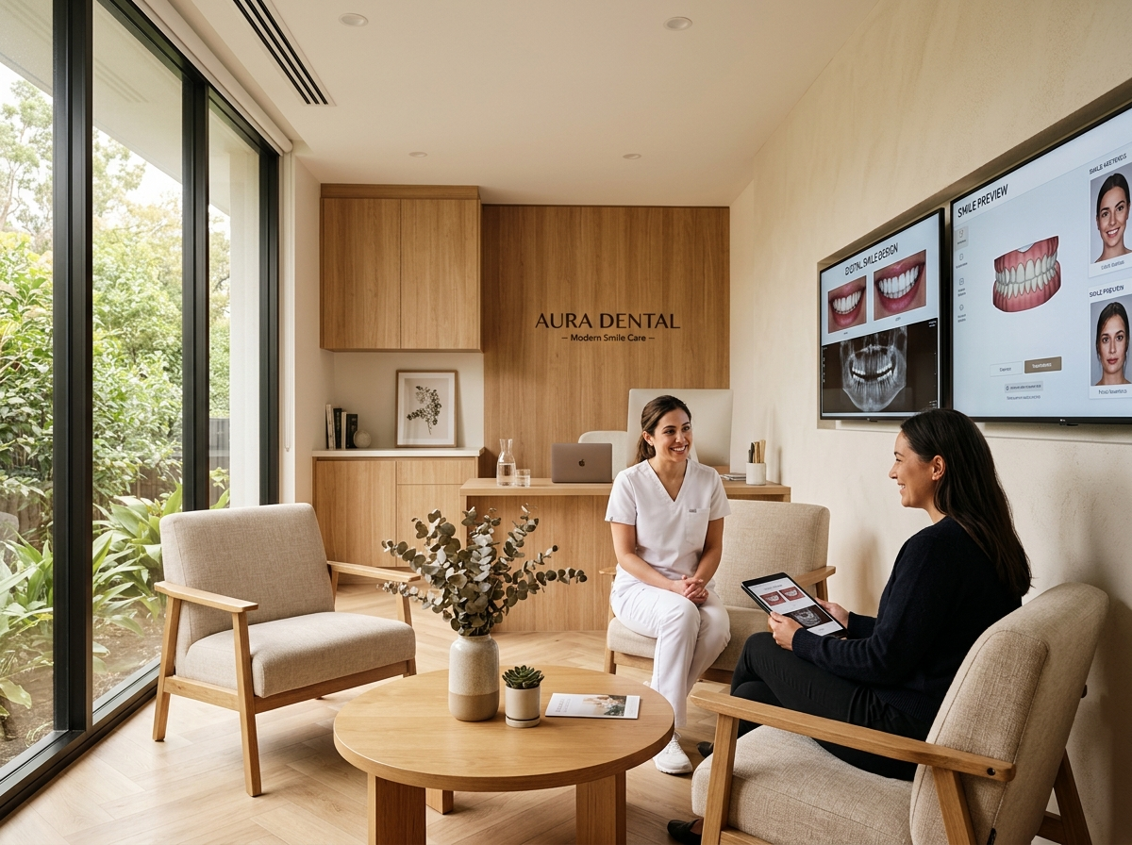
DESIGN SHOWCASE
Isha Dental Care — Complete Digital Experience
A modern, trustworthy, and patient-focused digital presence
Operatory & Digital X-Ray Diagnostic Suite
Patient Consultation Suite & Hygiene Lounge
Isha Dental Care · Website Design Presentation | 20-Slide Client Deck
Apex Healthcare Digital Studio

Slide 19
NEXT STEPS
Next Steps & Launch Checklist
Client approval items required to move from preview to live launch
☐ Confirm final clinic address, phone numbers, and WhatsApp line
☐ Confirm doctor profiles, qualifications, and consultation hours
☐ Provide final clinic operatory and consultation room photographs
☐ Confirm treatment service catalog & fee transparency details
☐ Provide genuine patient reviews / Google reviews to publish
☐ Final domain name selection & DNS connection (e.g. ishadentalcare.com)
☐ Cross-browser and mobile device final quality assurance testing
☐ Official website public launch & Google My Business linking
Isha Dental Care · Website Design Presentation | 20-Slide Client Deck
Apex Healthcare Digital Studio

Slide 20
THANK YOU
Isha Dental Care
"Your Smile. Our Care."
Questions, Feedback & Content Confirmation
Presented by: Apex Healthcare Digital Studio
Website: ishadentalcare.com | Email: contact@apexhealthcare.design

