Slide 1
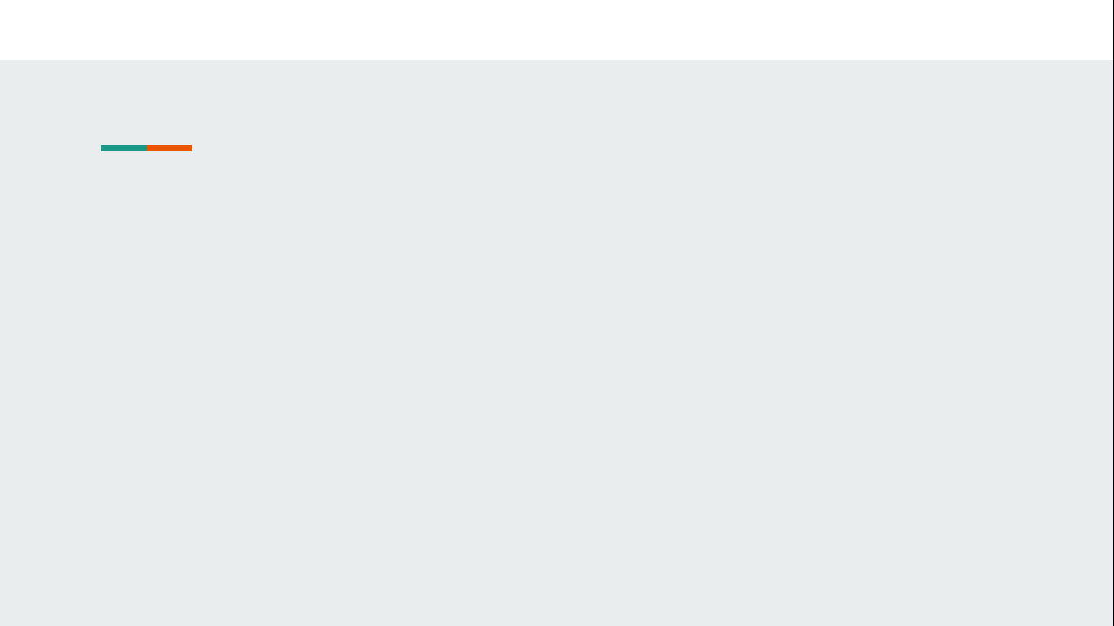
Understanding Toxicity Predictions Through Explainable AI
Shubham Thakur,
Supervisor : Prof. Dr. Gerhard Ecker
Mentors : Ece Asilar, Jennifer Hemmerich
Pharmacoinformatics Research Group
University of Vienna

Slide 2



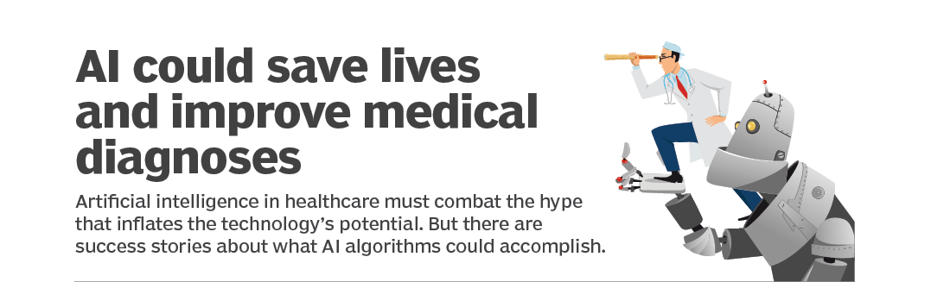
AI Success Stories
AI is helping people from everywhere to solve problems in exciting new ways
Ref : [1,2,3,4]
Notes:
I would first like to talk few success stories of how it is AI changing our lives. These are few of the stories where we can see AI helps with skin cancer ,AI could save the lives and many more. Now AI is helping …,With all these successes I would like to explain explainable AI is so important research area.

Slide 3
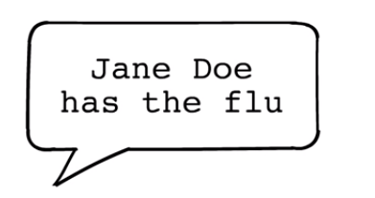
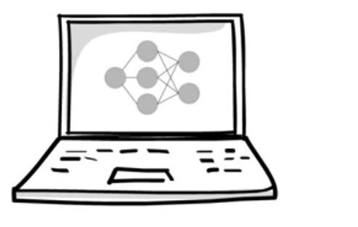

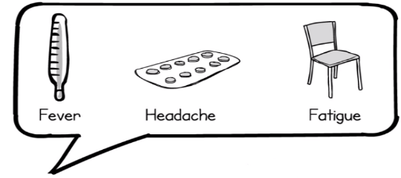


Why Explainable AI ?
Sometime you don’t know if you can trust an AI model prediction.
Why should I trust you?
But its easy to trust a prediction if you understand the reason for it.
Okay! Now I can trust you
Ref : [5,6,7,8,]
Notes:
Sometime you don’t know if you can trust an AI model prediction, A doctor will never diagnose the patient just because machine said so. But its easy to trust a prediction if you understand the reason for it. As you can see for this case the folloing are the reasons.To extract the explaination behind sertain prediction we need Explainable AI tools

Slide 4
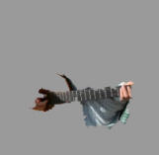

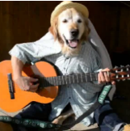

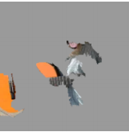

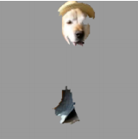
Available Tools For Explainable AI
SHAP: Easy to Implement but not suitable for our data.
LRP(Layer-Wise Relevance Propagation) : Robust but time consuming, we leave it for the future
LIME(Local Interpretable Model-Agnostics Explanation) : Easy to Implement and can be applied to both Image and tabular dataset.
Explaining Electric Guitar
Prob(Electric Guitar) :0.32
Black Box Model
LIME Explainer
Prob(Acoustic Guitar) :0.24
Explaining Acoustic Guitar
Test Case
Prob(Labrador) :0.21
Explaining Labrador
Ref::9
Notes:
Here are few explainable tools that are currently used to find the explanations. SHAP model is based on calculation of shapely value which is inspired from the concept of game theory. It is easy to implement but it is not suitable for our dataset.
LRPs are robust but time consuming models and hence we leave it for future .Whereas Lime is easy to implement and can be applied to both image and tabular dataset.
Here is the example used by the Lime guys where they put the image of Labrador holding guitar into a trained black box model where they get the prediction as…
When this prediction were further feeded into the lime explainer we got the corresponding parts that are responsible for the same. So we now understood facial part was responsible

Slide 5

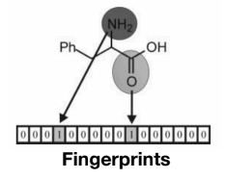
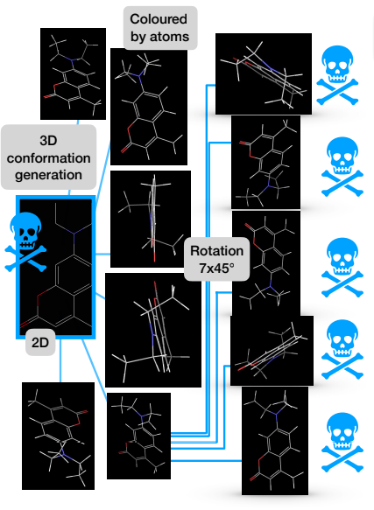
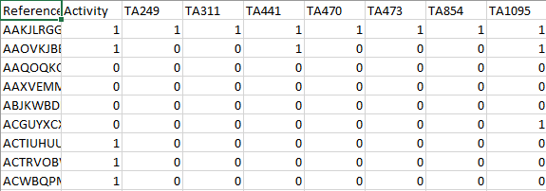
Datasets And Model
Tox-Alerts
Ref : [10,11]
Notes:
Having introduced the available explainable AI model now I will briefly introduced the dataset and the model used. We used Tox alert fingerprint dataset where reference is the unique ID and activity is the label which is binary i.e 1if molecule is active and 0 if molecule is inactive. And there are the alerts. The black model that we used was trained by Jenny. The second dataset is the tox21 dataset where 3D conformers and their rotation datasets were generate.

Slide 6
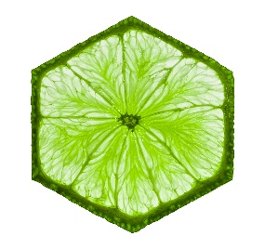
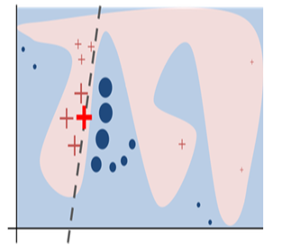
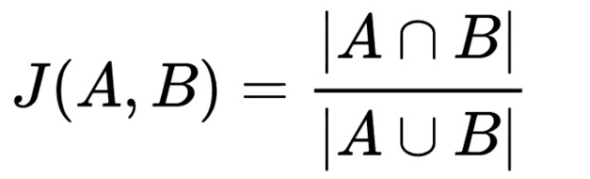
Working Principal Of LIME
With LIME we try to explain the closest decision boundary from the test case and decision involved for the same.
Step 1 : Permute N data points.
Step 2 : Calculate the similarity scores
Step 3 : Make prediction on this permuted data using black box model.
Step 4 : Fit simple linear model on the permuted data weighted by similarity scores.
Step 5 : Extract the feature weights from coefficients of simple linear model and use this as explanation for black box models local behaviour.
Similarity Score Calculations
A :
1 | 1 | 0 | 0 | 0 | 1
0 | 1 | 0 | 0 | 0 | 1
2
4
B :
0 | 1 | 0 | 1 | 0 | 1
1 | 1 | 0 | 1 | 0 | 1
Ref::12
Notes:
Now coming to the working principal, with lime we try to explain the closest decision boundary from the test case and decision involved for the same.
For this we first permute N datapoints then we calculate the similarity score which is for our case is jaccard similarity score which is for bitwise vector A and B is Aintersection B upon A union B.Then we make prediction on this permuted data using black box model. As a step 4 we fit simple linear model on the permuted data weighted by similarity scores such that the points that are farthest from the decision boundries are assigned low weights. As a final step we xtract the feature weights from coefficients of simple linear model and use this as explanation for black box models local behaviour. That is if the eqn is y = w1 + w2 … this w1,w2 .. Are the feature importance value.

Slide 7
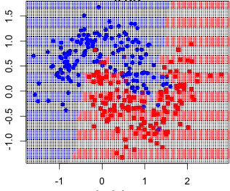
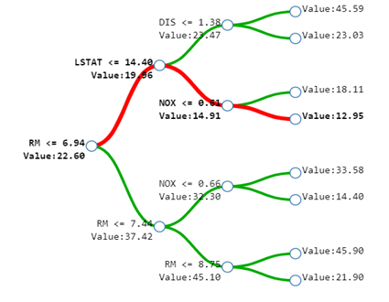
Non Linear Local Decision Boundary
Decision tree as the local model to capture non-linearity.
Used tree interpreter for calculating feature importance.
LSAT <= 14.40 Value : 19.96
NOX <= 0.61 Value : 14.91
Tree interpreter
Value : 12.95
RM <= 6.94 Value : 22.60
Each prediction is decomposed into a sum of contributions from each feature.
prediction = bias + feature₁contribution+…+feature_{n}contribution
Prediction: 12.95 ≈ 22.60 (trainset mean) - 2.64(loss from RM) - 5.04(loss from LSTAT) - 1.96(loss from NOX)
Ref :7
Ref : [13,14]
Notes:
So lime guys made the model considering local boundary as linear ,but what if it is not ?
So we added the decision tree model as local model by making few tweaks in the source code to capture the non-linearity in the dataset. We used tree interpreter for getting the class wise feature importance. Now lets look how tree interpreter calculates the feature importance from decision tree by decomposing a prediction into sum of contributions from each feature. Here is the trained decision tree with dataset having four features RM ,LSAT ,NOX and DIS. Now the prediction 12.95 can be seen as sum of bias which is 22.60 and the loss through RM which is 2.64 as you can see with the first split the value changes from 22.60 to 19.96 and so on …

Slide 8
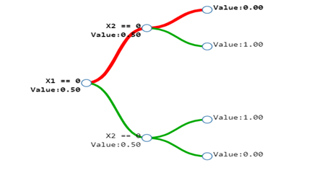
Conditional Feature Contribution From
Tree Interpreter
There might be the case where features individually contributes nothing towards prediction but becomes predictive in conjunction with the other input feature
Exclusive OR(XOR)
X1 | X2 | OUTPUT
0 | 0 | 0
0 | 1 | 1
1 | 0 | 1
1 | 1 | 0
prediction = bias + feature₁contribution +feature₂contribution + (feature₁,feature₂)contribution
Value : 0.00
X2 == 0 Value : 0.50
X1 == 0 Value : 0.50
Prediction: 0.00 ≈ 0.50 (trainset mean) + 0.00 (increase from X1 ) - 0.5 (decrease from X1,X2 )
Ref : [15]
Notes:
There might be the case where features individually contributes nothing towards prediction but becomes predictive in presence of the other. This could be important for our case where presence of certain tox alert is not as importance as the combination of tox alert.

Slide 9
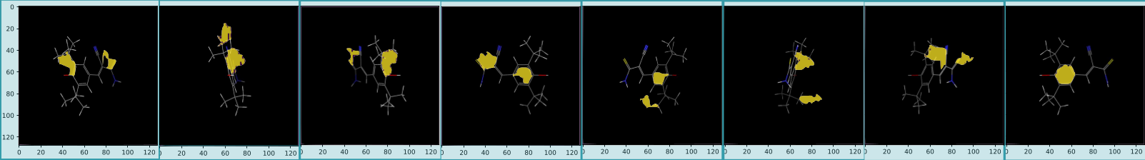
Results On Images
A toxic compound which is predicted as toxic with a probability of 0.84 using our models and predicted as toxic with LIME’s local linear model as toxic with a probability of 0.87. The most important two segments are shown.
Independent to the rotation our local model picked same region for four out of eight rotations.
Main Issues : No comparable measure across different images.
Notes:
Coming to the most interesting part that is the results. So we took a toxic compound which was even predicted as toxic by our black box model and tried to get explanation's for the 8 rotations and we found that independent to the rotation our local model picked same region for four out of eight rotations. But since we don’t really have any comparable measure across different images we implemented this method for the case of fingerprints where we can understand the predictions by calculating the importance based on presence or absence of the alerts

Slide 10

Results On Fingerprint Data
To verify our approach we generated an ideal dataset to mimic our fingerprint dataset. In this ideal dataset we intentionally engineered the expected importance of the features.
We tested our model for few data points of ideal dataset and the output importance matched with the expected importance.
Test Case :
Output :
Feature Combination | Importance values
(Feature2 , Feature4, Feature9 ) | -0.4107
(Feature4, Feature9) | -0.2614
(Feature9 , ) | 0.2432
For fingerprint dataset , since the deep learning model(black box) is trained on small data set the performance is not up to the mark with the approximate balanced accuracy of 60% and hence results could be unreliable.
Notes:
Here you see the percentage of 1s for each features in column and corresponding labels in the rows.As e.g. feature 9 is set to have 85% 1s for label 1 and 15% 1 for label 0s which makes it very important .Here for this example the resultant table looks like this. In this table we see, the combination of feature2 , 4,9 has the largest contribution to the decision. And this resukt is an agreement with our ideal dataset.So currently we are working on the real fingerprint dataset. We are experiencing rather low balanced accuracy in the predictive model and it makes the prediction unreliable.Ath this point I arrived my conclusion that we will co

Slide 11
Future Work
Build a robust deep learning model for fingerprint dataset.
Proper sampling across the local decision boundary.
Develop a comparable measure to find out globally important features for all the images.
We can check methods like LRP for further improvements in the model.

Slide 12
Thank You…
?

Slide 13
References
[1] :https://software.intel.com/en-us/articles/ai-helps-with-skin-cancer-screening
[2] : https://searchhealthit.techtarget.com/feature/Use-of-AI-in-healthcare-seen-saving-lives-of-patients
[3,4,10,11] : Ece’s CADD GRC presentation
[5,6,9.12] : https://github.com/marcotcr/lime
[13] : https://www.oreilly.com/library/view/data-analysis-with/9781788393720/7d7c538e-2f7f-4e7e-9661-cd34f37c4711.xhtml
[14]:http://blog.datadive.net/random-forest-interpretation-with-scikit-learn/
[15]:https://blog.datadive.net/random-forest-interpretation-conditional-feature-contributions/

Slide 14
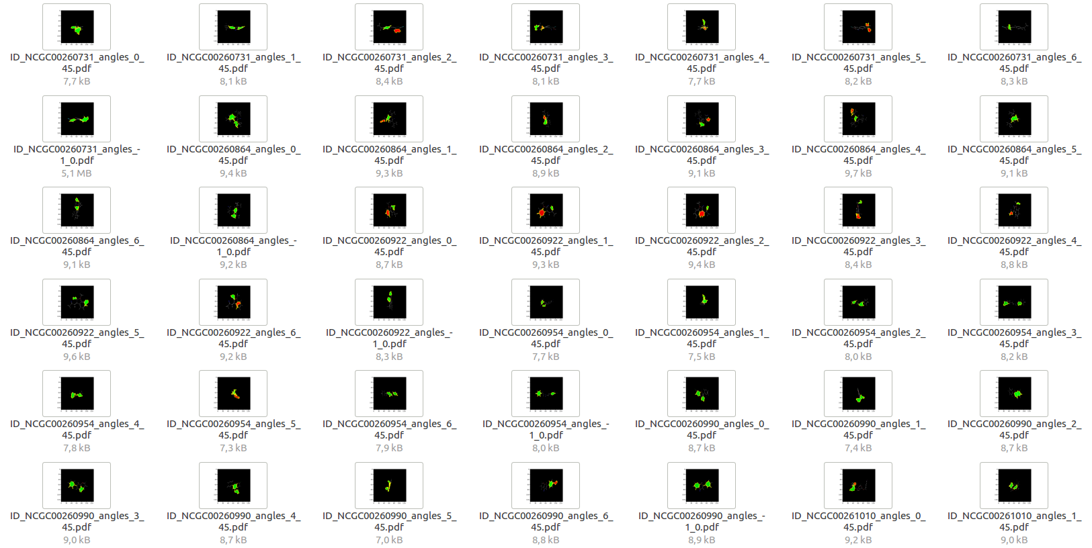
Back Up -1

Slide 15
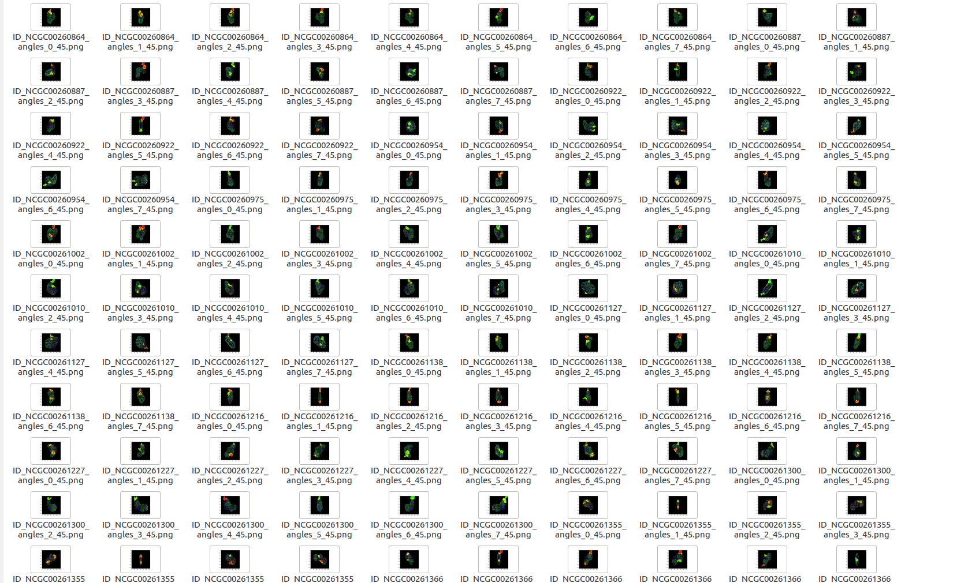
Back Up - 2

Slide 16
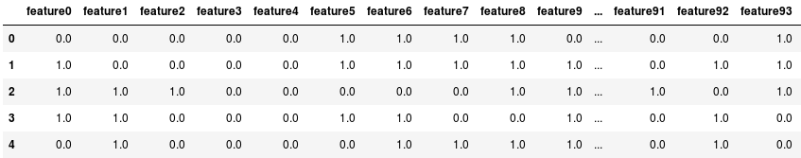
Back Up - 3
Ideal Dataset

Slide 17
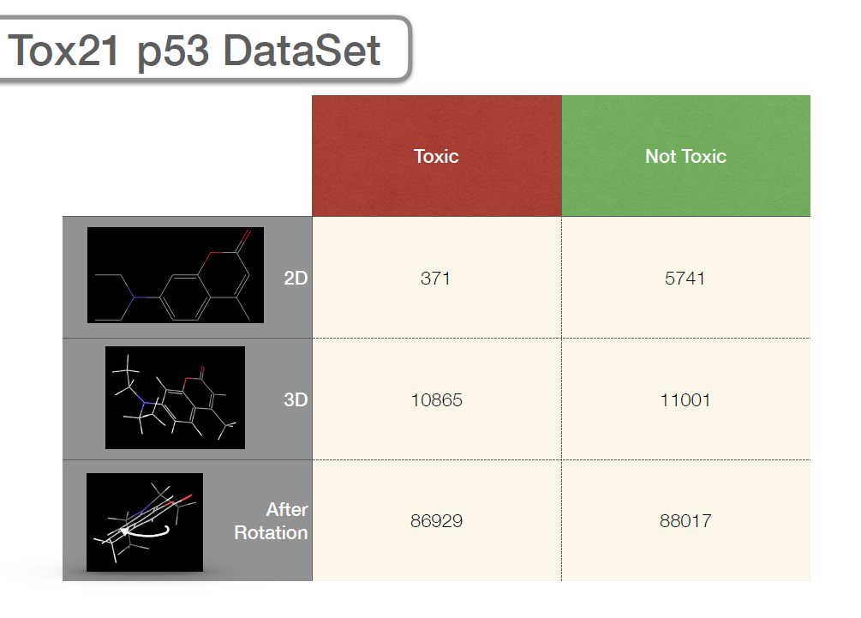
Back Up - 4
Description of the Datasets
Tox Alert dataset
Toxic | Non-Toxic
611 | 497

