Slide 1
Assignment
Below is the architecture diagram illustrating the real-time streaming pipeline using Kafka Streams. It shows data ingestion, processing, and aggregation flow, along with the integration with databases, monitoring, and dashboards for real-time analytics.

Slide 2
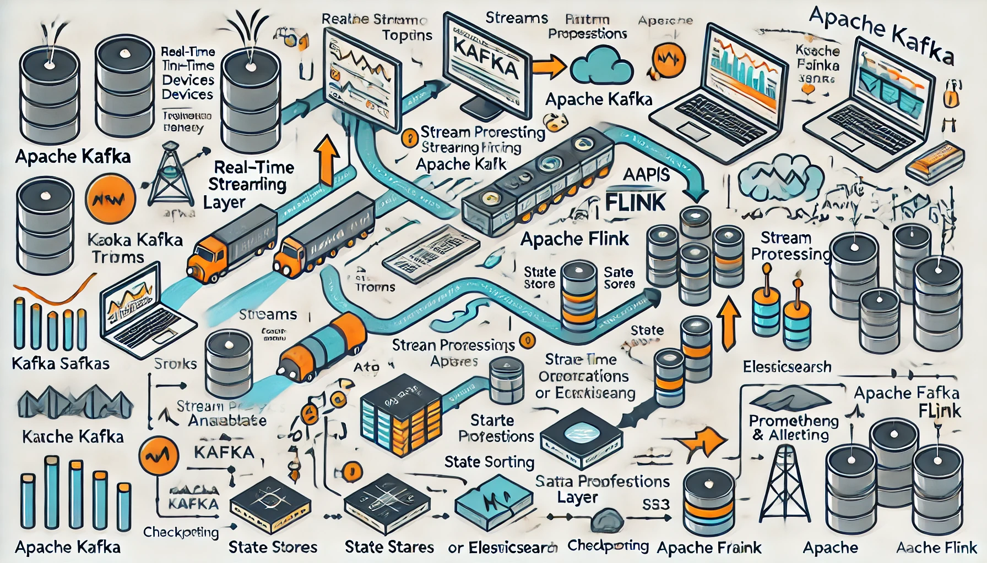

Slide 3
Task 1
GPS Real-Time Transactions (real time 4 sources via Kafka)
Schema: CustomerID, CarID, OfficeID, AgentID, TRXN Timestamp, CarDrivingStatus (Stopped/Idle/Moving), CurrentLongitude, CurrentLatitude, CurrentArea, KM
Note: these are 4 source systems (SRC01, SRC02, SRC03, SRC04) generating data with identical schema
Here is the architecture diagram illustrating the processing of GPS Real-Time Transactions from four source systems via Kafka. It showcases the flow from ingestion through Kafka, processing with a streaming engine like Kafka Streams, and storing results for real-time insights and analytics

Slide 4
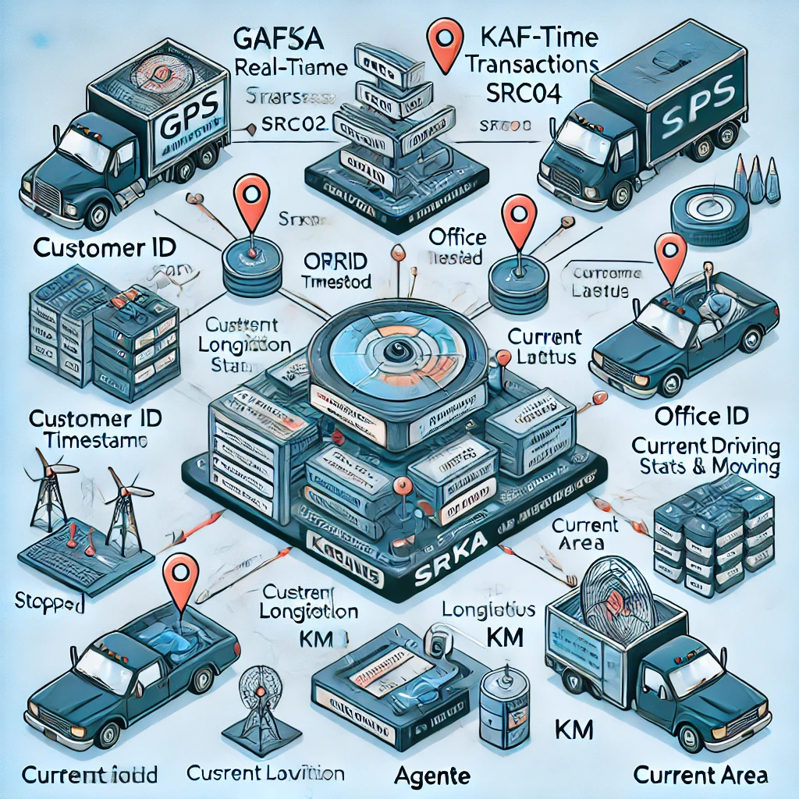

Slide 5
Sales Transactions (realtime API, sales system will submit the sales transaction to the Engine via API calls)
Schema: AgentID, OfficeID, CarID, CustomerID, Amount (USD)
Customer Data (realtime API, our engine pulls the new customer details via API calls to the CRM Oracle DB)
Schema: CustomerID, Mobile No, Name, Gender, Age, Nationality, PassportNo, ID No, Home Address, Lease Start Date, Lease Period
Car Data (realtime file update)
Schema: CarID, Car Make, Car Model, Plate No, Registration Date, Registration Expiry Date
Office Branch Data (batch file update)
Schema: OfficeID, Mobile No, Area, Office No, Working Hours
Sales Agent Data (batch file update)
Schema: AgentID, Mobile No, Name, Gender, Age, Nationality, OfficeID
Here is the architecture diagram showing the integration of real-time APIs and batch file updates for processing sales transactions, customer data, car data, office branch data, and sales agent data and E-R diagram.

Slide 6
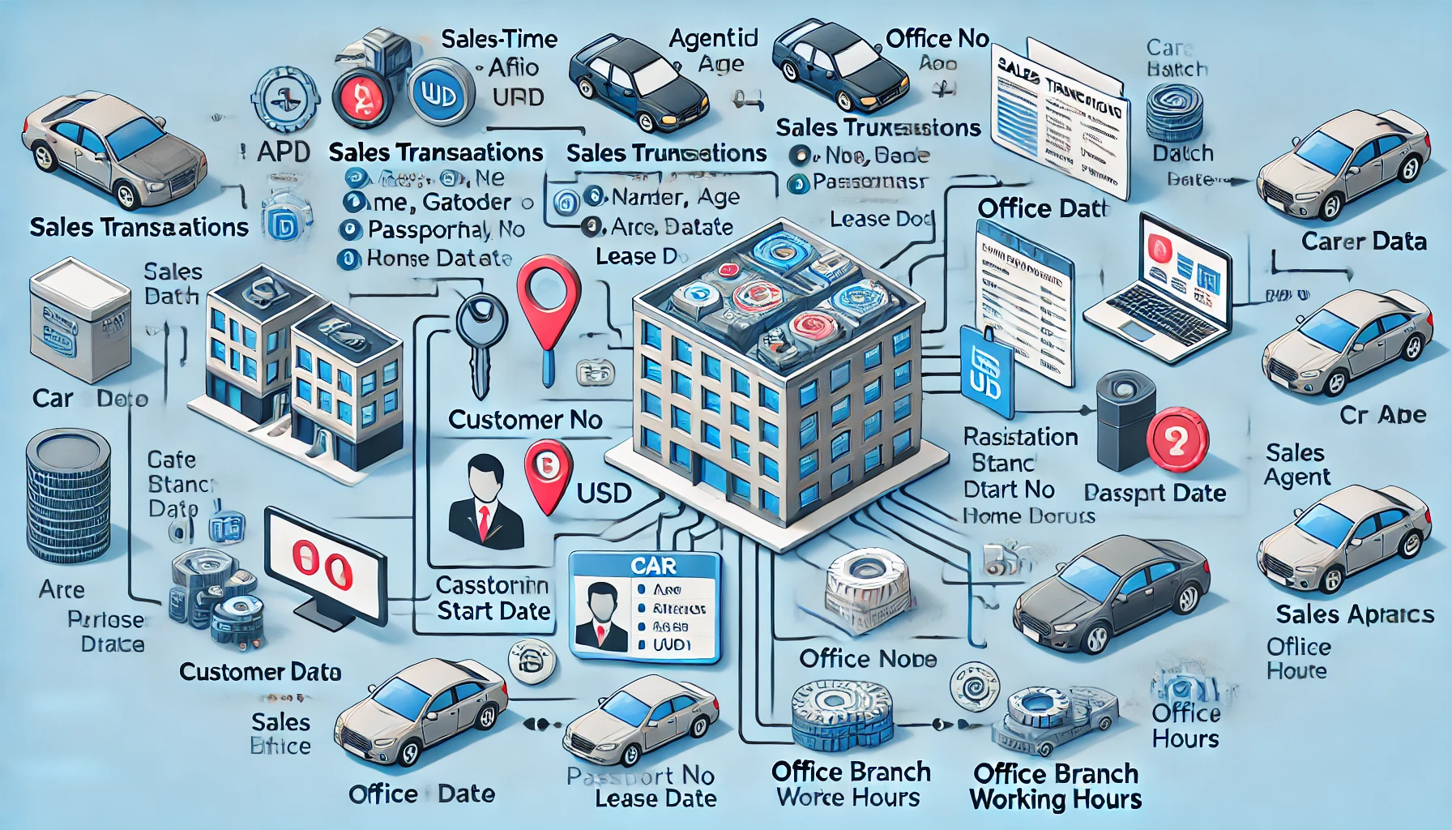

Slide 7
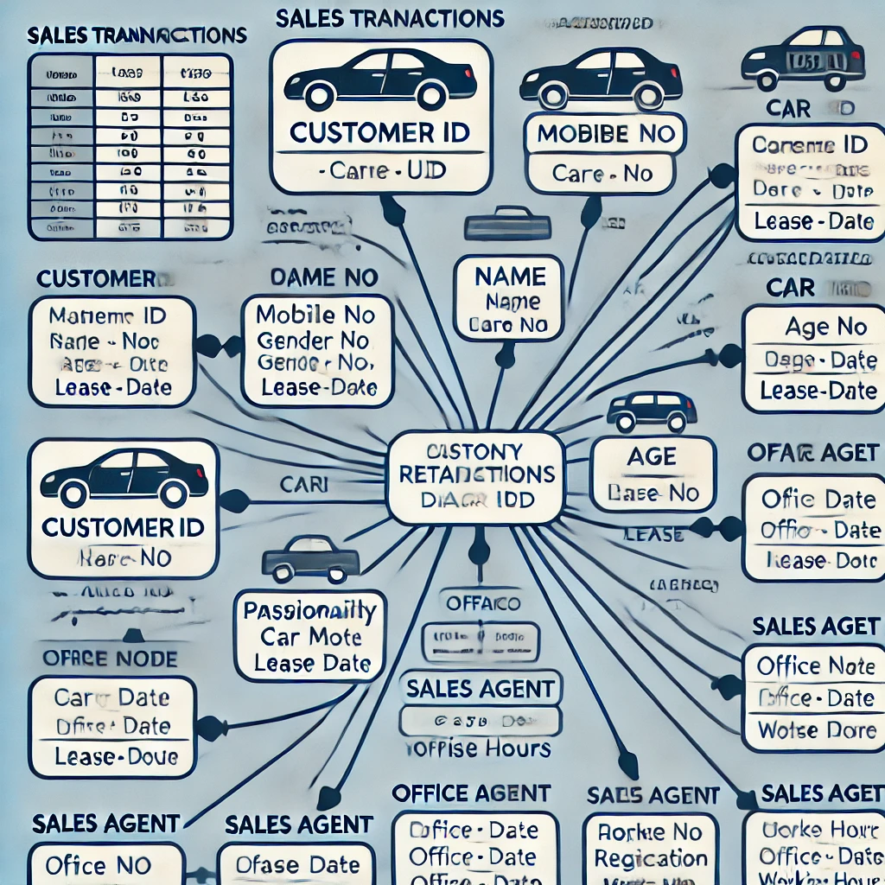
Process incoming data streams in real-time.
Apply data quality checks to clean the data.
Build real-time aggregates for analytics purposes (below are basic sample aggregations, feel free to add more based on the data):
Count of sales per month and year.
Volume of sales per month and year.
Count of Car Driving Status per area (Idle, Moving, Stopped).
Enrich transactional data by joining with reference data.
Filter data based on city name (e.g., "Dubai").
Anonymize mobile numbers using SHA256.

Slide 8
Flow diagram for below requirement in subsequent slide
Process incoming data streams in real-time.
Apply data quality checks to clean the data.
Build real-time aggregates for analytics purposes (below are basic sample aggregations, feel free to add more based on the data):
Count of sales per month and year.
Volume of sales per month and year.
Count of Car Driving Status per area (Idle, Moving, Stopped).
Enrich transactional data by joining with reference data.
Filter data based on city name (e.g., "Dubai").
Anonymize mobile numbers using SHA256.
Here is the flow diagram representing your real-time data processing pipeline requirements, including data ingestion, processing, aggregation, and final output

Slide 9
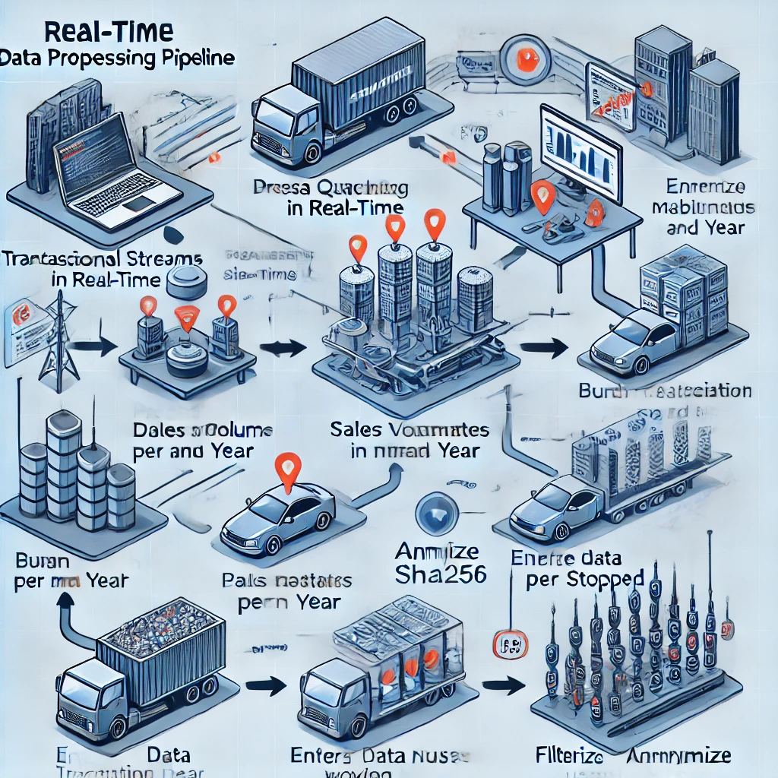

Slide 10
Data Transfer:
Transfer output filtered data file via sFTP in batches of 2000 records each file.
Sync the output data in realtime through API to an external system.
Output Data Structure: BatchID, TRXN Timestamp, Car Driving Status, Current Longitude, Current Latitude, Current Area, KM, Amount (USD), Customer Hashed Mobile No, Name, Gender, Age, Nationality, PassportNo, ID No, Home Address, Lease Start Date, Lease Period, Care Make, Car Model, Plate No, Registration Date, Registration Expiry Date, Office Mobile No, Area, Office No, Working Hours, Agent Mobile No, Name, Gender, Age Band, Nationality
Age Band [<18, 19-30, 31-50, 51+]
Store and maintain both anonymized and non-anonymized copies of the data.

Slide 11
[Start]
|
[Receive Data]
|
[Data Filtering]
|
[Batch Data Preparation] -> [Batch 1] -> [Transfer Data via sFTP]
| | -> [Log Status]
|
| (Repeat for each batch)
|
[Sync Data via API] -> [Log Status]
|
[Store Data]
|------------------|
| |
[Anonymized Copy] [Non-Anonymized Copy]
|
[Data Structure Validation]
|
[End]

Slide 12
E-R diagram flow
[Batch]
|
| (1:M)
|
[Transaction] <------ [Customer]
|
| (M:1)
|
[Agent]

Slide 13
Flow diagram
[Start]
|
[Source: Generate Dummy Data]
|
[Ingestion: Read Records]
|
[Reject Bad Records] <------ [Validation against Schema]
|
[Enrichment: Join Data]
|
[Anonymization: Apply SHA256]
|
[Filtration: Filter by City]
|
[Output: Generate Files (500 records each)]
|
[End]

Slide 14
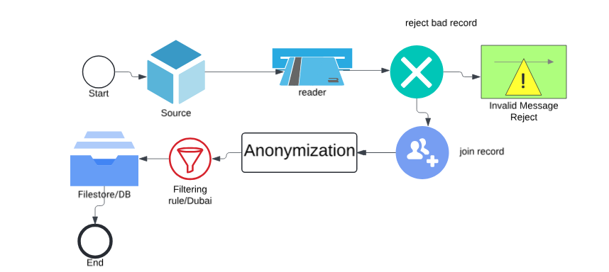
https://lucid.app/lucidchart/fbcc2671-afe7-42b5-ab65-c62bd0b21bfe/edit?beaconFlowId=CF4C573C5B3051E1&invitationId=inv_403a14c5-4540-4670-b7b9-ad8dd4195d55&page=0_0

Slide 15
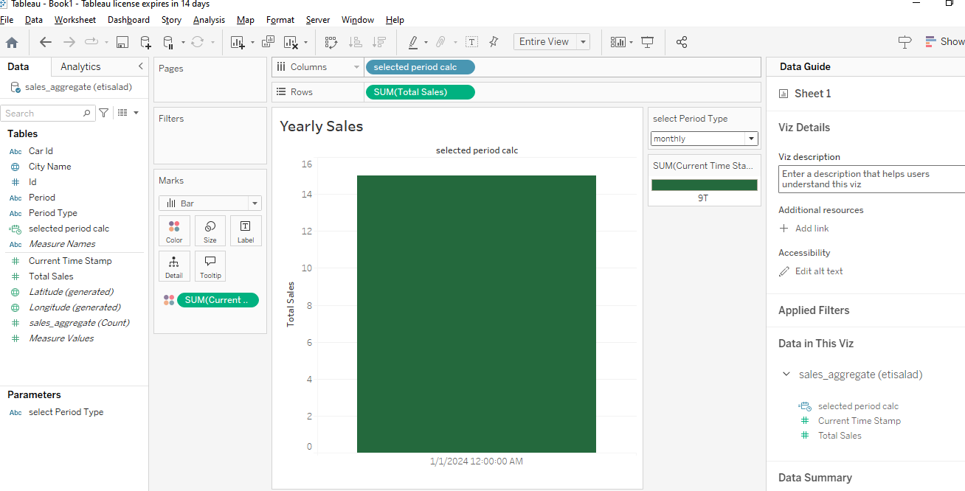

Slide 16
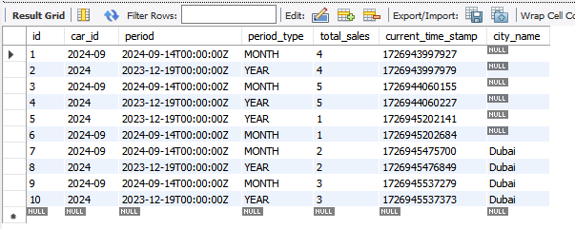
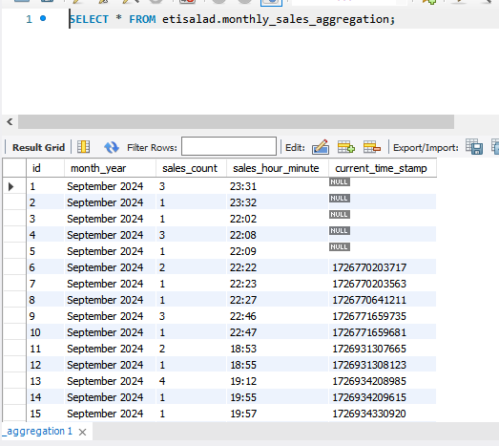
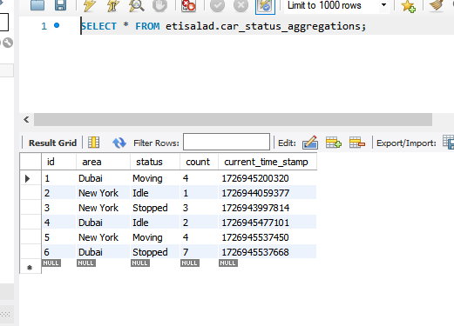
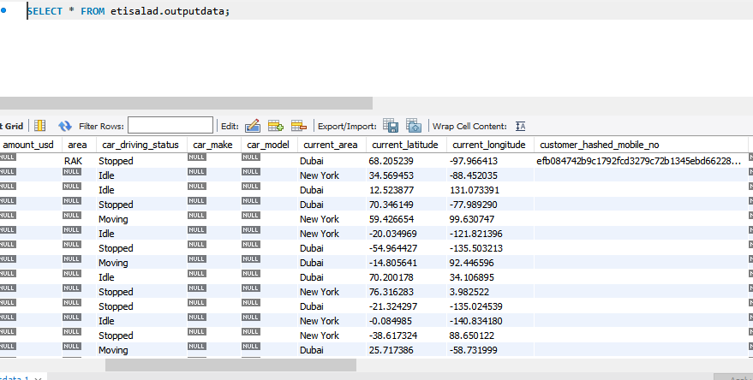

Slide 17
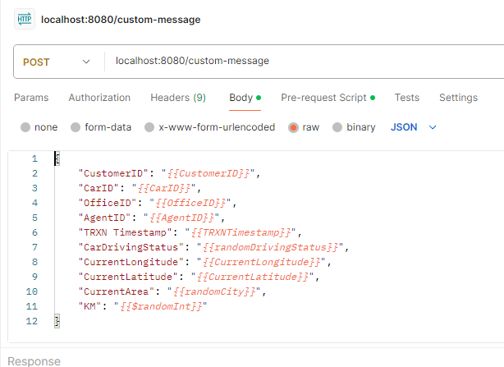
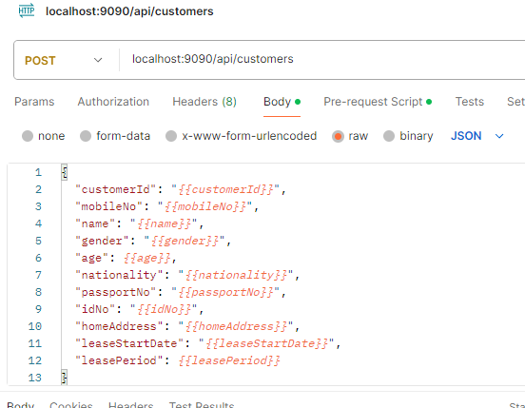
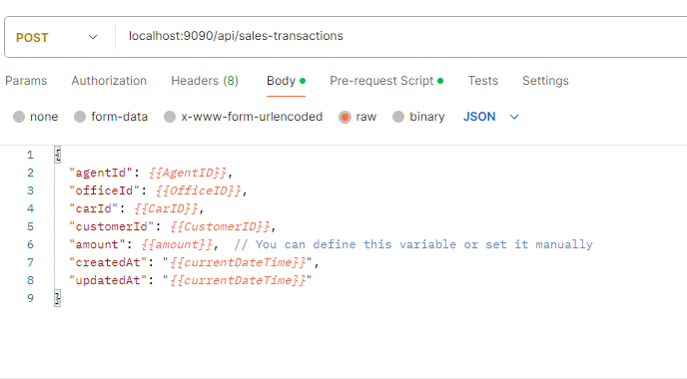
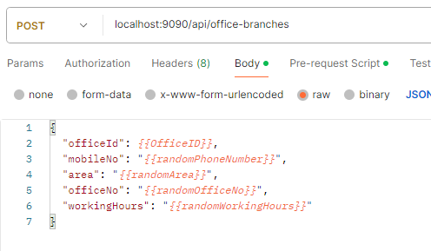

Slide 18
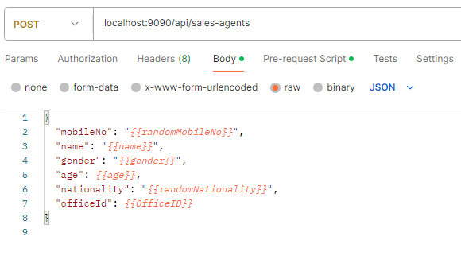
Sample javascript file to generate faker data
// Function to generate random phone numbers
function randomPhoneNumber() {
return Math.floor(Math.random() * (9999999999 - 1000000000 + 1)) + 1000000000;
}
// Function to generate random names
function randomName() {
const names = ["John Doe", "Jane Smith", "Alice Johnson", "Bob Brown"];
return names[Math.floor(Math.random() * names.length)];
}
// Function to generate a random gender
function randomGender() {
const genders = ["M", "F", "O"];
return genders[Math.floor(Math.random() * genders.length)];
}
// Function to generate a random nationality
function randomNationality() {
const nationalities = ["American","UAE", "British", "Canadian", "Australian"];
return nationalities[Math.floor(Math.random() * nationalities.length)];
}
// Function to generate a random passport number
function randomPassportNo() {
return 'P' + Math.floor(Math.random() * 10000000).toString().padStart(7, '0');
}
// Function to generate a random ID number
function randomIdNo() {
return 'ID' + Math.floor(Math.random() * 1000000000).toString().padStart(9, '0');
}
// Function to generate a random home address
function randomHomeAddress() {
return Math.floor(Math.random() * 1000) + " Main Street, Some City, Some Country";
}
// Function to generate a random lease start date
function randomLeaseStartDate() {
const startDate = new Date();
startDate.setFullYear(startDate.getFullYear() - Math.floor(Math.random() * 5)); // Up to 5 years ago
return startDate.toISOString().split('T')[0]; // YYYY-MM-DD format
}
// Function to generate a random lease period
function randomLeasePeriod() {
return Math.floor(Math.random() * 60) + 1; // Lease period between 1 and 60 months
}
// Set the environment variables with dynamic values
pm.environment.set("customerId", Math.floor(Math.random() * 1000)); // Random customer ID
pm.environment.set("mobileNo", randomPhoneNumber());
pm.environment.set("name", randomName());
pm.environment.set("gender", randomGender());
pm.environment.set("age", Math.floor(Math.random() * 100)); // Random age between 0 and 99
pm.environment.set("nationality", randomNationality());
pm.environment.set("passportNo", randomPassportNo());
pm.environment.set("idNo", randomIdNo());
pm.environment.set("homeAddress", randomHomeAddress());
pm.environment.set("leaseStartDate", randomLeaseStartDate());
pm.environment.set("leasePeriod", randomLeasePeriod());

