Slide 1
99 ACER. DATASET ANALYSIS
PRESENTED BY:
SHUBHAM UPADHYAY
PROJECT FILE: 99 ACRES DATASET ANALYSIS

Slide 2
Introduction
This dataset contains 10,679 entries detailing real estate properties for sale or rent. Key features include:
Location Details: City, locality, and society/building names.
Property Information: Type, area (carpet, super built-up), and facing direction.
Pricing: Minimum, maximum, per-unit, and total prices, along with brokerage fees.
Ownership and Transactions: Ownership type and transaction status (sale/rent).
With data on property preferences, pricing, and regional trends, this dataset is ideal for market analysis, consumer behaviour studies, and predictive modelling. Some columns contain missing values, requiring preprocessing for comprehensive analysis.

Slide 3
Objective
Download the CSV file from the website and upload it to Google Colab. Begin the data cleaning process by removing any unnecessary columns in the file. Next, identify any null values and address them appropriately. Check for outliers in the data set. Finally, analyse the dataset to extract key findings and create visual charts to represent your analysis.

Slide 4
Key Questions
QUESTION 1. | Which locality has the highest concentration of properties listed on 99 Acers?
QUESTION 2. | What is the most sought-after property type in the dataset?
QUESTION 3. | Which societies have the highest representation in the dataset?
QUESTION 4. | How does the average price of a property vary depending on its type?
QUESTION 5. | Do property prices show a significant correlation with the locality?
QUESTION 6. | Which combination of society, locality, and property type leads to the highest average property price?
QUESTION 7. | Which locality has the highest average price per square foot?
QUESTION 8. | Which property type has the highest average price per square foot?
QUESTION 9. | Which property type typically has the highest number of floors?
QUESTION 10. | How does the age of a property impact its average price?
QUESTION 11. | Which localities have the highest concentration of premium properties?
QUESTION 12. | Do property listings show any preferences for specific floor numbers?
QUESTION 13. | How do property prices fluctuate over time for different property types?
You can delete this slide when you’re done editing the presentation

Slide 5
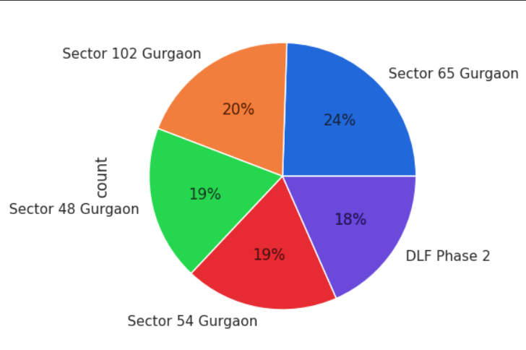
Top Property Hotspots on 99acres
The pie chart illustrates the distribution of a certain count across different locations in Gurgaon. The largest segment of the pie belongs to Sector 65 Gurgaon, accounting for 24% of the total count. Following closely is Sector 102 Gurgaon with 20%, while Sector 48 Gurgaon and Sector 54 Gurgaon both share 19% each. DLF Phase 2 holds the smallest share with 18% of the count. This visualization provides a clear overview of the relative proportions of the count across the mentioned locations in Gurgaon.

Slide 6
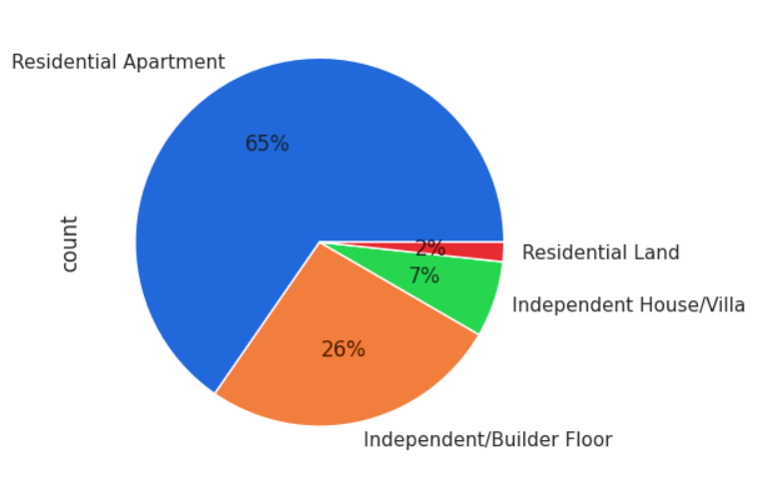
Most Sought-After Property
The pie chart presents a breakdown of property types in terms of their count. Most properties fall under the "Residential Apartment" category, representing a substantial 65% of the total count. Following this, "Independent/Builder Floor" holds a significant share at 26%. "Independent House/Villa" accounts for 7% of the properties, while "Residential Land" comprises the smallest portion at 2%.
This visual representation offers a clear picture of the distribution of property types, highlighting the dominance of residential apartments and the relatively smaller proportions of other property categories.

Slide 7
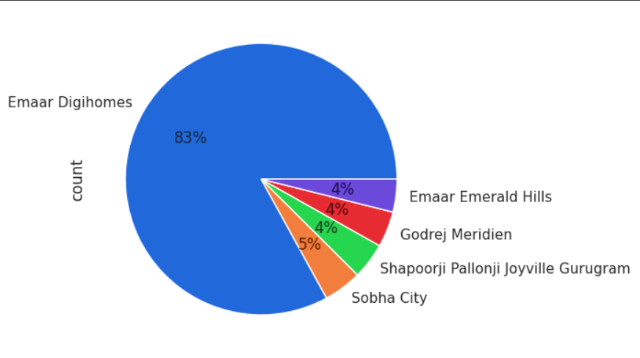
Top Societies
The pie chart illustrates the distribution of properties across different builders in Gurgaon. Emaar Digi Homes dominates the market, accounting for a substantial 83% of the total count. Sobha City follows this with 5%, while Emaar Emerald Hills, Godrej Meridien, and Shapoorji Pallonji Joyville Gurgaon each hold a relatively small share of 4%.
This visualization demonstrates the market dominance of Emaar Digi Homes in Gurgaon, highlighting its significantly larger presence compared to other builders in the area.

Slide 8
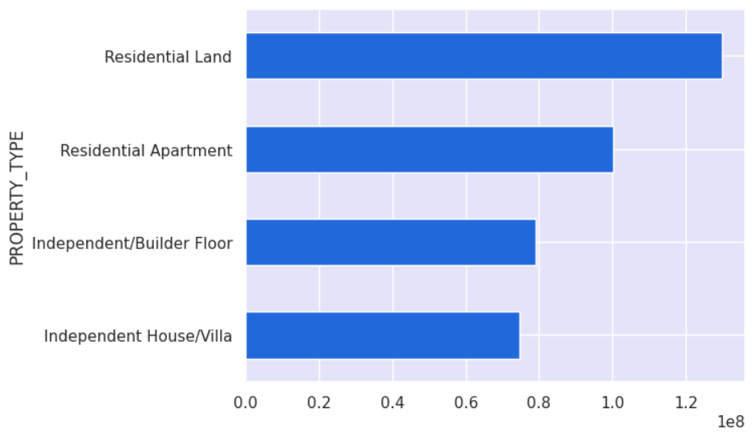
Price by Property Type
The bar chart presents the distribution of property types based on their count. The longest bar represents "Residential Land", indicating that it has the highest count among all property types. Following this, "Residential Apartment" has a significantly lower count, but still outnumbers the remaining categories. "Independent/Builder Floor" and "Independent House/Villa" have similar counts, both lower than "Residential Apartment" and "Residential Land".
This visualization clearly shows the relative proportions of each property type, highlighting the dominance of "Residential Land" and the significantly lower counts for the other types.

Slide 9
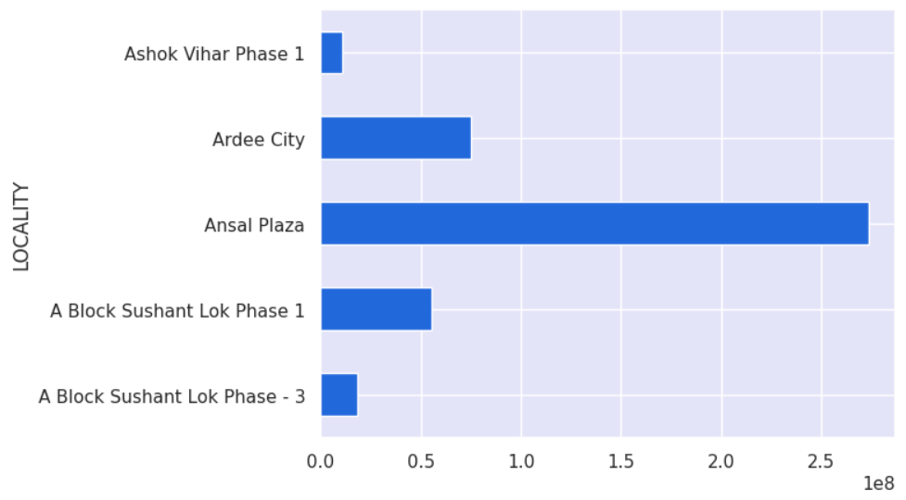
Prices vs. Locality
The bar chart presents the distribution of properties across different localities in Gurgaon. Ansal Plaza stands out with the highest count, significantly outnumbering the other localities. A Block Sushant Lok Phase 1 has the second-highest count, followed by Ardee City. Ashok Vihar Phase 1 and A Block Sushant Lok Phase - 3 have relatively lower counts.
This visualization demonstrates the uneven distribution of properties across the mentioned localities, with Ansal Plaza having a dominant presence compared to the others.

Slide 10
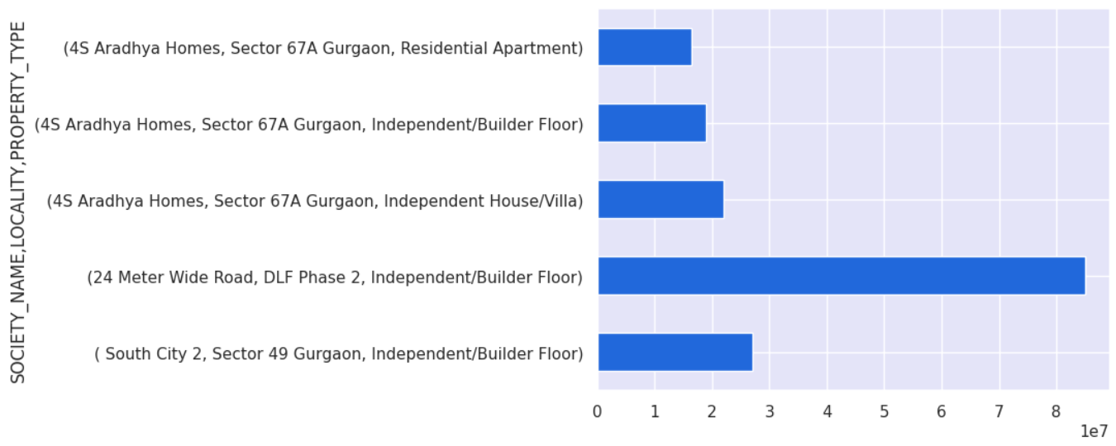
Highest Price Combinations
The bar chart presents the distribution of properties across different societies and localities in Gurgaon. "24-Meter-Wide Road, DLF Phase 2" has the highest count, significantly outnumbering the other societies. "4S Aradhya Homes, Sector 67A Gurgaon" has the second-highest count, followed by "South City 2, Sector 49 Gurgaon". The remaining societies, "4S Aradhya Homes, Sector 67A Gurgaon" for different property types, have relatively lower counts.
This visualization clearly demonstrates the uneven distribution of properties across the mentioned societies and localities, with "24 Meter Wide Road, DLF Phase 2" having a dominant presence compared to the others. Notably, "4S Aradhya Homes, Sector 67A Gurgaon" appears multiple times, suggesting it offers a variety of property types.

Slide 11
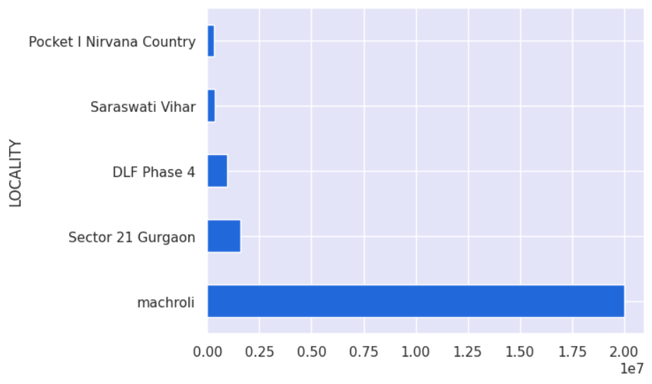
Highest Price per Sq. Ft.
The bar chart presents the distribution of properties across different localities in Gurgaon. Machroli stands out with the highest count, significantly outnumbering the other localities. Sector 21 Gurgaon has the second-highest count, followed by DLF Phase 4. Saraswati Vihar and Pocket I Nirvana Country have relatively lower counts.
This visualization demonstrates the uneven distribution of properties across the mentioned localities, with Machroli having a dominant presence compared to the others.

Slide 12
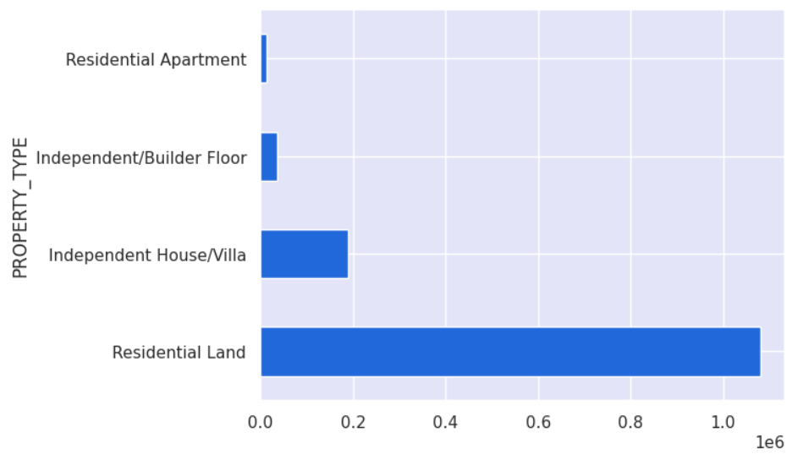
Highest Price per Sq. Ft. by Type
The bar chart shows the distribution of different property types. "Residential Land" dominates with the highest count, significantly exceeding all other categories. "Independent House/Villa" has the second-highest count, though considerably lower than "Residential Land". "Independent/Builder Floor" and "Residential Apartment" have the lowest counts, with "Residential Apartment" being the least frequent.
This visualization highlights the prevalence of "Residential Land" compared to other property types. The relatively lower counts of apartments and builder floors might indicate a preference for landed properties in the area or market being analyzed.

Slide 13
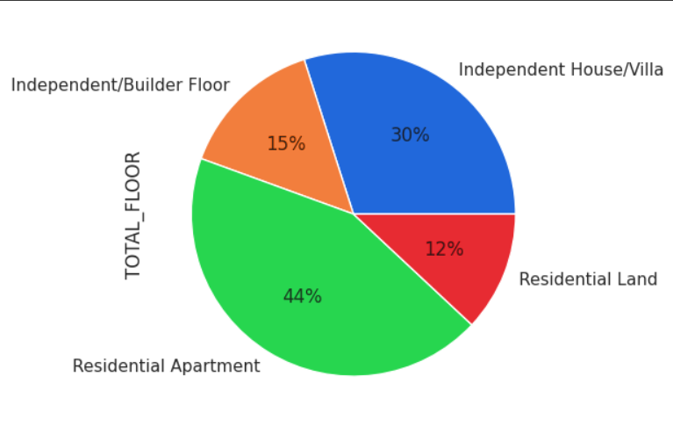
Property Type with Most Floors
The pie chart illustrates the distribution of property types based on their total floor area. "Residential Apartment" occupies the largest proportion of the total floor area at 44%. "Independent House/Villa" follows with 30%, while "Independent/Builder Floor" accounts for 15%. "Residential Land" contributes the smallest share at 12%.
This visualization provides insights into the composition of property types by floor area, highlighting the dominance of "Residential Apartment" and the relatively smaller contribution of "Residential Land" to the overall floor area.

Slide 14
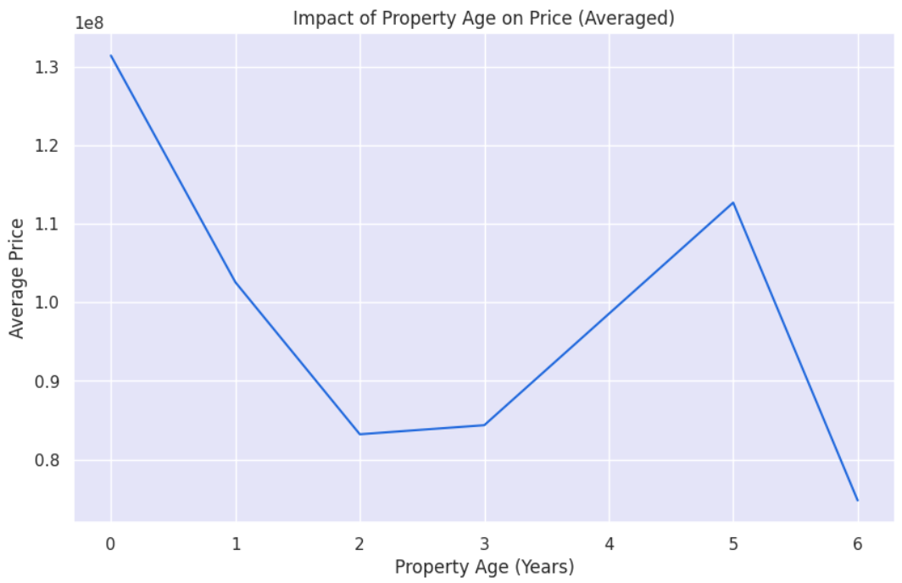
Property Age vs. Price
The line graph depicts the relationship between property age and average price. The price starts high at 1.3 crores for new properties (0 years old) and then decreases rapidly in the first year. It stabilizes between years 2 and 3, then increases slightly from year 3 to 5, before dropping significantly for properties older than 5 years.
This graph suggests that property value depreciates quickly in the early years but then stabilizes for a period before declining again in older age. This pattern could be influenced by factors like construction quality, maintenance costs, and market trends.

Slide 15
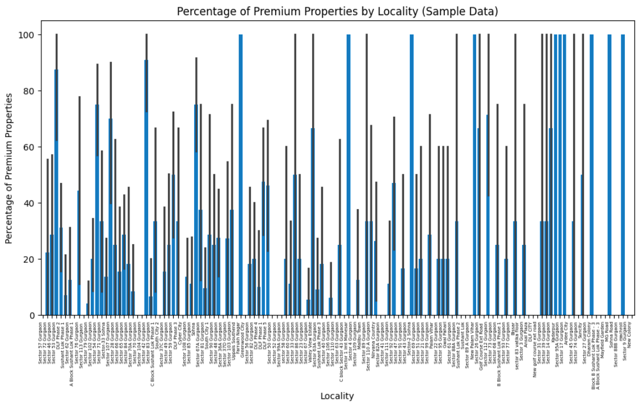
Localities with Premium Properties
The bar chart presents the percentage of premium properties in different localities of Gurgaon. The height of each bar represents the proportion of premium properties within that locality. It shows a wide variation in the percentage of premium properties across localities. Some localities, like Sector 104, Sector 103, and Sector 65, have a high percentage of premium properties, while others, like Sector 3, Sector 89, and Sector 110A, have a low percentage.
This visualization highlights the uneven distribution of premium properties across Gurgaon, with some areas having a significantly higher concentration than others. This information could be useful for real estate investors, developers, and buyers who are interested in identifying localities with a higher likelihood of finding premium properties.

Slide 16
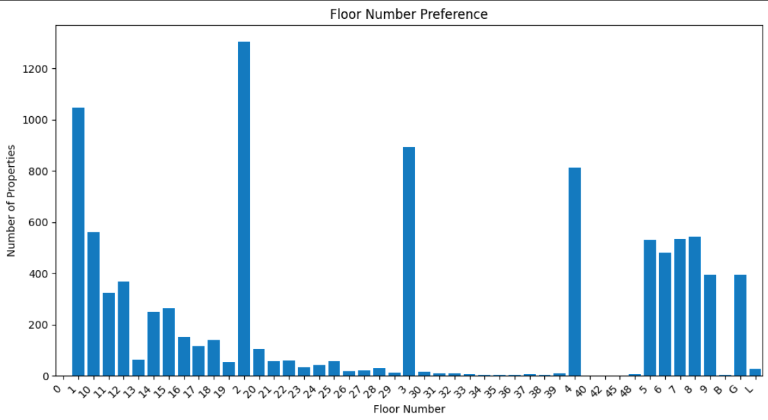
Floor Number Preferences in Listings
The bar chart presents the distribution of properties based on their floor number. The highest number of properties is found on the 2nd floor, followed by the 1st floor and the 4th floor. The 9th floor has the least number of properties. The chart also shows a peak in the number of properties on the 29th floor, indicating a potential preference for that specific floor number.
Overall, the chart suggests a preference for lower floors, with a noticeable peak on the 29th floor. This information can be useful for real estate developers and property managers in understanding the demand for different floor numbers and making informed decisions about property development and management.

Slide 17
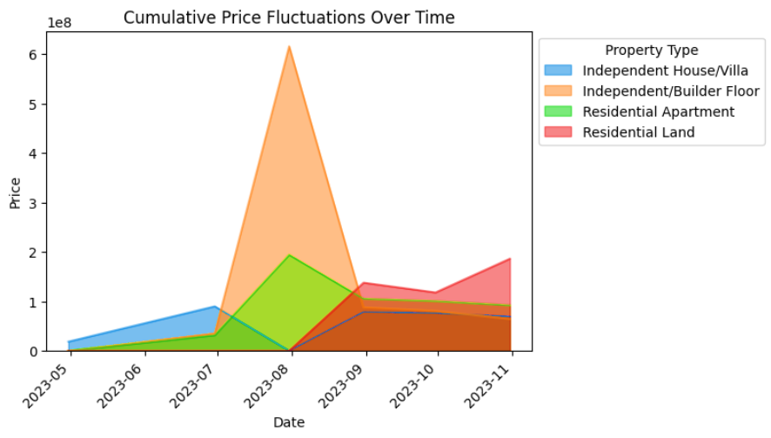
Price Fluctuations by Property Type
The line graph presents cumulative price fluctuations over time for different property types. From May to August 2023, we see a significant increase in cumulative prices for all property types. The "Independent/Builder Floor" category experiences the most substantial growth, reaching its peak in August. Subsequently, all property types show a decline in cumulative price until October. In November, "Residential Land" showed a slight increase, while the other types remained relatively stable.
This visualization highlights the dynamic nature of property prices over the given period. The initial surge in prices across all categories suggests a period of market activity and potential growth. The subsequent decline could indicate shifts in market conditions, economic factors, or other influencing variables. The varying trends across property types suggest that market dynamics may differ depending on the type of property.

Slide 18
CONCLUSION
In conclusion, this analysis of the 99 Acers dataset revealed key trends and patterns in the real estate market. We identified popular localities, dominant property types, and the influence of age and type on pricing. The insights into the most and least expensive properties empower buyers and sellers with valuable information for decision-making. Our analysis also highlighted property age and floor number preferences, showcasing the dynamism of the market. Future work could involve predictive modelling or exploring external factors' impact on property values. Overall, this project demonstrates the power of data analysis to guide informed choices in the real estate sector.
Changes Made:
Combined sentences: Merged related ideas to reduce the overall length.
Removed redundancy: Avoided repeating phrases or concepts.
Simplified language: Used more concise and direct wording.
Retained core message: Maintained the key findings and significance of the project.

Slide 19
Thank you so much

