Slide 1



MID TERM PROJECT
SHUBHAM UPRETI
BANK BRANCHING
STRATEGY
This project was submitted to Professor Aron Howard; MAT 115 Intro to Data Science for the fulfillment of Mid-term Project.

Slide 2



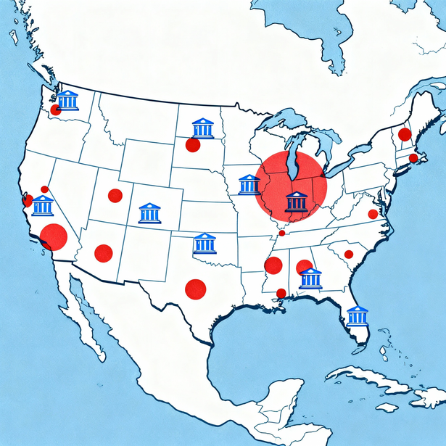

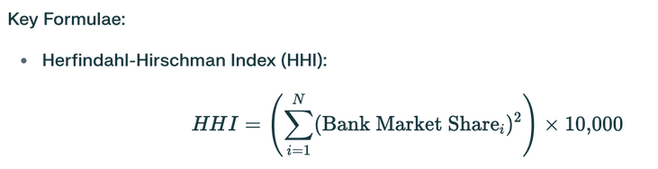
What Drives the Geographic Spread of Bank Branches Market Size (deposits) or Market Concentration (HHI)?
Why It Matters?
Challenges policy focus on competition metrics
Informs branch location strategy for banks
Relevant for regulators, managers, and methods
Shubham Upreti

Slide 3


Bouakez, H., Côté, J., & D’Souza, C. (2020). "A Spatial Model of Bank Branches in Canada." Bank of Canada Staff Working Paper 2020-4. (Provides direct empirical support for the finding that market structure is not correlated with the density/spread of bank branches, aligning with your HHI result).
DATA WRANGLING
Data Import & Cleaning:
Imported US bank branch dataset, selected necessary columns
Removed rows with missing or zero coordinates or deposit values
Feature Engineering:
Labeled metropolitan status (metro vs non-metro)
Aggregated deposits by bank and market (MSA)
Calculated individual bank deposit shares and squared them for HHI
Metric Construction:
Summed squared deposit shares to compute market-level HHI (competition index)
Used Haversine formula to calculate mean pairwise branch distance (lending radius) for each bank with ≥2 branches
Final Joins & Transformations:
Merged market HHI, average lending radius, and total market deposits into a single table
Filtered out incomplete or one-branch markets
Created categorical market concentration variable (competitive, moderate, high)
Log-transformed total deposits for regression analysis
SUMMARY
Transformed raw branch data into a clean, analyzable format with calculated market competition, geographic spread metrics, and structured variables for robust statistical modeling.​
Shubham Upreti

Slide 4

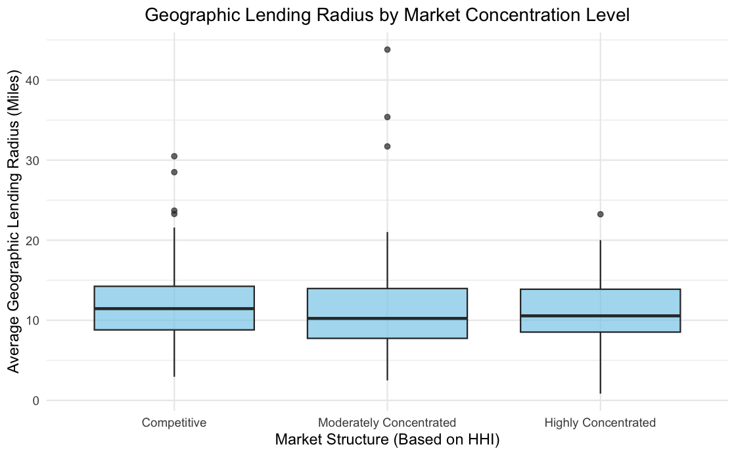
APPROACH
Used US bank branch data, calculated deposit shares and HHI for each metropolitan area
Applied Haversine formula for mean lending radius per bank
Regression model tested HHI and market size impact
Begenau, A., Oberfield, E., Rossi-Hansberg, E., & Wenning, D. (2024). "Banks in Space." National Bureau of Economic Research Working Paper 32262. (Directly supports the idea that bank expansion is driven by the spatial search for retail deposits and balancing loan demand).
MAIN FINDINGS
Market size (total deposits): Highly significant predictor of a bank’s physical spread
Market concentration (HHI): Not a significant factor
Shubham Upreti

Slide 5
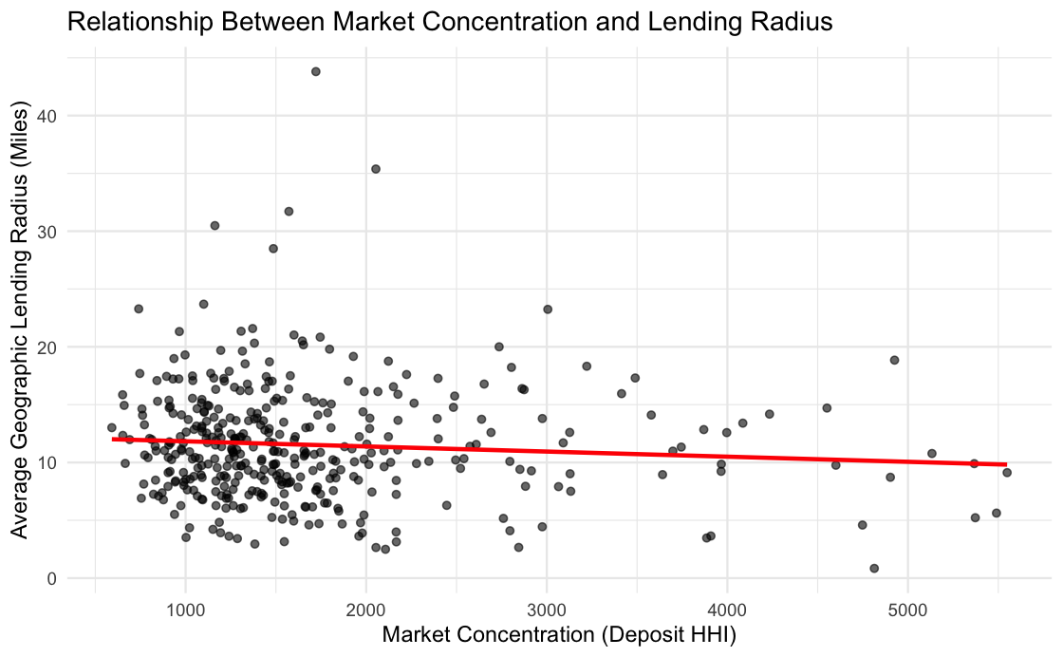


Figure 1
Market Concentration and Lending Radius
The distribution of points shows little to no correlation banks in highly concentrated markets (higher HHI) do not systematically have larger or smaller geographic spreads.
Regression Line: Nearly flat (red line), confirming that market concentration is not a significant predictor for branch geographic spread.
Group Insight: Markets, regardless of competition (HHI), show a wide variance in branch spreading
90%
75%
Shubham Upreti

Slide 6
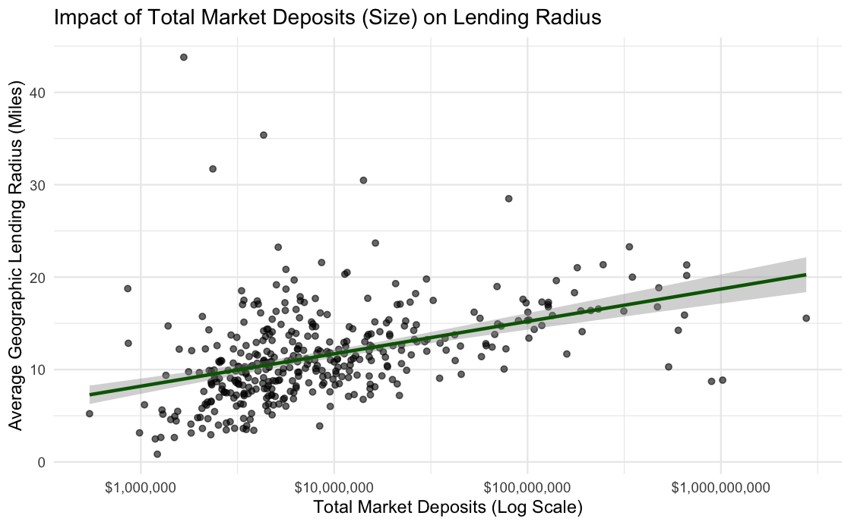





Figure 2
Clear positive trend
Regression Line
As total market deposits increase, banks tend to locate branches further apart (higher lending radius)
Upward sloping (green line) indicates a strong positive relationship between deposit market size and branch spread.
Shubham Upreti

