Slide 1
REVERsO
NEW WAY
TO
SHOP ONLINE

Slide 2

CAMERA DETECTION
FULL PHOTO OF THE PERSON FROM HEAD TO TOE
FACE PHOTO

Slide 3
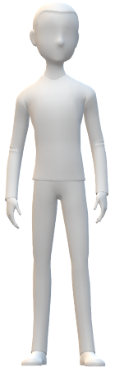

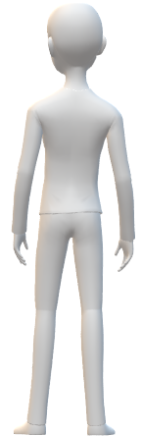
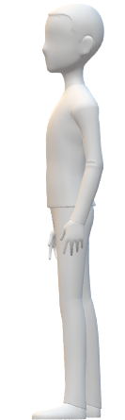
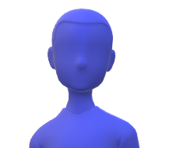

SCANNER FEATURE
FACE SCANNING

Slide 4
APPROX ANALYSER
HEIGHT
FACE CUT
WAIST SIZE
UPPER BODY SIZE

Slide 5
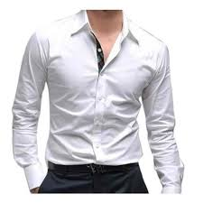

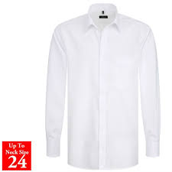
SCISSOR FEATURE
This is one of the most important feature in this app.
This feature will adjust the outfit and accessories according to the customer requirement.
That is whys it is known as scissor feature to scissor it out the outfits and accessories.

Slide 6
VIRTUAL TRIAL ROOM
LET’S GET STARTED
SHARE
ANALYSE

Slide 7
ANALYSE METER
GOOD
NICE
WORST
SUPERB

Slide 8
R
TECHNOLOGY
SOFT SCISSOR
VIRTUAL REALITY
PHONE CAMERA BOTH FRONT AND REAR
ARTIFICIAL INTELLIGENCE(AI)
360 DEGREE SCANNER
PROBLEM
NO TRIAL OF OUTFIT AND ACCESSORIES
RETURN POLICY
CLOTHES DOESN’T FIT VERY WELL
SOLUTION
REVERSO PROVIDES A TRIAL ROOM FOR THE CUSTOMER
IT REDUCES THE HECTIC JOB OF RETURNING
IT WILL HELP THE USER TO KNOW WHICH KIND OF SIZE FITS HIM WELL
FINANICAL
BUSINESS
IT WILL INCREASE FINANCAL STATUS OF ONLINE SITES
RETURNING POLICY WILL GET REDUCE WHICH WILL SAVE THEIR ENERGY AND RESOURCES

