Slide 1
Conditional Execution
Chapter 3

Slide 2
Conditional Steps
x = 5
X < 10 ?
Yes
print 'Smaller'
Program:
x = 5
if x < 10:
print 'Smaller‘
if x > 20:
print 'Bigger'
print 'Finis'
X > 20 ?
Yes
print 'Bigger'
print 'Finis'

Slide 3
Comparison Operators
Boolean expressions = an expression that evaluates to true or false
Boolean expressions use comparison operators evaluate to - True or False
Comparison operators look at variables but do not change the variables
<
Less than
<=
Less than or Equal
==
Equal to
>=
Greater than or Equal
>
Greater than
!=
Not equal
Remember: “=” is used for assignment.

Slide 4
Comparison Operators
x = 5
if x == 5 :
print 'Equals 5‘
if x > 4 :
print 'Greater than 4’
if x >= 5 :
print 'Greater than or Equal 5‘
if x < 6 :
print 'Less than 6'

Slide 5
X == 5 ?
Yes
No
print 'Is 5'
x = 5
if x == 5 :
print 'Is 5‘
print 'Is Still 5'
print 'Third 5’
print 'Still 5'
print 'Third 5'
The IF Statement

Slide 6
Indentation Rules
Increase indent after an if statement or for statement (after : )
Maintain indent to indicate the scope of the block (which lines are affected by the if/for)
Reduce indent to back to the level of the if statement or for statement to indicate the end of the block
Blank lines are ignored - they do not affect indentation
Comments on a line by themselves are ignored w.r.t. indentation

Slide 7
Warning: Turn Off Tabs
Most text editors can turn tabs into spaces - make sure to enable this feature
  NotePad++: Settings -> Preferences -> Language Menu/Tab Settings
  TextWrangler: TextWrangler -> Preferences -> Editor Defaults
Python cares a *lot* about how far line is indented. If you mix tabs and spaces, you may get “indentation errors” even if everything looks fine

Slide 8
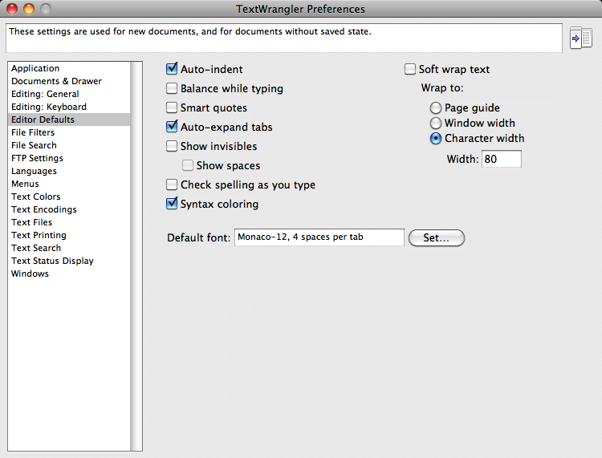

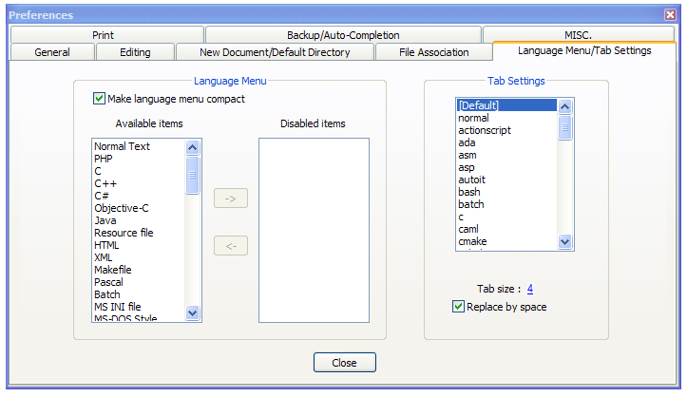
This will save you much unnecessary pain.

Slide 9
increase / maintain after if or for
decrease to indicate end of block
blank lines and comment lines ignored
x = 5
if x > 2 :
# comments
print 'Bigger than 2'
# don’t matter
print 'Still bigger'
# but can confuse you
print 'Done with 2'
# if you don’t line
# them up
x = 5
if x > 2 :
print 'Bigger than 2'
print 'Still bigger'
print 'Done with 2'
for i in range(5) :
print i
if i > 2 :
print 'Bigger than 2'
print 'Done with i', i

Slide 10
Two Way Decisions
X = 4
Sometimes we want to do one thing if a logical expression is true and something else if the expression is false
It is like a fork in the road - we must choose one or the other path but not both
no
x > 2
yes
print 'Not bigger'
print 'Bigger'
print 'All Done'

Slide 11
Two-way branch using else :
X = 4
x = 4
if x > 2 :
print 'Bigger'
else :
print 'Smaller'
print 'All done'
no
x > 2
yes
print 'Smaller'
print 'Bigger'
print 'All Done'

Slide 12
Nested Decisions
x > 1
yes
no
print 'More than one'
x = 42
if x > 1 :
print 'More than one'
if x < 100 :
print 'Less than 100'
print 'All done'
x < 100
yes
no
print 'Less than 100'
print 'All Done'

Slide 13
Chained Conditionals
yes
x < 2
print 'Small'
if x < 2 :
print 'Small'
elif x < 10 :
print 'Medium'
else :
print 'LARGE'
print 'All done'
no
x<10
yes
print 'Medium'
no
print 'LARGE'
print 'All Done'

Slide 14
Chained
Conditional
if x < 2 :
print 'Small'
elif x < 10 :
print 'Medium'
elif x < 20 :
print 'Big'
elif x< 40 :
print 'Large'
elif x < 100:
print 'Huge'
else :
print 'Ginormous'
# No Else
x = 5
if x < 2 :
print 'Small'
elif x < 10 :
print 'Medium'
print 'All done'

Slide 15
Multi-way Puzzles
if x < 2 :
print 'Below 2'
elif x < 20 :
print 'Below 20'
elif x < 10 :
print 'Below 10'
else :
print 'Something else'
Which will never print?
if x < 2 :
print 'Below 2'
elif x >= 2 :
print 'Two or more'
else :
print 'Something else'

Slide 16
The try / except Structure
You surround a dangerous section of code with try and except.
If the code in the try works - the except is skipped
If the code in the try fails - it jumps to the except section

Slide 17
astr = 'Hello Bob‘
istr = int(astr)
print 'First‘
istrastr = '123‘
istr = int(astr)
print 'Second', istr
$ python notry.py Traceback (most recent call last): File "notry.py", line 2, in <module> istr = int(astr)ValueError: invalid literal for int() with base 10: 'Hello Bob'

Slide 18
astr = 'Hello Bob'
try:
istr = int(astr)
except:
istr = -1
print 'First', istr
astr = '123'
try:
istr = int(astr)
except:
istr = -1
print 'Second', istr
When the first conversion fails - it just drops into the except: clause and the program continues.
Output:
First -1
Second 123
When the second conversion succeeds - it just skips the except: clause and the program continues.

Slide 19
try / except
astr = 'Bob'
print 'Hello'
astr = 'Bob'
try:
print 'Hello'
istr = int(astr)
print 'There'
except:
istr = -1
print 'Done', istr
istr = int(astr)
print 'There'
istr = -1
print 'Done', istr
Safety net

Slide 20
Sample try / except
rawstr = raw_input('Enter a number:')
try:
ival = int(rawstr)
except:
ival = -1
if ival > 0 :
print 'Nice work’
else:
print 'Not a number’
Enter a number:42
Nice work
Enter a number:fourtytwo
Not a number

Slide 21
Exercise
Write a pay computation program that gives the employee 1.5 times the hourly rate for hours worked above 40 hours (and regular 1.0 rate for less than 40 hours)
Enter Hours: 45
Enter Rate: 10
Pay: 475.0
475 = 40 * 10 + 5 * 15

Slide 22
Exercise
Rewrite your pay program using try and except so that your program handles non-numeric input gracefully.
Enter Hours: 20
Enter Rate: nine
Error, please enter numeric input
Enter Hours: forty
Error, please enter numeric input

Slide 23
Summary
Comparison operators == <= >= > < !=
Logical operators: and or not
Indentation
One Way Decisions
Two way Decisions if : and else :
Nested Decisions and Multiway decisions using elif
Try / Except to compensate for errors

