Slide 1

Skills proven, not claimed.
SkillProof turns a student profile into a measurable readiness score and an adaptive roadmap, with the evidence behind every number.
Bit N Build 2026, UP Regionals | Problem statement 05, education and employability

Slide 2
SkillProof
The problem
A student knows the role they want. Nobody tells them what they are missing for it.
Resumes are self reported
a listed skill and a proven skill look identical on paper
Roadmaps are generic
the same eight week plan for a student with four shipped projects and one with none
Nothing is measurable
no number to argue with, so no way to know if this month helped
The result
months on the wrong skill, and a portfolio that does not answer the recruiter question

Slide 3
SkillProof
Why existing tools fall short
Tool | What it does | What it misses
Course platforms | Sell a fixed syllabus | No idea what you already know
Resume scanners | Match keywords to a job description | Trusts the resume completely
A chatbot | Writes a plausible roadmap | No evidence, no score, no memory, invented links
Placement portals | List openings | Never say what you are missing for them

Slide 4
SkillProof
SkillProof
Skills proven, not claimed. Four steps, all visible to the student.
Collect evidence
resume gives claimed skills, GitHub code gives observed skills traced to the file, a quiz gives verified skills
Price the gaps
readiness is the job description weighted share of the role you can prove
Plan against the evidence
ranked by cost, ordered by prerequisite, packed into your hours, ending in a proof project
Replan on proof
every new piece of evidence recalculates the score and rebuilds the weeks you have not touched

Slide 5
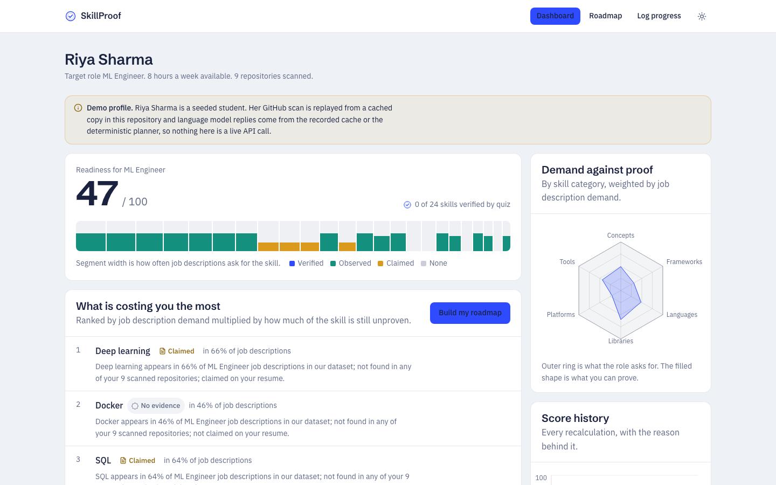
SkillProof
One number, and the evidence behind it
Readiness 47 out of 100 for ML Engineer. Every segment is a skill the role asks for.
Segment width is job description demand
Colour is the evidence level
Fill is how much of it is proven

Slide 6
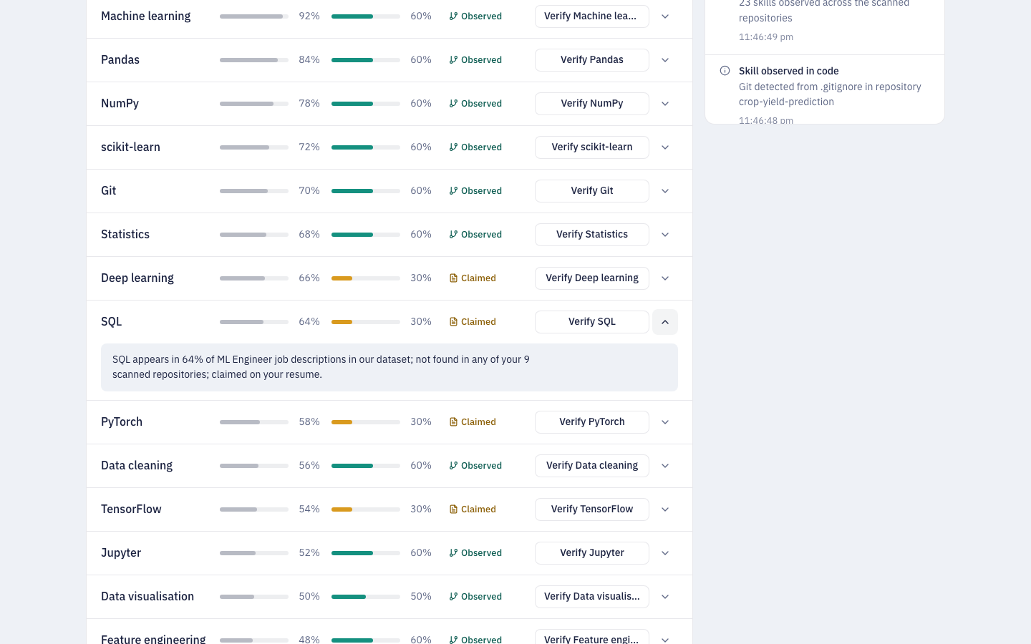
SkillProof
Every claim is traceable
SQL appears in 64% of ML Engineer listings, sits on her resume, and appears in none of her nine repositories.
Claimed
on the resume only
Observed
found in code, with the repository and file named
Verified
passed an adaptive quiz

Slide 7
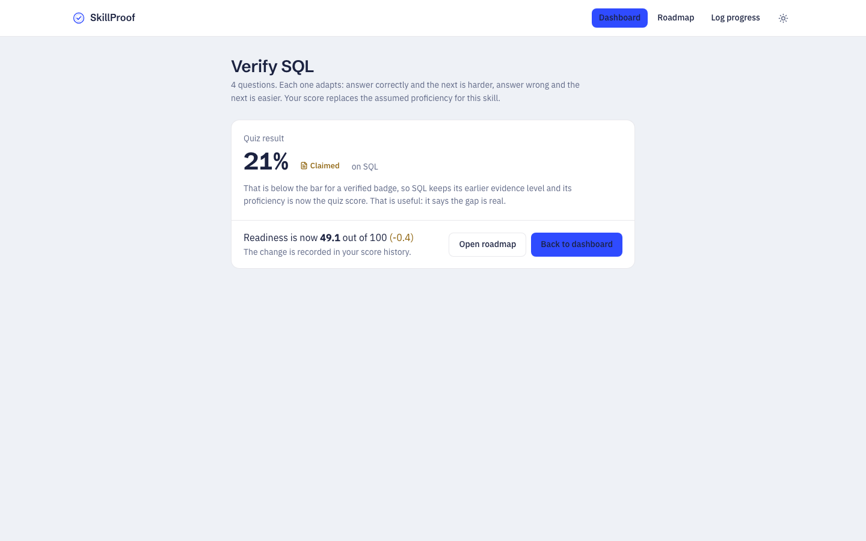
SkillProof
Claiming is not proving
SQL was on the resume. Under four adaptive questions it scores 25%, and the badge stays amber.
Harder after a correct answer, easier after a wrong one
Scored by difficulty weight, not raw count
The answer never reaches the browser before you answer

Slide 8
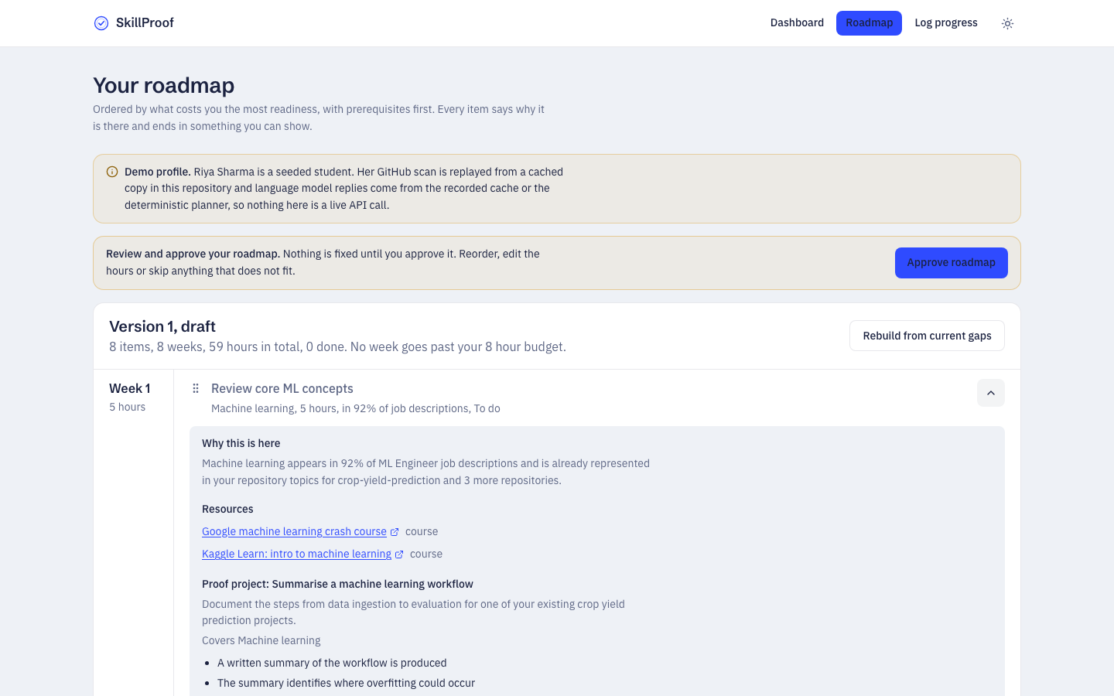
SkillProof
A roadmap that answers why
Eight weeks, eight hours a week, nothing over budget, prerequisites respected.
Why is written in numbers, not motivation
Resources come from a whitelist, so no invented links
Every item ends in a proof project with checkable criteria

Slide 9
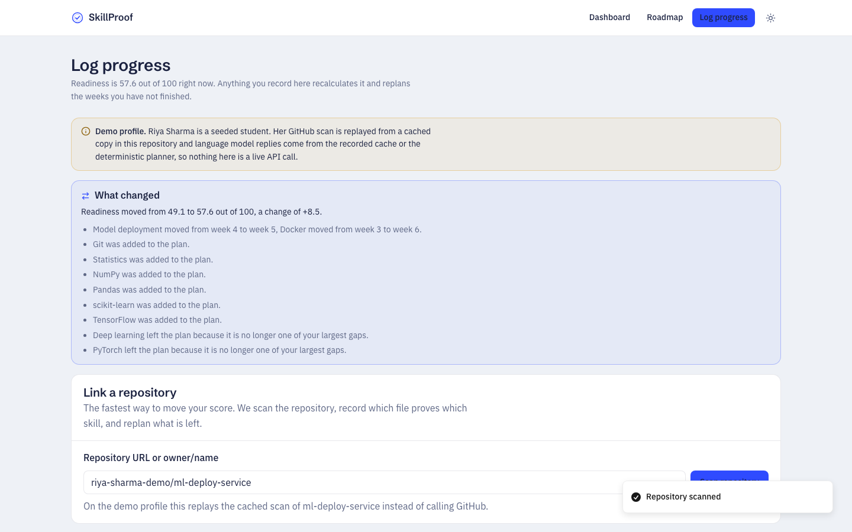
SkillProof
It replans when you prove something
Marking a task done changes nothing. Linking the repository moves the score by 8.5 points.
Docker, FastAPI and AWS become observed evidence
The plan rebuilds around what is left
Anything the student edited stays locked

Slide 10
SkillProof
How it is built
Deterministic where it matters, AI where it helps.
Deterministic core
scoring, gap ranking and skill detection are plain TypeScript, so the same profile always gives the same score
AI at the edges
Sarvam AI writes the explanations and quiz questions, with Groq and Gemini as fallbacks
Everything validated
zod at every boundary, one repair retry, then the next provider, then built in logic
Runs with zero keys
the whole product works on deterministic logic when no provider is available

Slide 11
SkillProof
Stack and engineering
Layer | Choice
Frontend | Next.js 14 App Router, TypeScript strict, Tailwind with a custom token system, Recharts
Agent | Resume and GitHub ingestion, 84 skill taxonomy, deterministic scoring and planner
Models | Sarvam AI sarvam-105b-conversations, then Groq gpt-oss-120b, then Gemini 3.8 Flash
Data | Supabase Postgres in Mumbai, local JSON store when unconfigured
Quality | 69 unit tests, typecheck, lint and build in GitHub Actions

Slide 12
SkillProof
Impact and what is next
For a student
one number to argue with, a ranked list of what to fix, a portfolio project per gap
For a placement cell
the same engine across a cohort shows where training should actually go
Next
live job description ingestion, Hindi interface, mentor review as a fourth evidence level
Live demo https://skillproof.vercel.app
Source
https://github.com/shubhamverma-devx/skillproof

