Slide 1
Cat Activity Checker Elimination Classification
Pet care and food space company
Spring Board Project
Confidential
14-11-2022
Shubham Verma

Slide 2
Topics/Agenda
01
｜
Objective
06
｜
Train model to predict the urination and defecation
02
｜
Data Preparation
07
｜
Business Insights
03
｜
Data exploration and Hypothesis Validation
08
｜
Conclusion
04
｜
Feature Engineering
05
｜
Train model to predict the elimination and non-elimination activity

Slide 3
01
Objective

Slide 4
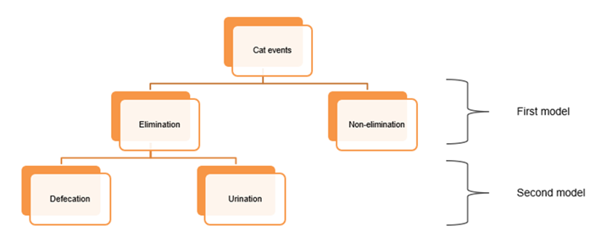
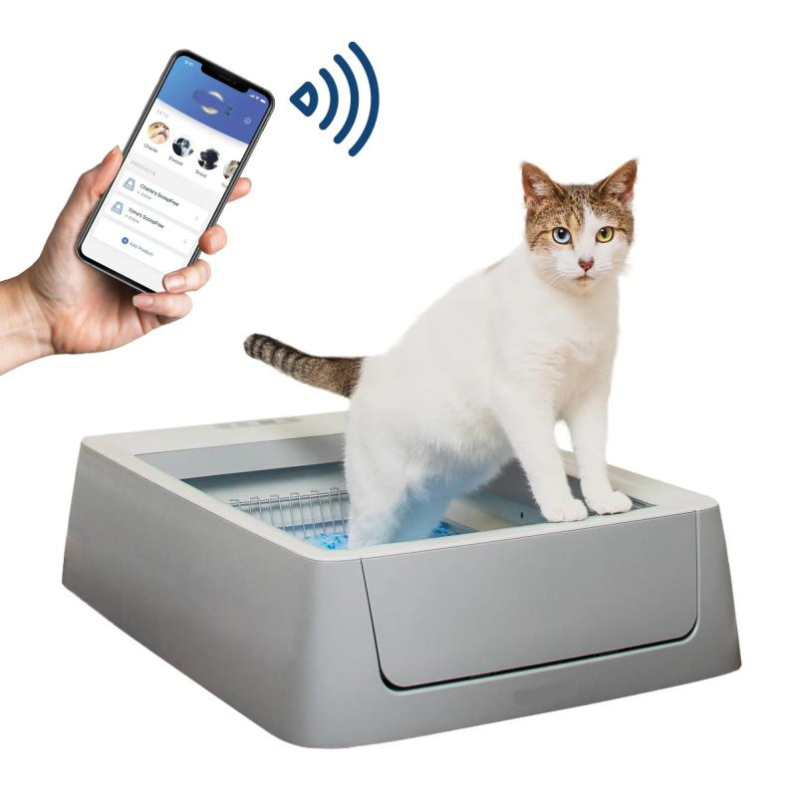
01. Objective
Smart Litter Sytem
Pet Care and food space
objective of this project is to develop a solution approach to correctly classify the events as elimination or non-elimination and further classify the elimination events into urination and defecation.
Relation between
Cat Activity vs Sensor signals
Cat Activity vs time
Cat Activity Vs Cat Power use
Cat weight Vs Activity
Type of Cat vs Activity

Slide 5
02. Data Preparation a) Decisions on data selection b) Decisions on merging the data, joining key c) Decisions on the target variable
Provided data for Analysis
Elimination is depending on cat behavior:
Load sensor data(lc0 , Ic1, lc1 , Ic3 )
Historic Cat Activity/Behavior
Duration of Activity
Cat power/energy used by cat
Cat energy entropy
Cat Type
Cat Weight
Time & Season

Slide 6
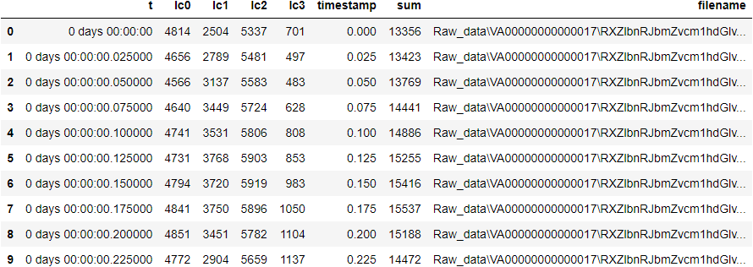
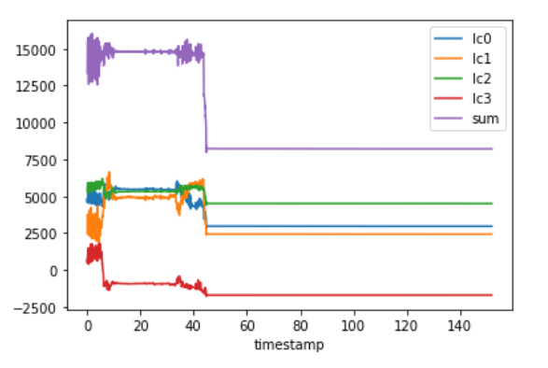
02 – Data Prepration
Convert CSV File to Data frame of each load sensor reading
Data Selection / Extraction from load sensors
Duration of Activity
Load sensor merge at statistical measure
Lc sum Mean
Lc sum Min
Lc sum Median
Lc sum Max.
Lc sum Std
Lc sum Range
10 Features
Lc sum entropy
Lc sum rms
Lc sum skew
Lc sum kurtosis
We have 13075 csv file. Each has 4 load sensor reading with time gap of 0.025 sec
Each csv has json file which has property of the event occurs.
From 4 sensors value of :
Mean, Max, Min, std, log energy entropy
Mean
Minimum
4*4 = 16 Features
Std
Maximum
Duration of Activity
Total = 26 Features Extract for statistical measure

Slide 7
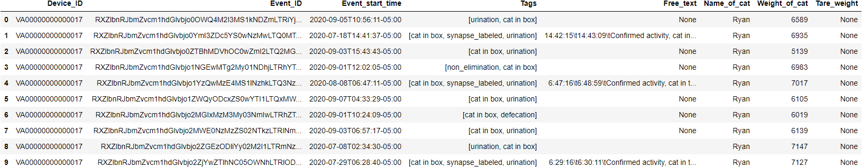
02 – Data Prepration
Convert JSON File to Data frame
Extract Diff. Activity from Tags and free text
Event Time features
Data Merging with Joining key
Elimination
Vomit
Year Month
JSON FILE:
EVENT_ID
CSV FILE:
File Name
Defecation
Jumped
Day Time
Urination
Cat Rubbing
Features that may not impact
Cat In box
Drift
Device ID
Final
Dataset
Synapse labelled
Covering & Digg.
Tare Weight

Slide 8
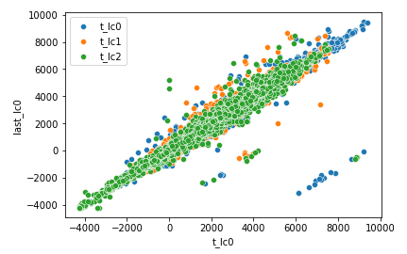
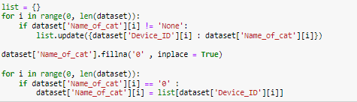
02 – Data Prepration
Merged Dataset
Dataset prepare after statistical measure on the load sensor and activity extract from the tags and free text
Data Cleaning : Missing Value
A) Impute Missing value :Tare value
B) Impute Missing value : Cat Name
Linear relation between tare value and last value of the sensor
Each Device ID has unique Cat name so impute by same
Notes:
Insert new data with some text below

Slide 9
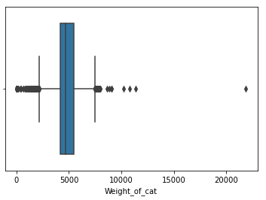
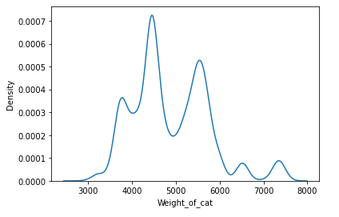
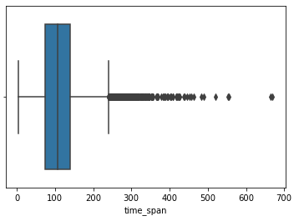
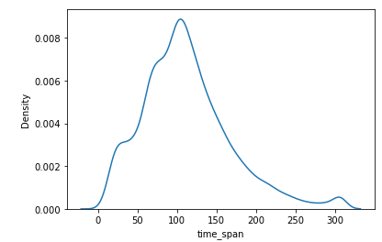
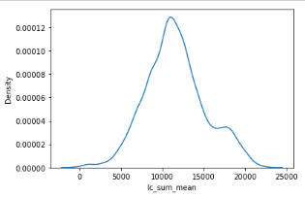
02 – Data Prepration
Data Cleaning : Treated Outlier Value
After Exploring Cat Weight so, find some cat name that has more or less weight, so Treat the Outlier of by Cat Name median weight value
By Exploring Time span, find no particular reason for the large duration so treat by upper bound value of IQR method.
By Exploring Time span, find no particular reason for the large duration so treat by upper bound value of IQR method.
Box plot of weight of all cat
Distribution after treating outlier of weight
Box plot of time span by cat
Distribution after treating outlier of weight
Distribution of load sensor sum mean

Slide 10
03. Data Exploration
Time duration of activities
Statistical measures of load sensor data differ for each activity
Activities’ behavior visualization of raw signals for different activities
For elimination (defecation and urination), the cat usually digs up the litter, eliminates it, and covers it up. The relation between digging up and covering activity differs between urination and defecation
4. Summary of activity patterns

Slide 11
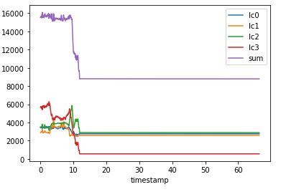
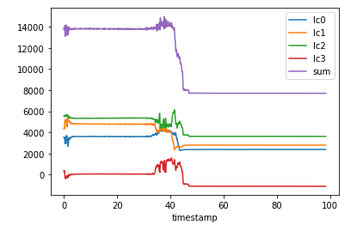
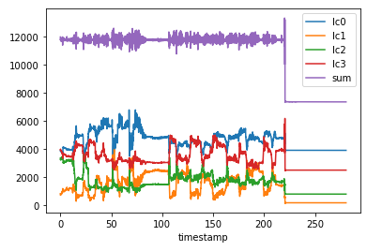
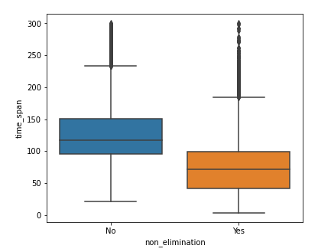
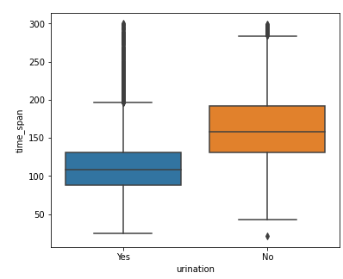
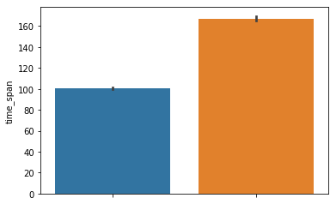
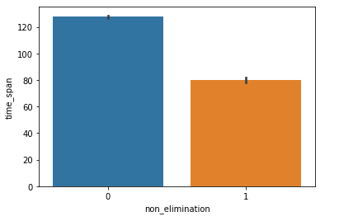
03 – Exploratory data Analysis(Bi-variate analysis)
Activity : Non-Elimination, Urination and Defecation
,
In Non-Elimination there is no pattern but happens in short time
In Elimination(Urination) there is no pattern that happens .
In Elimination(defecation) there is more disturbance or less stable in signal
In Non-Elimination there is pattern that happens in short time
Non-elimination Urination Defecation
In Elimination(Urination) there is pattern that happens in short time with non-Eli.
Clearly shows how different activity takes time for non-elimination

Slide 12
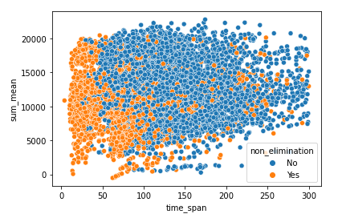
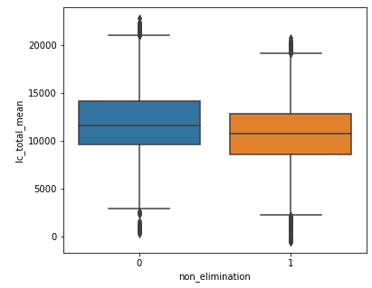
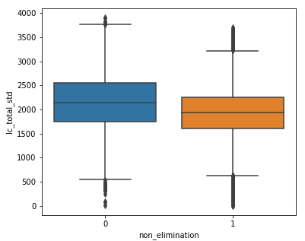
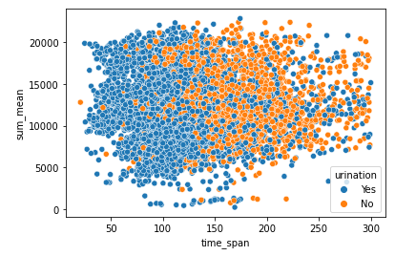
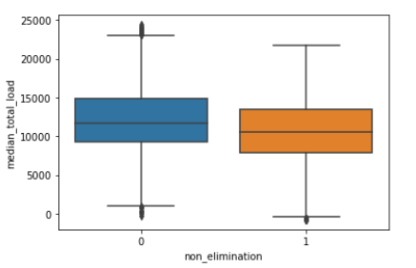
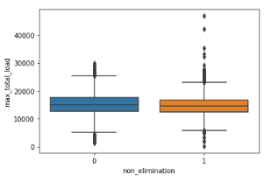
03 – Exploratory data Analysis(Bi-variate analysis)
Activity : Non-Elimination, Urination and Defecation
,
There is no pattern in the total load sensor measure in the activity
There more total load mean in the elimination activity
There more total load std in the elimination activity
In elimination, low time span there is Urination
There more total load median in the elimination activity
Std deviation of load has no
pattern for elimination activity

Slide 13
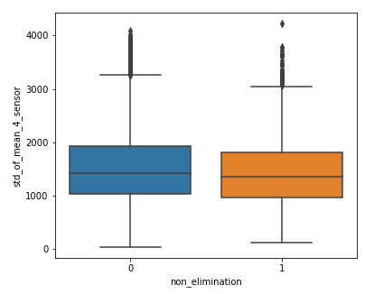
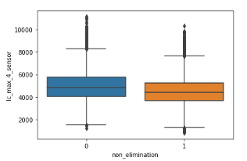
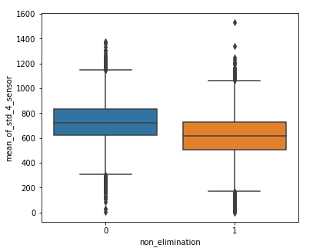
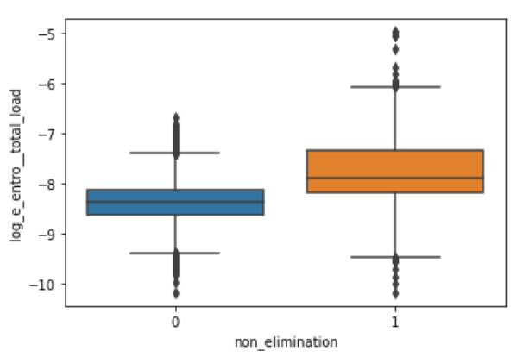
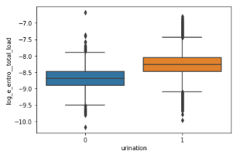
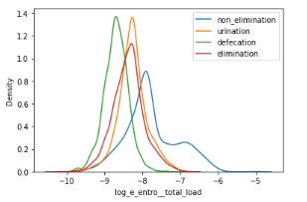
03 – Exploratory data Analysis(Bi-variate analysis)
Load signal statistics vs Target Variable
Mean of four load has higher in case of elimination overall
Std of four mean load sensor has more in elimination overall
Max of four load mean sensor has more in elimination overall
Log energy entropy of total load has lower in elimination overall
Log energy entropy of total load has lower in defecation overall
Activity takes to more on elimination

Slide 14
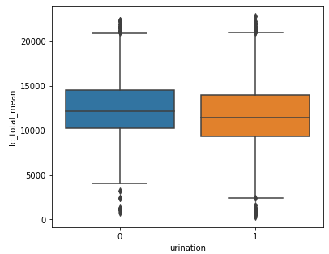
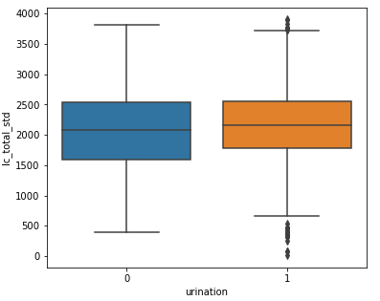
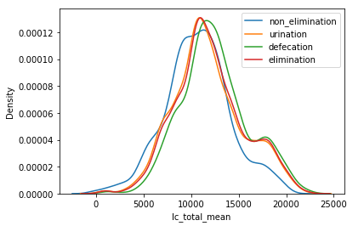
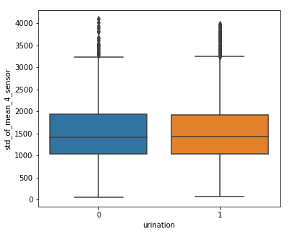
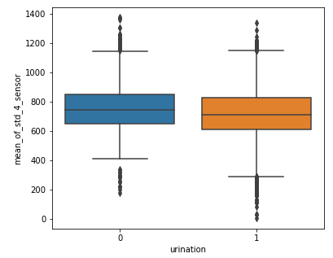
03 – Exploratory data Analysis(Bi-variate analysis)
By exploring raw data, signal, non-elimination and urination have no such pattern, whereas defecation has more disturbance in load values. And if we see the time duration of the activity, we can see the avg time excretion takes more than urination and defecation.
If we explore the load sensor values, we can say that the elimination median load sponsor has more deals, but there is no pattern in the maximum or total load.
If we see that each particular load sensor data mean of std is more in elimination but less in energy entropy in the case of defecation compared to urination.
Activity : Non-Elimination, Urination and Defecation
,
There is no pattern in the total load sensor mean in the activity
There is no pattern in the total load std measure in the activity
There is no pattern in the defecation and urination activity
Observation:
Time span , load mean of elimination was more, but log energy entropy was less.
Mean of std of load each sensor is higher for elimination
There is no pattern of particular load sensor in Urination and Defecation
Mean of std of load has no pattern for elimination activity
Std deviation of load has no
pattern for elimination activity

Slide 15
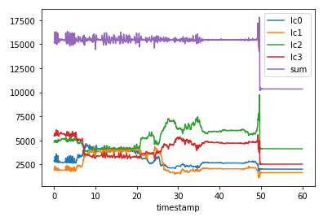
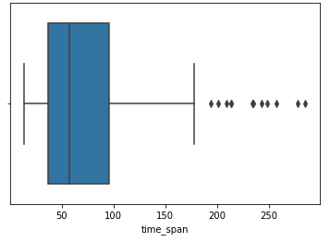
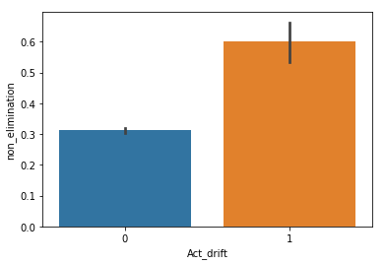
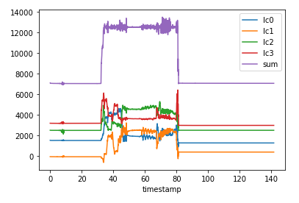
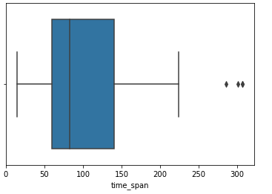
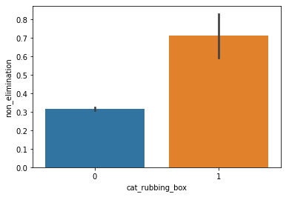
03 – Exploratory data Analysis(Bi-variate analysis)
Activity A) Drift
Drift activity load sensor change/drop at last 10 second only with less stable load
Time span of activity is usually takes minimum 40seconds
Drift activity takes to less on elimination
Activity B) Cat Rubbing Box
Starting and ending load was same that means activity happen between
Time span of activity is no pattern with time duration
Rubbing activity takes to less on elimination

Slide 16
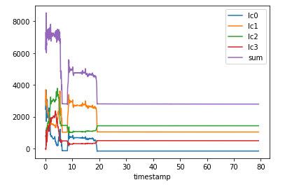
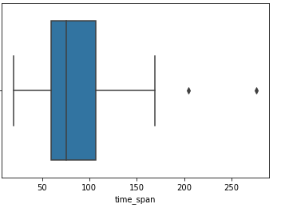
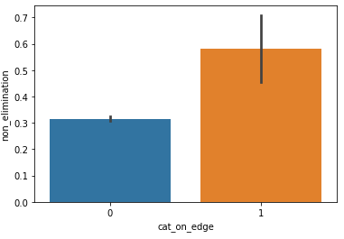
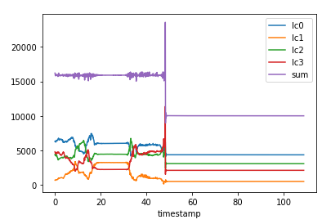
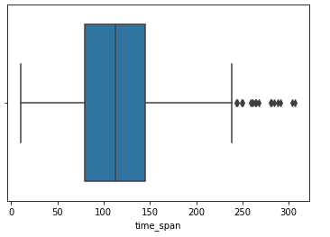
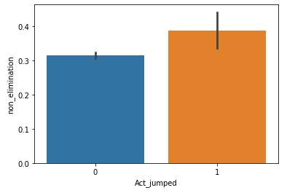
03 – Exploratory data Analysis(Bi-variate analysis)
Activity C : Cat on the Edge
Cat on edge activity load sensor has no pattern in raw signals with time
Time span of activity is usually takes minimum 40seconds
Cat on the edge activity takes to less on elimination
Activity D: Jumped
Jumped activity load sensor change very high at any point of time
Time span of activity is usually takes more time( 60seconds)
Jumped takes to almost same on elimination vs non_elimination

Slide 17
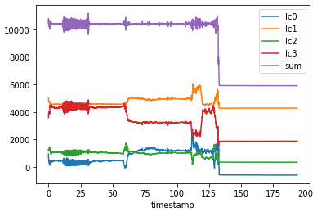
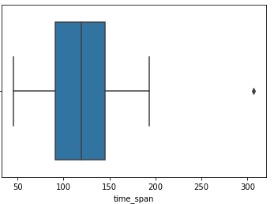




03 – Exploratory data Analysis(Bi-variate analysis)
Activity E : Vomit
Vomit activity load sensor has no pattern in raw signals with time
Time span of activity is usually takes minimum 50seconds
Vomit activity takes to less on elimination
Activity F: Digging & Covering
Digging activity load sensor change adaptively before 10 sec. for 20 sec
Time span of activity is usually takes minimum 40seconds
Digging activity takes to more on elimination

Slide 18





03 – Exploratory data Analysis(Bi-variate analysis)
Observation:
All activity has no impact less impact on elimination compare to digging and covering
Almost all activity takes less time than digging and covering with minimum time of 40 second
Digging and covering has more load compare to the other activity
There is no relation between behaviour of digging in urination and defecation activity
Total load mean has lower in non-elimination activity
There is relation between activity and elimination
There is no major difference in activity digging and urination or defecation
Chi2 test between Urination and activity
Chi2 test between elimination and activity
Digging activity load sensor higher in digging compare to no digging
There is less difference in other activity vs digging activity of load sensor

Slide 19
04. Feature Engineering
Features & Cat behavior
Perform data transformation (for frequency domain , time domain)
cat have a specific behaviour pattern
the relationship of features with target variable

Slide 20




04 – Feature Engineering
Feature A: Signal Processing (Power Spectral Density)
Transformations between time and frequency-domain
Fast Fourier Transform (FFT) : It is an efficient algorithm for calculating the Discrete Fourier Transform (DFT) and is the de facto standard to calculate a Fourier Transform.
Power Spectral Density : Similar to the FFT, it describes the frequency spectrum of a signal. But in addition to the FFT it also takes the power distribution at each frequency (bin) into account.
Autocorrelation : The auto-correlation function calculates the correlation of a signal with a time-delayed version of itself.
PSD Distribution for elimination
PSD Distribution for elimination
PSD Distribution for urination
PSD Distribution for defecation

Slide 21



04 – Feature Engineering
Feature A:Power Spectrum Density Breed Elimination
We can divide the whole frequency in 4 parts
PSD Having impact on the elimination
PSD Having impact on the urination
Feature that are Extracted from the data
PSDF_0_5Hz_Mean
PSDF _5_10Hz_Mean
PSDF _10_15Hz_Mean
PSDF _15_20Hz_Mean
PSDF_0_5Hz_Median
PSDF _5_10Hz _Median
PSDF _10_15Hz_ Median
PSDF _15_20Hz _Median
20 Features
PSDF _0_5Hz_Maximum
PSDF _5_10Hz _Maximum
PSDF _10_15Hz_ Maximum
PSDF _15_20Hz _Maximum
PSDF _0_5Hz_Minimum
PSDF _5_10Hz _Minimum
PSDF _10_15Hz_ Minimum
PSDF _15_20Hz _Minimum
PSDF _0_5Hz_Std
PSDF _5_10Hz _Std
PSDF _10_15Hz_ Std
PSDF _15_20Hz _Std

Slide 22




04 – Feature Engineering
Feature B: Cat Weight
Decision on Bins:
On the basis of Weight there is pattern and type of cat that are occurs :
Weight less than 3400 - 'Marlowe', 'Meera’
Weight more than 6500 weight - Ryan', 'Lexi', 'Zeb', 'Simon'
Weight of the Cat Beed can be Bin
Low less weight cat breed has less elimination compare to more weight
Feature C: Cat elimination event time
Usually elimination happens in early moring(05-07), evening(17-19) and night(21-22)
In elimination, low time span there is Urination
In elimination, low time span
there is Urination

Slide 23


04 – Feature Engineering
Feature D: Cat Elimination Month wise
August to October non-elimination process is more likely be done
Month wise non-elimination bar plot
Binning month wise plot
Feature Selection Process
Features
VIF Selection
Backword elimination
Final Features
Total Features 70
Features 25
Features 16
Final features
Features created by dummy
Feature of Time, name removed
Features having corelated
Have removed
Features that are important
Has been selected
Features not having corelation
Having p value < 0.05

Slide 24






04 – Feature Engineering
Feature Selection
Load values Features that are co-related
Features that are extracted
Features by reducing co-linearity
Final Features
PSD values Features that are co-related

Slide 25
05. Train Model to Elimination & Non- Elimination
Right Modeling Technique
Different modelling technique for prediction
Justification of the models based on
Hold out validation : Create train, test and validation datasets
Model Performance using the evaluation metrics: Confusion Matrix, Multiclass overall and class wise metrics
Residual analysis
Summarize the cause/patterns in misclassifications

Slide 26

06 –Model : Elimination and Non-Elimination
Class imbalance & Test Train Split
Accuracy of different model
 | Non elimination | Class %
0 | 8358 | 0.67
1 | 4073 | 0.33
 |  | Class %
Train | 7458 | 0.60
Test | 2486 | 0.20
Validation | 2486 | 0.20
Result Summary of Models
 | LOGIT REGRESSION (Threshold value = 0.5) |  |  | LOGIT REGRESSION (Threshold value = 0.4) |  |  | LOGIT REGRESSION (Threshold value = 0.6) |  |  | XG Boost (Hyperparameter by Grid search)
 | Train | Valid | Test | Train | Valid | Test | Train | Valid | Test | Train | Valid | Test
Accuracy | 81.7 | 82.4 | 83.4 | 79.97 | 80.45 | 83.4 | 80.7 | 81.2 | 82.5 | 88.12 | 85.28 | 86.33
Recall | 0.92 | 0.93 | 0.92 | 0.85 | 0.85 | 0.92 | 0.96 | 0.97 | 0.97 | 0.97 | 0.95 | 0.94
Precision | 0.83 | 0.83 | 0.85 | 0.85 | 0.86 | 0.85 | 0.79 | 0.80 | 0.81 | 0.87 | 0.85 | 0.87
Fi-Score | 0.87 | 0.88 | 0.88 | 0.85 | 0.85 | 0.88 | 0.87 | 0.87 | 0.88 | 0.92 | 0.90 | 0.90

Slide 27




05 – Model : Elimination and Non-Elimination
Train Test: Logistic regression
ROC-AUC Curve for the Train set
ROC-AUC Curve for the validation set
Features that can be related by negative coef. sign have negative impact on the elimination of cat
Log energy entropy, PSD and time has high in coef. So more important
ROC-AUC Curve for the Test set

Slide 28





05 – Model Interoperability : Elimination and Non-Elimination
Shap value Graph
Shap value impact on the model
Mean Shap value from the XG Boost model
Shap value impact on the XG Boost model
ROC-AUC Curve for the Test set
ROC-AUC Curve for the validation set

Slide 29





05 – Model Misclassification : Elimination and Non-Elimination
Misclassification
For lower PSDF 0-5Hz there is misclass.
For low mean std there is misclass.
No impact of misclass on log energy entropy
PSD and mean of std that causes the misclassification of activity
All the misclassification activity are no pattern in time distribution
No impact of misclass on Max. load value
No impact of misclass on Med. load value

Slide 30
06. Train Model to Urination & Deflamation
Right Modeling Technique
Identify the right modelling technique
Justify the models based on
Hold out validation : Create train, test and validation datasets
Model Performance using the evaluation metrics: Confusion Matrix, Multiclass overall and class wise metrics
Residual analysis
Summarize the cause/patterns in misclassifications

Slide 31

06 – Model : Urination and Defecation
Class imbalance & Test Train Split
Accuracy of different model
 | Non elimination | Class %
Urination | 6367 | 0.76
Defecation | 1991 | 0.24
 |  | Class %
Train | 7458 | 0.60
Test | 2486 | 0.20
Validation | 2486 | 0.20
Result Summary of Models
 | LOGIT REGRESSION (Threshold value = 0.5) |  |  | LOGIT REGRESSION (Threshold value = 0.4) |  |  | LOGIT REGRESSION (Threshold value = 0.6) |  |  | XG Boost (Hyperparameter by Grid search)
 | Train | Valid | Test | Train | Valid | Test | Train | Valid | Test | Train | Valid | Test
Accuracy | 82.11 | 82.0 | 83.0 | 80.81 | 80.98 | 83.00 | 82.83 | 83.31 | 84.21 | 93.32 | 86.86 | 86.24
Recall | 0.41 | 0.41 | 0.44 | 0.28 | 0.29 | 0.44 | 0.58 | 0.57 | 0.61 | 0.80 | 0.62 | 0.62
Precision | 0.70 | 0.73 | 0.76 | 0.74 | 0.79 | 0.76 | 0.65 | 0.69 | 0.70 | 0.91 | 0.76 | 0.77
Fi-Score | 0.52 | 0.53 | 0.56 | 0.41 | 0.43 | 0.56 | 0.61 | 0.62 | 0.65 | 0.85 | 0.68 | 0.69

Slide 32





06 – Model Interpretability : Urination and Defecation
Shap value Graph
Shap value impact on the model
ROC-AUC Curve for the Train set
ROC-AUC Curve for the validation set
ROC-AUC Curve for the Test set
ROC-AUC Curve for the validation set
Feature importance of the variables

Slide 33






06 – Model Misclassification : Urination and Defecation
For higher time span then there is misclass.
For lower log entropy of std then there is misclass.
No impact of misclass on skew of load
Higher PSDF tends to miss class.
No impact of misclass on PSDF mean value
Higher std of PSD on misclass

Slide 34


07. Business Insight
Defecation
Urination
Non-Elimination
Non-elimination Urination Defecation
Defecation
Urination
Non-Elimination
A) Log energy entropy is directly says that more entropy will cause the non- elimination that is directly impacted on the health of Cat
B) Time taken is directly impact on the type of activity may be used to describe the health that product used
C) PSD OF Freq 0-5Hz is directly impact on the type of activity may be used to behaviour and health

Slide 35
07. Business Insight
D) Event Month can say the August to October has less impact on the elimination
E) Early morning and evening time have more likely to eliminate and
F) Overall load value of elimination is more compare to the non-elimination

Slide 36
08. Conclusion
Energy Entropy of the load sensor can determine the different activities, which we can also use to detect the health of the Cat.
If there is an elimination activity done by the cat, then there would be more time, but the log energy entropy would be less.
Starting power density received by the sensor is a lower case of cat elimination.
Activity day/month timing also plays an essential part in defining the activity, like the month and day part of the activity.
Cat breed will also impact the urination activity in our case good weight cat has more importance than others.
Each activity(drift, digging, and covering) also play a good part in detecting the elimination but has no impact on defining elimination and defecation.

Slide 37
Thank You
Do you have any questions?
Shubham Verma
Shubham.verma@tigeranalytics.com
+91-8077085794

