Slide 1
🛡️ TrustKYC Vault |
| Tokenised, Consent-Driven Digital KYC |
| for Secure Financial Ecosystem
HaRBInger 2025
Innovation for Transformation
TrustKYC Vault
Tokenised, Consent-Driven Digital KYC for Secure Financial Ecosystem
👤 Presented By:
Reema Srivastava — Project Leader - 9120758672
Shubham Kumar Vishnoi — Team Member - 9058612403
🧰 Technology Focus: .NET Development

Slide 2
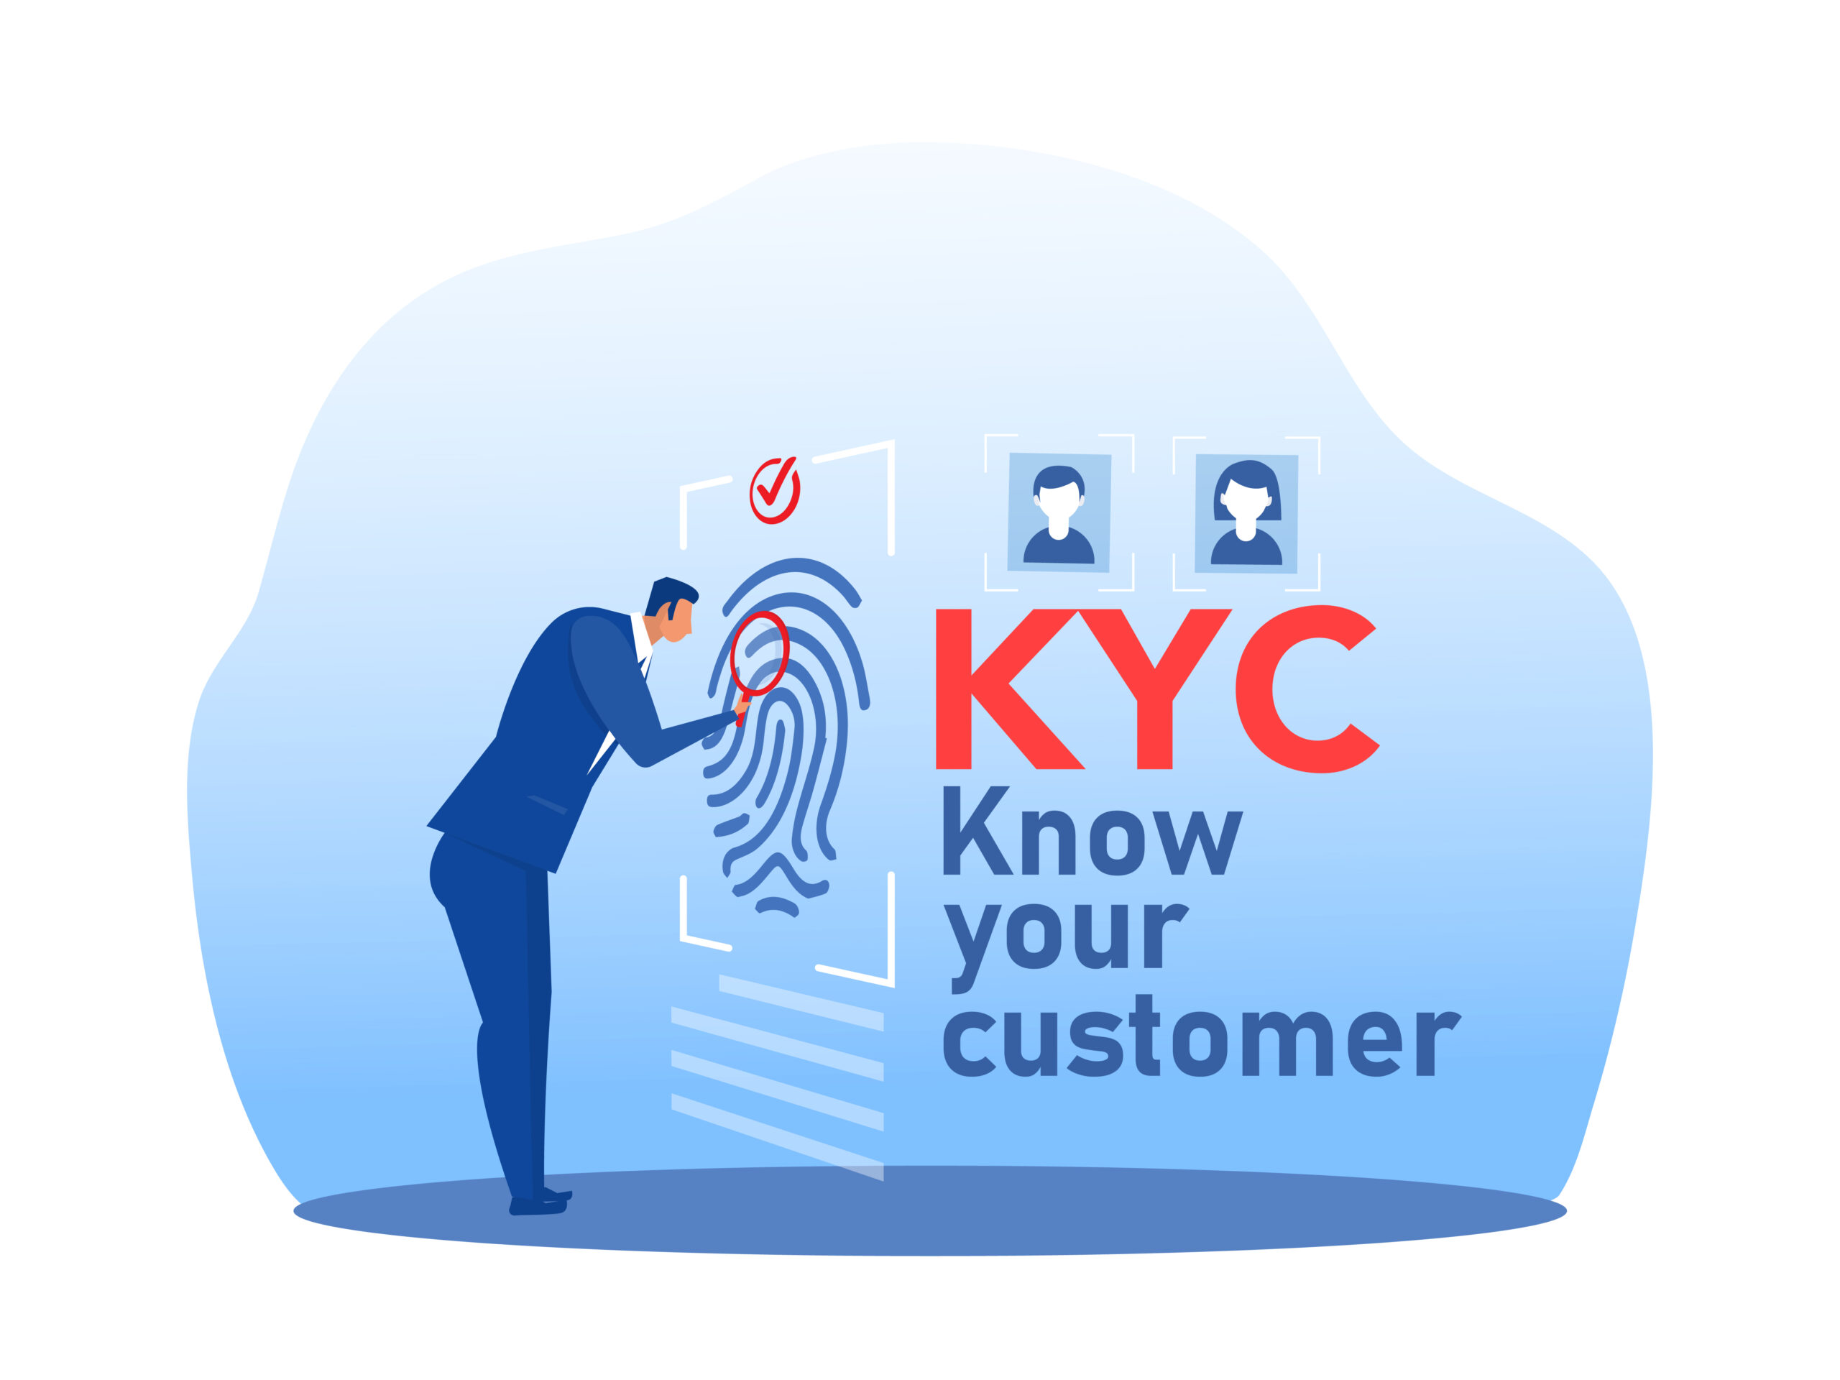
TrustKYC: Tokenised, Consent-Driven Digital KYC for India
✔ Project Name: TrustKYC
✔ Team Name: AI Innovation Team
✔ Team Members: 2 Member
✔ Submission Category: Theme 1 — Tokenised KYC

Slide 3
Slide 2 — Problem Background & Why It Matters
Today in India, every bank, wallet, insurance provider, and financial application requires a separate KYC process.
This results in:
User onboarding friction
Repeated verification cost
Higher risk of identity exposure & data leaks
Slow digital financial inclusion
Repeated KYC effort = Over ₹100 crore annual cost to the financial ecosystem (estimated)

Slide 4
Current System | Issue
Separate KYC for each institution | Redundant and costly
Aadhaar + OTP Model | No selective disclosure
Identity stored across multiple systems | Higher breach risk
No unified consent mechanism | Lack of transparency & user control
Slide 3 — Gap Analysis: What’s Missing Today?

Slide 5
Slide 4 — Vision Statement
“To create a reusable digital KYC identity token controlled by the user and accepted across all financial institutions in India.”

Slide 6
Slide 5 — Solution Concept: TrustKYC
Our solution introduces a secure and reusable KYC token model that supports:
✔ One-time KYC verification
✔ Secure encrypted identity tokens
✔ Consent-driven data sharing
✔ Tamper-proof verification with audit logs
✔ Interoperability with Aadhaar, DigiLocker, and CKYCR

Slide 7

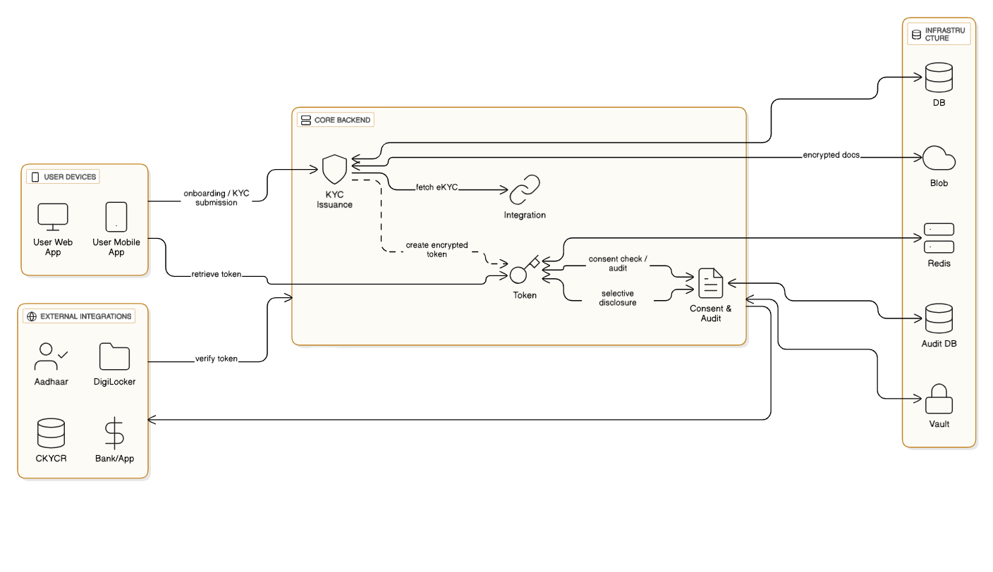
Slide 6 — System Architecture
Title: Tokenised KYC System Architecture

Slide 8
Slide 7 — Workflow Summary
User Onboarding
Aadhaar / DigiLocker-based identity authentication
KYC verification completed
Encrypted TrustKYC token generated
Sharing with a New Financial Institution
User shares token
Institution verifies via TrustKYC API
Only required data is shared (selective disclosure)
Update & Revocation
Change in identity → Token updated
Updated record is reflected across institutions

Slide 9
Slide 8 — Key Features
🔐 Zero-trust security model
🎯 Selective disclosure with consent control
📦 Plug-and-play API ecosystem
♻ Reusable identity across institutions
🏛 Full compliance with CKYCR and RBI guidelines

Slide 10
Layer | Technology
Backend Framework | ASP.NET Core 8 Web API
Authentication | OAuth2 + OpenID Connect + JWT
Database | PostgreSQL / SQL Server
Caching | Redis
Security | RSA/ECDSA + AES-256 Encryption
Token Format | JSON-LD + W3C Verifiable Credentials
Client App (Optional) | .NET MAUI
Cloud | Azure / AWS
Logging | Serilog + Seq
Slide 9 — Technology Stack (.NET Focused)

Slide 11

Slide 10 — Security Model
Public-private key cryptography
Secure key vault for signing and storage
Token tamper detection and verification
Support for Zero-Knowledge Proofs (ZKP) for privacy-preserving validation

Slide 12
Slide 11 — Compliance & Integration
The system aligns with existing and upcoming Indian digital identity standards:
Aadhaar Offline Verification
DigiLocker API integration
CKYCR dataset compliance
India Data Protection Act & RBI Digital Identity Framework

Slide 13
Slide 12 — Business Impact & Scalability
✔ Reduction in repeated KYC processing cost
✔ Faster onboarding (seconds instead of days)
✔ Increased trust and fraud reduction
✔ National identity interoperability at scale

Slide 14
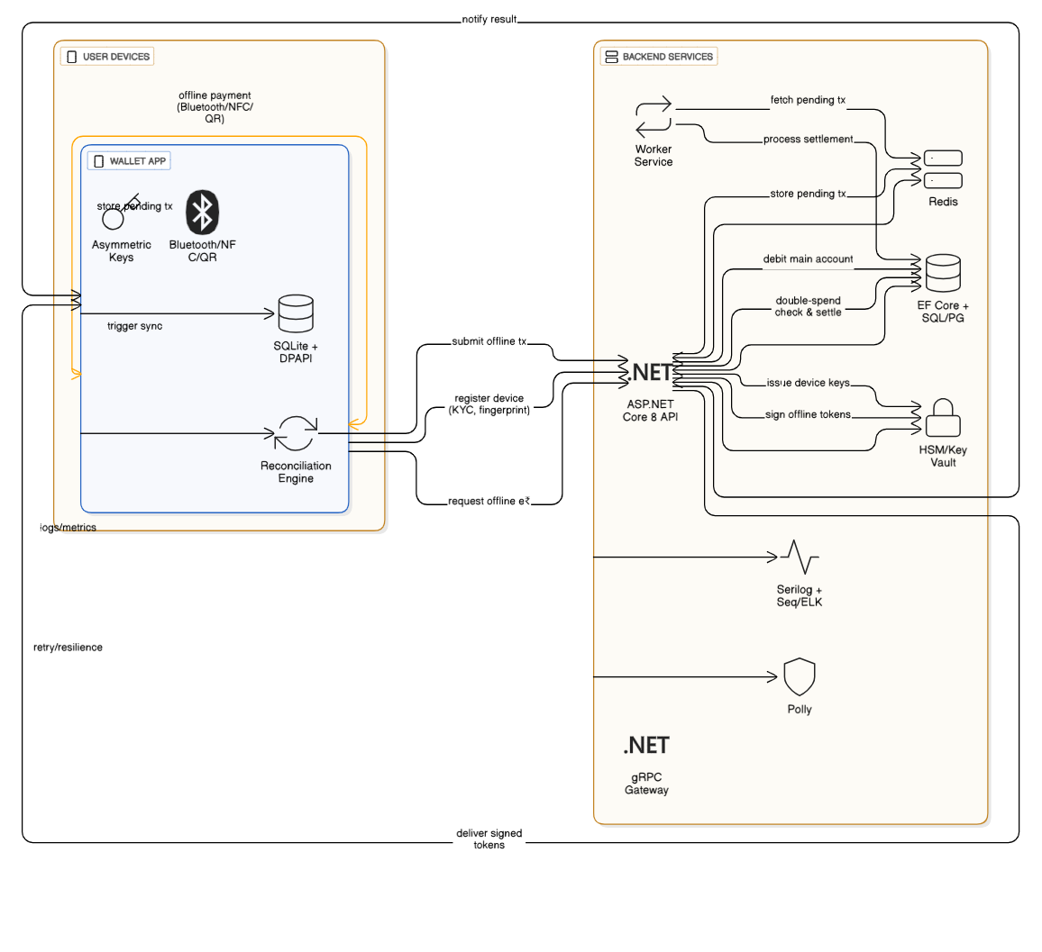
Slide 13 – Flow Chart Working Scenerios (Demo)

Slide 15
Slide 14 — Roadmap
We are a dedicated and solution-driven team, and we are confident that we can complete this project even before the proposed timeline. We have already developed and launched multiple applications in the market, including wallet-based systems that support payments without the need for internet connectivity.
Given our experience and proven capability, if we are provided the opportunity, we will deliver this solution efficiently and in a significantly shorter time frame
Phase | Duration | Output
Prototype | 30 Days | Working demo + Token API
Pilot | 3–6 Months | Deployment with two FI partners + CKYCR integration
Scaling | 1–2 Years | National adoption and ecosystem standardization

Slide 16
Slide 15 — What Can Our Team Deliver
Strong expertise in .NET architecture and secure backend development
Hands-on experience in identity systems, APIs, and cryptography
Understanding of Aadhaar, DigiLocker, and digital public infrastructure
Experience building scalable enterprise-grade software

Slide 17
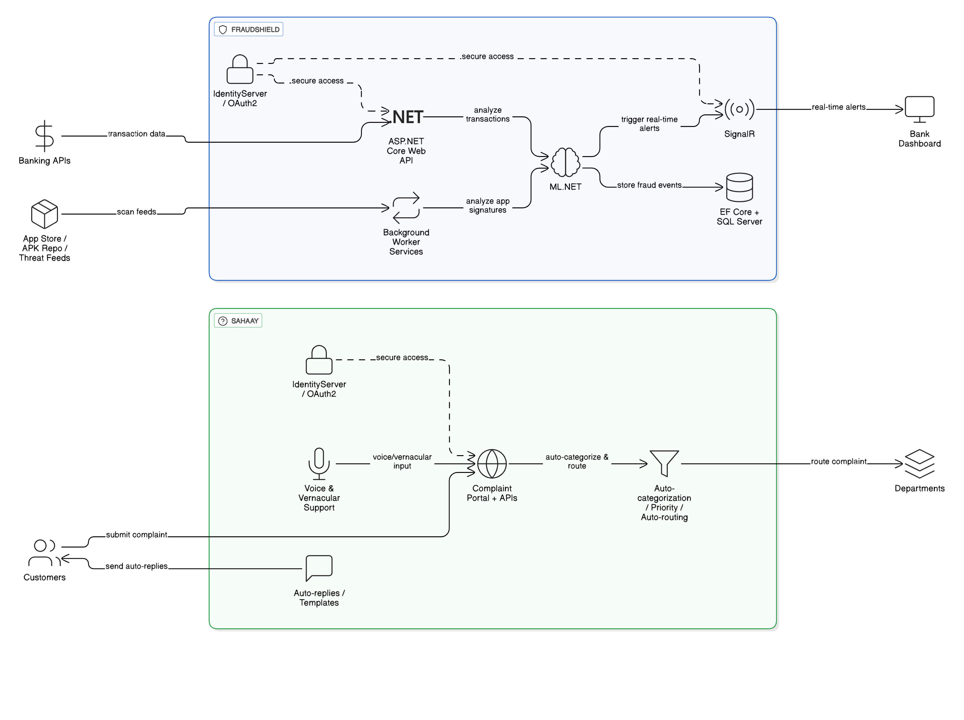
Slide 16 — Final Message
TrustKYC enables secure, reusable, and consent-driven identity verification — building a more trusted and frictionless digital financial system for India.

Slide 18


