Slide 1

KIET GROUP OF INSTITUTIONS
Mini project Title : DS_Arena
Project Mentor
Mr. Naresh Chandra
Assistant Professor
Team Members :
Shubham Kumar Vishnoi (Team Leader)
Shivam Nerwal ( Member)

Slide 2
Acknowledgement
For this journey from learning to implementation we are very thankful to Our mentor Mr. Naresh Chandra sir our project coordinators D.R. Vipin Kumar sir and MR. S.D. sir who motivated us during this whole journey and tell us that what to learn and from where to learn apart from this they suggest us how to manage our learning and implementation curve of the project. And how to make the use of new and latest technologies in our practice so that we will avheive the mastery in our field.

Slide 3
ABOUT PROJECT
Our project DS_Arena is a single page web application which provides the knowledge about the main fundamental data structures.
Each and every topic is explained in a proper language and the interactive user interface along with images and gifs are used.
Whole the application is single page. The technology which we have learned is utilized in the project.

Slide 4
Technology used
React JS
JSX
React Hooks
UseState
ReactRouterDOM
CSS 3
JavaScript
Node Js( Decided for future scope )

Slide 5
Future scope :-
We are working to add backend in our application for that we are learning NodeJS
And we are collecting ideas that how to make our application more interactive and user friendly.
Some of our plans are as follows:-
Planning to add user login form .
Planning to add discussion form.
Planning to add feedback form.
Planning to add quiz and selected programming questions with company tags.

Slide 6
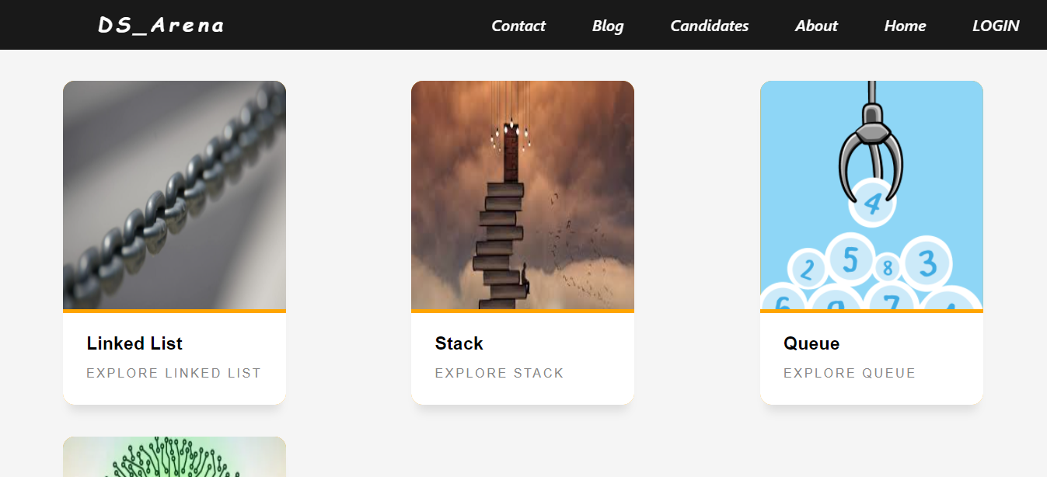
Front Page of Application

Slide 7
GitHub repository link of Project
https://github.com/shivamnerwal1998/DS_Arena.git

Slide 8
Conclusion
This project helped us a lot from project management to learning new skills we learned some good concepts of CSS and We learned how to use react hooks and how to utilize a component oriented language and make applications by help of them from scratch .

Slide 9
Thanking You

