Slide 1
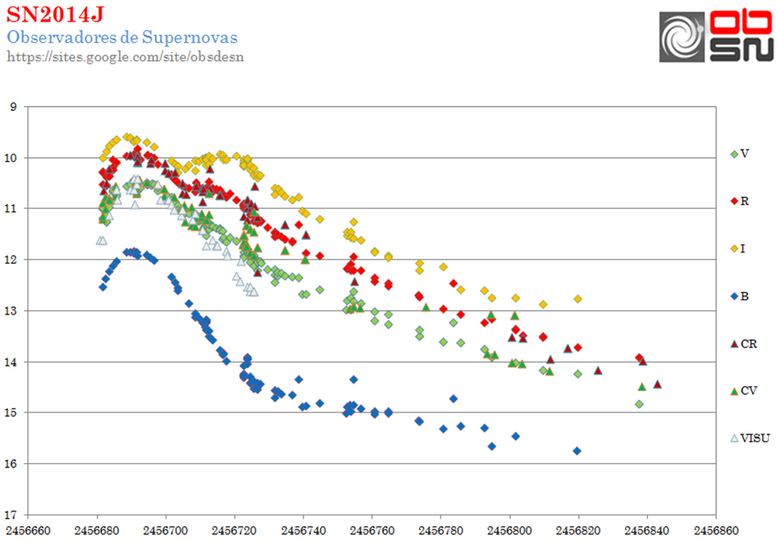
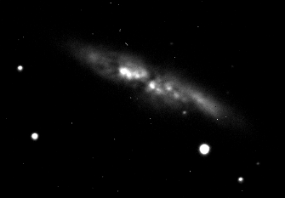
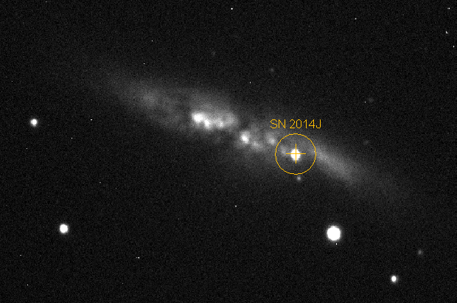
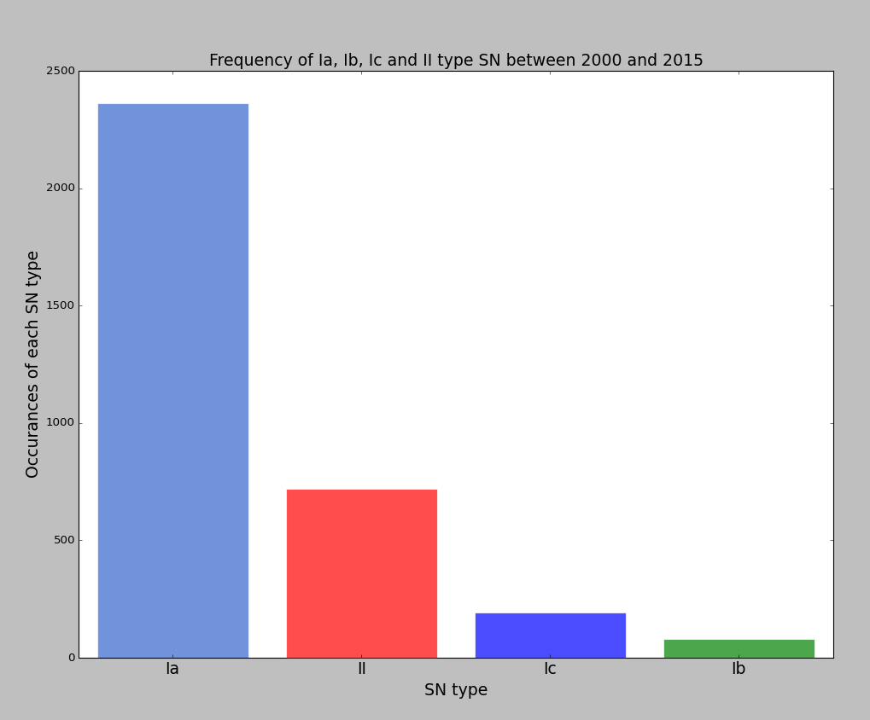
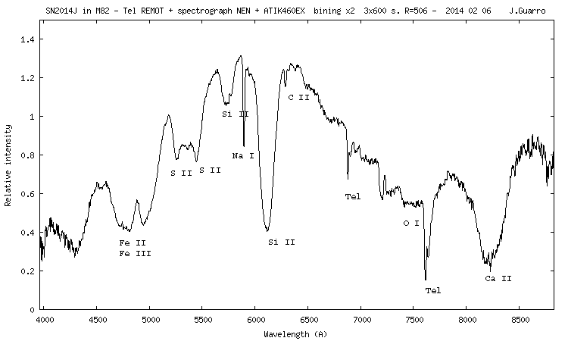
Project Supernova
Bayfordbury Supernova Survey
Thomas Spriggs Supervisors – Elias Brinks, Mark Gallaway
Motivation for a Supernova (SN) survey:
To test the potential of the Bayfordbury Observatory by conducting a SN survey.
Add to the global catalogue of Supernovae (SNe) observations for continuously ongoing scientific studies:
Dark Energy and redshift surveys. (Cosmology)
Development of the Standard Candle use of SN Ia.
Personal Motivation
To develop astro-photometry skills.
This project will allow me an insight into observational surveys on a small scale.
Rare opportunity to use telescopes for an extended project.
Fig.1 - SN 2014J Light Curves in different filters [1]
Supernova Classification:
Type Ia – White Dwarf (WD) exceeding Chandrasekhar core mass limit; M_{Ch}≈1.4 M_{ʘ}, via accretion. Found within all galaxies, type Ia normally peak at absolute B magnitude of between -19 and -20 mags. [4]
Type Ib/c and Type II – Found primarily in spiral galaxies with recent star formation. Triggered by core collapse of larger stellar mass objects: M>5-8 M_{ʘ}. Examples being Wolf-Rayet stars, Red Super Giants and Asymptotic Giant Branch (AGB) stars. Strong hydrogen lines present in spectra due to hydrogen in outer shells and He burning cores. [3]
Fig.1 - Light curves plotted based on observations through different broad-band filters. Peak magnitude and subsequent light curve powered by the radioactive beta-decay process of ⁵⁶Ni → ⁵⁶Co → ⁵⁶Fe. [5]
Fig.2 – Observations taken of the galaxy M82; before and during SN 2014J. It is clear to see how a SN can outshine its host galaxy, making them great distance measurement objects.
Fig.4 - Emission spectrum from 2014J, note the presences of Si II and Fe II and Fe III, signs that it was a SN Ia. These heavier elements are produced from the runaway nuclear fusion occurring during the WD core collapse, and then expelled into the surrounding ISM via the supernovae's shock wave.
SNe last approximately a month, a blip in comparison to the cosmological timescales for other large-scale events.
Fig.2 - M82 SN 2014J [2]
Fig.3 - Relative frequency of each type of SN
The plan:
Start by selecting targets for observation, sticking to a fair sized population, increasing my chances of finding an SNe but also baring in mind the limited timeframe over which the survey can run, with other restrictions such as the famous British Weather.
I aim to keep track of at least 40 galaxies in total over the period of the survey, making periodic observations, checking for any changes. This part of the survey will require shorter exposure times.
Attempt to recognise SN progenitor via plotted light curves, differences in magnitude across different Johnson filters (I, B, V, R etc.) and potentially through the observations of spectral emissions.
Provide a background of SNe theory and look at why surveys are conducted.
Assess the feasibility of such a survey being executed using the Bayfordbury Observatory.
Using the peak magnitudes measured from the CCD and read off from .FITS, get an estimate measure for the distance to the host galaxy.
Fig.4 - SN 2014J Spectral emissions [1]
Statistical limitations / parameters:
Considering that there are ~10¹¹ stars in a galaxy, with estimates of 1 supernova every 100 years, the survey needs to observe at least 100 galaxies to get a reasonable chance of finding a SN. Choosing spiral galaxies over ellipticals and star clusters etc. means a higher proportion of SN progenitors per image, resulting in a higher chance of detection.
Bayfordbury has an apparent limiting magnitude of ~19 mag, depending upon sky / atmospheric conditions. This limit is down to a few factors: Telescope diameter, location and CCD resolving power.
The weather will determine the amount of time that can be spent observing, especially when attempting to continuously observe SNe over any length of time (i.e. days or weeks).
To reduce limitations for this survey, external reports on SNe will be used to determine the targets for observation, as it takes time to survey a large number of galaxies repeatedly. Unsurprisingly it is almost impossible to predict when an SN will occur in any given region.
References:
[1] - Observadores De Supernovas, accessed: 24/11/2015. Fig.4 obtained by Joan Piggy.
<https://sites.google.com/site/obsdesn/home/sn2014j>
[2] - Supernova image: Bayfordbury archive – M82, B filter, 240s and 300s exposure times, Nov. 2013 and Feb 2014.
, January and April 2014, accessed 20/11/2015 [3] - Turatto, M. 2003, "Classification of Supernovae". Available from: <arXiv:astro-ph/0301107> [accessed 24/11/2015]
[4] - Brown, P.J. et. al. 2010, "The Absolute Magnitudes of Type Ia Supernovae in the Ultraviolet", The Astrophysical Journal, vol. 721, no. 2, pp. 1608-1626. <arXiv:1007.4842 [astro-ph.CO]>, accessed: 24/11/2015
[5] - Blondin, S. et. al. 2012, "The spectroscopic diversity of Type Ia supernovae", Astronomical Journal, vol. 143, no. 5.<arXiv:1203.4832 [astro-ph.SR]> accessed 30/11/2015
Notes:
B curve the same for most SN Ia, other bands have distinct features, such as twin peaks etc.
Type II 30 times fainter, 3 magnitudes fainter than Ia

