Slide 1

Server Management System
PRESENTED BY:
Shubham Yadav
Bharghavateja vardhan
Prakash k
Bharath sai

Slide 2
Abstract
This project presents a Server Management Dashboard designed to monitor and manage server performance in real time. It integrates Python, Flask, MongoDB, Socket.IO, and Chart.js to create a dynamic web-based solution where server metrics—specifically CPU and memory usage—are updated every 5 seconds directly in the database and pushed to the client dashboard. Administrators can perform CRUD operations on server records, view real-time data, and visualize historical trends with side-by-side interactive charts. Additionally, the system incorporates basic predictive analytics for potential server failures and generates maintenance schedules to ensure proactive service management. This dashboard exemplifies a scalable, user-friendly approach to server monitoring, providing immediate insights and facilitating efficient maintenance planning.

Slide 3
Problem Statement
CRUD: Server details, health metrics, and logs.
•predict server failure(server_id): Predict potential server failures based on metrics.
.generate maintenance schedule(server_id): Create a maintenance schedule for servers.

Slide 4
Project Objectives
Web-based Interface
Automation
Provide a user-friendly web interface for managing servers, accessible from anywhere.
Automate server creation and basic operations, simplifying the process and reducing errors.

Slide 5
Technology Stack
Frontend
Backend
HTML, CSS, JavaScript - used for creating the user-friendly web interface.
Python (Flask) - provides the core logic for server management and automation.

Slide 6
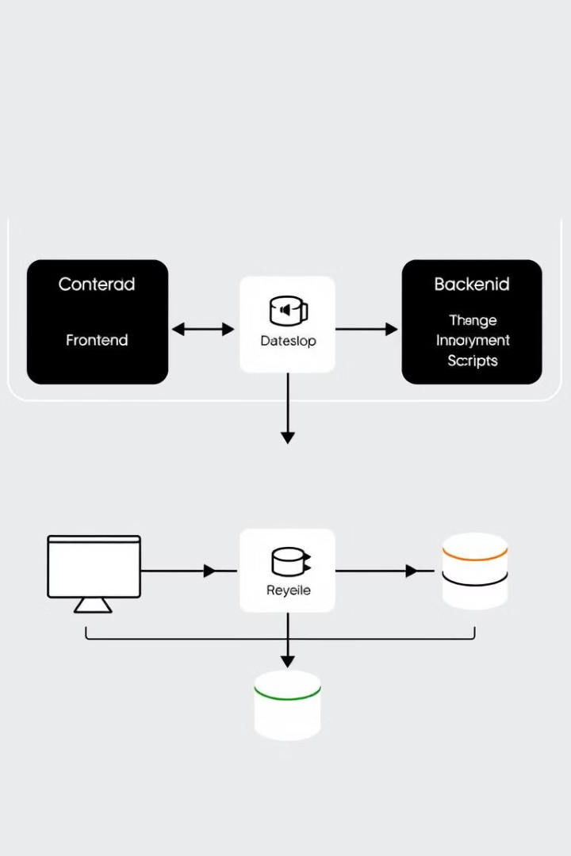
System Architecture
User Interface
The web interface allows users to interact with the system.
Backend
The backend handles server management logic and interacts with server management scripts.

Slide 7
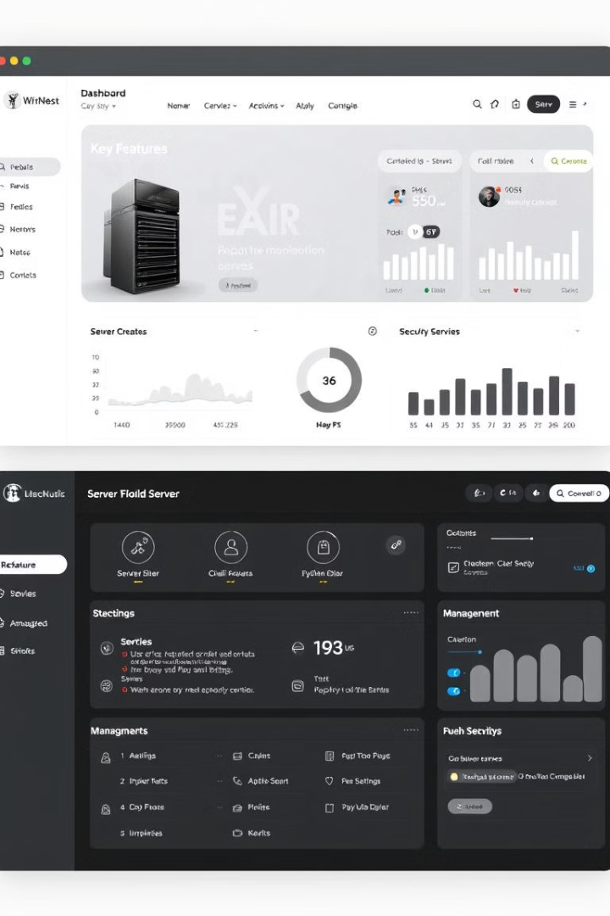



Features & Implementation
Web Interface
Server Creation
Management Functions
A user-friendly dashboard provides a central point for managing servers.
A dedicated module automates server setup, reducing manual configuration time.
Functions like start, stop, restart, and monitor allow users to control servers efficiently.

Slide 8
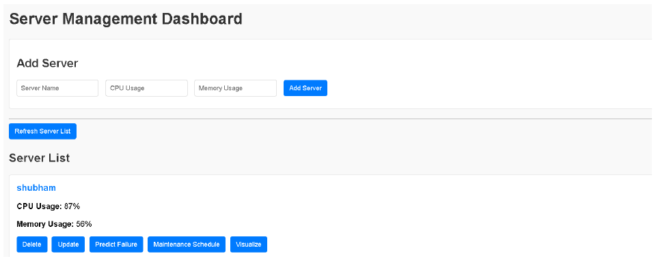
OUTPUT

Slide 9

Conclusion

