Slide 1

What is cyber warfare
Cyber warfare is the use of computer technology to disrupt the activities of a state or organization, especially the deliberate attacking of information systems for strategic or military purposes.

Slide 2
Cyber Threats
Cyber warfare can present a multitude of threats towards a nation. At the most basic level, cyber attacks can be used to support traditional warfare. For example, tampering with the operation of air defenses via cyber means in order to facilitate an air attack.

Slide 3
Types of Cyber warfare attack
Espionage
Sabotage
Propaganda
Economic Disruption
Surprise Cyber Attack

Slide 4
What is Cyber Security?
Cyber Security is the technique of protecting computers, networks, programs, and data from unauthorized access or attacks that are aimed for exploitation.

Slide 5
TO UNDERSTAND
What are the security problems in Cyber field
How to implement and maintain Security of a Cyber field around us
What is need of Cyber Security

Slide 6

Major security problems
Virus
Hacker
Malware
Trojan horses
Password cracking

Slide 7
Ways To Combat Malware Attacks
Watch For The Signs Of A Malicious Software Attack
Install Antivirus Software
Perform Ongoing Software Updates
Install A Firewall
Verify The Source Of Downloads And Emails
Conduct Periodic Data Backups
Use A Digital File Shredder

Slide 8
Cyber targets
Military Networks
Government System and Websites
Ecommerce and Financial Institutes
Telecommunication Companies
Others

Slide 9
Cyber Attacks in india
First Cyber attack: May 1998
Reason: Pokhran 2 Nuclear Tests
Target: Bhabha Atomic Research Center, India
Responsible group: Milworm
Disclosure of sensitive mails regarding nuclear tests

Slide 10
Cyber Attacks in india
Malware associated with the Lazarus Group was used to collect technical information from KNPP in 2019.
The Nuclear Power Corporation of India Ltd. (NPCIL) confirmed on Oct. 30 that a cyberattack against the Kudankulam Nuclear Power Plant in Tamil Nadu had occurred in early September.

Slide 11
reason
The investigation revealed that the infected personal computer belonged to a user who was connected in the internet connected network for administrative purpose.
The North Korean hackers sent a malware link to two employees Kakodkar and Bharadwaj’s on official and personal email accounts. Once Kakodkar and Bharadwaj clicked on the link while still using the Kudankulam plant’s domain, the malware spread quickly through the IT networks.

Slide 12
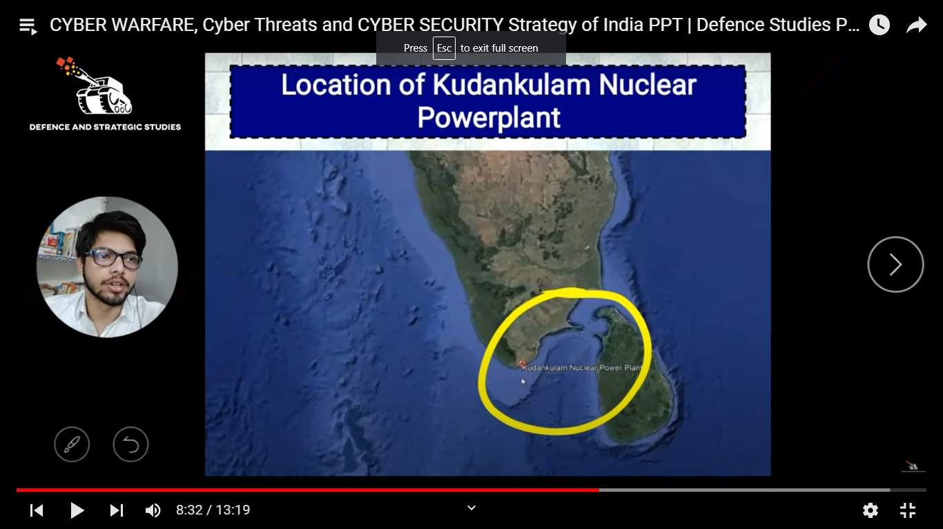
Location of kudankulam nuclear powerplant

Slide 13
Examples
Stuxnet Virus
Stuxnet was a worm that attacked the Iranian nuclear program. It is among the most sophisticated cyber attacks in history. The malware spread via infected Universal Serial Bus devices and targeted data acquisition and supervisory control systems. According to most reports, the attack seriously damaged Iran’s ability to manufacture nuclear weapons.

Slide 14
Sony Pictures Hack
An attack on Sony Pictures followed the release of the film “The Interview”, which presented a negative portrayal of Kim Jong Un. The attack is attributed to North Korean government hackers. The FBI found similarities to previous malware attacks by North Koreans, including code, encryption algorithms, and data deletion mechanisms.

Slide 15
Fancy Bear
CrowdStrike claims that the Russian organized cybercrime group Fancy Bear targeted Ukrainian rocket forces and artillery between 2014 and 2016. The malware was spread via an infected Android application used by the D-30 Howitzer artillery unit to manage targeting data.
Ukrainian officers made wide use of the app, which contained the X-Agent spyware. This is considered to be a highly successful attack, resulting in the destruction of over 80% of Ukraine’s D-30 Howitzers.

Slide 16
Thank you

