Slide 1
TESTING
- 25 SHUBHAMKUMAR YADAV

Slide 2
INTODUCTION
At first stage:- Testing is a process of executing a program with the intention of finding errors.
At last stage:- Testing is the process of demonstrating that errors are not present (after the completion of all bugs)

Slide 3
WHY TESTING?
To find and correct defects.
To check whether the Client/User needs are satisfied.
To avoid user detecting problems.
Also to provide Quality Product.

Slide 4
WHY DOES SOFTWARE HAVE BUGS?
Miscommunication or No Communication (That we are not clear about what an application should do or shouldn’t do).
Time Pressure (Time scheduling).
Changing Requirements.
Programing Mistakes.

Slide 5
WHAT ARE TESTING TECHNIQUES?
Testing Techniques is the method applied to evaluate a system or a component with a purpose to find if it satisfies the given requirements. Testing of a system helps to identify gaps, errors, or any kind of missing requirements differing from the actual requirements.

Slide 6
TYPES OF TESTING TECHNIQUES
Software Testing
Static and dynamic Testing
White Box Testing
Black Box Testing

Slide 7
SOFTWARE TESTING
Software testing is a method used to ensure that a software application is tested for software bugs and also checks if the developed software meets the specific requirements to produce a quality product.

Slide 8
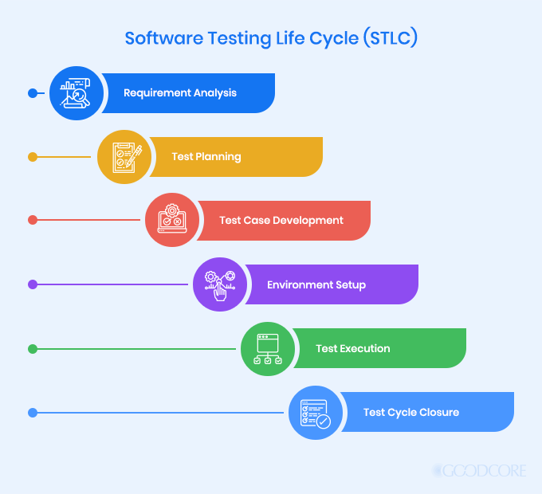

Slide 9
STATIC AND DYNAMIC TESTING
Static testing: Static testing doesn’t need actual execution of program module. Code Reviews, walkthroughs, or inspection are considered as static testing
Dynamic Testing: Dynamic Testing methods are traditionally divided into black box and white box testing.

Slide 10
WHITE BOX TESTING
White box testing is a method of software testing that tests internal programming structures of an application. This type of testing technique is known as clear box testing, open box testing, structural testing, and transparent box testing. Its operation is opposite to black-box testing and is used at unit, integration, and system levels of the testing process.

Slide 11
THE TESTING TECHNIQUES OF WHITE-BOX TESTING INCLUDE:
Statement Coverage
Branch Coverage
Path Coverage

Slide 12
BLACK BOX TESTING
Black box testing is a type of software testing, which checks for the functionality of a software or an application without knowing the design, internal components, or structure of an application to be tested. It is also referred to as Specifications-based testing.
The black box testing method is mainly used to find missing functions, performance errors, initialization errors, and errors while accessing the external database.

Slide 13
THE TESTING TECHNIQUES OF BLACK-BOX TESTING INCLUDE:
Equivalence Partitioning
Boundary Value Analysis
Cause-effect Graph
Error Guessing
All-pairs Testing

Slide 14
ADVANTAGES OF TESTING TECHNIQUES
Highly efficient
Quality
Satisfies customer
Good product, good revenue
User experience
Business optimization

Slide 15
DISADVANTAGES OF TESTING TECHNIQUES
Appropriate communication and coordination with the tester
Competition among similar service providers
Lack of experienced professionals
Finding the right service provider

Slide 16
LEVELS OF TESTING
Level of testing includes the different methodologies that can be used while conducting Software Testing. Following are the main levels of Software Testing.
Functional Testing
Non-Functional Testing

Slide 17
FUNCTIONAL TESTING
Unit Testing
Integration Testing
System Testing
Acceptance Testing

Slide 18
Non-functional Testing
Performance testing
Security testing
Usability testing
Compatibility testing

