Slide 1

Amazon Sales Data Analysis SQL Capstone Project
Analyzing Sales Trends and Customer Behavior
: By SHUBHAM PRATAP SINGH
Date: 17/June/2024

Slide 2
Introduction
Purpose of the project
Amazon Sales Analysis: Discovering Trends and Extracting Insights.
Understand factors affecting sales in different branches

Slide 3
About the data
Data Overview:
1000 rows, 17 columns
Sales transactions from branches in Mandalay, Yangon, Naypyitaw
Columns:
['invoice_id’, 'branch’, 'city’, 'customer_type’, 'gender’, 'product_line', 'unit_price’, 'quantity’, 'tax_5%’, 'total’, 'date','time’, 'payment’, 'cogs’, 'gross_margin_percentage’, 'gross_income’, 'rating']

Slide 4
Data Exploration
timeofday: Morning, Afternoon, Evening
dayname: Days of the week
monthname: Months of the year
Data Wrangling:
Data inspection
Handling NULL values (set NOT NULL constraints)
Feature Engineering:
timeofday: Morning, Afternoon, Evening
dayname: Days of the week
monthname: Months of the year

Slide 5
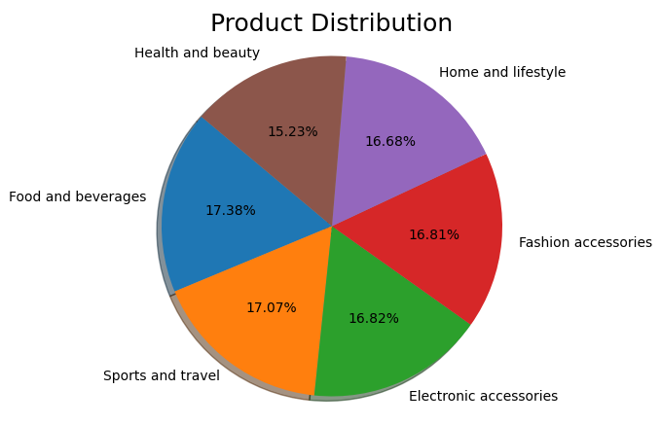
Product Analysis
Food and Beverages, as well as Sports and Travel product lines, are performing the best.
Health and Beauty product line sales need improvement.

Slide 6
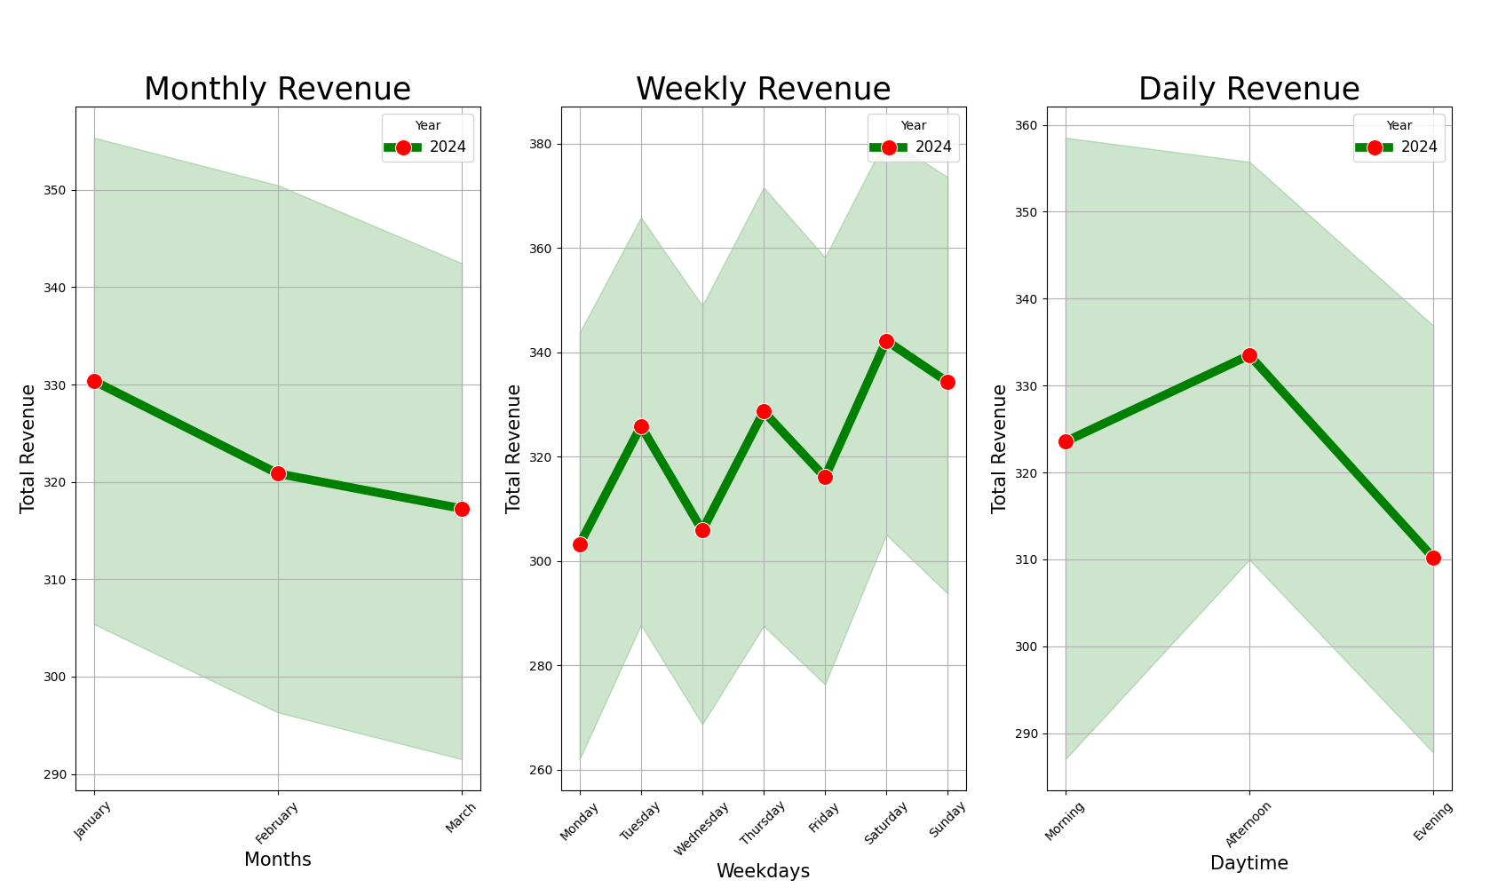
Sales Analysis
In January, the highest sales were recorded
Among the days of the week, Saturday had the highest sales.
In terms of time of day, the Afternoon saw the highest sales.

Slide 7
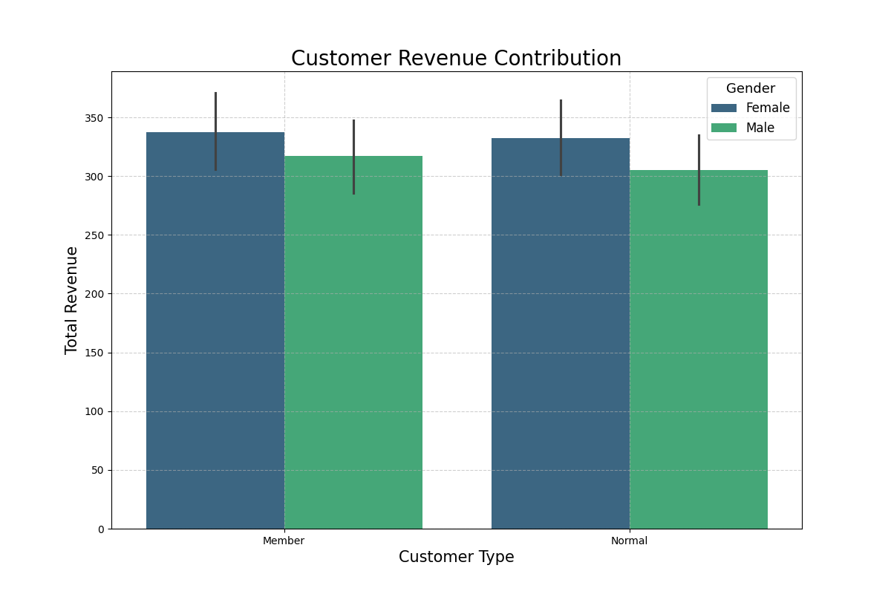
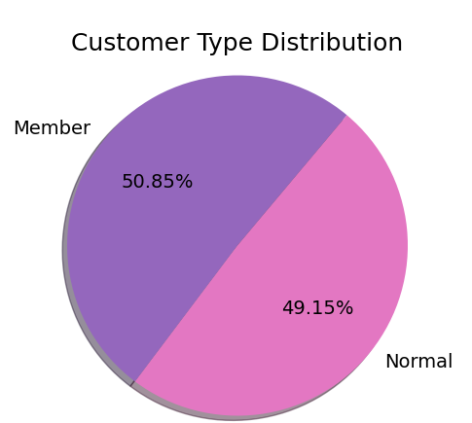
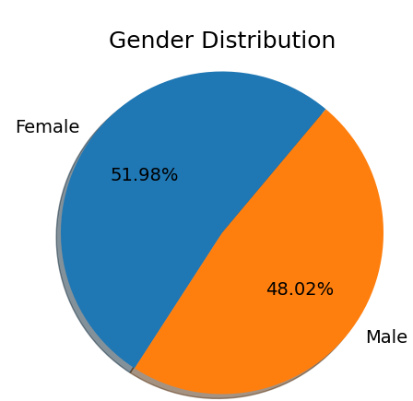
Customer Analysis
Contribution of sale by members is higher than the normal customer.
Female contributed more in sale than the male.

Slide 8
Let’s Answer the Business Question

Slide 9
THANK YOU

