Slide 1
Shell sed
Divya Kumar
CSED, MNNIT

Slide 2
What is sed?
Sed : a “Stream EDitor”
A non-interactive stream editor
Interprets sed instructions and performs actions
Use sed to:
Automatically perform edits on file(s)

Slide 3
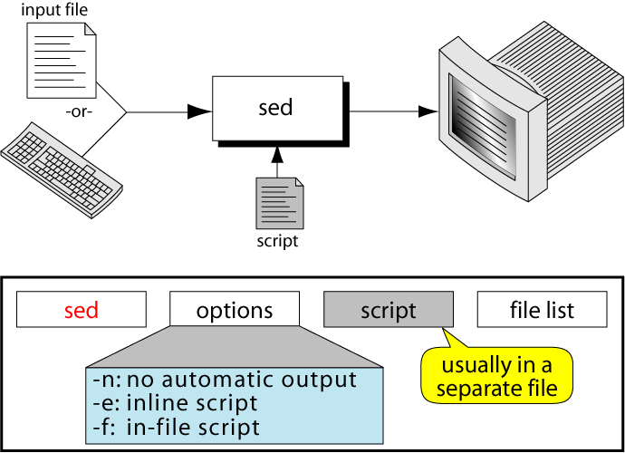
The sed command

Slide 4
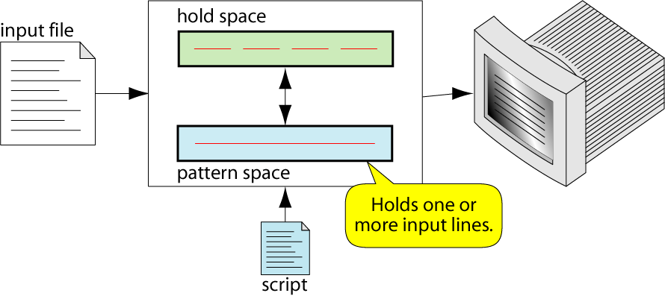
sed Operation

Slide 5
sed Operation
While (read line){
1 ) Sed reads an input line from STDIN or a given file, one line at a time, into the pattern space.
Pattern Space = a data buffer - the “current text” as it’s being edited
2) For each line, sed executes a series of editing commands (written by the user, you) on the pattern space.
3) Writes the pattern space to STDOUT.
}

Slide 6
Invoking Sed Commands
$ sed [-e script] [-f script-file] [-n] [files...]
-e an "in-line" script, i.e. a script to sed execute given on the command line. Multiple command line scripts can be given, each with an -e option.
-f read scripts from specified file, several -f options can appear
files are the files to read, if a "-" appears, read from stdin, if no files are given, read also from stdin
Notes:
<number>
-e option is only required if more than one executable

Slide 7
Invoking Sed Commands
-n by default, sed writes each line to stdout when it reaches the end of the script (being whatever on the line) this option prevents that. i.e. no output unless there is a command to order SED specifically to do it
Notes:
<number>
-e option is only required if more than one executable

Slide 8

sed instruction format
address determines which lines in the input file are to be processed by the command(s)
if no address is specified, then the command is applied to each input line
address types:
Single-Line address
Set-of-Lines address
Range address

Slide 9
Regular Expressions
^ matches the beginning of the line
$ matches the end of the line
. Matches any single character
\ Escapes any metacharacter that follows
(char)* Match arbitrarily many occurences (character)
(char)? Match 0 or 1 instance of (character)
(char)+ Match 1 or more instances of (character)

Slide 10
Regular Expressions (cntd…)
(char)\{m,n\} Match m-n repetitions of (char)
(char)\{m,\} Match m or more repetitions of (char)
(char)\{,n\} Match n or less (possibly 0) repetitions of (char)
(char)\{n\} Match exactly n repetitions of (character)

Slide 11
Regular Expressions (cntd…)
The following character classes are short-hand for matching special characters.
[:alnum:] Printable characters (includes white space)
[:alpha:] Alphabetic characters
[:blank:] Space and tab characters
[:cntrl:] Control characters
[:digit:] Numeric characters
[:graph:] Printable and visible (non-space) characters

Slide 12
Regular Expressions (cntd…)
[:lower:] Lowercase characters
[:print:] Alphanumeric characters
[:punct:] Punctuation characters
[:space:] Whitespace characters
[:upper:] Uppercase characters
[:xdigit:] Hexadecimal digits

Slide 13
Regular Expressions (cntd…)
/^M.*/ Line begins with capital M, 0 or more chars follow
/..*/ At least 1 character long (/.+/ means the same thing)
/^$/ The empty line
ab|cd Either ‘ab’ or ‘cd’

Slide 14
sed substitution (s)
sed s/day/night/ old >new
echo day | sed s/day/night/
>>night
echo Sunday | sed 's/day/night/'
>>Sunnight

Slide 15
sed substitution (s)
> cat file.txt
unix is great os. unix is opensource. unix is free os.
learn operating system.
unixlinux which one you choose.

Slide 16
sed substitution (s)
>sed 's/unix/linux/2' file.txt
unix is great os. linux is opensource. unix is free os.
learn operating system.
unixlinux which one you choose.
>> ‘g’ or ‘I’ also.

Slide 17
sed substitution (s)
>echo "123 abc" | sed 's/[0-9]*/& &/'
123 123 abc
>echo "123 abc" | sed 's/[0-9][0-9]*/& &/'
123 123 abc

Slide 18
Is sed recursive?
sed 's/loop/loop the loop/g' <old >new
??
This will not cause an infinite loop.

Slide 19
sed print (p)
Print Command (p)
copies the entire contents of the pattern space to output
will print same line twice unless the option “–n” is used

Slide 20
sed print (p)
Here are ways to duplicate the function of grep with sed:
sed -n 's/pattern/&/p' <file
Or we can use
sed -n '/pattern/p' file
pattern is a RE…

Slide 21
Multiple commands with -e command
sed -e 's/a/A/' -e 's/b/B/' <old >new

Slide 22
Passing arguments into a sed script
#!/bin/sh
sed -n 's/'$1'/&/p'

Slide 23
Addresses and Ranges of Text
Restricting to a line number
The simplest restriction is a line number. If you wanted to delete the first number on line 3, just add a "3" before the command:
sed '3 s/[0-9][0-9]*//' <file >new

Slide 24
Addresses and Ranges of Text
Patterns as restriction.
To delete the first number on all lines that start with a "#," use:
sed '/^#/ s/[0-9][0-9]*//'

Slide 25
Addresses and Ranges of Text
Ranges by line number
You can specify a range on line numbers by inserting a comma between the numbers.
To restrict a substitution to the first 100 lines, you can use:
sed '1,100 s/A/a/'

Slide 26
Addresses and Ranges of Text
Ranges by line number (cntd…)
An easier way is to use the special character "$," which means the last line in the file.
sed '101,$ s/A/a/'

Slide 27
Addresses and Ranges of Text
Ranges by patterns
You can specify two regular expressions as the range.
Assuming a "#" starts a comment, you can search for a keyword, remove all comments until you see the second keyword.
In this case the two keywords are "start" and "stop:“
sed '/start/,/stop/ s/#.*//'

Slide 28
Delete with d
You can delete the lines a file by specifying the line number or a range or numbers.
>sed '2 d' file.txt
>sed '5,$ d' file.txt
>sed '/^#/ d' file.txt

Slide 29
Delete with d
You can delete the lines a file by specifying the line number or a range or numbers.
>sed '2 d' file.txt
>sed '5,$ d' file.txt
>sed '/^#/ d‘ file.txt

Slide 30
Reversing the restriction with !
The "!" character, which often means not in UNIX utilities, inverts the address restriction.
sed -n '/pattern/ !p' </tmp/b
--prints all lines that don't contain the pattern

Slide 31
Relationships between d, p, and !
Sed Range Command Printed Results
sed -n 1,10 p first 10 lines
sed -n 11,$ !p first 10 lines
sed 1,10 !d first 10 lines
sed 11,$ d first 10 lines

Slide 32
The q or quit command
This command is most useful when you wish to abort the editing after some condition is reached.
sed '11 q'
which quits when the eleventh line is reached.

Slide 33
The q or quit command
Display the first 50 lines and quit
$ sed -e ’50q’ datafile
>>>> ?? sed '1,10 q'

Slide 34
Append a line with 'a'
The "a" command appends a line after the range or pattern.
#!/bin/sh
sed '/WORD/ a\
Add this line after every line with WORD'

Slide 35
Append a line with 'a'
Adding more than one line
#!/bin/sh
sed '
/WORD/ a\
Add this line\
This line\
And this line
'

Slide 36
Insert a line with 'i'
You can insert a new line before the pattern with the "i" command:
#!/bin/sh
sed ' /WORD/ i\
Add this line before every line with WORD'

Slide 37
Change a line with 'c'
You can change the current line with a new line.
#!/bin/sh
sed ' /WORD/ c\
Replace the current line with the line'

Slide 38
Print line number with =
The "=" command prints the current line number to standard output.
One way to find out the line numbers that contain a pattern is to use:
sed -n '/PATTERN/ =' file

Slide 39
Transform with y
The sed command can be used to convert the lower case letters to upper case letters by using the transform "y" option.
For instance, to change the letters "a" through "f" into their upper case form, use:
sed 'y/abcdef/ABCDEF/' file

Slide 40
Combined examples
> cat file.txt
unix is great os. unix is opensource. unix is free os.
learn operating system.
unixlinux which one you choose.

Slide 41
Combined examples
> sed 's/unix/{&&}/' file.txt
{unixunix} is great os. unix is opensource. unix is free os.
learn operating system.
{unixunix}linux which one you choose.

Slide 42
Combined examples
>sed 's/unix/linux/p' file.txt
linux is great os. unix is opensource. unix is free os.
linux is great os. unix is opensource. unix is free os. learn operating system.
linuxlinux which one you choose.
linuxlinux which one you choose.

Slide 43
Combined examples
>sed -n 's/unix/linux/p' file.txt
linux is great os. unix is opensource. unix is free os.
linuxlinux which one you choose.

Slide 44
Combined examples
>sed '/linux/ s/unix/centos/' file.txt
unix is great os. unix is opensource. unix is free os.
learn operating system.
centoslinux which one you choose.

Slide 45
Combined examples
>sed '/unix/ a "Add a new line"' file.txt
unix is great os. unix is opensource. unix is free os.
"Add a new line"
learn operating system. unixlinux which one you choose.
"Add a new line"

Slide 46
Combined examples
>sed '/unix/ i "Add a new line"' file.txt
"Add a new line"
unix is great os. unix is opensource. unix is free os.
learn operating system.
"Add a new line"
unixlinux which one you choose.

Slide 47
Combined examples
>sed '/unix/ c "Change line"' file.txt
"Change line"
learn operating system.
"Change line"

Slide 48
Combined examples
>sed 'y/ul/UL/' file.txt
Unix is great os. Unix is opensoUrce. Unix is free os.
Learn operating system.
UnixLinUx which one yoU choose.

Slide 49
The slash as a delimiter
If you want to change a pathname that contains a slash –
say /usr/local/bin to /common/bin
you could use the backslash to quote the slash:
sed 's/\/usr\/local\/bin/\/common\/bin/' <old >new

Slide 50
The slash as a delimiter
It is easier to read if you use some another delimiter:
sed 's_/usr/local/bin_/common/bin_' <old >new
sed 's:/usr/local/bin:/common/bin:' <old >new
sed 's|/usr/local/bin|/common/bin|' <old >new
>>>>Count 3

Slide 51
Writing a file with the 'w' command
Syntax: w filename
Write the pattern space to filename
The filename will be created (or truncated) before the first input line is read
all w commands which refer to the same filename are output through the same FILE stream

Slide 52
Writing a file with the 'w' command
Example that will only write lines that start with an even number
sed -n '/^[0-9]*[02468]/ w even' <file

