Slide 1
F I N A L P R O J E C T R E V I E W | B A M A T 2 0 7
Breast Cancer Classification
using Probabilistic Machine Learning
569
Tumour samples; 30 numerical features
98.25%
Highest held-out test accuracy (Logistic Regression)
From initial probability models to statistical testing, model tuning and explainable results
p = 0.0312
Exact planned McNemar comparison: LR versus GNB
Shubhang Shrivats (25BCE2578) | Aryan Singh (25BCE0324)
Sarasij Roy (25BDS0259) • VIT Vellore • Dr. Pallavi Mishra
Notes:
This final review revisits our breast cancer classification project from Review 1 and adds the remaining statistical analysis. We use 30 numerical measurements extracted from digitized biopsy-cell images, not the raw images themselves. The main models are Logistic Regression and Gaussian Naive Bayes; the extension adds Random Forest. Logistic Regression achieved 98.25 percent accuracy on the held-out test set. The reported McNemar p-value is for our preplanned LR versus Naive Bayes comparison.

Slide 2
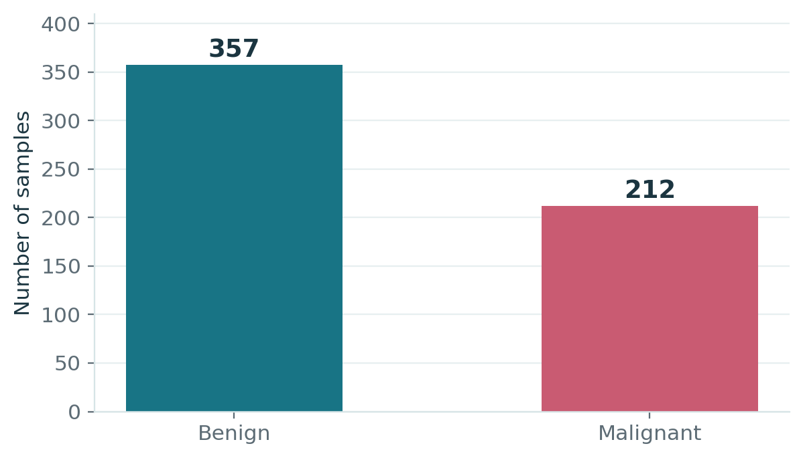
1 | PROBLEM AND DATASET
What exactly are we predicting?
Each row is a pre-extracted numerical description of cell nuclei - not an input medical scan.
PROJECT OBJECTIVE
Given 30 measurements from a biopsy sample, predict whether the tumour is malignant or benign, along with a probability.
569
30
samples
features
212
357
malignant
benign
A model that always predicts “benign” would already reach 62.7% accuracy; therefore we also evaluate recall, errors and ROC-AUC.
Dataset: Wisconsin Diagnostic Breast Cancer (WDBC), via scikit-learn / UCI; no missing values.
Breast Cancer Classification | BAMAT207 Final Review
2
Notes:
The dataset is the Wisconsin Diagnostic Breast Cancer dataset. There are 569 samples, with 212 malignant and 357 benign tumours. For each sample, there are 30 precomputed features describing properties of cell nuclei such as radius, area and concavity. The extraction from microscope images was performed by the dataset creators, so this is tabular classification rather than computer vision. Because the data contain more benign than malignant examples, accuracy alone can hide dangerous misses.

Slide 3
2 | REVIEW 1 RECAP
Two probabilistic models, one fair experiment
We applied the same train-test split to both models, and kept scaling inside training and CV.
Logistic Regression (LR)
Gaussian Naive Bayes (GNB)
Learns a weighted score from 30 standardized inputs. The sigmoid turns that score into P(benign). Coefficients are fitted by penalised maximum likelihood.
Starts from class priors and combines Gaussian feature likelihoods using Bayes’ theorem. It assumes the features are independent once the class is known.
p = 1 / (1 + e⁻ᶻ) | z = β₀ + Σ βⱼxⱼ
P(class | x) ∝ P(class) × ∏ P(xⱼ | class)
EXPERIMENTAL PIPELINE
1
Load and explore
2
Stratified split
3
Scale safely
4
Train + evaluate
569 × 30 table; plots and correlation
455 train / 114 test (80:20)
Fit StandardScaler on training only
Confusion matrix, AUC and 5-fold CV
Breast Cancer Classification | BAMAT207 Final Review
3
Notes:
Our first comparison used two different statistical approaches. Logistic Regression computes a linear combination of standardized measurements and applies a sigmoid to estimate probability; its weights are fitted using penalized maximum likelihood. Gaussian Naive Bayes applies Bayes theorem to class priors and Gaussian distributions for each feature, with an independence assumption. We created a stratified 80-20 split of 455 training and 114 test samples. The scaler was fitted only on training examples to prevent leakage, and evaluation included cross-validation and ROC-AUC.

Slide 4
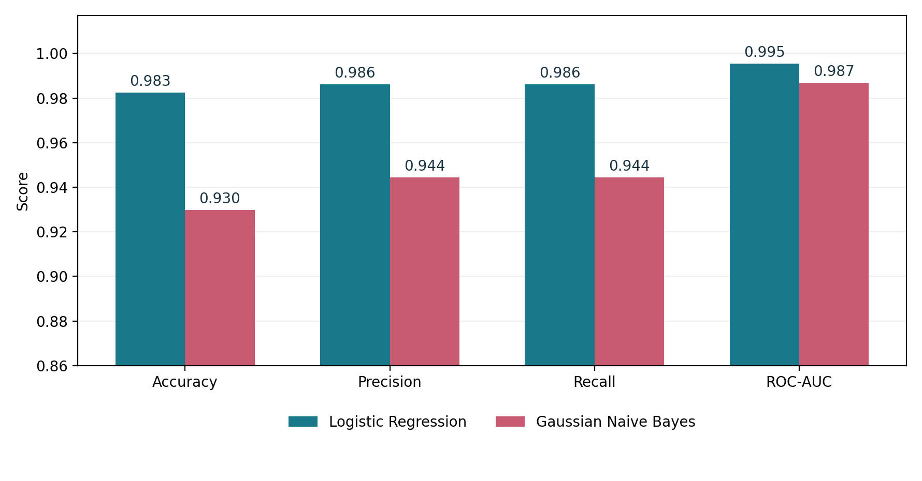
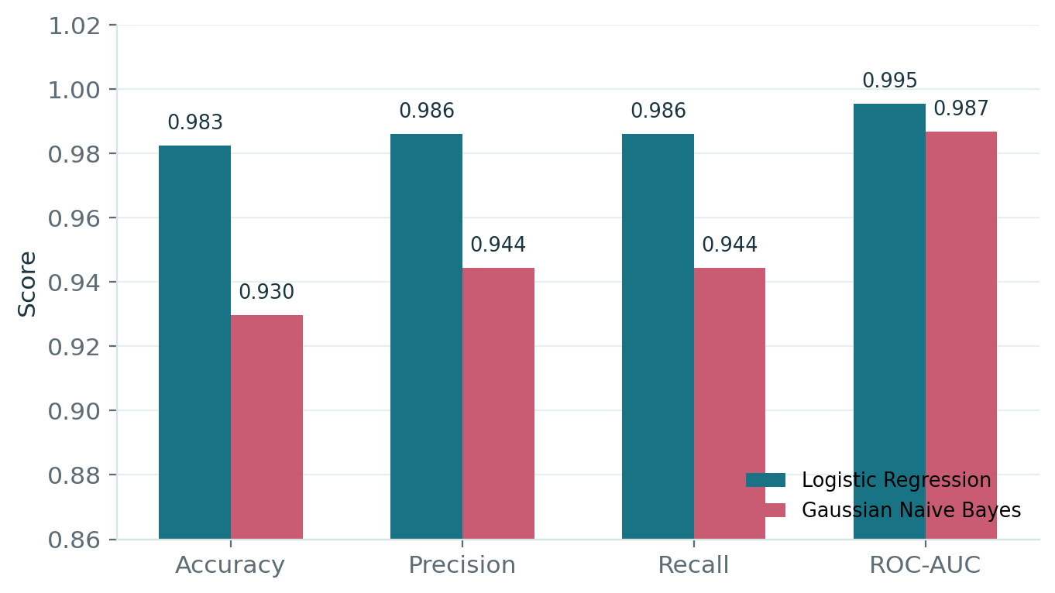
3 | REVIEW 1 RECAP
Review 1 results: Logistic Regression outperformed Naive Bayes
We evaluated both classifiers on the same 114 unseen samples. Precision and recall here use benign as the positive class.
98.25% vs 92.98%
Accuracy on the 114-sample test set (LR vs GNB)
1 vs 4
Malignant tumours wrongly predicted as benign, out of 42
WHY NAIVE BAYES PERFORMED WORSE
Radius, perimeter and area are strongly correlated (r ≈ 0.99). This challenges Naive Bayes’ assumption that the features provide independent evidence.
Review 1 conclusion: Logistic Regression achieved higher accuracy (112/114 correct) and missed fewer malignant cases (1 vs 4). The result applies to this dataset and test split.
Breast Cancer Classification | BAMAT207 Final Review
4
Notes:
In Review 1, Logistic Regression achieved 98.25 percent test accuracy and a ROC-AUC of 0.9954. Gaussian Naive Bayes achieved 92.98 percent accuracy and an AUC of 0.9868. Logistic Regression missed one out of 42 malignant cases, while Naive Bayes missed four. The original precision and recall here use benign as the positive category, so be careful when referring to malignant recall separately. A potential reason Naive Bayes performs worse is that measured radius, perimeter and area are highly correlated, violating the naive conditional independence assumption.

Slide 5
4 | FINAL REVIEW EXTENSIONS
Work completed after Review 1
After comparing Logistic Regression and Gaussian Naive Bayes, we tested whether the accuracy gap was meaningful, tuned the model, added Random Forest and evaluated probability reliability.
01
Tested the accuracy difference
02
Tuned Logistic Regression
We applied McNemar’s paired test to the same test patients, estimated a 95% bootstrap confidence interval, and cross-checked the result with repeated cross-validation.
We compared 13 regularisation strengths (C) using 5-fold cross-validation and selected a decision threshold using F2, which prioritises malignant recall.
03
Trained a third classifier
04
Evaluated probability reliability
We trained Random Forest as a non-linear alternative and used SHAP values to identify which cell measurements influenced its predictions.
We plotted calibration and ROC curves, compared Brier scores and log-loss, and examined whether each model’s predicted probabilities were dependable.
The following slides explain what we tested, what the numbers mean, and which changes did or did not improve performance.
Breast Cancer Classification | BAMAT207 Final Review
5
Notes:
After the first review, the remaining work had four parts. First, we checked whether the accuracy advantage of Logistic Regression over Naive Bayes was statistically convincing using paired tests. Second, we tuned the regularization parameter C and tested a malignancy-focused threshold. Third, we introduced Random Forest and used SHAP to interpret its feature importance. Fourth, we assessed probability calibration and prepared the final comparison. Importantly, an experiment can be successful even if the best setting is unchanged or a new threshold fails to improve the test outcome.

Slide 6
5 | STATISTICAL SIGNIFICANCE
Was the 5.26-point accuracy gap statistically meaningful?
We used McNemar’s test because both models predicted the same 114 patients. The test focuses on cases where only one model was correct.
PAIRED RESULTS
0.0312
+5.26 pts
GNB correct
GNB wrong
Exact McNemar p-value. Below 0.05 for the planned LR–GNB comparison.
LR exceeded GNB by 5.26 percentage points on the test set.
LR correct
106
6
LR wrong
0
2
TWO SUPPORTING CHECKS
Bootstrap 95% CI: +1.75 to +9.65 percentage points
Repeated 5-fold CV: corrected t-test p = 0.0012
LR was correct in 6 cases GNB missed; GNB had no cases where it alone was correct.
Important caution: across all 3 exploratory pairwise model comparisons, the Bonferroni-adjusted LR–GNB p-value is 0.0938. The unadjusted 0.0312 applies to the preplanned comparison.
Breast Cancer Classification | BAMAT207 Final Review
6
Notes:
The difference between model accuracies on the same patients is a paired comparison, so McNemar is suitable. Both classifiers were right on 106 patients and both wrong on 2. Logistic Regression was right while Naive Bayes was wrong on 6, and the reverse never occurred. The exact McNemar test gives p=0.0312 for this planned hypothesis. The paired bootstrap interval for the accuracy difference is +1.75 to +9.65 percentage points, and a repeated cross-validation corrected t-test gives p about 0.0012. However, when we explore all three model pairs, a Bonferroni correction raises the adjusted LR versus GNB p-value to about 0.0938, so it is not significant at 5% under that broader family of comparisons.

Slide 7
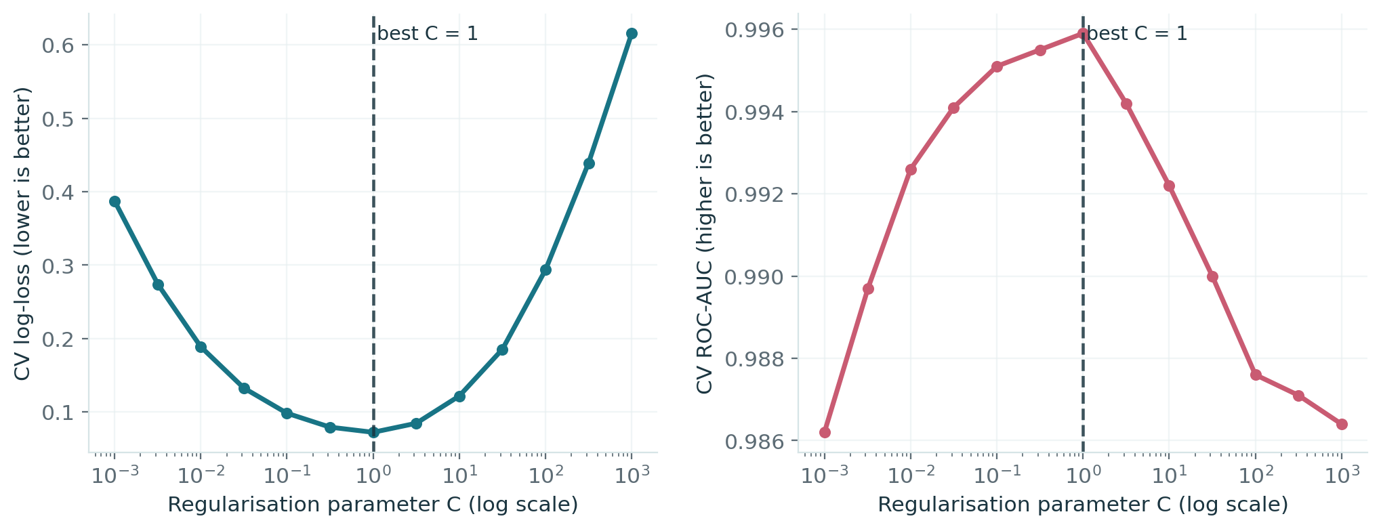
6 | HYPERPARAMETER SEARCH
Regularisation tuning: the default C was already best
We tested 13 values of C (0.001–1000) using 5-fold cross-validation on training data. Lower log-loss means more reliable probability predictions.
Best C = 1.0
Min. log-loss = 0.0723
CV AUC = 0.9959
What we found: C = 1.0 gave the lowest validation log-loss (0.0723) and highest AUC in our search (0.9959). We retained the default instead of changing a setting that already worked.
Breast Cancer Classification | BAMAT207 Final Review
7
Notes:
The logistic regression model uses L2 regularization. The parameter C is the inverse of regularization strength, so smaller C shrinks coefficients more aggressively. We evaluated 13 choices on logarithmic scale using cross-validation inside the training set, and selected by log-loss because our model outputs probabilities. The minimum mean cross-validation log-loss was 0.0723 at C equals 1, and that same value had the highest AUC of 0.9959 in this grid. This is the default C of scikit-learn, so the search validated rather than replaced the baseline choice.

Slide 8
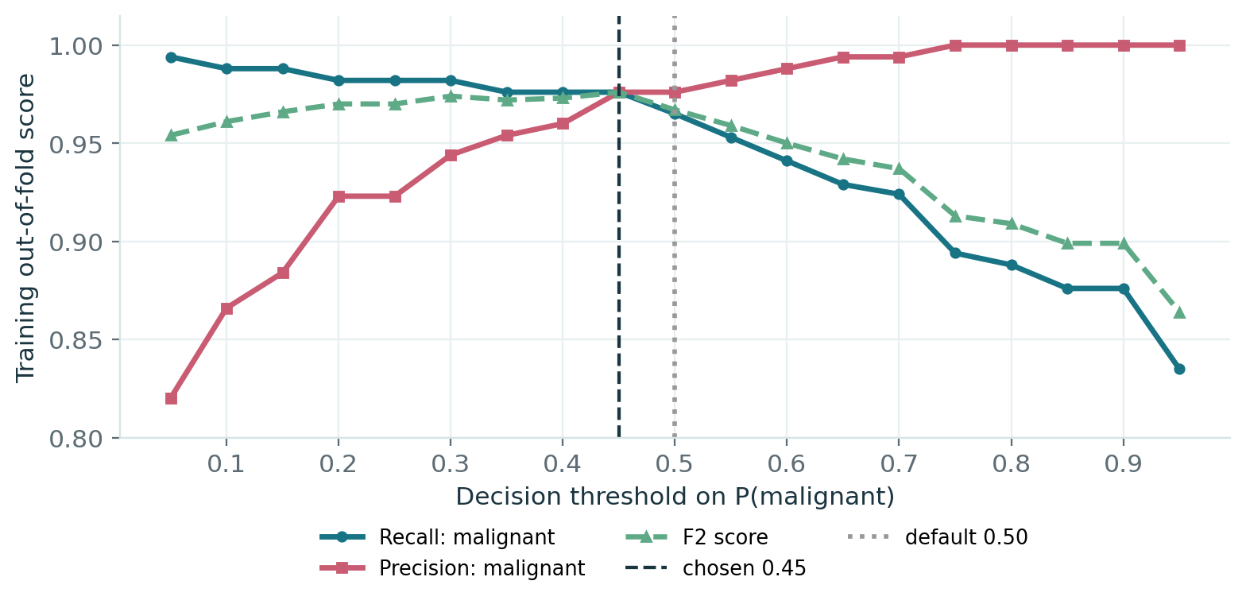
7 | THRESHOLD OPTIMIZATION
Threshold tuning: lowering the cutoff increased false alarms
We chose threshold 0.45 by maximising F2 on out-of-fold training predictions. F2 assigns more importance to detecting malignant cases than avoiding false alarms.
TEST-SET EFFECT
Threshold 0.50
Threshold 0.45
Malignant caught
41 / 42
41 / 42
Malignant missed
1
1
Benign falsely flagged
1
4
Overall accuracy
98.25%
95.61%
On the unseen test set, both thresholds detected 41 of 42 malignant cases. The 0.45 cutoff flagged 3 additional benign cases incorrectly, so we retained 0.50.
Breast Cancer Classification | BAMAT207 Final Review
8
Notes:
The original rule predicts malignant when its probability is at least 0.50. To prioritize detecting malignant cases, we tested thresholds between 0.05 and 0.95 and chose the threshold maximizing F2, which weights recall more than precision. The best out-of-fold training F2 occurred at 0.45. On the untouched test set, however, the threshold of 0.45 still caught 41 of the 42 malignant cases. It also falsely flagged four benign samples instead of one, reducing accuracy from 98.25 percent to 95.61 percent. Therefore we retained 0.50 as the preferable tested threshold on these results; the tuned threshold is not presented as a performance improvement.

Slide 9
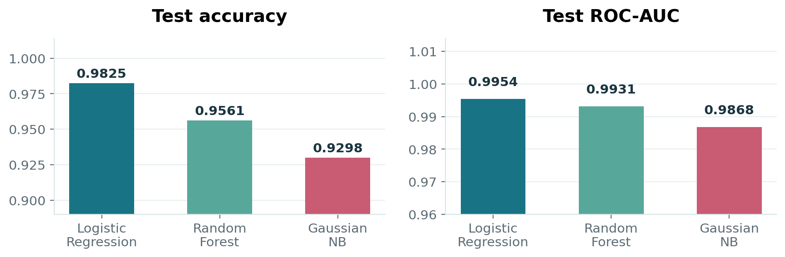
8 | THIRD MODEL
Random Forest: a third, non-linear comparison model
We trained a Random Forest that combines many decision trees. Unlike the other models, it can capture non-linear interactions without assuming independent features.
95.61%
Random Forest test accuracy (109 / 114 correct)
0.9931
Random Forest test ROC-AUC
3 of 42
Malignant cases missed by Random Forest
Random Forest achieved 95.61% accuracy and 0.9931 AUC on the test set, but missed 3 malignant cases. Logistic Regression still led with 98.25% accuracy and only 1 missed malignancy.
Breast Cancer Classification | BAMAT207 Final Review
9
Notes:
We added a Random Forest with 500 trees as a third comparison model. Each tree learns if-then splits, and the forest aggregates their predictions, allowing nonlinear relationships and interactions between features. Random Forest achieved 95.61 percent accuracy, ROC-AUC 0.9931, and missed 3 malignant test samples, compared with one for Logistic Regression. Its shuffled five-fold cross-validation AUC was 0.9896 plus or minus 0.0077. So this was a useful alternative, but the test results did not support replacing our Logistic Regression baseline.

Slide 10
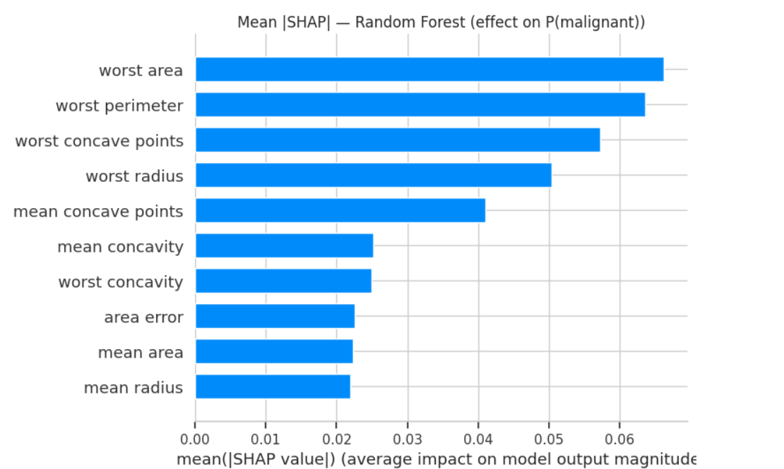
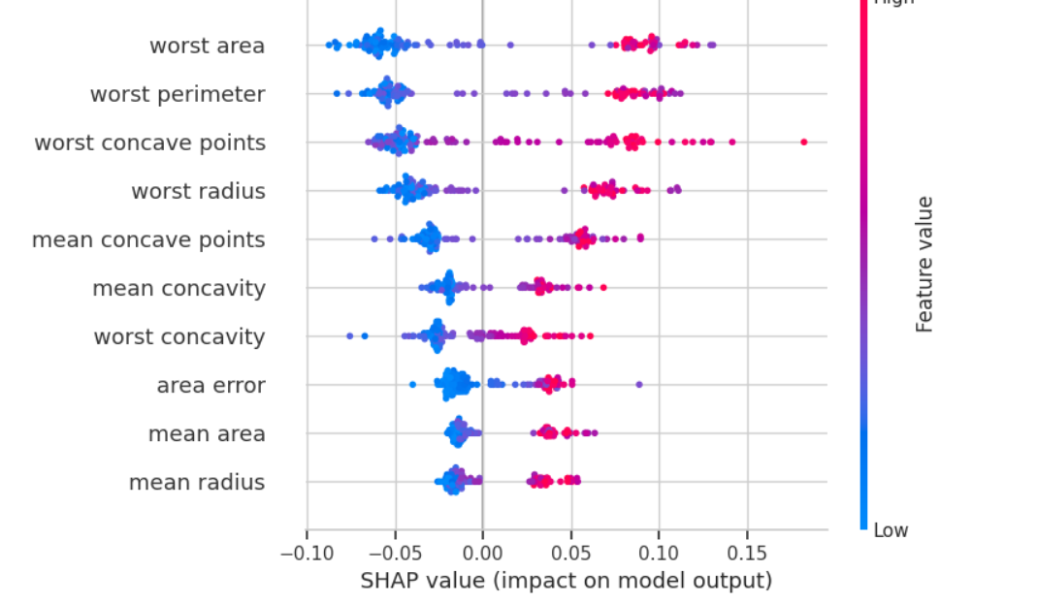
9 | EXPLAINABILITY
SHAP explained the Random Forest predictions
We used SHAP to estimate how much each measurement shifted a prediction toward malignant or benign. The bars show average influence; the dot plot shows the direction and variation.
Average importance (bar plot)
Direction of each feature’s effect (beeswarm)
The largest effects came from worst area, worst perimeter and worst concave points. Six of the top 10 important measurements overlapped with Logistic Regression.
Breast Cancer Classification | BAMAT207 Final Review
10
Notes:
Feature importance is not enough to show how a feature affects an individual prediction, so we used SHAP for the Random Forest. In the bar plot, the longest bars correspond to the greatest mean absolute SHAP contribution. The most influential features are worst area, worst perimeter and worst concave points. In the beeswarm, red indicates a higher feature value; to the right of zero means a contribution toward malignancy in this class-specific view. Logistic Regression coefficient magnitudes and Random Forest SHAP are not directly equal, but six of the ten leading feature names overlap; the Spearman correlation between ranks across all 30 features is 0.71. These are model explanations, not causal relationships.

Slide 11
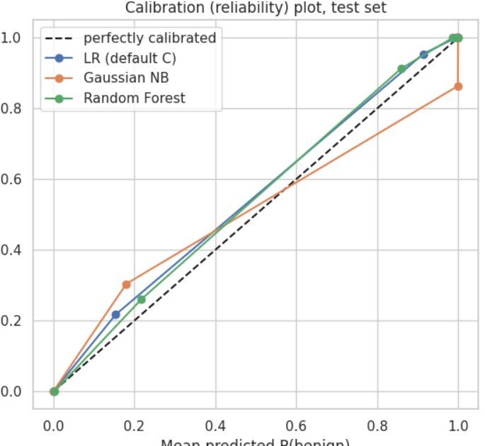
10 | PROBABILITY RELIABILITY
Calibration: did predicted probabilities match observed outcomes?
We checked whether predicted probabilities matched actual outcomes. For example, cases assigned about 80% benign probability should be benign about 80% of the time.
Brier score / log-loss (lower is better)
Model
Brier
Log-loss
Logistic Regression
0.0215
0.0777
Random Forest
0.0319
0.1089
Gaussian NB
0.0602
0.4370
What this tells us
Logistic Regression had the lowest Brier score (0.0215) and log-loss (0.0777), indicating the best probability estimates in this test. The small sample makes calibration curves approximate.
Breast Cancer Classification | BAMAT207 Final Review
11
Notes:
A classification probability should be meaningful, not merely rank the correct class higher. We plotted mean predicted probability of benign against the observed proportion of benign cases. Perfect calibration would follow the dashed diagonal. Logistic Regression and Random Forest were relatively close to that line, while Naive Bayes deviated more. Brier score and log-loss confirm this: Logistic Regression had the lowest Brier score, 0.0215, and log-loss, 0.0777. Random Forest scored 0.0319 and 0.1089, and Naive Bayes scored 0.0602 and 0.4370. The reliability curves have few distinct points due to the small test size and probabilities concentrated near the extremes.

Slide 12
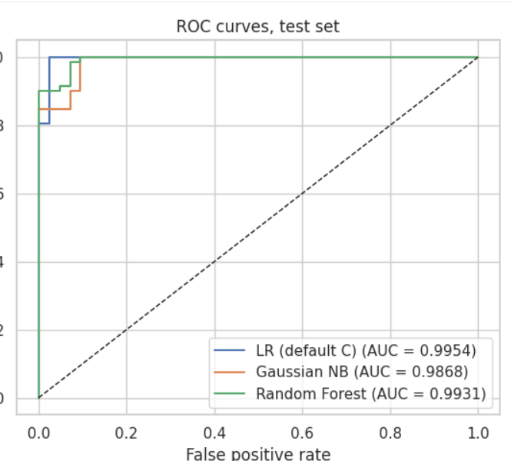
11 | COMBINED RESULTS
Final comparison of all tested approaches
All four rows use the same 114-patient test set. Accuracy counts correct labels; ROC-AUC measures how well probabilities rank cases; Brier measures probability error (lower is better).
Model
Accuracy
ROC-AUC
Malig. missed
Brier
Logistic Regression
98.25%
0.9954
1
0.0215
Random Forest
95.61%
0.9931
3
0.0319
Gaussian Naive Bayes
92.98%
0.9868
4
0.0602
LR, threshold 0.45
95.61%
0.9954
1
0.0215
Changing the threshold affected classifications but not the underlying probabilities, so ROC-AUC and Brier remained unchanged. Accuracy fell, without detecting another malignancy.
Breast Cancer Classification | BAMAT207 Final Review
12
Notes:
This table summarizes the final test results. Logistic Regression with its default C and 0.50 threshold performed best at 98.25 percent accuracy, an AUC of 0.9954, one missed malignant case, and Brier score 0.0215. Random Forest came next with 95.61 percent accuracy, and Naive Bayes had 92.98 percent. The tuned 0.45 threshold version of Logistic Regression still has the same AUC and Brier score because probability predictions are unchanged, but accuracy falls to 95.61 percent and malignant missed remains one. The ROC plot shows that all three models have high discriminative ability, but this alone does not establish clinical safety.

Slide 13
FINAL REVIEW | CONCLUSIONS
Final conclusions and practical limitations
1
Logistic Regression performed best in our comparison
On 114 unseen cases, it achieved 98.25% accuracy and 0.9954 ROC-AUC, with only 1 of the 42 malignant cases missed.
2
Our planned LR–GNB comparison showed a difference
McNemar’s exact p-value was 0.0312 for the planned comparison. After correcting for all three pairwise comparisons, the adjusted value was 0.0938.
3
Additional tuning and model complexity did not guarantee gains
Cross-validation selected the original C = 1.0, threshold 0.45 caused more false alarms, and Random Forest performed well but did not beat Logistic Regression.
LIMITATION
Single benchmark dataset • 114 test samples (42 malignant) • no external validation • not a medical diagnostic tool
Notes:
Our overall conclusion is that Logistic Regression was the strongest method in this particular benchmark comparison. The original model achieved the best test accuracy and probability-quality scores, and detected 41 of the 42 malignant test cases. Our preplanned statistical comparison against Gaussian Naive Bayes gave an exact McNemar p-value of 0.0312, but it does not remain below 0.05 after correction for the three exploratory pairwise tests. The regularization search showed the default parameter C equals one was already best. The threshold change worsened accuracy without recovering an extra malignant case, and Random Forest was competitive but did not exceed Logistic Regression on test accuracy. These results illustrate methods for Probability and Statistics and are not evidence of a deployable cancer-diagnosis system because our dataset and held-out test set are small and there is no external validation.

