Slide 1
Advancing Arrhythmia Detection in Micro ECG Through Convolutional Neural Networks
Shubhang Gupta
(2020IMT-098)
Under the supervision of
Dr. Sandesh Jain
August 25, 2023

Slide 2
Outline
The Electrocardiogram(ECG)
Characteristics of ECG signal
Introduction
Literature Review
Project Objectives
About Dataset
Data Preprocessing
Workflow Of The Project
Comparison Of The Network Architecture
Proposed Methodology
Results
Conclusion
References

Slide 3
The Electrocardiogram(ECG)
Invented ~ 1900 by Willem Einthoven, Nobel prize in medicine 1924
Detect small (uV) potential changes on the skin surface
Non-invasive test to help diagnose disease:
Myocardial infarction (heart attack)
Cardiomyopathies
Repolarization abnormalities
Arrhythmias (atrial fibrillation)
Read by experienced cardiologists and algorithms

Slide 4
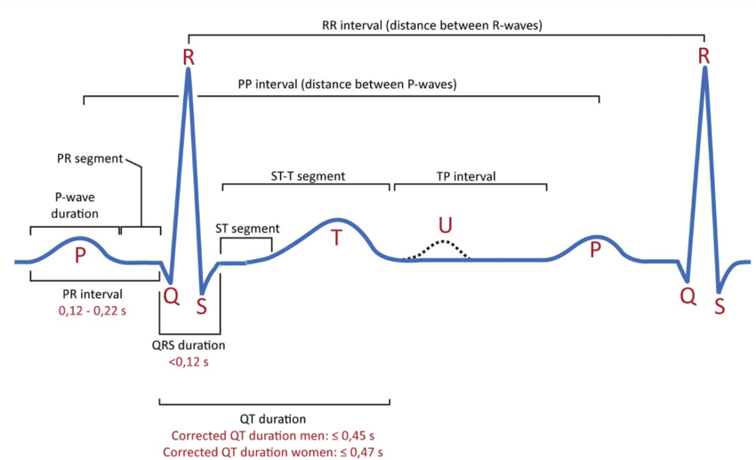
Characteristics of ECG signal
P wave is the ECG display of atrial depolarization and contraction
QRS complex is the ventricular contraction
Figure 1: Classical ECG signal characteristics

Slide 5
Contd…
Q wave is the first part of the QRS complex, but only if it goes downward
R wave is the upward deflection of the QRS complex whether there is a q wave or not
S wave follows R wave and is called as such as long as the S wave dips below the baseline.
T wave is repolarization of the ventricles i.e., their return to a resting state

Slide 6
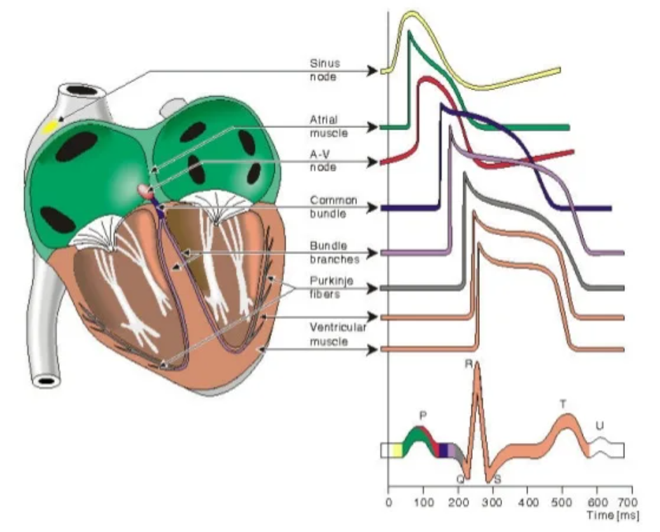
Contd…
Figure 2: The heart’s anatomy with waveforms from different specific part of the heart

Slide 7
Introduction
Cardiovascular disease is a common disease that seriously threatens human health.
ECG analysis is an effective way of evaluating heart health. Therefore, the identification and classification of ECG signals are essential to cardiovascular diseases.
ECG is an electrocardiogram of the heart which is a graph of voltage versus time of the electrical activity of the heart using electrodes placed on the skin. These electrodes detect the small electrical changes that are a consequence of cardiac muscle depolarization followed by repolarization during each cardiac cycle (heartbeat).

Slide 8
Contd…
However, there are many types of heart diseases, and long-term manual detection makes it easy to cause false detection.
Intelligent automatic recognition and classification of ECG signals have become an inevitable choice to improve the efficiency and accuracy of ECG recognition while keeping the complexity as low as possible(i.e. trainable parameters of the model).

Slide 9
Literature Review
Name of study | Year of publication | Journal | Summary
Network In Network | 2014 | arXiv: 1312.4400v3 | Compared to dense layers Global average pooling is more meaningful and interpretable as it enforces correspondence between feature maps and categories, which is made possible by a stronger local modeling using the micro network.
ECG Heartbeat Classification Using Convolutional Neural Networks | 2020 | IEEE Access | Proposes automatic analysis and categorization of each heartbeat using a computer-aid.
A Study on Arrhythmia via ECG Signal Classification Using the Convolutional Neural Network | 2021 | Frontiers in Computational neuroscience | Highlights problems in the existing works like manual feature recognition, complex models, and long training time. It also tells us that there is very little or no study related to micro classes of the ECG signal.
<number> / 18

Slide 10
Project Objectives
The objective of the project are as follows:
To reduce the complexity(i.e. trainable parameters) of the 12-layer deep 1D CNN model as a step towards edge computing.
To classify the five micro-classes, (normal (NOR), left bundle branch block (LBBB), right bundle branch block (RBBB), Atrial premature beats (AP), and premature ventricular beats (PVC), of heartbeat types in the MIT-BIH Arrhythmia database.

Slide 11
About Dataset
In this project MIT-BIH dataset is used. The dataset contains 48 ECG recordings, each recording time is 30 min long.
Number of Samples: 109446
Number of Categories: 5
Classes: ['N': 0, 'S': 1, 'V': 2, 'F': 3, 'Q': 4]

Slide 12
Contd…
Table 2: Categories of heartbeats existed in the MIT-BIH database based on AAMI (Association for the Advancement of Medical Instrumentation).
Category | Class
Normal(N) | • Normal beat (N) • Left and right bundle branch block beats (L,R) • Atrial escape beat (e) • Nodal (junctional) escape beat (j)
Supraventricular ectopic beat(S) | • Atrial premature beat (A) • Aberrated atrial premature beat (a) • Nodal (junctional) premature beat (J) • Supraventricular premature beat (S)
Ventricular ectopic beat(V) | • Premature ventricular contraction (V) • Ventricular escape beat (E)
Fusion beat(F) | • Fusion of ventricular and normal beat (F)
Unknown beat(Q) | • Paced beat (/) • Fusion of paced and normal beat (f) • Unclassifiable beat (U)

Slide 13
Data Preprocessing
Raw ECG signal usually contains noise, so noise is filtered.
Then normalization is done using Z-score normalization.
Then Unbalanced dataset is balanced by performing undersampling and oversampling.
Classes with high count is undersampled and classes with low count are oversampled.

Slide 14
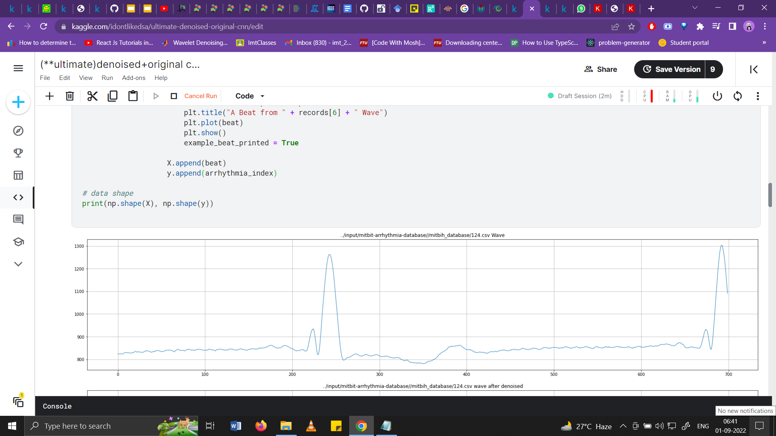
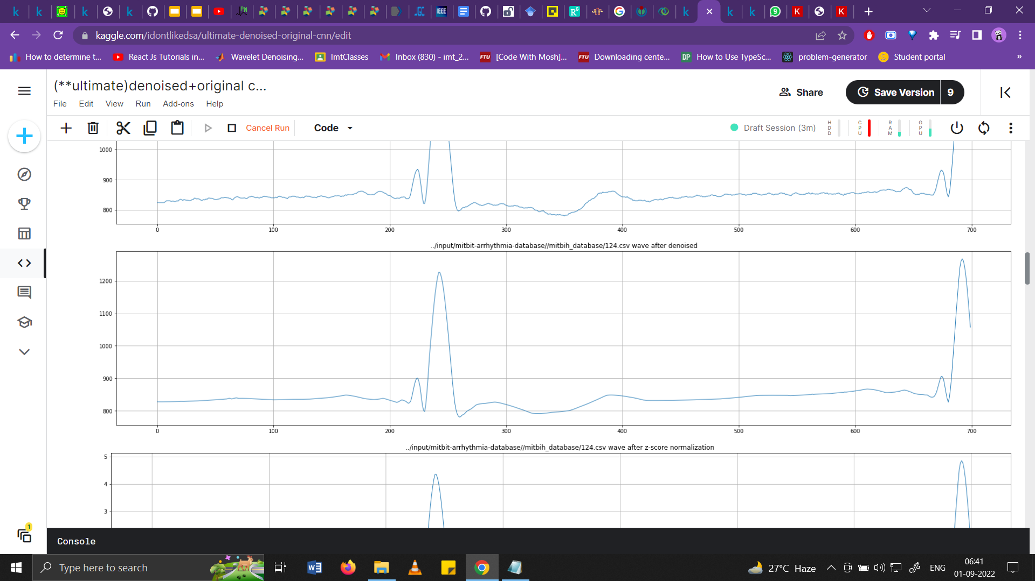
Contd…
Figure 3: ECG signal before filtering
Figure 4: ECG signal after filtering

Slide 15
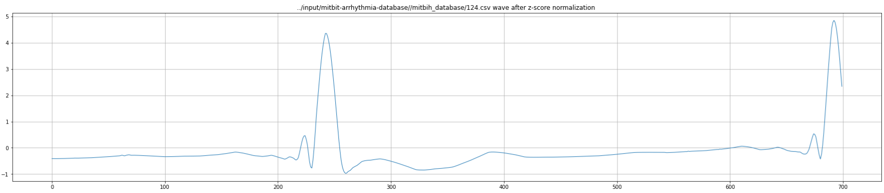
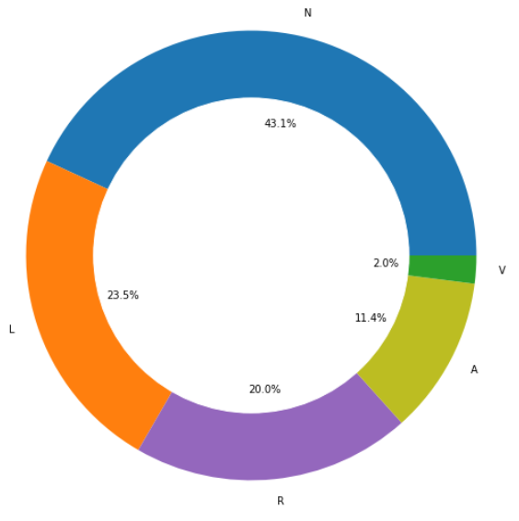
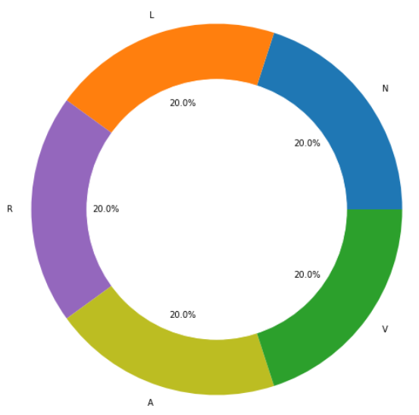
Contd…
Figure 5: ECG signal after Z-score normalization
Figure 6: Unbalanced dataset
Figure 7: Balanced dataset

Slide 16
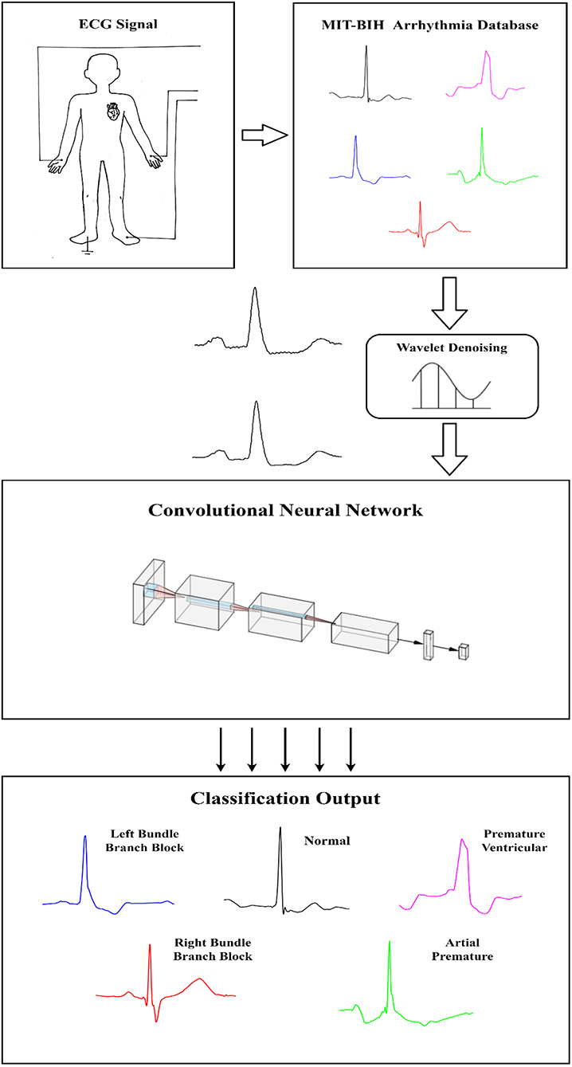
Workflow Of The Project
Figure 8: - Proposed flowchart of the ECG Classification

Slide 17
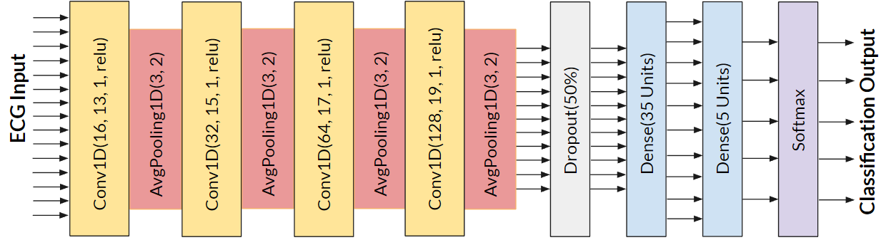
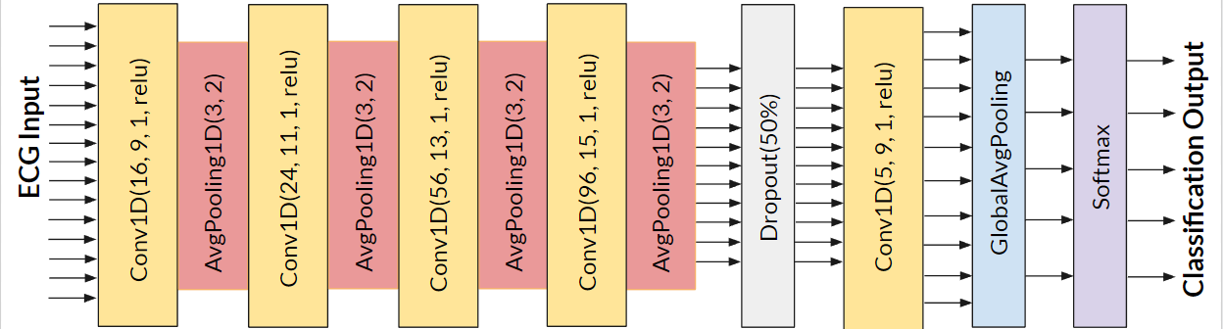
Comparison Of The Network Architecture
Figure 9: Network Architecture Of The 12-layer Deep 1D CNN
Figure 10: Network Architecture Of The 12-layer Deep 1D CNN

Slide 18
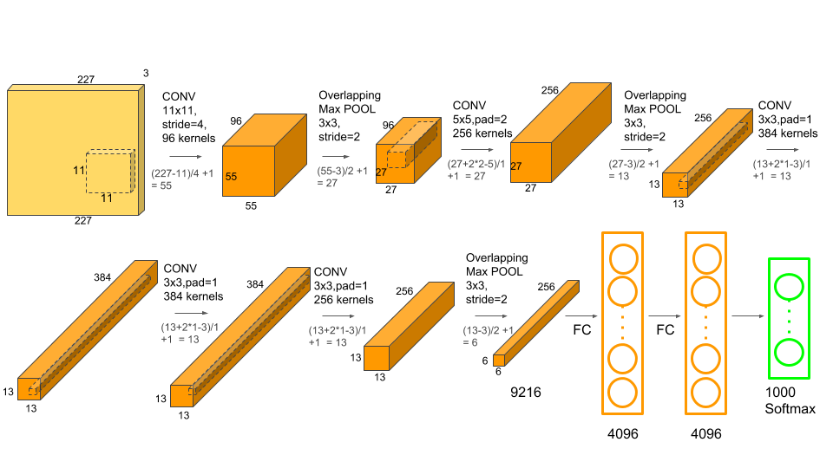
Proposed Methodology
To reduce trainable parameters, following steps are performed:
Parameters are pruned by tuning hyperparameter, that is kernel size and filters in the CNN layers are reduced.
NO. Of Parameters In A Layer = (Kernel_Size X Input Channels + 1) X No. Of Filters
Figure 11: Representation of parameters and hyperparameters in a demo cnn model

Slide 19
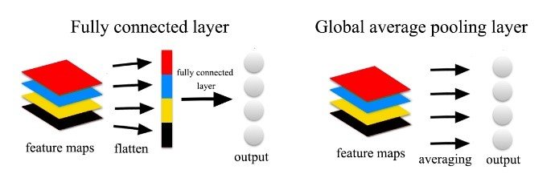
Contd...
Instead of adopting the traditional fully connected layers for classification in CNN, we used Global Average Pooling layer
Figure 12: Dense layer and Global average pooling layer

Slide 20
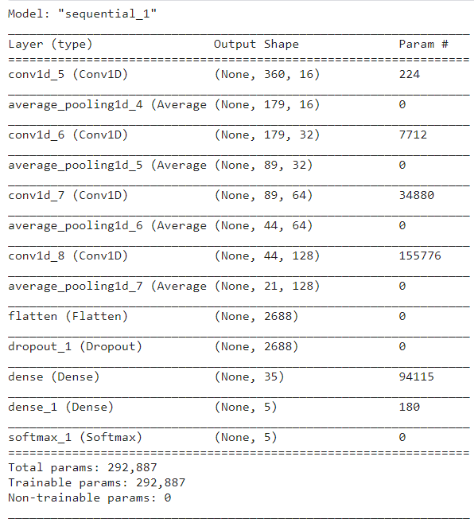
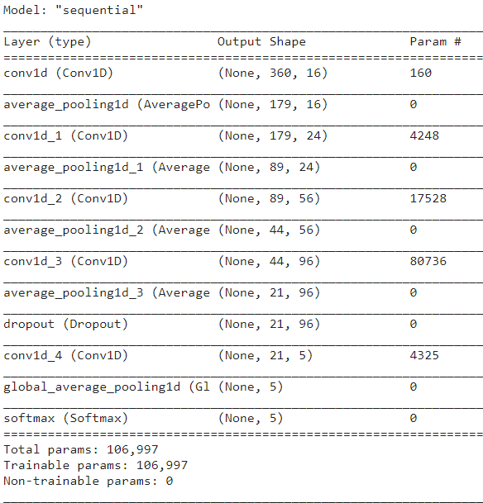
Summary Tables Of The Previous And Proposed Model
Table 3: Summary table of the 12-layer deep 1D CNN
Table 4: Summary table of the modified 12-layer deep 1D CNN

Slide 21
Results
Table 5: 12 Layer one dimensional convolutional network
Micro classes | Precision | Recall | FI-score | Support
N | 1.00 | 1.00 | 1.00 | 1161
L | 1.00 | 1.00 | 1.00 | 1236
R | 1.00 | 1.00 | 1.00 | 1219
A | 1.00 | 1.00 | 1.00 | 1151
V | 1.00 | 1.00 | 1.00 | 1233
Accuracy |  |  | 99.91% | 6000

Slide 22
Results
Table 6: modified 12 layer deep one dimensional convolutional neural network
Micro classes | Precision | Recall | FI-score | Support
N | 1.00 | 0.99 | 1.00 | 1161
L | 1.00 | 1.00 | 1.00 | 1236
R | 1.00 | 1.00 | 1.00 | 1219
A | 0.99 | 1.00 | 1.00 | 1151
V | 1.00 | 1.00 | 1.00 | 1233
Accuracy |  |  | 99.78% | 6000

Slide 23
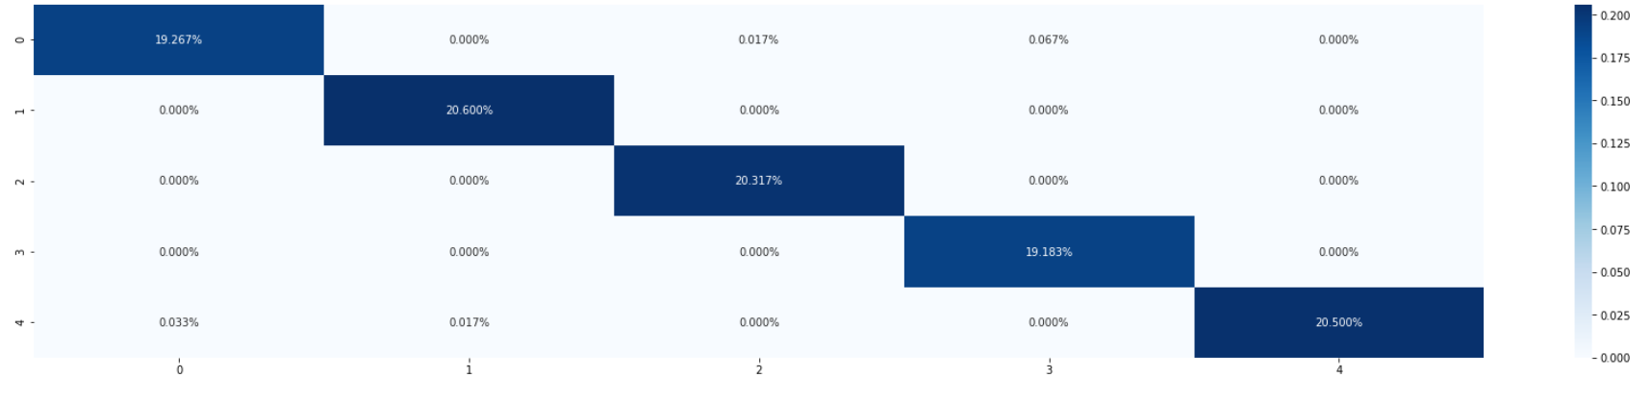
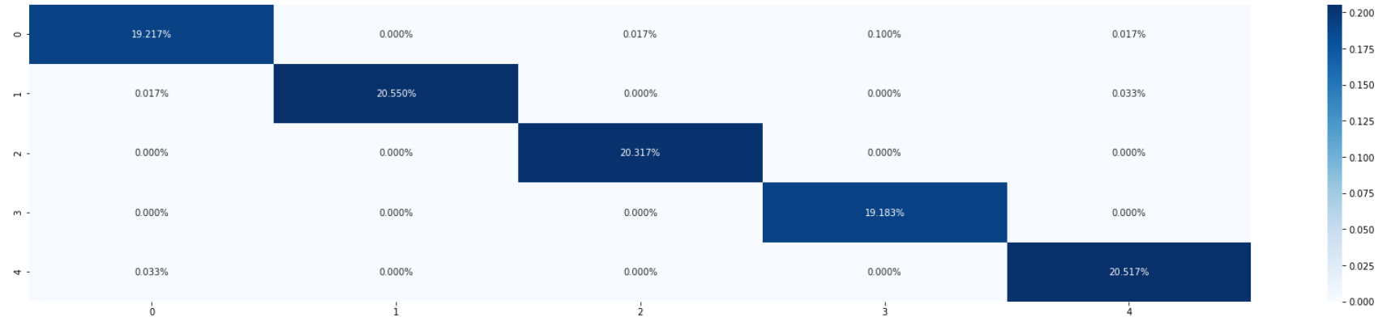
Contd…
Figure 13: Confusion matrix of the 12-layer deep 1D CNN model to get the overall idea of classification of five micro classes of ECG signal
Figure 14: Confusion matrix of the modified 12-layer deep 1D CNN model to get the overall idea of classification of five micro classes of ECG signal

Slide 24
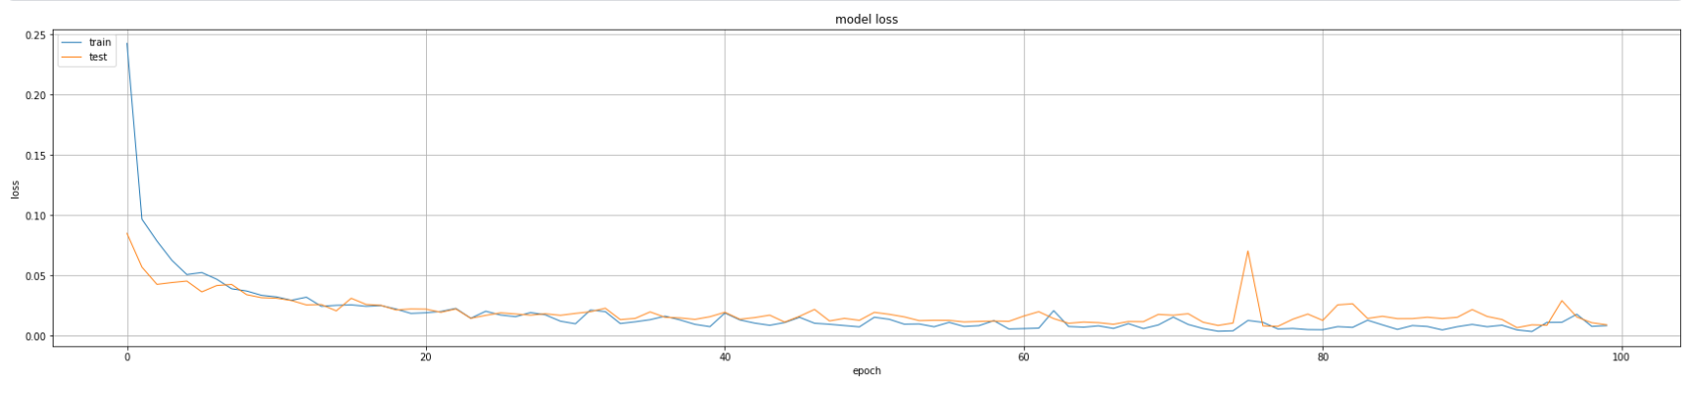
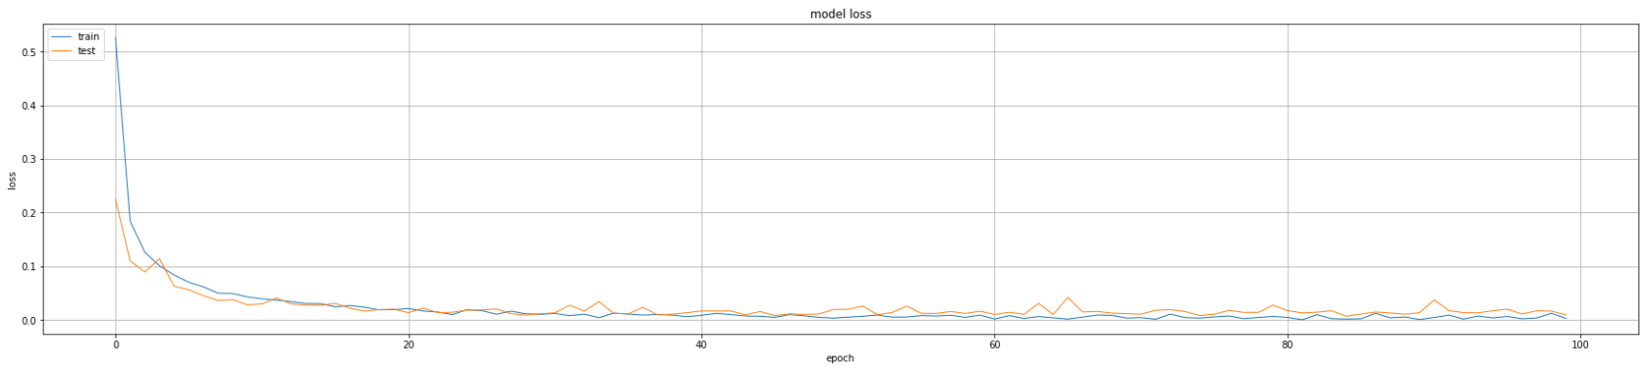
Contd…
Figure 15: Loss v/s Epoch graph of 12-layer deep 1D CNN model to get the overall idea of loss occurred for 100 epochs.
Figure 16: Loss v/s Epoch graph of the modified 12-layer deep 1D CNN model to get the overall idea of loss occurred for 100 epochs.

Slide 25
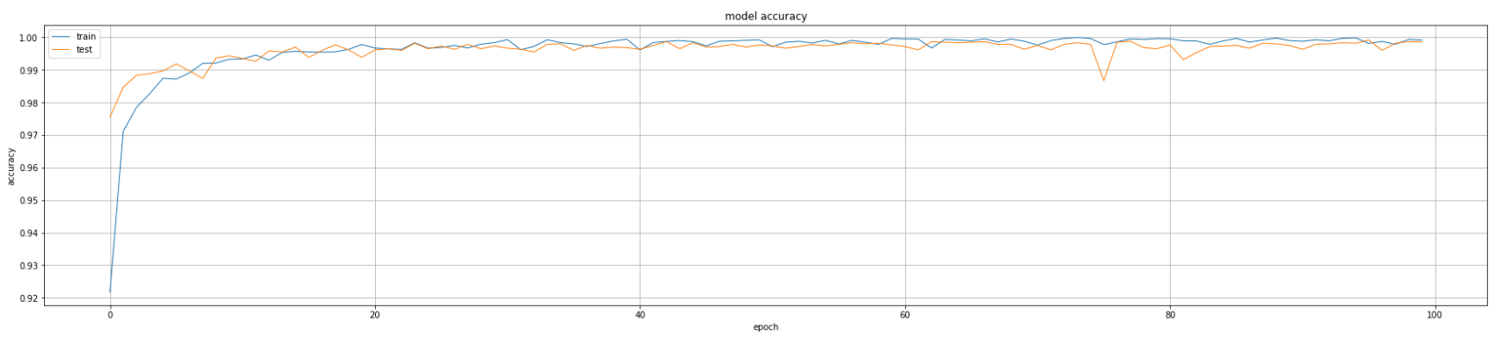
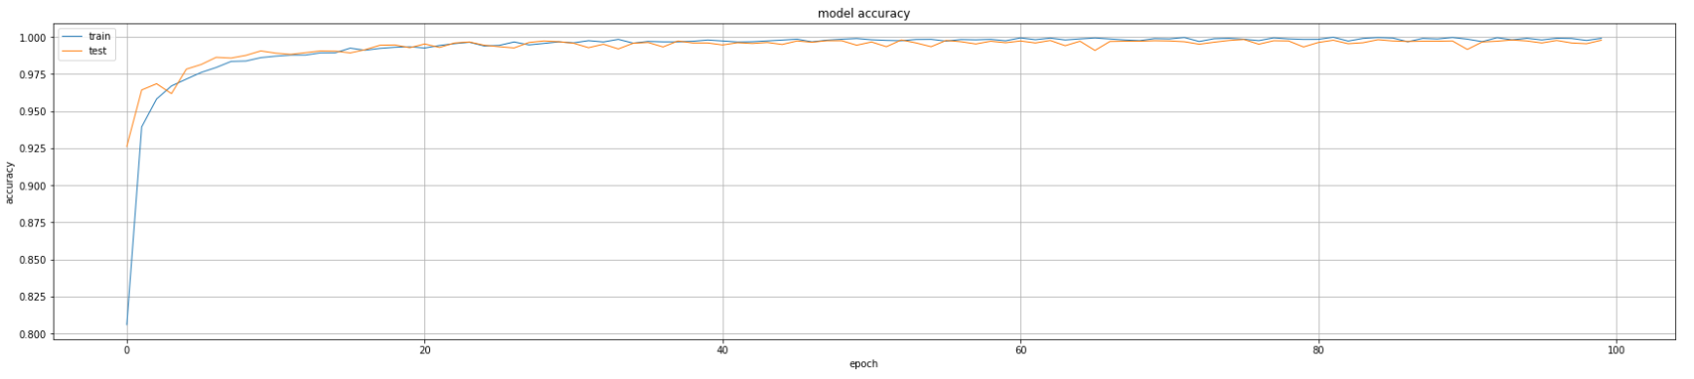
Contd…
Figure 17: Accuracy v/s Epoch graph of the 12-layer deep 1D CNN model to get the overall idea of accuracy for 100 epochs.
Figure 18: Accuracy v/s Epoch graph of the modified 12-layer deep 1D CNN model to get the overall idea of accuracy for 100 epochs.

Slide 26
Conclusion
Contributions
Reduced the 12-layer deep 1D model complexity by tuning hyperparameters(i.e. No. of filters and kernel size) and by using global average pooling layer instead of dense layers
Limitations
Tuning of no. of filters and kernel size must be done in limitas there will be high chances that if not done in limit, predictions done by model will not be accurate. Hence leading to ambiguity in classification of micro classes.
Future Scope
Some other techniques may be used in future to further reduce complexity of the model,like the idea of knowledge distillation may be used to compress the model. Furthermore, the idea of quantization can be used.

Slide 27
X. Xu and H. Liu, “Ecg heartbeat classification using convolutional neural networks,” IEEE Access, vol. PP, pp. 1–1, 01 2020, doi: 10.1109/ACCESS.2020.2964749
M. Wu, Y. Lu, W. Yang, and S. Y. Wong, “A study on arrhythmia via ecg signal classification using the convolutional neural network,” Frontiers in Computational Neuroscience, vol. 14, 2021, doi: 10.3389/fncom.2020.564015.
M. Lin, Q. Chen, and S. Yan, “Network in network,” 12 2013.
Contd…

Slide 28
Thank You

