Slide 1

Explore Zomato restaurants dataset in the
Gurgaon City

Slide 2
INTRODUCTION
Gurgaon is a city just southwest of New Delhi in northern India. It’s known as a financial and technology hub.
The Kingdom of Dreams is a large complex for theatrical shows. Sheetal Mata Mandir is an orange-and-white-striped
Hindu temple. The Vintage Camera Museum showcases cameras and prints spanning a century. West of the city, Sultanpur
National Park is home to hundreds of bird species.
The official language of Gurgaon and the one that is most widely spoken is Hindi. However, English is also spoken as
a formal language within businesses and government agencies. Over last decades it is continuously growing because of the
city’s important role in government and commercial business.
With it’s diverse culture , comes diverse food items. There are many restaurants in Gurgaon City, each belonging to
different categories like Chinese , Italian , French etc. So as part of this project , we will list and visualize all
major parts of Gurgaon City and find which place is good for people so that can eat their favourite food of particular
cuisine.

Slide 3
OBJECTIVES
Questions that can be asked using the above mentioned datasets
What is best location in Gurgaon City for Chinese Cuisine ?
Which areas has large number of Chinese Restaurants?
Which all areas have less number of restaurants ?
Which is the best place to stay if I prefer Chinese Cuisine ?
Which places are having best restaurants in Gurgaon?

Slide 4
DATA
For this project we need the following data :
Gurgaon Restaurants data that contains list of Locality, Restaurant name, Rating along with their latitude and longitude.
Data source : Zomato Kaggle dataset
Description : This data set contains the required information. And we will use this data set to explore various locality of Gurgaon city. Nearby places in each locality of Gurgaon city.
Data source : Foursquare API
Description : By using this API we will get all the venues in each neighborhood.

Slide 5
APPROACH
Collect the Gurgaon city data from Zomato Kaggle dataset
Using Foursquare API we will find all venues for each neighborhood.
Filter out all venues that are nearby by locality.
Using aggregative rating for each restaurant to find the best places.
Visualize the Ranking of neighborhoods using folium library(python)

Slide 6
RESULTS

Slide 7
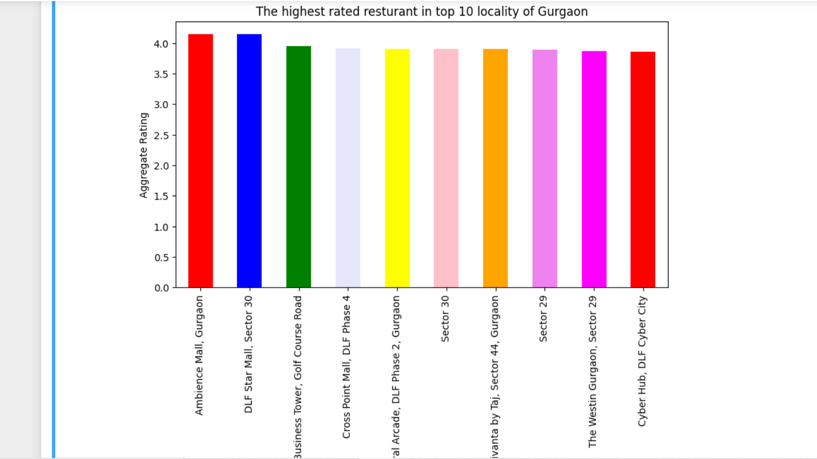

Slide 8
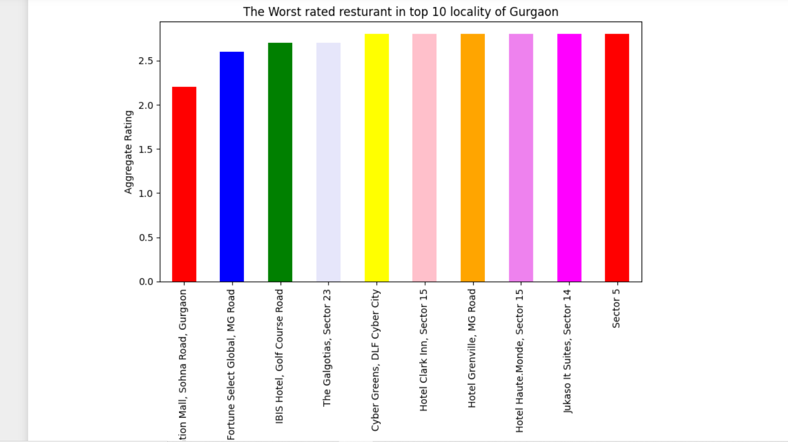

Slide 9
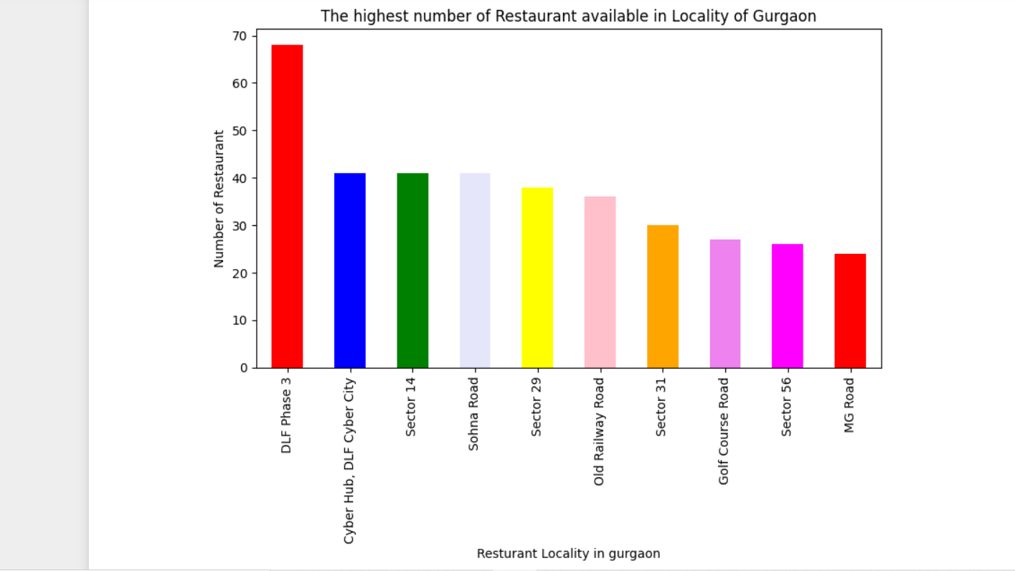

Slide 10
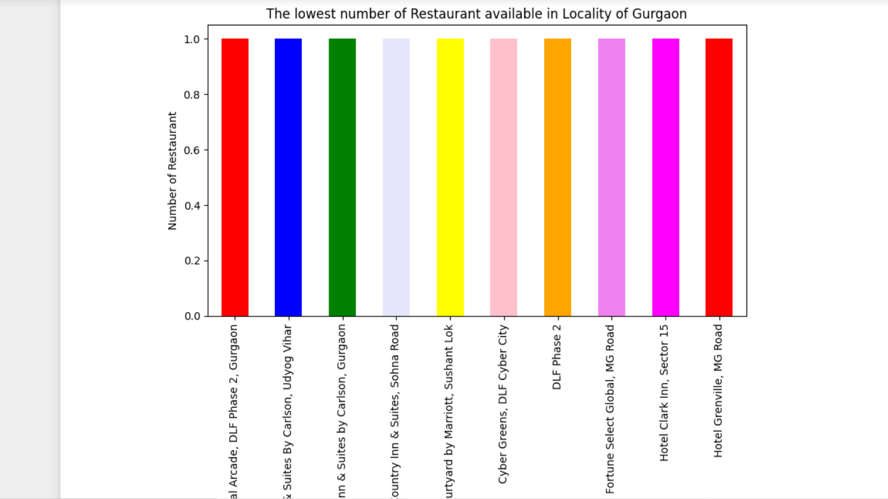

Slide 11
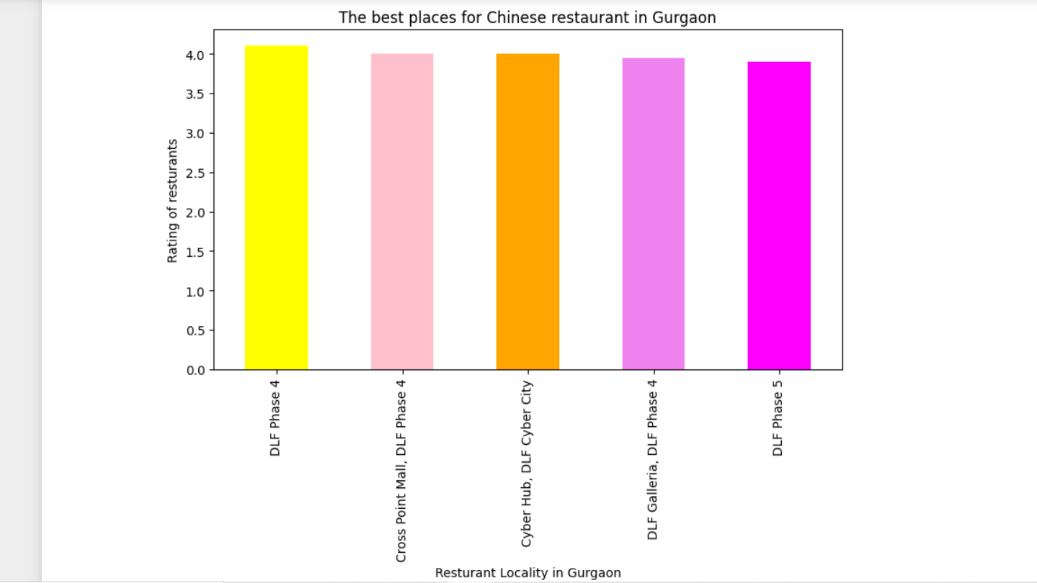

Slide 12
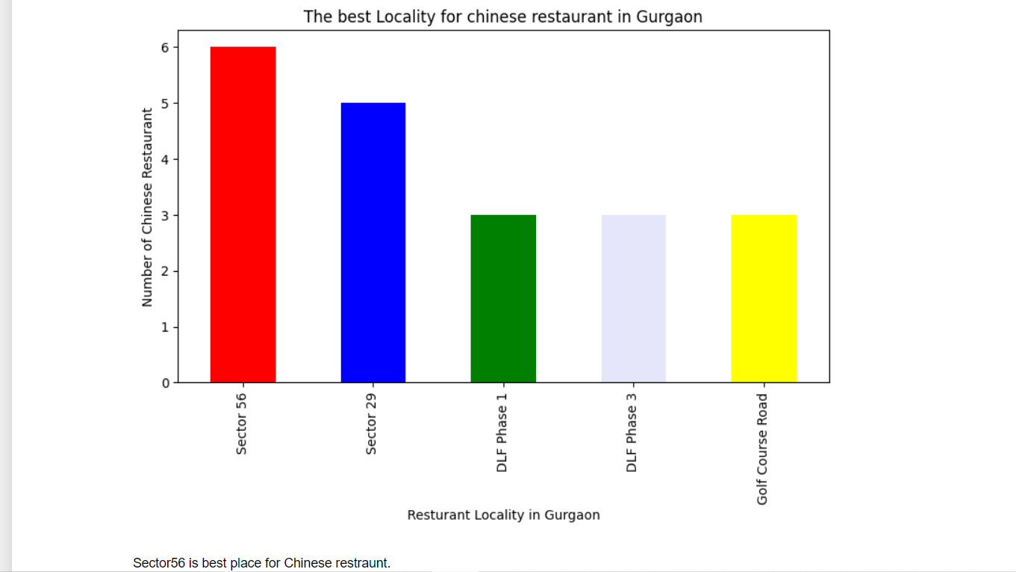

Slide 13
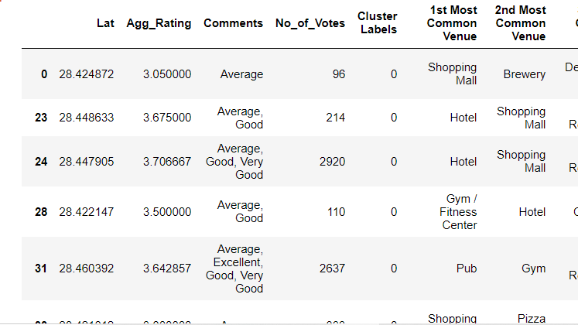
Cluster 1:
Shopping Malls are most recommended venues nearby the locations.

Slide 14
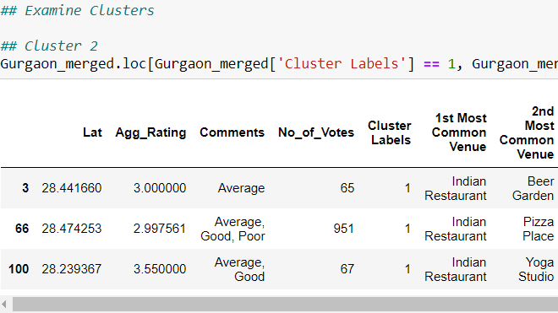
Cluster 2:
The Indian Restaurants are most recommended venues nearby the locations

Slide 15
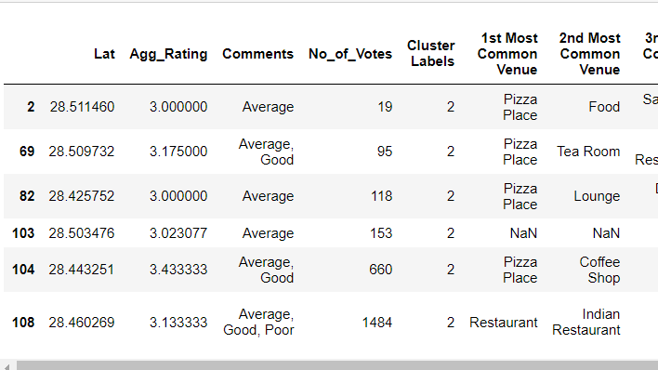
Cluster 3:
Pizza Café is the most recommended venue.

Slide 16
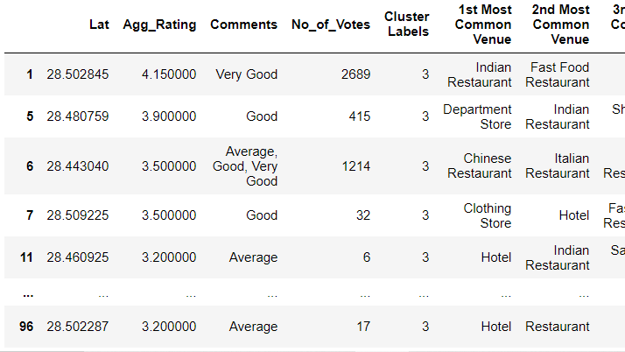
Cluster 4:
Indian Restaurants and Hotel are most recommended venues.

Slide 17
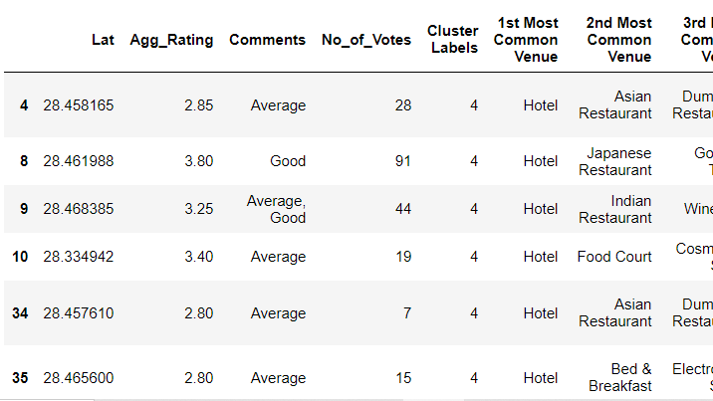
Cluster 5:
Hotel and Asian restaurant are most common venue.

Slide 18
CONCLUSION
Sector56 has the best Chinese Restaurant.
DLF Phase3 is the best place for edible person.
The worst restaurants is in Omaxe Celebration Mall, Sohna Road.
Ambience Mall and DLF Star Mall, Sector30 have best restaurants.

